Slide 1

<Coding>
Best Practices & Tips
Nick Thesing
Matthijs Molhoek

Slide 2
What to expect
Javascript
HTML / CSS
Why you don’t need jQuery! (its slow)
Nick Thesing
Matthijs Molhoek

Slide 3
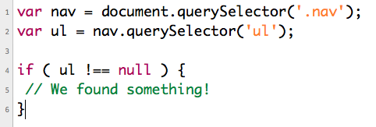


Javascript & jQuery
jQuery .find() vs …
#1:
#2:
Nick Thesing
Matthijs Molhoek

Slide 4
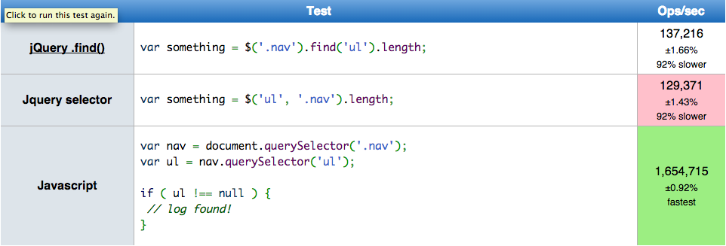
Javascript
jQuery .find() vs …
http://jsperf.com
Nick Thesing
Matthijs Molhoek

Slide 5
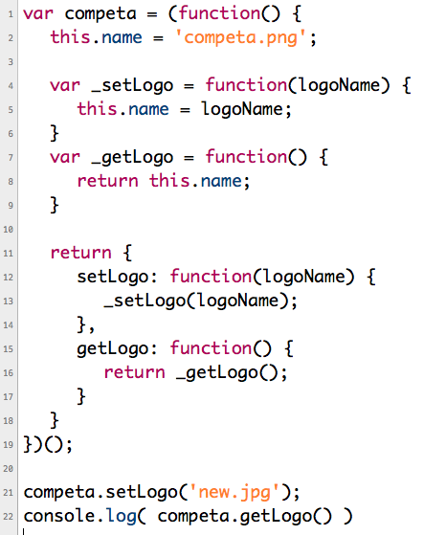
Javascript private & public
Nick Thesing
Matthijs Molhoek

Slide 6
Javascript ternary operators
if (isMember) {
console.log("The fee is $2.00”);
} else {
console.log("The fee is $10.00”);
}
console.log("The fee is " + (isMember ? "$2.00" : "$10.00"))
Nick Thesing
Matthijs Molhoek

Slide 7
Literal notation for objects and arrays
//create an object
var obj = new Object();
obj.company = “Competa”;
obj.country = “nl”;
//create an array
var arr = new Array(“lettuce”, “tomato”, “cucumber”);
This is faster, easier to read and requires less code:
//create an object
var obj = {obj.company: “Competa”, obj.country: “nl”};
//create an array
var arr = ["lettuce”, “tomato”, “cucumber"];
Nick Thesing
Matthijs Molhoek

Slide 8
Optimize loops
Try to optimize your loops. Some tips:
Everyone knows:
for (var i = 0; i < arr.length; i++) { // Do something }
HOWEVER, length of arr is recalculated every time
So.. add len = arr.length to the loop, so it’s stored
PROTIP: if the order is irrelevant, go in reverse it’s the fasted
for (var i = arr.length; i--;) { // in reverse }
Nick Thesing
Matthijs Molhoek

Slide 9
== vs === equals
Works the same, EXCEPT == has typecasting, so === has to be same type for equal.
42 == “42” // true, because typecasting to string
42 === “42” // false, because int != string
Nick Thesing
Matthijs Molhoek

Slide 10
== vs === equals
Works the same, EXCEPT == has typecasting, so === has to be same type for equal.
42 == “42” // true, because typecasting to string
42 === “42” // false, because int != string
Nick Thesing
Matthijs Molhoek

Slide 11
CSS naming conventions
NO camelcase(.myClassName) or underscores(.my_class_name)
USE dashes and lowercase(.my-class-name)
Also, try to avoid using or very rarely use IDs. They can be acceptable on major sections of your app(header, content, footer), but shouldn’t be necessary. And if you do, make sure you don’t target them in your CSS. They can cause major specificity issues(and headaches).
More reading:
http://css-tricks.com/specifics-on-css-specificity/
https://medium.com/@drublic/css-naming-conventions-less-rules-more-fun-12af220e949b
Nick Thesing
Matthijs Molhoek

Slide 12
2015!!!!!!!
Lot of new scripts/plugins/libraries coming in 2015
AngularJS 2.0?
MeteorJS
http://jsperf.com
Nick Thesing
Matthijs Molhoek

