Slide 1
RAG-Powered Rule Extraction & Automated Validation
Invoice Processing Agent

Slide 2
The Problem
Slow: Manual processing takes days
Error-prone: 70-80% require manual review
Expensive: Significant labor costs
Compliance risks: Inconsistent validation
Current State: 70-80% of invoices require manual review

Slide 3
Why RAG-Powered LLM
ACCURACY & GROUNDING:
Grounded in actual contract content,
85-95% accurate
SPEED TO DEPLOYMENT:
1 day
COST:
$0
FLEXIBILITY & UPDATES:
Just add documents
EXPLAINABILITY:
Fully traceable, audit-ready
HANDLING CUSTOM CONTRACTS:
Universal, no special handling
DATA PRIVACY & SECURITY:
100% local, no data leaves your system,
maximum security & compliance

Slide 4
Two-Phase Sequential Model
PHASE 1 Contract Discovery & Rule Extraction
PHASE 2 Invoice Discovery & Validation
Phase 1: Parse contracts → Create FAISS vector store → Extract 12 rules via RAG (10-30 sec/contract)
Phase 2: Parse invoices → Extract fields → Validate against rules → Generate results (<1 sec/invoice)

Slide 5
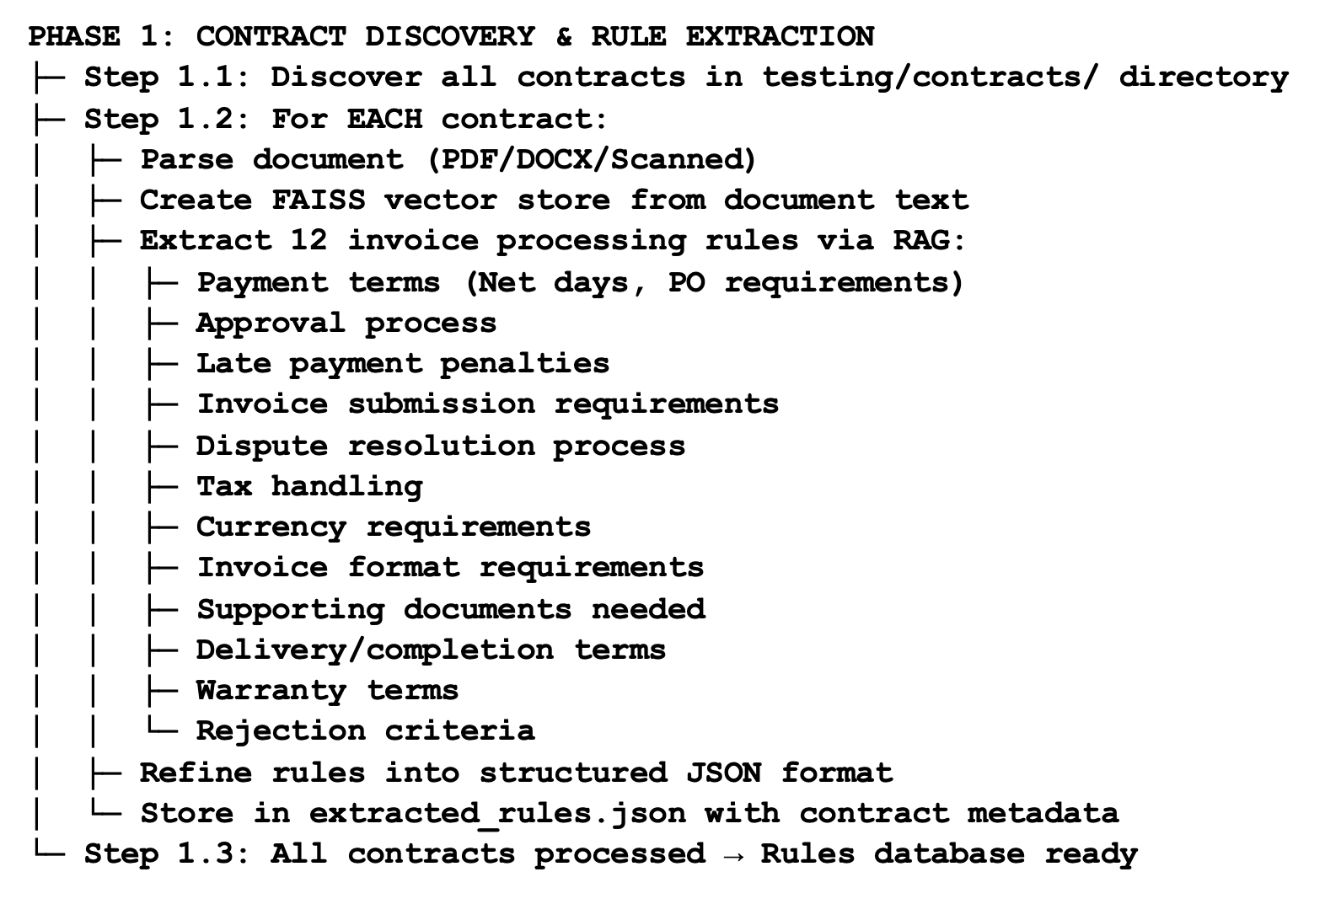
Part 1: Rule Extraction Agent (RAG-powered)

Slide 6
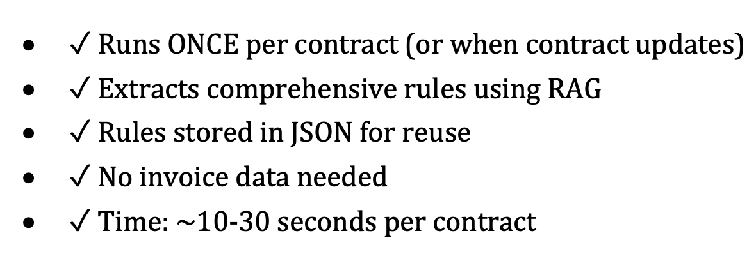
Part 1: Key Characteristics

Slide 7
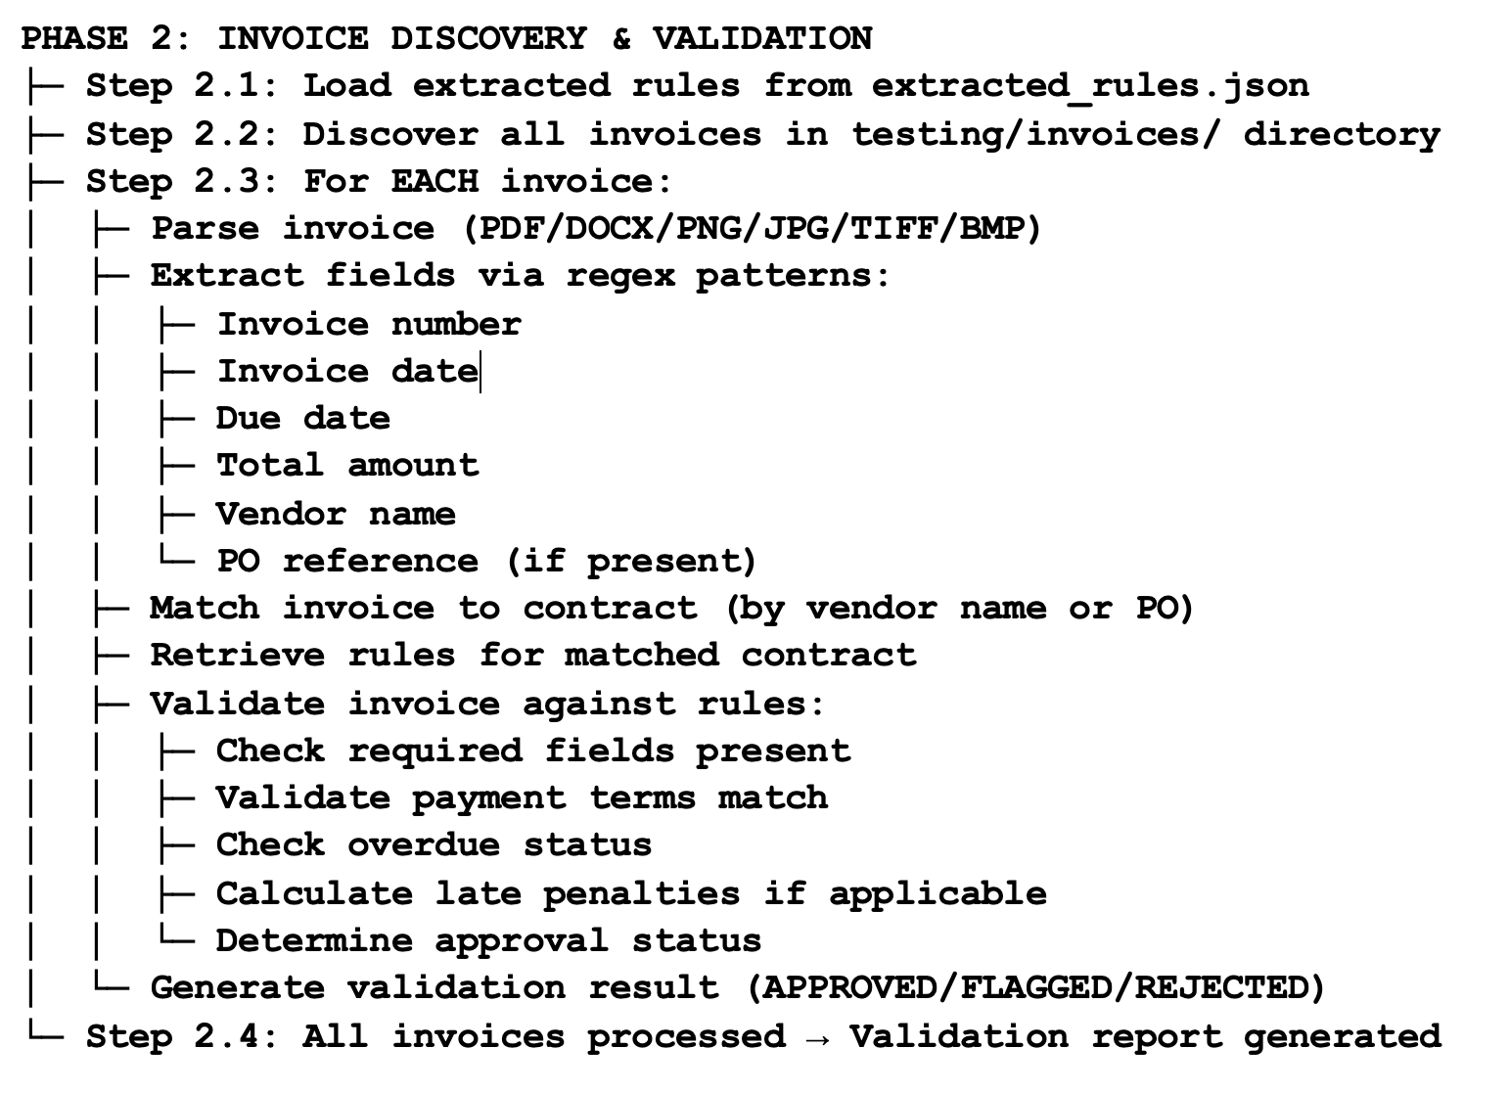
Part 2: Invoice Processor (Rule-based validation)

Slide 8
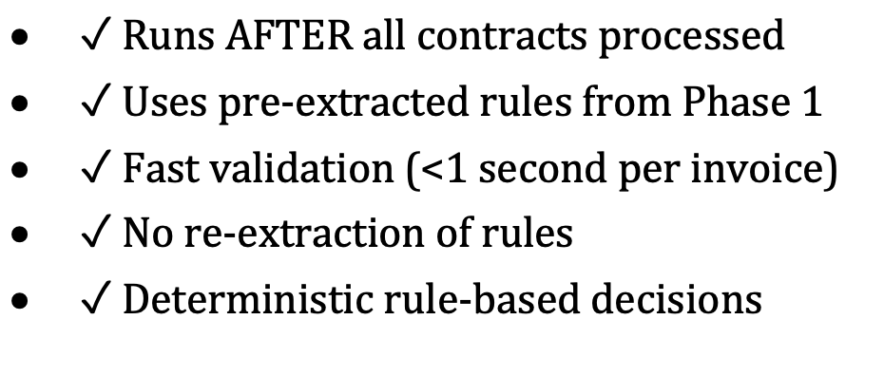
Part 2: Key Characteristics

Slide 9
Architecture
Technology Stack:
• Local LLM: Ollama (gemma3:270m)
• Embeddings: nomic-embed-text
• Vector Store: FAISS (semantic search)
• OCR: pytesseract (scanned documents)
• Framework: LangChain
Key Advantage: All local processing (no cloud APIs)

Slide 10
Document Requirements Matrix
Service-Based Contracts:
• Large corporate: MSA + SOW + PO + Invoice
• Fixed-price: MSA + PO + Invoice (no SOW)
• Retainer: MSA + SOW + Invoice (no PO)
Goods-Based Contracts:
• Product sale: PO + Invoice (optional Supply Agreement)

Slide 11
Rule Extraction Process (Phase 1)
Question
Semantic Search
Retrieve Top-3
Send to LLM
Generate Answer
Example: Q: 'What are the payment terms?'
Retrieved: 'Payment terms: Net 30 days from invoice receipt'
LLM Answer: 'Payment terms are Net 30 days with mandatory PO'
Extracted Rule: {type: payment_term, description: ...}

Slide 12
Invoice Validation Process (Phase 2)
Step 1: Parse Invoice (PDF/DOCX/PNG/JPG)
Step 2: Extract Fields (regex patterns)
Step 3: Match to Contract (by vendor/PO)
Step 4: Retrieve Rules (from Phase 1)
Step 5: Validate Against Rules
Step 6: Determine Status (APPROVED/FLAGGED/REJECTED)

Slide 13
Validation Decision Logic
APPROVED ✓
All checks pass Auto-approved
FLAGGED ⚠
Warnings present Review recommended
REJECTED ✗
Critical issues Manual review

Slide 14
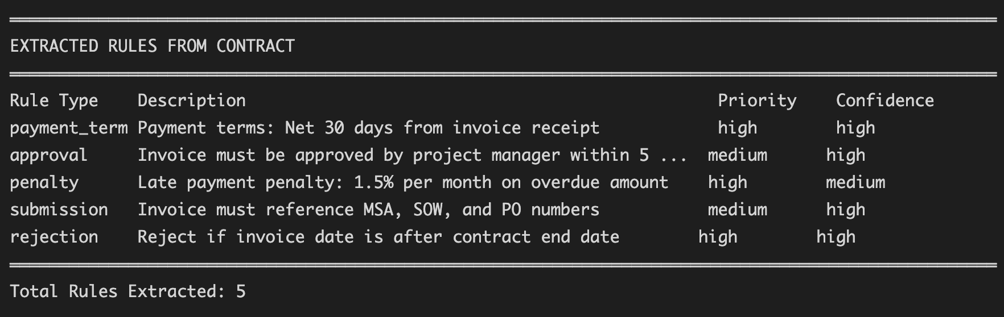
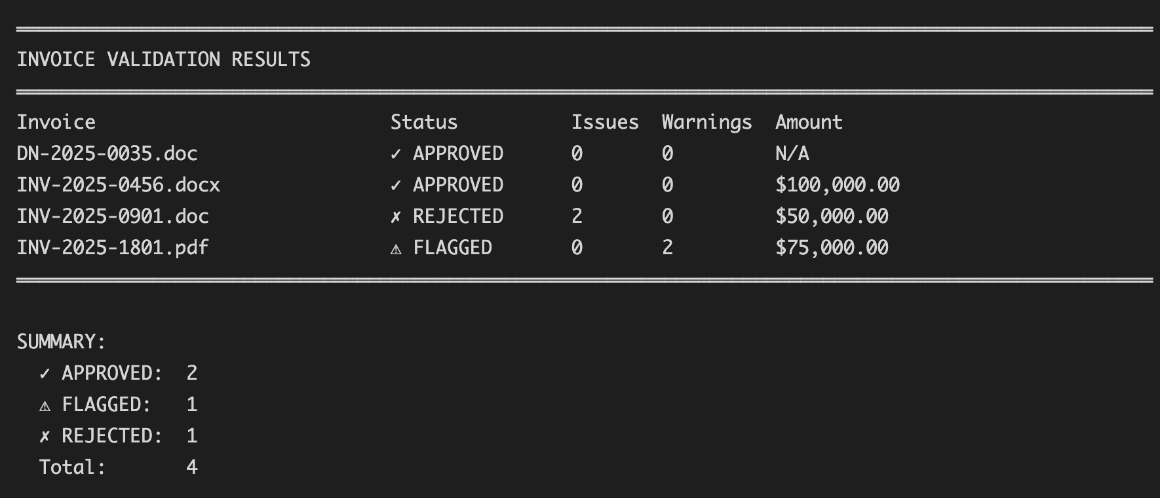
Example

Slide 15
Performance Metrics
SPEED:
• Rule extraction: 10-30 seconds per contract
• Invoice validation: <1 second per invoice
ACCURACY:
• Field extraction: 85-95%
• Rule extraction: 80-90%
• Validation decisions: >95%
SCALABILITY:
• Up to 500-page contracts
• Hundreds of invoices per batch

Slide 16
Business Value
✓ 70-80% Auto-Approved: Reduce manual review workload
✓ <1 Second Per Invoice: Faster processing than manual
✓ >95% Accuracy: Rule-based deterministic decisions
✓ Complete Audit Trail: Track all validation decisions
✓ Cost Savings: Reduced labor costs for invoice processing
ROI: Typically, positive within 3-6 months
Example: 1000 invoices/month × 30 min each = 500 hrs./month → 100 hrs. with system = 400 hrs. saved = $20,000/month

Slide 17
Constraints & Limitations
Current Constraints:
• Sequential execution (Phase 1 → Phase 2)
• Single machine (not distributed)
• Batch processing (all contracts, then all invoices)
• No real-time updates (rules extracted once)
• JSON storage (single point of failure)
Roadmap: Async version with message queues (Q4 2025)

