Slide 1

DIGITAL SOLUTIONS

Slide 2

Why Net World Solutions?
Why Net World Solutions?
Net World Solutions is a web development company based in Delhi, India. We create creative high quality web development for clients from all areas in the India, UK, Canada as well as other international clients. Our digital services include web application development and custom development as well as implementing a wide range of open source software which offers great web power and and value for our clients.
Our client base covers a broad spectrum of sectors we operate in such as Retail, Financial, Automotive, Charity, Leisure, Government, and Engineering etc. Some of which have been our clients for well over 5 years, testament to the service we provide and relationships we keep. We promise to not just design to decorate, but we design to communicate and provoke effective and memorable design masterpieces.
"We are always listening, advising and ultimately aiming to deliver above and beyond clients expectations.“

Slide 3
We Love Digitals. How!!!
Domain Registrations
Website Hosting
Website Designing
Graphic Designing
Website Development
SEO
SMO / Bulk FB Likes
Bulk Emailing
Website Maintenance
Payment Gateway Integration Solutions

Slide 4

Domain Registration!
Register your domain for your brand improvement, advertisement and marketing with very low low price. Our web hosting service include free open source one click installation of Joomla, Wordpress, PhpBB and more.
lots of application to save in website design price. Our domain name search functionality is very easy which guide you step by step to register your keywords rich domain name.

Slide 5

Web Hosting!
Linux web hosting services have a reputed place for providing both stable and reliable hosting services. It is suitable for PHP programming, Perl programming and MySQL database. Linux web hosting services provided by us are reliable and full of satisfaction with our aim to provide the best to our users for all hosting solutions as per their requirements with the affordable price. .
Linux web hosting solution is the best for the webmasters, whom are using Linux web hosting features.

Slide 6

Web Designing!
Our expert Website Designers have an interest and skills for assisting companies from various field and organization look PRO and create a plan with the enterprises to help create innovative
visitors circulation techniques.
Our core competency exceeds that of web design and flows into creating corporate identity, logo design and website design. Our smooth project execution process and excellent customer service make it a breeze to start a new or redesign an existing website.

Slide 7

Web Development!
Our team of PHP developers always strives to create powerful and competent business applications to win you top-quality leads and maximize audience participation. We use new-age technologies such as MySQL, Linux, and AJAX to implement our designs into reality.
Our services are 100% genuine, innovative, ethical, and custom-made. We deliver within timelines; uphold confidentiality and security; use the best manpower resources; and offer only the required services as per your online business need with hidden cost

Slide 8

Digital Marketing!
We do the right things in the most ethical manner, ensuring your site never gets hit by any updates. In fact, as Google continuously aims to bring in quality links to the users, our rankings also improve with it!
Our SMO strategy focuses on mixing both traditional and new-age advertising. Our SMO portfolio includes marketing for LinkedIn, Facebook, YouTube, and other online media.

Slide 9












Brand Associated….
Notes:
Clients should brief the creative and media agency together to ensure both agencies are working towards the same objective. Any questions that the agencies might have should be answered in this session or within the next few days to ensure that no one goes down the wrong path.
The creative and media agency should set-up a campaign timeline and meetings to share their progress through the process which will ensure communication is happening. The campaign timeline should include a discussion about deadlines for each agency, taking into account client approval and any revisions that may be necessary.
Don’t forget the fancy food since the client will be attending! ;)

Slide 10
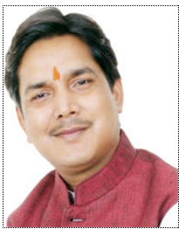
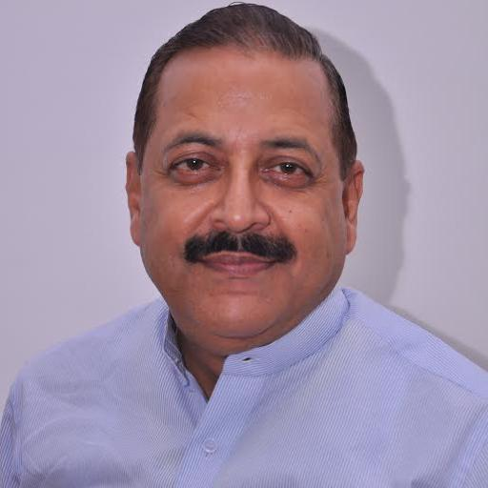
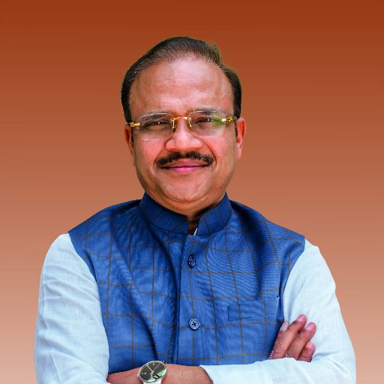

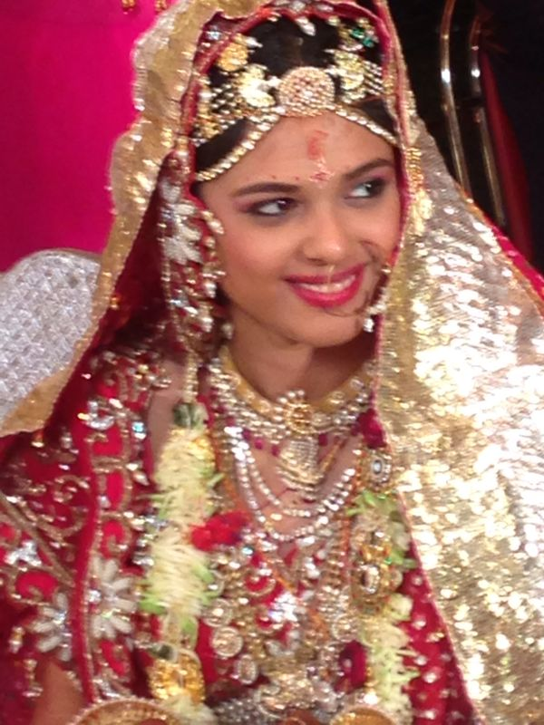
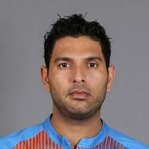
Reputation Work Done

Slide 11






Brand Owned….
Notes:
Clients should brief the creative and media agency together to ensure both agencies are working towards the same objective. Any questions that the agencies might have should be answered in this session or within the next few days to ensure that no one goes down the wrong path.
The creative and media agency should set-up a campaign timeline and meetings to share their progress through the process which will ensure communication is happening. The campaign timeline should include a discussion about deadlines for each agency, taking into account client approval and any revisions that may be necessary.
Don’t forget the fancy food since the client will be attending! ;)

Slide 12







Technology Partners….
Notes:
Clients should brief the creative and media agency together to ensure both agencies are working towards the same objective. Any questions that the agencies might have should be answered in this session or within the next few days to ensure that no one goes down the wrong path.
The creative and media agency should set-up a campaign timeline and meetings to share their progress through the process which will ensure communication is happening. The campaign timeline should include a discussion about deadlines for each agency, taking into account client approval and any revisions that may be necessary.
Don’t forget the fancy food since the client will be attending! ;)

Slide 13
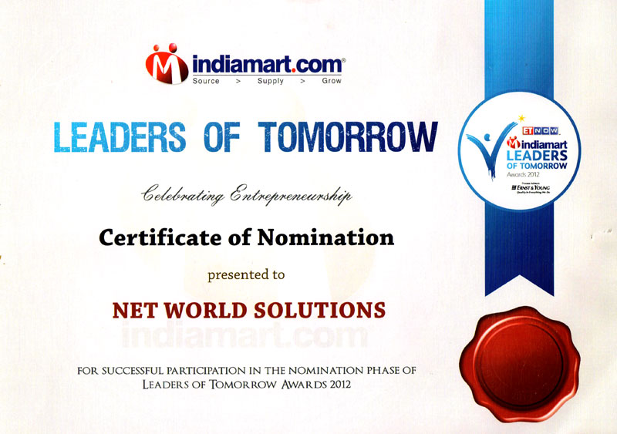
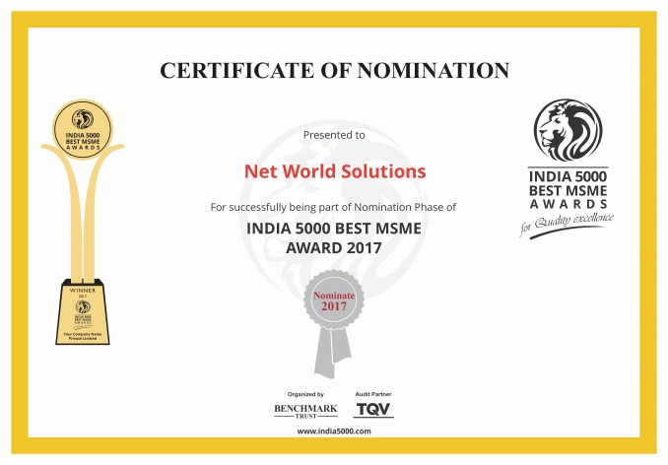
Thank you for recognizing us

Slide 14
THE END

