Slide 1



Website Design & Development
Janssen & Associates - www. draak.net

Slide 2

About Us
The Internet gives you the opportunity to promote your company, your products and your services on a worldwide basis through your own website. We are here to help you accomplish this.
We offer affordable website design and development services for individuals and small businesses by ascertaining your target market and evaluating your particular website needs.
We create shopping cart solutions to sell your products and services on the Internet and also develop websites in Spanish.
Janssen & Associates - www. draak.net

Slide 3

Mission Statement
It is the mission of Janssen & Associates to create
websites to:
Bring customers to your door
Maximize your visibility
Ensure that you are found on the Information
Superhighway.
Reflect the personality of your business
Work as an around-the-clock employee for you
Provide product and company information to your
customers
Market yourself and your business online
Janssen & Associates - www. draak.net

Slide 4

About Genia Janssen
Born in Peru, Genia Janssen received both Bachelor's and
Master's degrees in engineering and has over 22 years of
software and firmware development experience. In 1999
she decided to leave the high-tech industry for good to
focus her code-writing talents full-time on website
development. Most of all, she gets the greatest joy helping
people with small businesses realize more success with
e-commerce, creativity and visibility on the Internet.
Genia has been a featured speaker at several small
business forums and is a regular guest on the KKUP radio
station. She does Web pages in both English and Spanish.
Janssen & Associates - www. draak.net

Slide 5

Services
E-business solutions consultation to small and home-based businesses at an affordable cost.
E-business
Website development, ranging from one to several pages depending on your needs.
Development
Make your website work better so that others can find you on the World Wide Web.
Searches
Janssen & Associates - www. draak.net

Slide 6
More Services
Add shopping carts to existing websites to have the capability of selling products and services online.
Shopping
Translation of English websites into Spanish and vice versa.
Spanish
Submit websites to all the search engines and rank them against the competition to come out on top..
Submission
Janssen & Associates - www. draak.net.

Slide 7
Even More Services
Content, appearance and structure of the website can now be done entirely with Cascading Style Sheets.
CSS-P
Website pages are automatically updated using
database-driven code modifiable by the user.
Dynamic Site
Convert your FrontPage website into a Dreamweaver
website and take advantage of Macromedia products.
Conversion
Janssen & Associates - www. draak.net.

Slide 8
… And Even More Services
Flash is the premier Web software for animated graphic presentations, websites and splash pages.
Flash
Graphics, tables and other elements are edited and
optimized to prevent slow-loading pages.
Tune-ups
When audio and/or video elements are added to
websites, the possibilities are endless.
Audio/Video
Janssen & Associates - www. draak.net.

Slide 9
About Websites
Having a presence on the World Wide Web does not have to be expensive. We will design and develop your website based on your ideas and specifications.
The way we do this is to set up a free initial consultation in order to determine your needs and requirements. Then we will give you an estimate in a couple of days.
You can start with a couple of pages in the beginning and then add more later, or you can do it all together ... the choice is yours.
Janssen & Associates - www. draak.net

Slide 10

Why Winners Have Websites
As a 24/7 employee your website works, even if you don’t.
Websites increase referrals because information gets forwarded on without even asking.
A website turns contacts into prospects and vice versa, because some people are more comfortable contacting you online rather than calling you. Inviting contacts to your website will get them to know you better.
A good website will create the right first impression since people will “know” you before they know you.
Janssen & Associates - www. draak.net

Slide 11

Spanish Websites
Janssen & Associates - www. draak.net

Slide 12
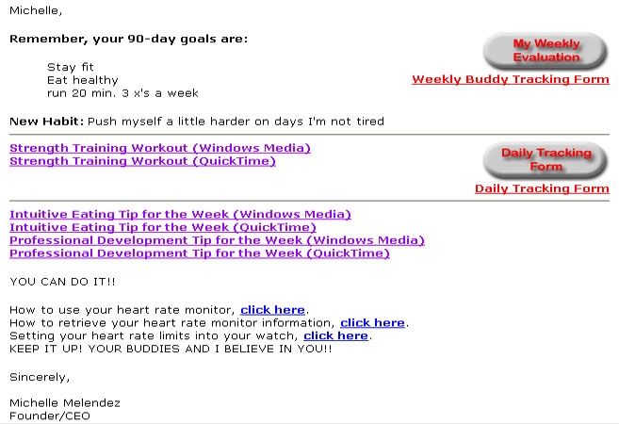
Automated E-mails
Janssen & Associates - www. draak.net

Slide 13

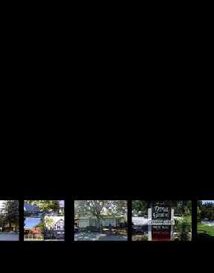
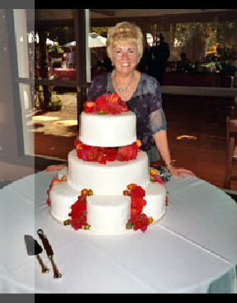
Flash Animation
Splash Page Movie
Showcase Products
Having a presence on the World Wide Web does not have to be expensive.
We will design and develop your website based on your ideas and specifications.
Janssen & Associates - www. draak. net

Slide 14
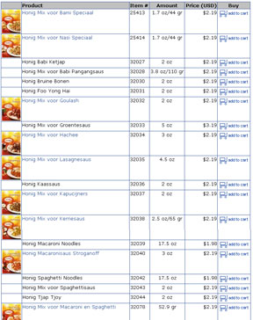
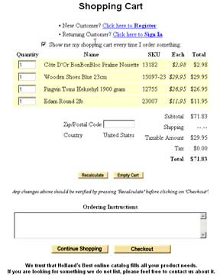
Shopping Carts
Select Your Products
View Shopping Cart
Janssen & Associates - www. draak. net

Slide 15
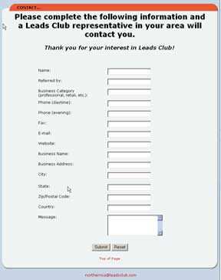
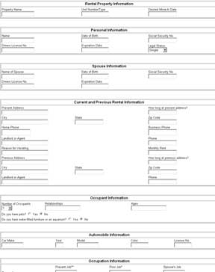
Forms
Contact Form
Rental Application
Janssen & Associates - www. draak. net

Slide 16
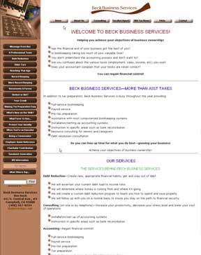
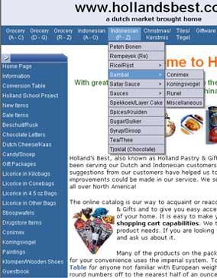
Navigation Menus
Simple Rollover
Pull-down / Pull-out
Janssen & Associates - www. draak. net

Slide 17
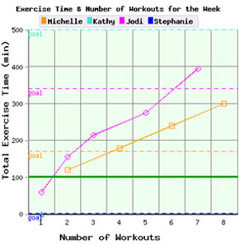
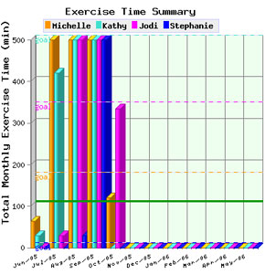
Real-Time Graphs
2-D Graph
3-D Graph
Janssen & Associates - www. draak. net

Slide 18
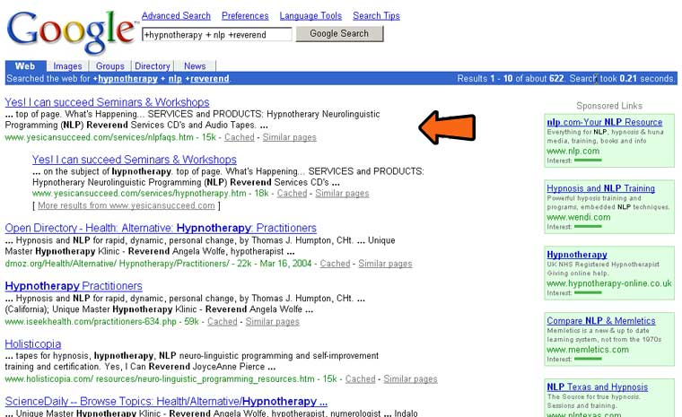
Search Engine Optimization
Janssen & Associates - www. draak.net

Slide 19
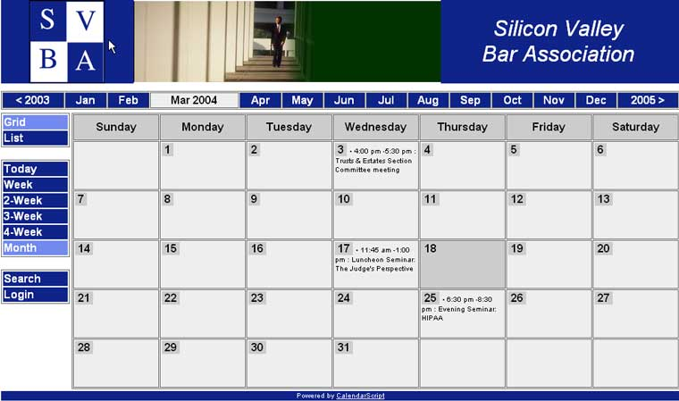
Calendars
Janssen & Associates - www. draak.net

Slide 20
Key Questions
Why do you need a website?
What is the purpose and goal of your website?
What is your expected outcome from your
website?
How much money and time are you willing to
spend on your website?
Who is your target audience and how will your
website be designed to reach them?
Janssen & Associates - www. draak.net

Slide 21
Why Janssen & Associates?
We take pleasure and pride in solving technical and
creative challenges and we bring the best quality and
value to our customers.
A good website acts as a powerful advertising tool.
Your customers use it to know you before they know
you. Don’t become road kill on the Information
Superhighway --- use Janssen & Associates to create
a website that works for you.
We create websites that work for you and with you.
Janssen & Associates - www. draak.net

