Slide 1

OBJECT DETECTION, TRACKING & CLASSIFICATION IN 4D IMAGING RADAR in partnership with Provizio
Presented by Nick Timaskovs

Slide 2
Problem Statement: Current issues faced in autonomous vehicles
Sensor Fusion and Perception
Clutter and Interference
Detection of Vulnerable Road Users
Safety and Reliability
Data Collection and Processing
Cost and Implementation

Slide 3
Aim of Thesis
The aim of this thesis is to develop software for Object Detection, Tracking, and Classification Using RNNs in 4D Radar in the context of autonomous vehicles, along with some User Interface to be able to demonstrate the efficiency and robustness of the model and algorithm that I will develop.

Slide 4
Motivation:
Personal Experience - wanting to improve road safety
Specialize in computer vision & ML to work in this field
Improve current solutions to help drive innovation in ADAS
Interest in the automotive industry.

Slide 5
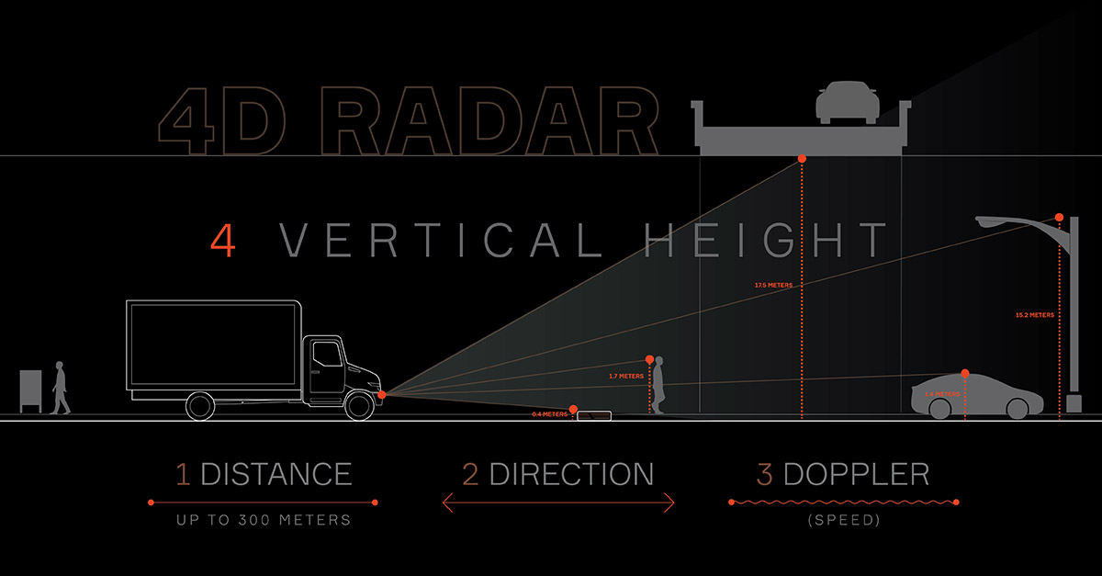
What is 4D Radar?

Slide 6
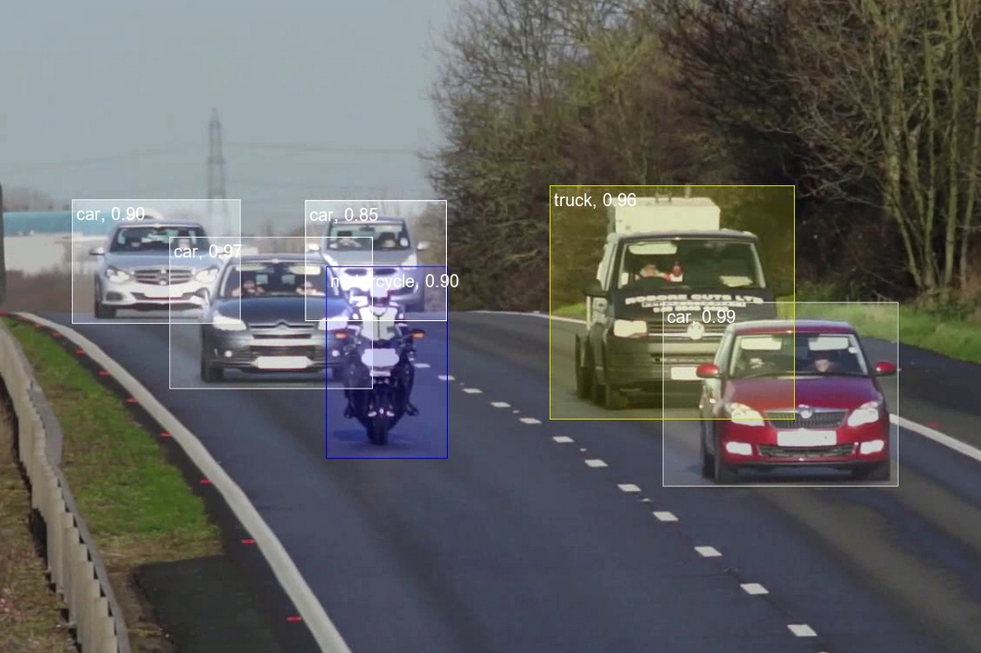
Research Question: "How can recurrent neural networks (RNNs) be effectively applied to improve the accuracy and efficiency of object detection, tracking, and classification in 4D radar data, and what novel architectures and techniques can be developed to address the unique challenges posed by this multidimensional and dynamic data?"

Slide 7
Objectives:
Literature Review
Data Collection and Preprocessing
Model Architecture Design
Training and Optimization
Object Detection
Object Tracking
Object Classification
Testing
Performance Evaluation

Slide 8
Outcome:
Desired outcome and inspiration for the User Interface
https://provizio.ai/

Slide 9
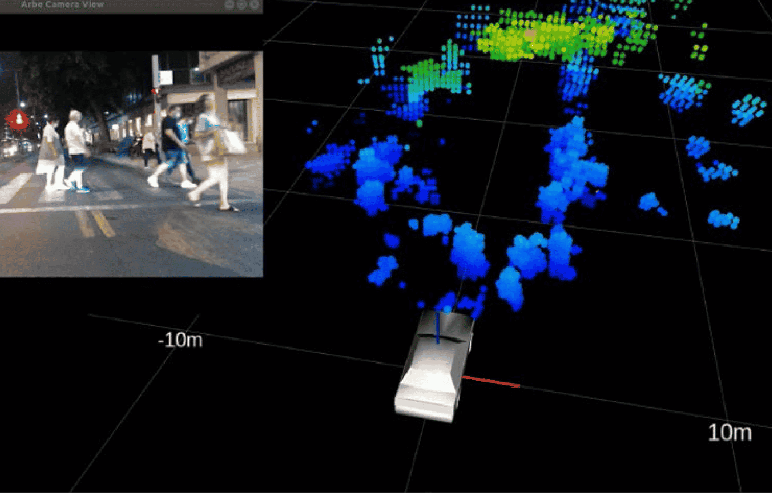
Questions?

