Slide 1
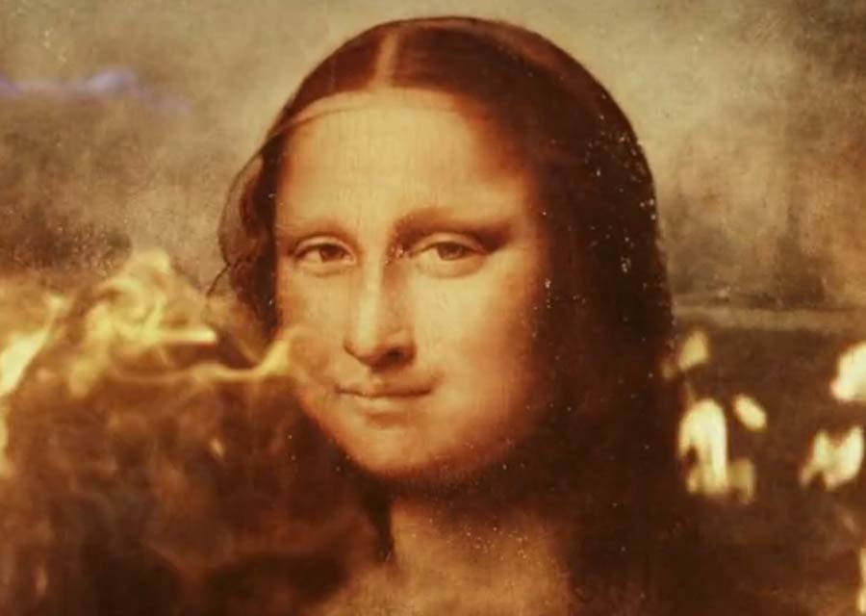
Nick’s Smart Art Defense Room https://www.hackster.io/nicktolk/smartroom-2635f6

Slide 2
Why make a private gallery smarter?
When the Mona Lisa was destroyed earlier this year while on loan to Ed Norton, the most significant expenses were transportation, protection, and insurance.
An override for the local protections installed surreptitiously by Mr. Norton, paired with a lack of insight into display conditions for the insurance company, caused an irreplaceable work of art to be destroyed.
Reproducing the conditions could help understand the situation that allowed the catastrophe, and avoid another.

Slide 3
What could be smarter?
Although an override similar to the one installed for the Mona Lisa is in-place for this mock-up, temperature conditions are published and accessible to the insurance company.
Remote monitoring adds transparency through the layers present in the display room, and could allow control of protection measures.

Slide 4
Parts:
Argon #1: Runs display room. Has lockdown controls, environment monitors, and display. Periodically publishes conditions to the cloud.
Argon #2: Runs insurance company. Watches for publishes from display room, and reflects the conditions it sees in case of fire.
BME280: Monitors environment conditions that may interest the insurance company.

Slide 5
Other Parts Used
SSD1306 display: Shows current conditions as marquis, as well as showroom’s current “Open”/”Closed”/”Open but hiding” state.
Servo: Simulates locking doors.
Neopixels: Indicate the most recent temperature that the insurance company saw from the art room.
Button: Ed’s secret override toggle. Keeps display room open and hides temp from the cloud.
LEDs: Quick reflection of open/closed/hiding states.

Slide 6
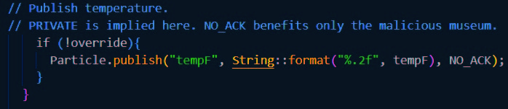
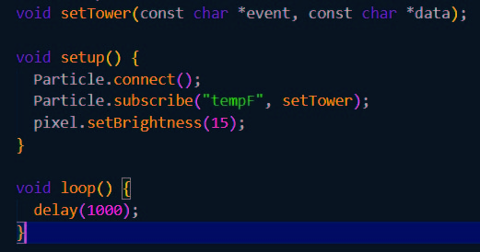
Publish and handle code
Art room publish:
Insurance company receive:

Slide 7
Challenges
Networking. Conflicts between local IoT device handling and cloud publishing were an opportunity for learning and character growth.
Cloud operations. Particle will allow several methods for publishing and access, including variables treated as global globally, functions that can be run on the Argon remotely, and publish/subscribe operations like are used here.

Slide 8
Questions?
This is the time for questions.
So feel free to ask questions.
I will answer those questions.*
*To the best of my ability, or deflect/stall otherwise.

