Slide 1
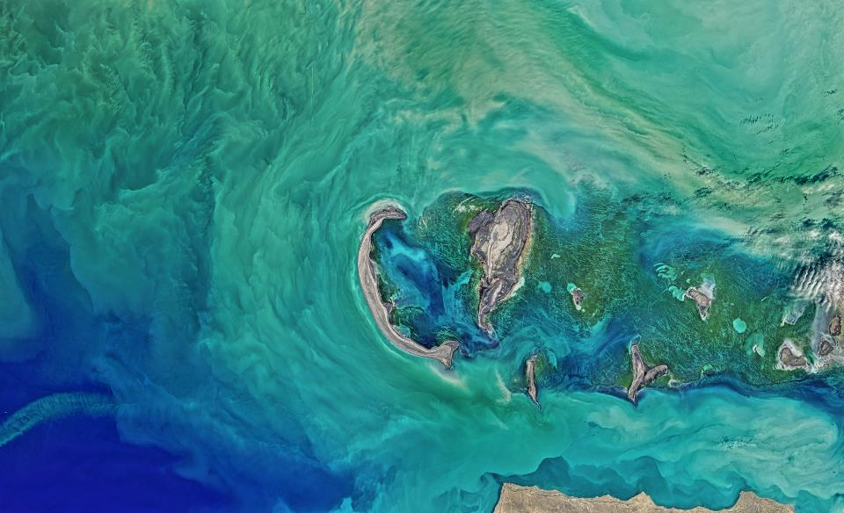

DevCruise 2019
OAuth 2.0 and OpenID Connect

Slide 2
OAuth 2.0 and OpenID Connect
Basic concepts
OAuth2 vs OpenID Connect
JSON Web Token (JWT)
Flows
Implicit Flow
Resource owner Flow
Client Credential Flow
Authorization Code Flow
Refresh Code Flow
Hybrid Flow
Device Code Flow
Bearer tokens

Slide 3
Basic Concepts
The problem
Every system that needs authentication, needs the same kind code for it, posing the same kind of security issues and potential weaknesses. Users generally don’t want to create and remember a new username and password for every application.
The goal
Delegate authentication logic to a trustworthy, external system that is secure, can reuse user accounts and is based on proven standards.
The solution
Claims-based Authentication

Slide 4
Claims-Based Authentication
Client Application
This application would like to gain access to a resource owned by the Resource Server.
Resource Server (Relying Party)
This server holds resources that need to be secured, but does not want to handle authentication and authorization. It delegates those to the Authorization Server.
Authorization Server (Identity Provider or Security Token Server)
This server is tasked with establishing the user’s identity, authorizing the request and creating a trusted Token for the resource server.

Slide 5
Claims-Based Authentication
Token
Data structure consisting of a set of claims and a signature that can be independently verified by a Resource Server. It has an audience, requested resource(s) and a validity.
Claim
Is a key-value pair representing a validated fact about the user.

Slide 6
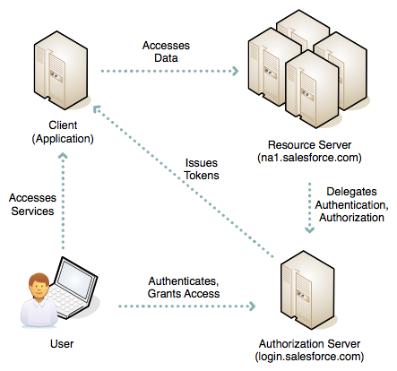
Claims-Based Authentication

Slide 7


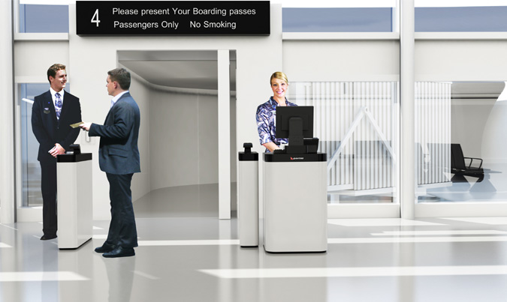
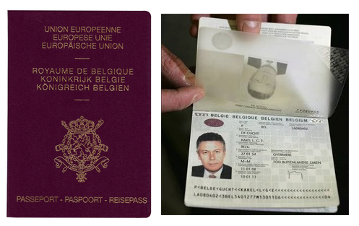


Claims-Based Authentication
How do you use the Airplane service?
Authentication Services
Resource Server / Relying Party
Tokens
Access token
ID token

Slide 8

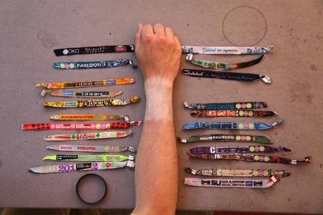
Other types of Access Tokens

Slide 9
Claims-Based Authentication
WS-Federation
Aimed at: SOAP
Token type: SAML2
Published by: OASIS
First published: 2002
WS-Federation is still widely used and supported, but its complicated setup and reliance on XML-standards make it unattractive for new development.
OAuth 2.0
Aimed at: REST
Token type: JSON
Published by: IETF
First published: 2012
OAuth 1.0 was first published in 2010, but had a serious design flaw allowing session fixation attacks.

Slide 10
OAuth 2.0 and OpenID Connect
Basic concepts
OAuth2 vs OpenID Connect
JSON Web Token (JWT)
Flows
Implicit Flow
Resource owner Flow
Client Credential Flow
Authorization Code Flow
Refresh Code Flow
Hybrid Flow
Device Code Flow
Bearer tokens

Slide 11

OAuth2 vs OpenID Connect
“OAuth provides to clients a "secure delegated access" to server resources on behalf of a resource owner. It specifies a process for resource owners to authorize third-party access to their server resources without sharing their credentials.”
… it in fact does not specify how to authenticate the user.
The result:
Every identity provider had its own implementation and flow
Every consumer needed to have separate clients for each provider and had to map the issued claims
https://oauth.net/articles/authentication/

Slide 12

OAuth2 vs OpenID Connect
“OpenID Connect 1.0 is a simple identity layer on top of the OAuth 2.0 protocol. It allows Clients to verify the identity of the End-User based on the authentication performed by an Authorization Server, as well as to obtain basic profile information about the End-User in an interoperable and REST-like manner.”
… so OpenID Connect in fact is OAuth2.
The result:
Uses well known and proven standards
It does specify how to authenticate a user and present basic identity claims
Eliminates the need to have multiple different clients and mostly the need to map claims
Provides a certification for Identity Providers and Client libraries
Provides an (optional) discovery mechanism to auto-configure the client
http://openid.net/connect/

Slide 13
OpenID Connect Basics
Requires a discovery (metadata) endpoint
Used for auto-configuration of both the client and the relying party
[https://abc.xyz.com/... ]/.well-known/openid-configuration
List scopes supported
List claims supported
Location of the required endpoints
Link to the public keys for validating signatures
…
Specifies certain standard claims
Makes login authentication more consistent across providers
Notes:
Azure AD: https://login.microsoftonline.com/euri.com/v2.0/.well-known/openid-configuration

Slide 14
{
"authorization_endpoint": "https://login.microsoftonline.com/0b53d2c1-bc55-4ab3-a161-927d289257f2/oauth2/v2.0/authorize",
"token_endpoint": "https://login.microsoftonline.com/0b53d2c1-bc55-4ab3-a161-927d289257f2/oauth2/v2.0/token",
"token_endpoint_auth_methods_supported": [ "client_secret_post", "private_key_jwt", "client_secret_basic"],
"jwks_uri": "https://login.microsoftonline.com/0b53d2c1-bc55-4ab3-a161-927d289257f2/discovery/v2.0/keys",
"response_modes_supported": ["query", "fragment", "form_post"],
"subject_types_supported": ["pairwise"],
"id_token_signing_alg_values_supported": ["RS256"],
"http_logout_supported": true,
"frontchannel_logout_supported": true,
"end_session_endpoint": "https://login.microsoftonline.com/0b53d2c1-bc55-4ab3-a161-927d289257f2/oauth2/v2.0/logout",
"response_types_supported": ["code", "id_token", "code id_token", "id_token token"],
"scopes_supported": ["openid", "profile", "email", "offline_access"],
"issuer": "https://login.microsoftonline.com/0b53d2c1-bc55-4ab3-a161-927d289257f2/v2.0",
"claims_supported": ["sub", "iss", "cloud_instance_name", "cloud_instance_host_name", "cloud_graph_host_name",
"msgraph_host", "aud", "exp", "iat", "auth_time", "acr", "nonce", "preferred_username", "name", "tid",
"ver", "at_hash", "c_hash", "email" ],
"request_uri_parameter_supported": false,
"userinfo_endpoint": "https://graph.microsoft.com/oidc/userinfo",
"tenant_region_scope": "EU",
"cloud_instance_name": "microsoftonline.com",
"cloud_graph_host_name": "graph.windows.net",
"msgraph_host": "graph.microsoft.com",
"rbac_url": "https://pas.windows.net"
}

Slide 15
Required endpoints
Endpoint | Type | Use
authorization_endpoint | Interactive | Start a login flow from a browser
token_endpoint | Non-interactive | Get a token through a backchannel
end_session_endpoint | Interactive | Logout a user in the browser
userinfo_endpoint | Non-Interactive | Get user information through a backchannel

Slide 16
Token Types
Token type | Response Type | Form | Usage
Access token | token | JWT | Grants access to one or more resources
ID token | id_token | JWT | Contains the profile claims of a user
Authorization code | code | Code | Used to delegate access to a resource ⇨ Only Auth. Code or Hybrid flow
Refresh token | refresh_token | Code | Used to refresh access tokens ⇨ Requires authorization code and “offline_access” scope

Slide 17
Scopes
There are 2 types of scopes:
ID scopes: request access to information
Resource scopes: request access to resources
Well-known OpenID Connect Scopes
Scope | Claims
openid | required scope
profile | name, family_name, given_name, middle_name, nickname, preferred_username, profile, picture, website, gender, birthdate, zoneinfo, locale, updated_at
email | email, email_verified
address | address
phone | phone_number, phone_number_verified
offline_access | requests refreshtoken

Slide 18
OAuth 2.0 and OpenID Connect
Basic concepts
OAuth2 vs OpenID Connect
JSON Web Token (JWT)
Flows
Implicit Flow
Resource owner Flow
Client Credential Flow
Authorization Code Flow
Refresh Code Flow
Hybrid Flow
Device Code Flow
Bearer tokens

Slide 19
JSON Web Token
JSON Web Token (JWT) is a JSON-based open standard (RFC 7519) for creating access tokens that assert some number of claims.
It consists of 3 parts separated by a “.”:
Header: identifies which algorithm is used to generate the signature
Payload: contains the claims that we wish to make
Signature: is calculated by base64url encoding the header and payload
https://jwt.io/introduction/

Slide 20
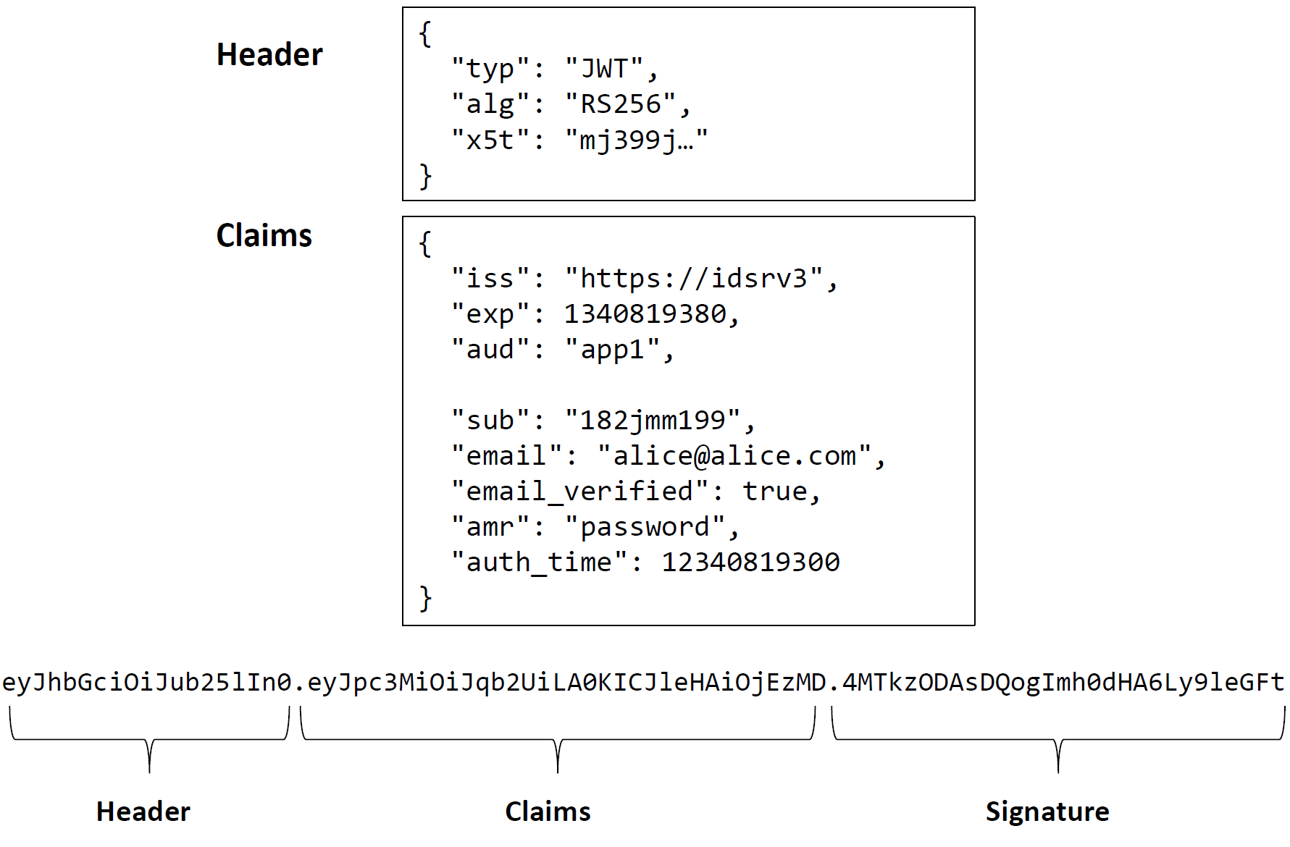
JSON Web Token

Slide 21
OAuth 2.0 and OpenID Connect
Basic concepts
OAuth2 vs OpenID Connect
JSON Web Token (JWT)
Flows
Implicit Flow
Resource owner Flow
Client Credential Flow
Authorization Code Flow
Refresh Code Flow
Hybrid Flow
Device Code Flow
Bearer tokens

Slide 22
Implicit Flow
Scenario:
A Client application wants to authenticate the user and/or to access a resource on a Resource Server and the user can authenticate interactively with the Authorization Server.
Typical use:
A web application, single page application or browser-based mobile application wants to authenticate and/or has to call a REST service and needs to authenticate the user to do so.
Steps:
Client prepares an Authentication Request containing the desired request parameters.
Client sends the request to the Authorization Server.
Authorization Server Authenticates the End-User.
Authorization Server obtains End-User Consent/Authorization.
Authorization Server sends the End-User back to the Client with an ID Token and, if requested, an Access Token.
Client validates the ID token and retrieves the End-User's Subject Identifier.

Slide 23
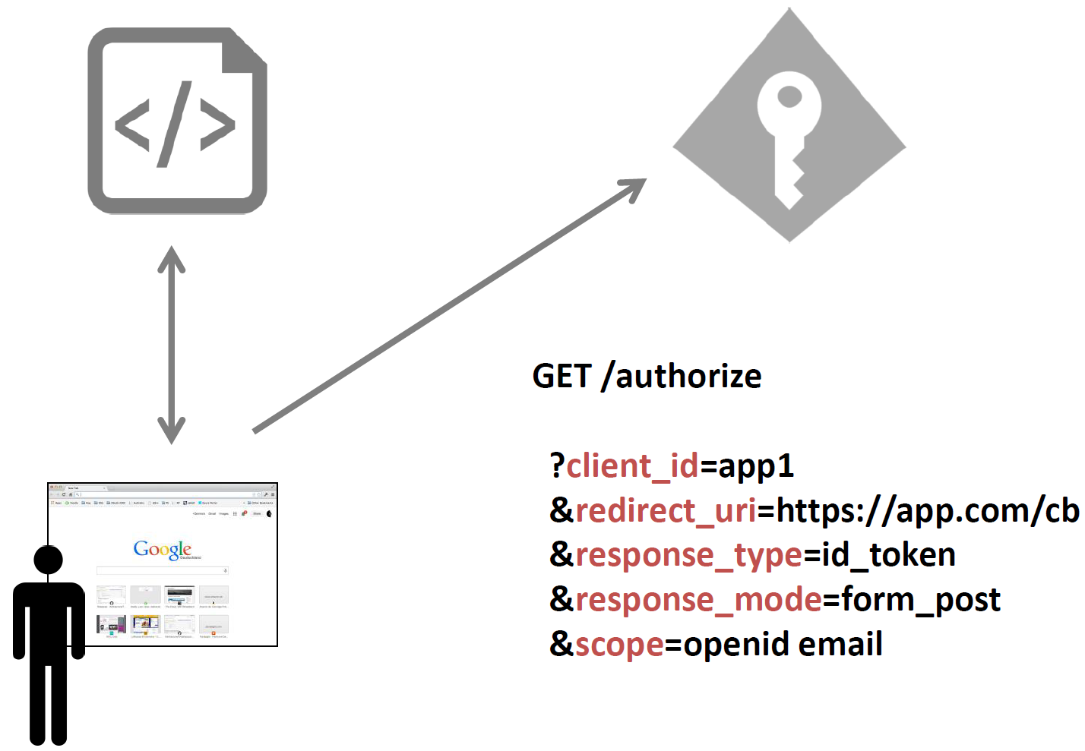
Implicit Flow
Start (web application)

Slide 24
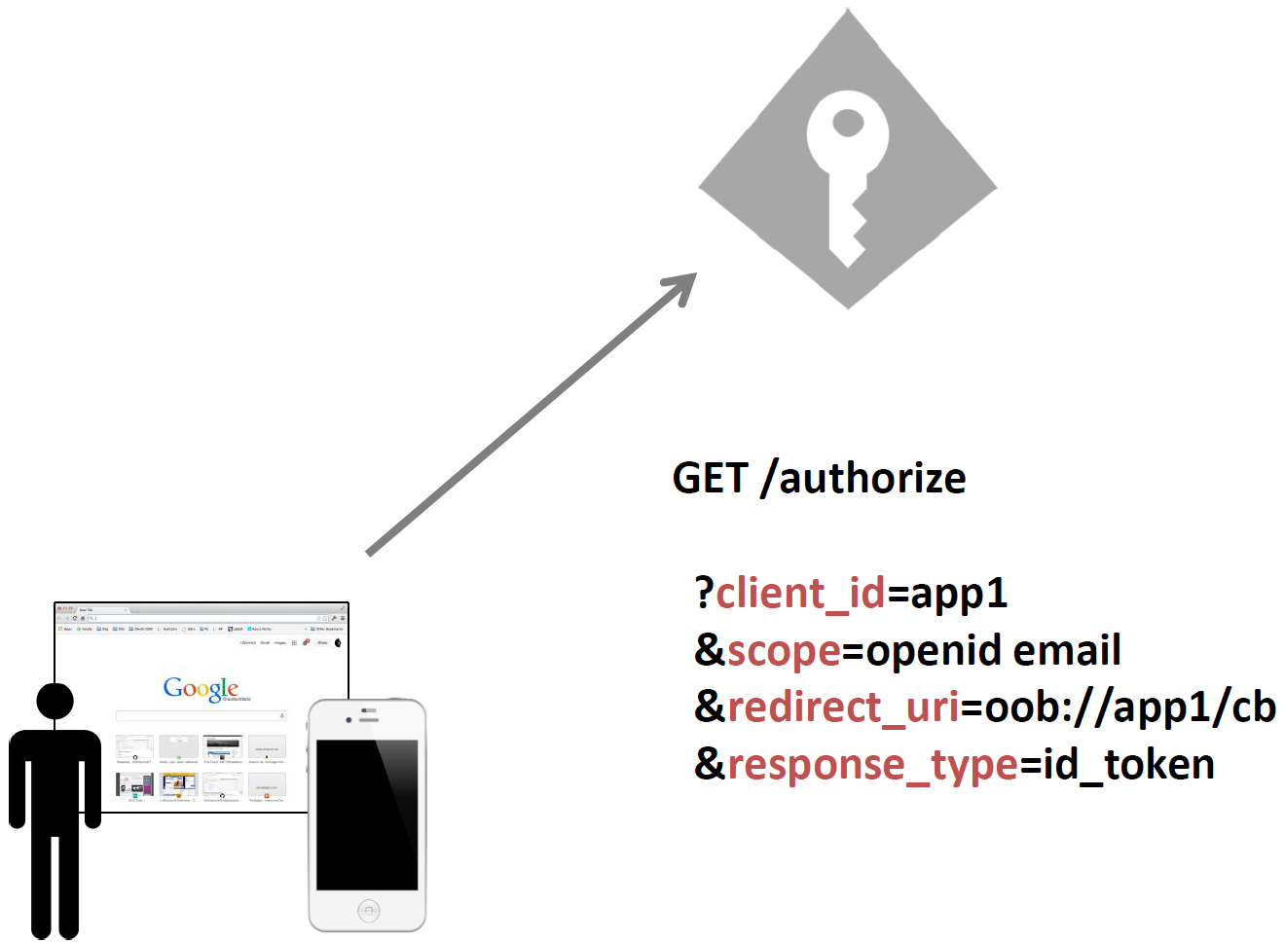
Implicit Flow
Start (native application)

Slide 25
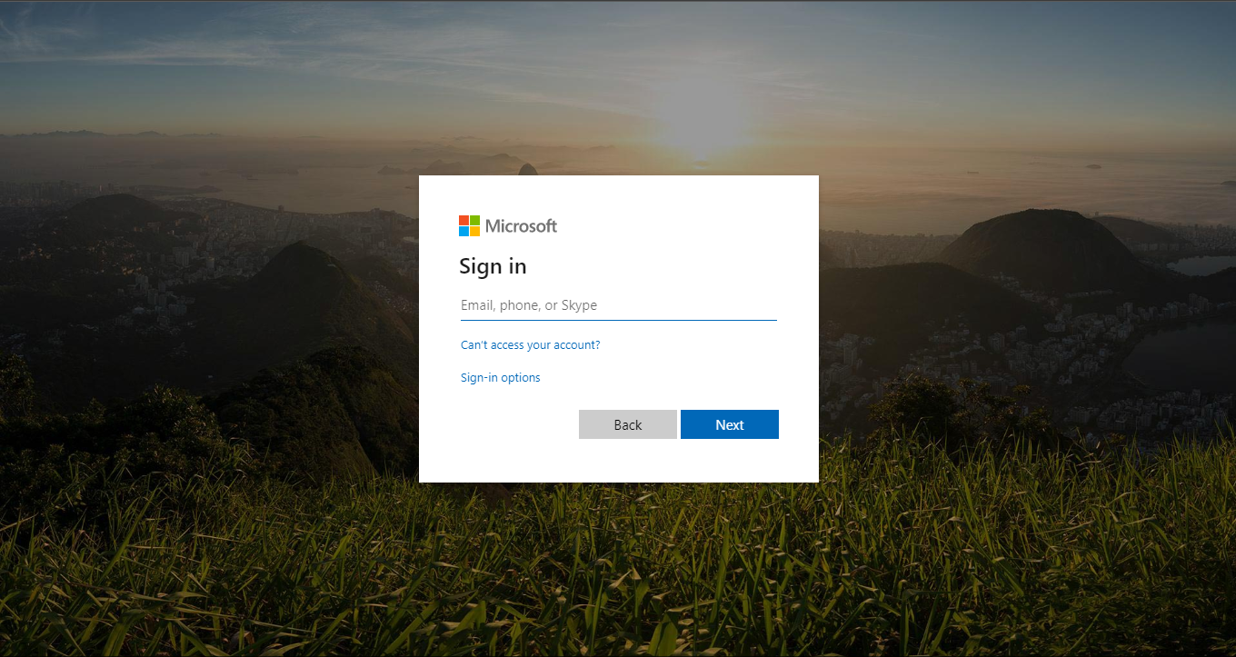
Implicit Flow
User Authentication

Slide 26
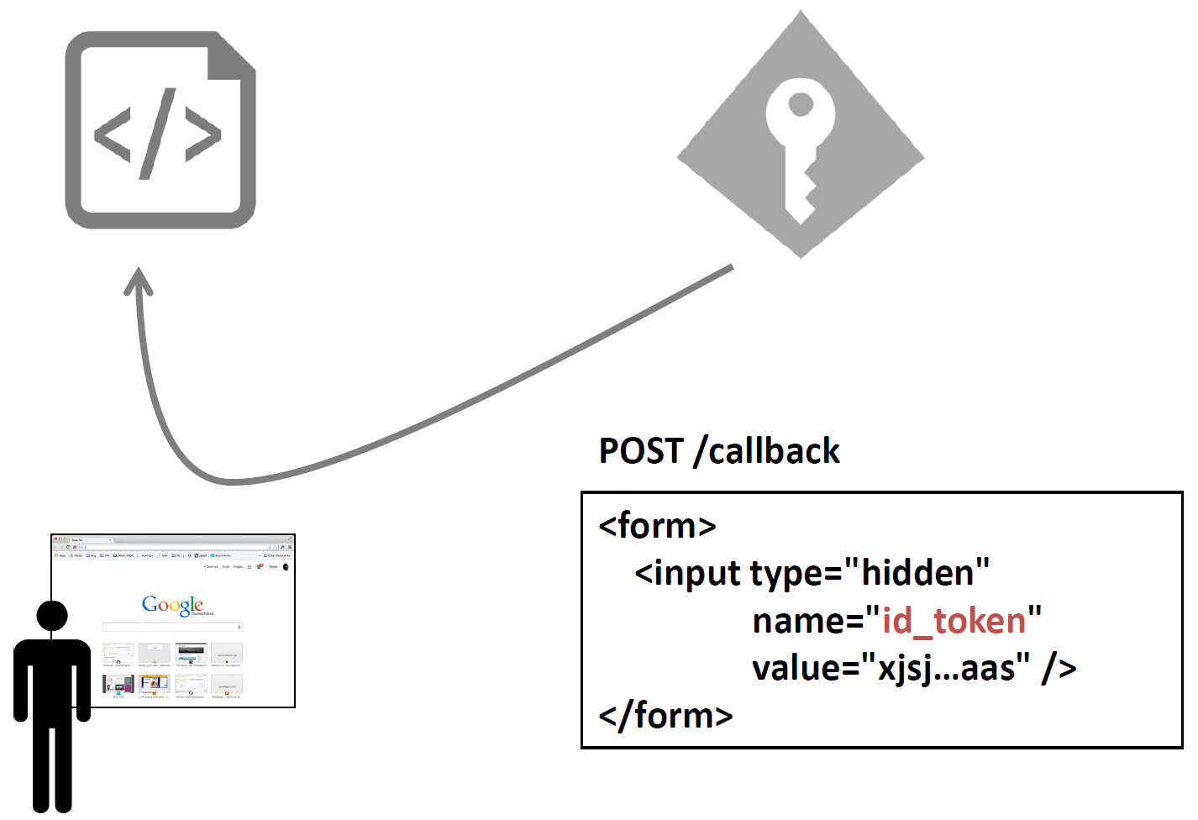
Implicit Flow
Authentication response (web application)

Slide 27
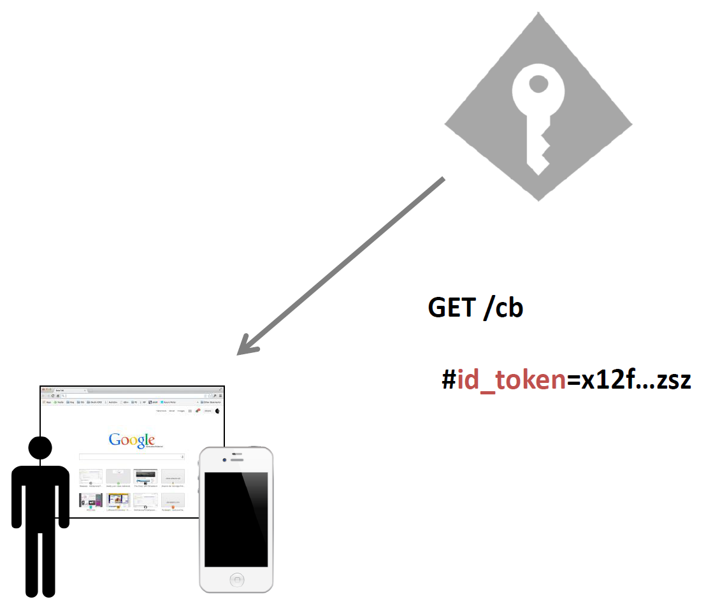
Implicit Flow
Authentication response (native application)

Slide 28
Implicit flow example
https://login.microsoftonline.com/0b53d2c1-bc55-4ab3-a161-927d289257f2/oauth2/v2.0/authorize?
client_id=de411acd-f5d7-4040-8da6-3d3adce56901 &
redirect_uri=https%3A%2F%2Fkudobox.azurewebsites.net%2Fauth &
response_type=id_token%20token &
scope=openid%20profile%20api%3A%2F%2Fkudobox.euri.com%2Fapi &
state=ef9bf2407a6244d7b752525d8bcdf68d &
nonce=38064509aff94d7eb5a736bcbc1b5548
Client ID
Redirect URI
Scopes
Response Type
State
Nonce

Slide 29
Implicit flow example
https://kudobox.azurewebsites.net/auth#
access_token=eyJ0eXAi…DpcZk-fA &
token_type=Bearer &
expires_in=3599 & scope=api://kudobox.euri.com/api &
id_token=eyJ0eXAiOiJ…kNjj9JfA &
state=ef9bf2407a6244d7b752525d8bcdf68d &
session_state=e5e0c607-d1ef-4859-a1bf-30a9d183f385

Slide 30
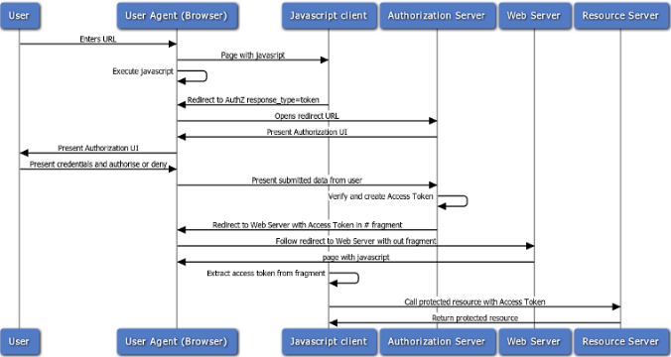
Implicit Flow

Slide 31
Resource Owner Flow
Scenario:
A Client application wants to access a resource on a Resource Server and sends the user’s and its own credentials to the Authorization Server.
Typical use:
An application want to access a resource, but cannot or does not want to have an interactive login to do so.
Steps:
Resource Owner provides credentials to the Client
Client provides Resource Owner credentials and its own to Authentication Server
Authentication Server authenticates Resource Owner credentials and Client
Authorization Server sends answers Client with an ID Token and, if requested, an Access Token.

Slide 32
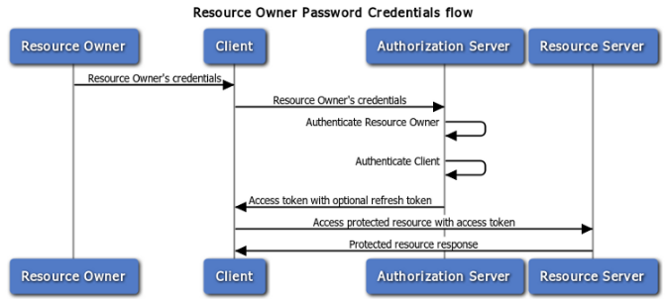
Resource Owner Flow

Slide 33
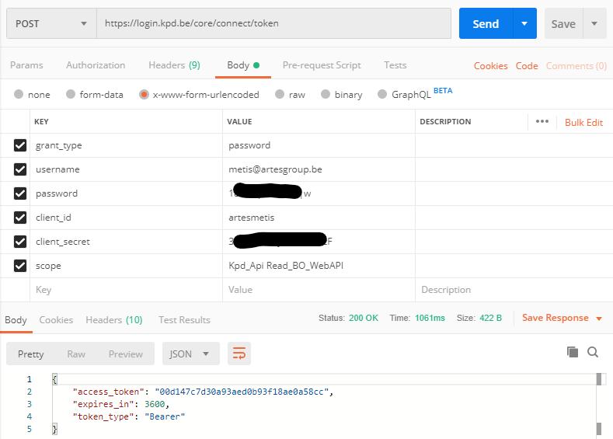
Resource Owner Flow
Username
Password
Client ID
Client Secret
Scope
Grant type
Token type
(Acr values)
(Resource)

Slide 34
Client Credentials Flow
Scenario:
A Client application wants to access a resource on a Resource Server and sends only its own credentials to the Authorization Server.
Typical use:
An application want to access a resource, but cannot or does not want authenticate the user to do so.
Steps:
Client provides its own to Authentication Server
Authentication Server authenticates Client
Authorization Server sends answers Client with an Access Token.

Slide 35
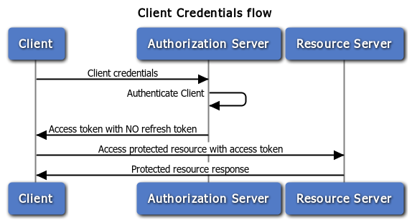
Client Credentials Flow

Slide 36
Client credential flow
POST /contoso.com/oauth2/token HTTP/1.1
Host: login.microsoftonline.com
Content-Type: application/x-www-form-urlencoded
grant_type=client_credentials&client_id=625bc9f6-3bf6-4b6d-94ba-e97cf07a22de&
client_secret=qkDwDJlDfig2IpeuUZYKH1Wb8q1V0ju6sILxQQqhJ+s=&
resource=https%3A%2F%2Fservice.contoso.com%2F
Client Id
Client Secret
Grant type
Token type

Slide 37
Authorization Code Flow
Scenario:
A Client application wants to delegate access a resource on a Resource Server to another application without further user interaction and the user can authenticate interactively with the Authorization Server
Typical use:
An application want to access a resource or wants to delegate access, and needs to authenticate the user to do so.
Steps:
Client redirects End-User to Authorization Server to authenticate and authorize the server to access data on their behalf.
Authorization Server Authenticates the End-User.
Client receives a callback with an authorization code.
Client passes back the authorization code to obtain an access token.
Authorization Server verifies the authorization code.
Authorization Server passes back a token response to Client.

Slide 38
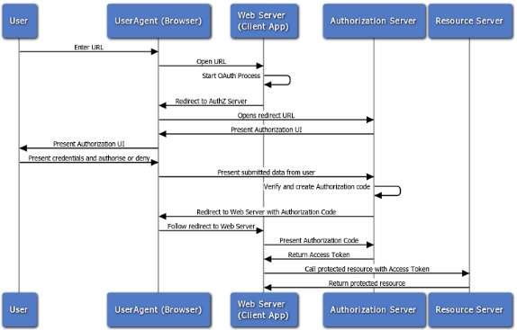
Authorization Code Flow

Slide 39
Authorization Code Flow
Step 1:
Interactive
Like implicit flow but response_type includes “code”
The offline_access scope can be added to receive a refresh token in step 2
An authorization code is returned to the browser
Step 2:
A back channel call is done equivalent to client credential flow
grant_type is “authorization_code” and includes the “code” parameter

Slide 40
Authorization Code Flow
https://login.microsoftonline.com/0b53d2c1-bc55-4ab3-a161-927d289257f2/oauth2/v2.0/authorize?
client_id=de411acd-f5d7-4040-8da6-3d3adce56901 &
redirect_uri=https%3A%2F%2Fkudobox.azurewebsites.net%2Fauth &
response_type=code &
scope=openid%20profile%20api%3A%2F%2Fkudobox.euri.com%2Fapi &
state=ef9bf2407a6244d7b752525d8bcdf68d &
nonce=38064509aff94d7eb5a736bcbc1b5548
Client ID
Redirect URI
Scope
Response type
State
Nonce
Client ID
Client Secret
Code
Grant type
POST /0b53d2c1-bc55-4ab3-a161-927d289257f2/oauth2/v2.0/token HTTP/1.1
Host: login.microsoftonline.com
grant_type=authorization_code
&code=xxxxxxxxxxx
&client_id=xxxxxxxxxx
&client_secret=xxxxxxxxxx

Slide 41
Refresh Token Flow
Scenario:
A Client application wants to access a resource on a Resource Server and sends its own credentials and a refresh token to the Authorization Server.
Typical use:
An application has a refresh token and want to access a resource.
Steps:
Client sends the refresh token to Authorization Server.
Authorization Server validates the refresh token.
Authorization Server passes back a token response to Client.

Slide 42
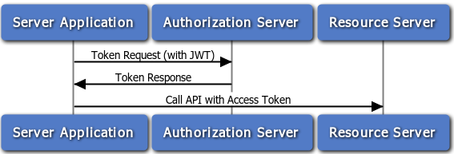
Refresh Token Flow

Slide 43
Hybrid Flow
Scenario:
A Client application wants to both delegate access to a resource on a Resource Server to another application and authenticate the user interactively with the Authorization Server
Typical use:
An application needs both an access and/or an id token, and an authorization code.
Steps:
Client prepares an Authentication Request containing the desired request parameters.
Client sends the request to the Authorization Server.
Authorization Server Authenticates the End-User.
Authorization Server obtains End-User Consent/Authorization.
Authorization Server sends the End-User back to the Client with an Authorization Code and, depending on the Response Type, one or more additional parameters.
Client requests a response using the Authorization Code at the Token Endpoint.
Client receives a response that contains an ID Token and Access Token in the response body.
Client validates the ID Token and retrieves the End-User's Subject Identifier.

Slide 44
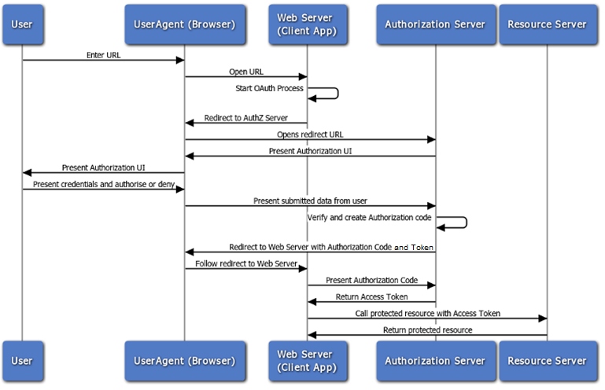
Hybrid Flow

Slide 45
Device Code Flow
Scenario:
A Client application wants to authenticate the user and/or to access a resource on a Resource Server and the user can authenticate interactively with the Authorization Server, but the client cannot host a browser.
Typical use:
A command-line or equivalent wants to authenticate and/or has to call a REST service and needs to authenticate the user to do so. Could also be a device with limited UI capabilities.
Steps:
Client asks the Authorization Server for a Device Code and Verification Uri.
Client prompts the user to open the Verification Uri in a browser and enter the Device code.
Authorization Server Authenticates the End-User.
Authorization Server obtains End-User Consent/Authorization.
Client meanwhile keeps polling the Authentication Server for an ID Token and, if requested, an Access Token.

Slide 46
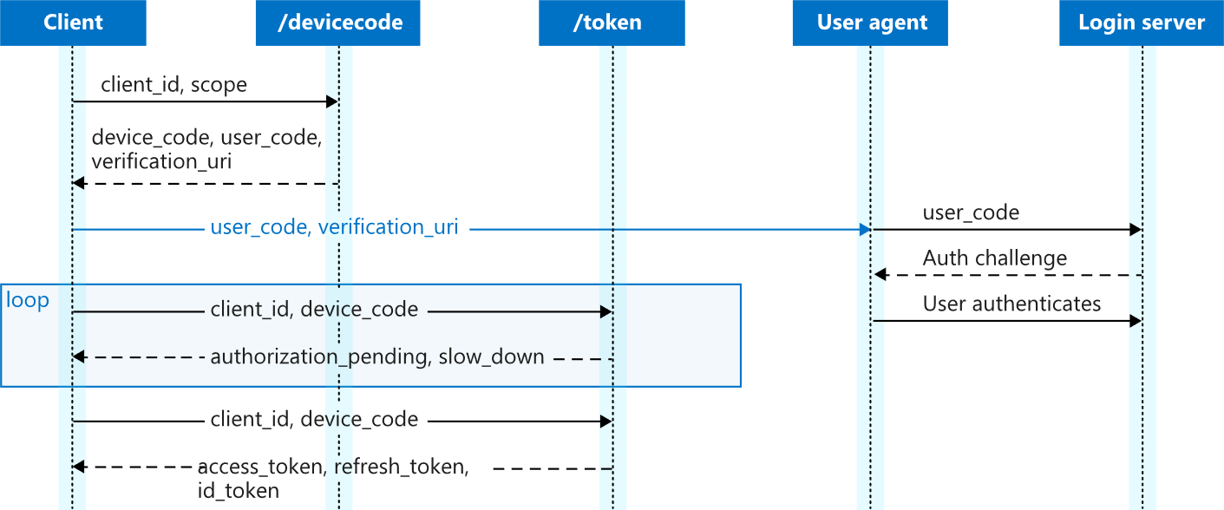
Device code flow

Slide 47
OAuth 2.0 and OpenID Connect
Basic concepts
OAuth2 vs OpenID Connect
JSON Web Token (JWT)
Flows
Implicit Flow
Resource owner Flow
Client Credential Flow
Authorization Code Flow
Refresh Code Flow
Hybrid Flow
Device Code Flow
Bearer tokens

Slide 48
Bearer Tokens
Used to authorize access to a resource (for example an API)
Carried in the HTTP Authorize header using the "Bearer" scheme
Usually an OAuth2 JWT Access Token
Thing that are used to verify access:
Issuer
Signature
Validity (not before and expiry)
Audience (this is optional, but can be useful)
Scopes (requested by the user, confirmed by the authentication server)
POST /rsvp?eventId=123 HTTP/1.1 Host: events-organizer.com Authorization: Bearer AbCdEf123456 Content-Type: application/x-www-form-urlencoded User-Agent: Mozilla/5.0 (X11; Linux x86_64) AppleWebKit/1.0 (KHTML, like Gecko; Gmail Actions) rsvpStatus=YES

Slide 49
Processing a request
Receive
Authenticate
Authorize
Respond
Check signature
Check audience
Check validity
Check scopes
Get authorization header
Check JWT
Process request
Check other claims

Slide 50
Any more questions?

