Slide 1


DevCruise 2019
OAuth 2.0 and OpenID Connect

Slide 2
OAuth 2.0 and OpenID Connect
Basic concepts
OAuth2 vs OpenID Connect
JSON Web Token (JWT)
Flows
Implicit Flow
Resource owner Flow
Client Credential Flow
Authorization Code Flow
Refresh Code Flow
Hybrid Flow
Bearer tokens

Slide 3
Basic Concepts
The problem
Every system that needs authentication, needs the same kind code for it, posing the same kind of security issues and potential weaknesses. Users generally don’t want to create and remember a new username and password for every application.
The goal
Delegate authentication logic to a trustworthy, external system that is secure, can reuse user accounts and is based on proven standards.
The solution
Claims-based Authentication

Slide 4
Claims-Based Authentication
Client Application
This application would like to gain access to a resource owned by the Resource Server.
Resource Server (Relying Party)
This server holds resources that need to be secured, but does not want to handle authentication and authorization. It delegates those to the Authorization Server.
Authorization Server (Identity Provider or Security Token Server)
This server is tasked with establishing the user’s identity, authorizing the request and creating a trusted Token for the resource server.

Slide 5
Claims-Based Authentication
Token
Data structure consisting of a set of claims and a signature that can be independently verified by a Resource Server. It has an audience, requested resource(s) and a validity.
Claim
Is a key-value pair representing a validated fact about the user.

Slide 6
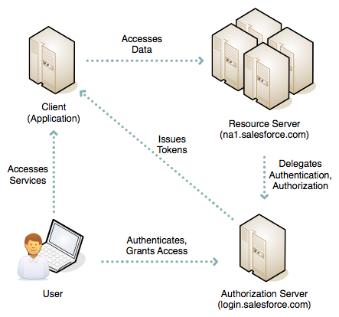
Claims-Based Authentication

Slide 7



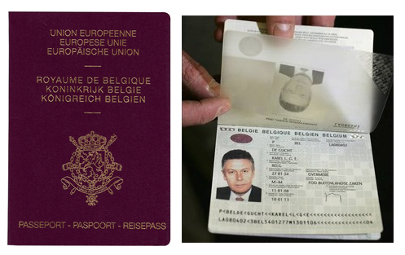


Claims-Based Authentication
How do you use the Airplane service?
Authentication Services
Resource Server / Relying Party
Tokens
Access token
ID token

Slide 8


Other types of Access Tokens

Slide 9
Claims-Based Authentication
WS-Federation
Aimed at: SOAP
Token type: SAML2
Published by: OASIS
First published: 2002
WS-Federation is still widely used and supported, but its complicated setup and reliance on XML-standards make it unattractive for new development.
OAuth 2.0
Aimed at: REST
Token type: JSON
Published by: IETF
First published: 2012
OAuth 1.0 was first published in 2010, but had a serious design flaw allowing session fixation attacks.

Slide 10
OAuth 2.0 and OpenID Connect
Basic concepts
OAuth2 vs OpenID Connect
JSON Web Token (JWT)
Flows
Implicit Flow
Resource owner Flow
Client Credential Flow
Authorization Code Flow
Refresh Code Flow
Hybrid Flow
Bearer tokens

Slide 11

OAuth2 vs OpenID Connect
“OAuth provides to clients a "secure delegated access" to server resources on behalf of a resource owner. It specifies a process for resource owners to authorize third-party access to their server resources without sharing their credentials.”
… it in fact does not specify how to authenticate the user.
The result:
Every identity provider had its own implementation and flow
Every consumer needed to have separate clients for each provider and had to map the issued claims
https://oauth.net/articles/authentication/

Slide 12

OAuth2 vs OpenID Connect
“OpenID Connect 1.0 is a simple identity layer on top of the OAuth 2.0 protocol. It allows Clients to verify the identity of the End-User based on the authentication performed by an Authorization Server, as well as to obtain basic profile information about the End-User in an interoperable and REST-like manner.”
… so OpenID Connect in fact is OAuth2.
The result:
Uses well known and proven standards
It does specify how to authenticate a user and present basic identity claims
Eliminates the need to have multiple different clients and mostly the need to map claims
Provides a certification for Identity Providers and Client libraries
Provides an (optional) discovery mechanism to auto-configure the client
http://openid.net/connect/

Slide 13
OAuth 2.0 and OpenID Connect
Basic concepts
OAuth2 vs OpenID Connect
JSON Web Token (JWT)
Flows
Implicit Flow
Resource owner Flow
Client Credential Flow
Authorization Code Flow
Refresh Code Flow
Hybrid Flow
Bearer tokens

Slide 14
JSON Web Token
JSON Web Token (JWT) is a JSON-based open standard (RFC 7519) for creating access tokens that assert some number of claims.
It consists of 3 parts separated by a “.”:
Header: identifies which algorithm is used to generate the signature
Payload: contains the claims that we wish to make
Signature: is calculated by base64url encoding the header and payload
https://jwt.io/introduction/

Slide 15
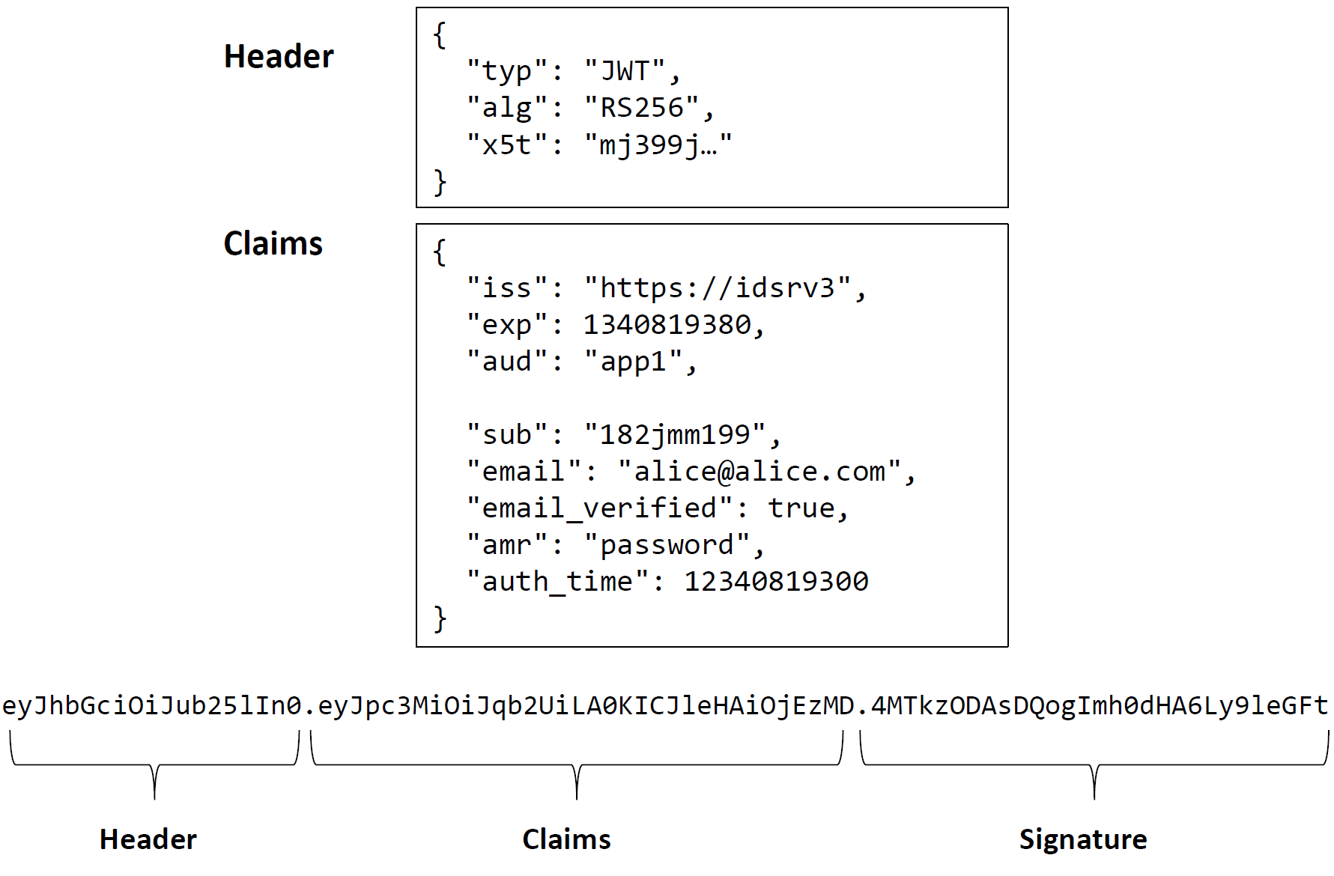
JSON Web Token

Slide 16
OAuth 2.0 and OpenID Connect
Basic concepts
OAuth2 vs OpenID Connect
JSON Web Token (JWT)
Flows
Implicit Flow
Resource owner Flow
Client Credential Flow
Authorization Code Flow
Refresh Code Flow
Hybrid Flow
Bearer tokens

Slide 17
Implicit Flow
Scenario:
A Client application wants to authenticate the user and/or to access a resource on a Resource Server and the user can authenticate interactively with the Authorization Server.
Typical use:
A web application, single page application or browser-based mobile application wants to authenticate and/or has to call a REST service and needs to authenticate the user to do so.
Steps:
Client prepares an Authentication Request containing the desired request parameters.
Client sends the request to the Authorization Server.
Authorization Server Authenticates the End-User.
Authorization Server obtains End-User Consent/Authorization.
Authorization Server sends the End-User back to the Client with an ID Token and, if requested, an Access Token.
Client validates the ID token and retrieves the End-User's Subject Identifier.

Slide 18
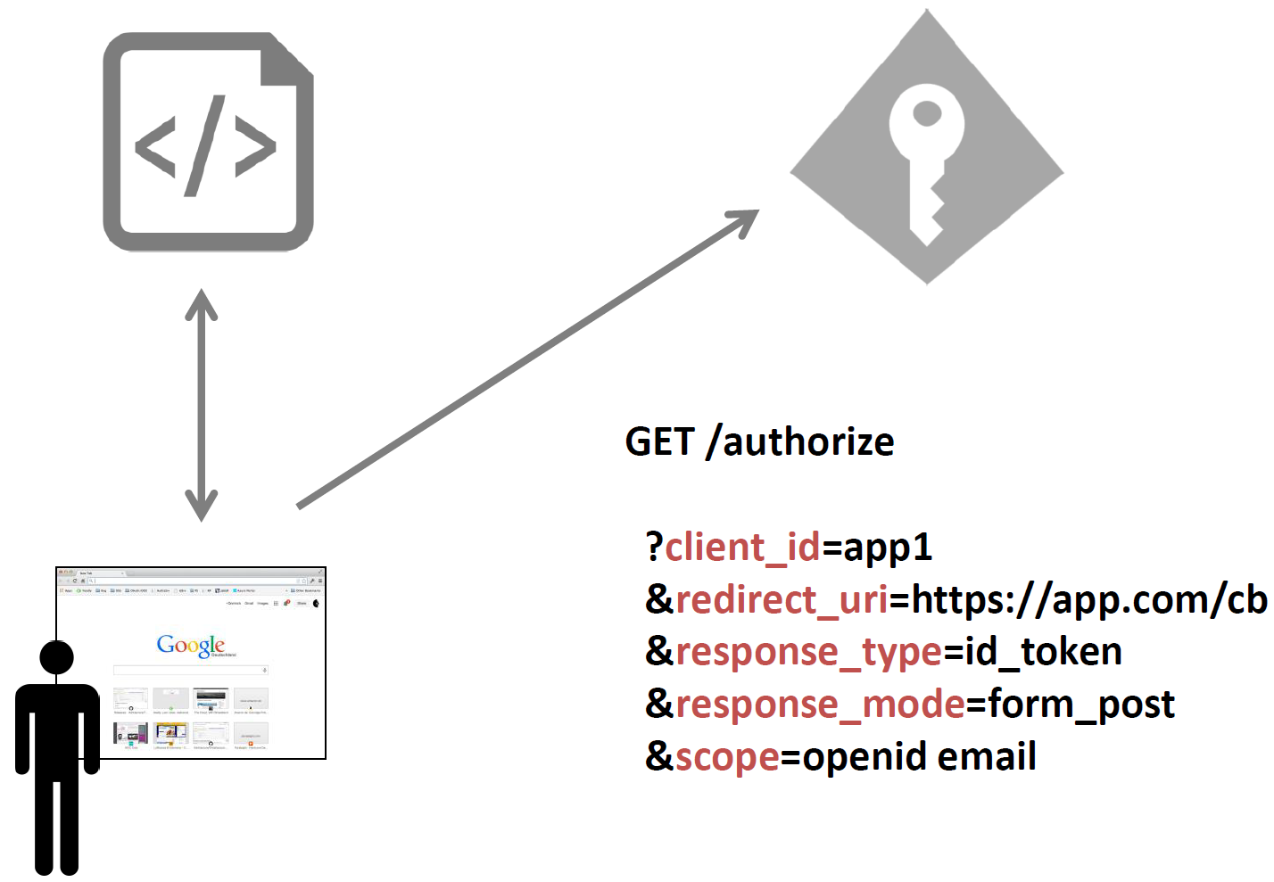
Implicit Flow
Start (web application)

Slide 19
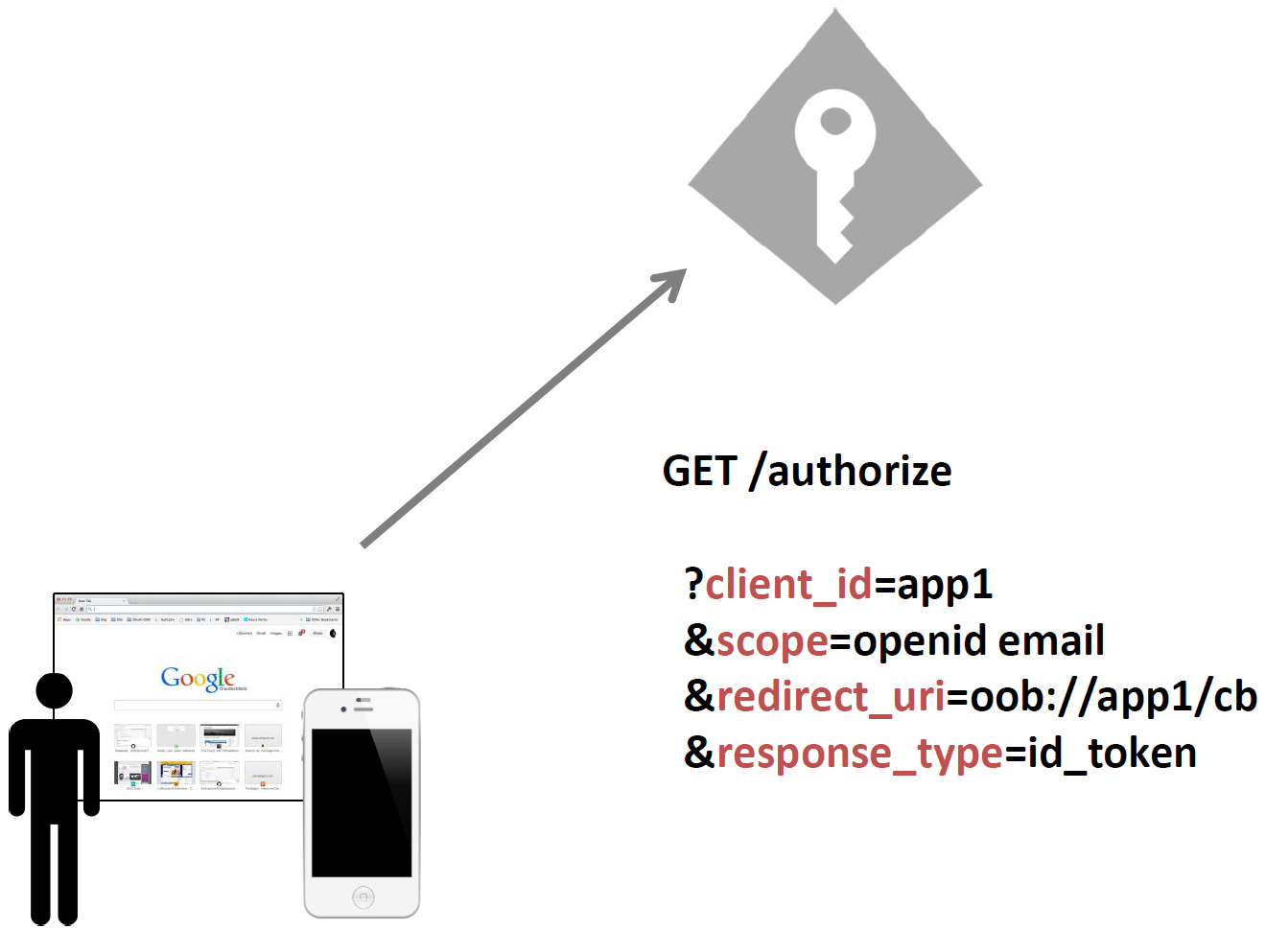
Implicit Flow
Start (native application)

Slide 20
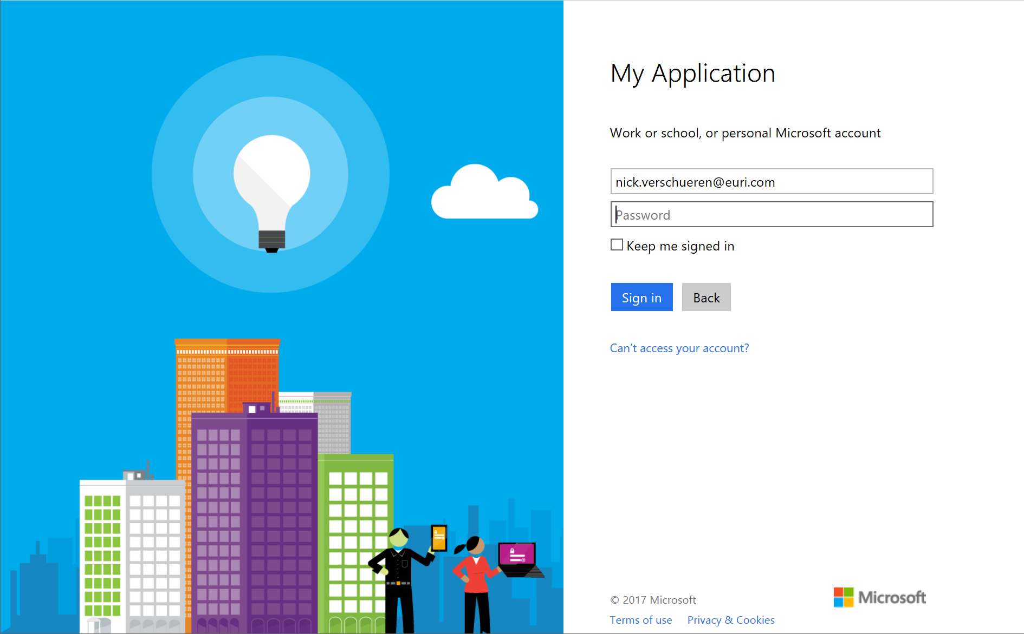
Implicit Flow
User Authentication

Slide 21
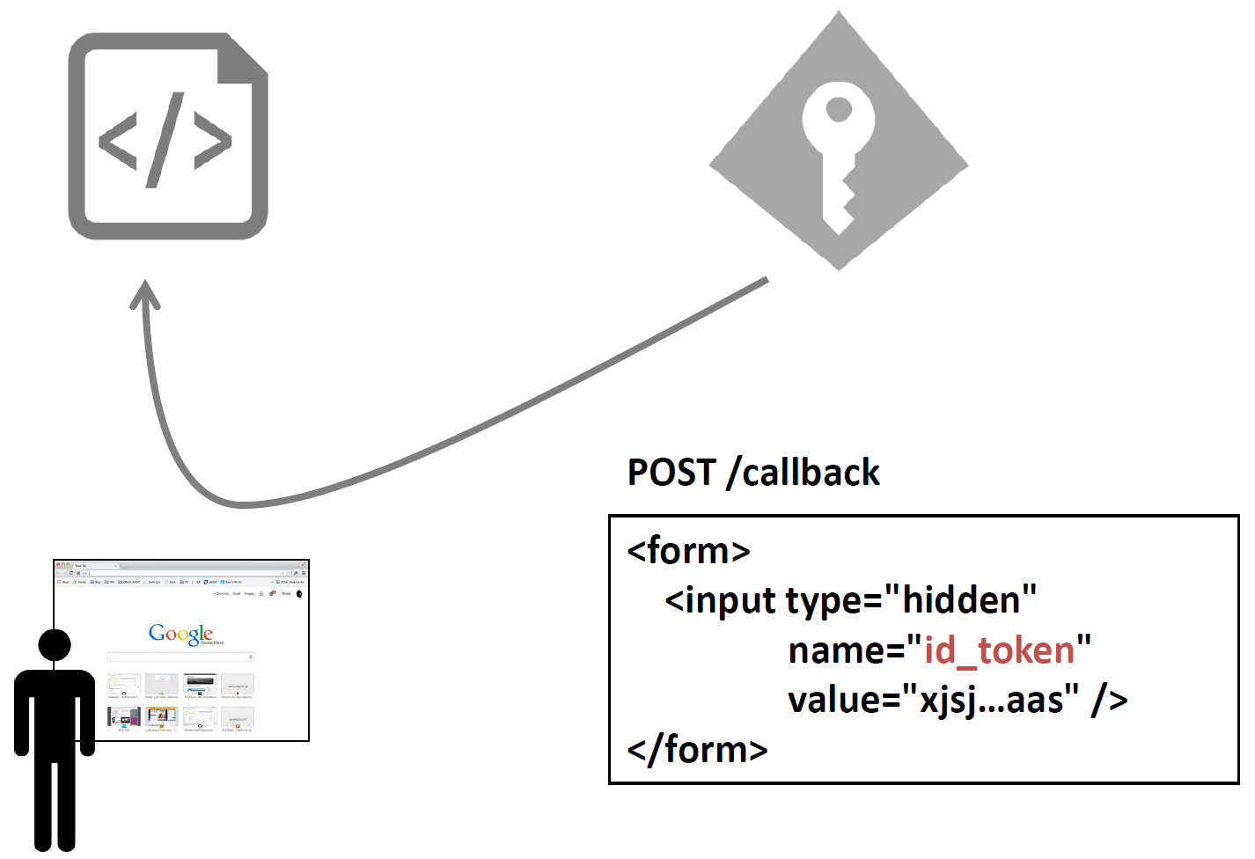
Implicit Flow
Authentication response (web application)

Slide 22
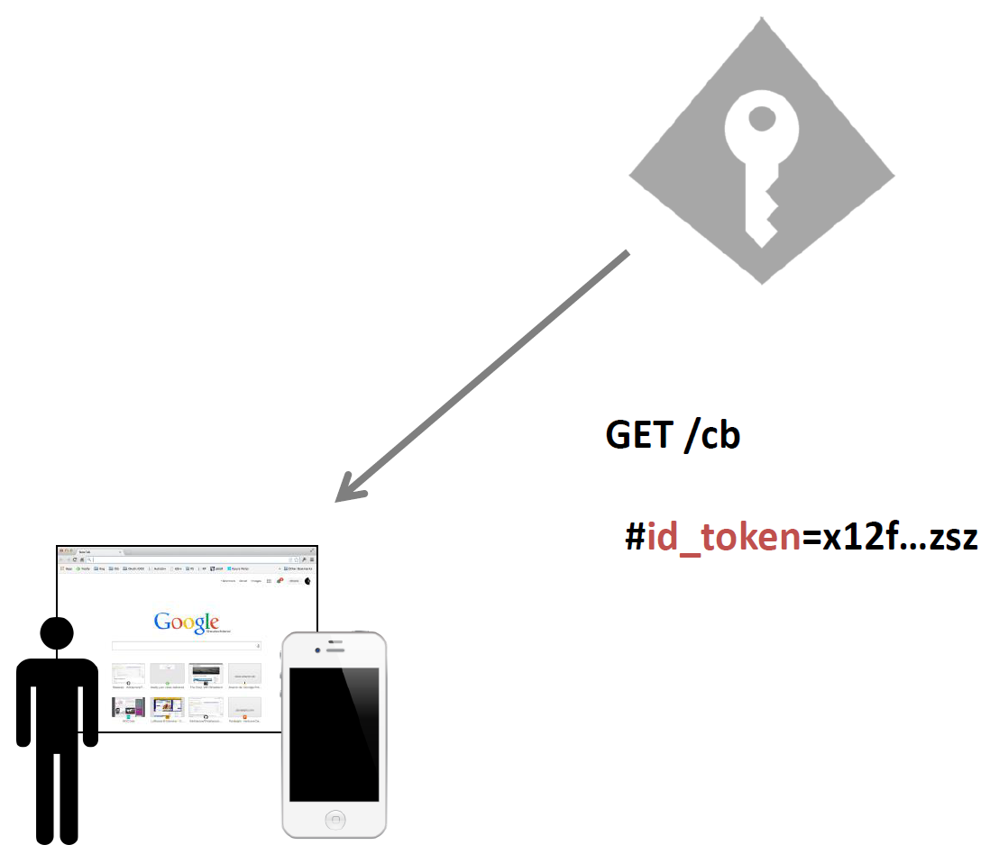
Implicit Flow
Authentication response (native application)

Slide 23
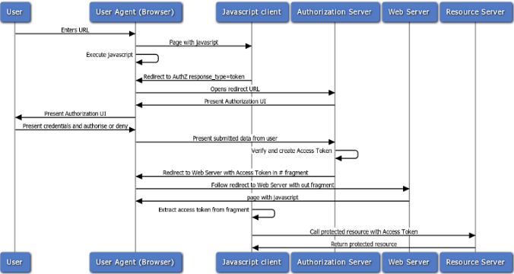
Implicit Flow

Slide 24
Scopes
There are 2 types of scopes:
ID scopes: request access to information
Resource scopes: request access to resources
Well-known OpenID Connect Scopes
Scope | Claims
openid | required scope
profile | name, family_name, given_name, middle_name, nickname, preferred_username, profile, picture, website, gender, birthdate, zoneinfo, locale, updated_at
email | email, email_verified
address | address
phone | phone_number, phone_number_verified
offline_access | requests refreshtoken

Slide 25
Token Types
Token type | Response Type | Form | Usage
Access token | token | JWT | Grants access to one or more resources
ID token | id_token | JWT | Contains the profile claims of a user
Authorization code | code | Code | Used to delegate access to a resource ⇨ Only Auth. Code or Hybrid flow
Refresh token | refresh_token | Code | Used to refresh access tokens ⇨ Requires authorization code and “offline_access” scope

Slide 26
Resource Owner Flow
Scenario:
A Client application wants to access a resource on a Resource Server and sends the user’s and its own credentials to the Authorization Server.
Typical use:
An application want to access a resource, but cannot or does not want to have an interactive login to do so.
Steps:
Resource Owner provides credentials to the Client
Client provides Resource Owner credentials and its own to Authentication Server
Authentication Server authenticates Resource Owner credentials and Client
Authorization Server sends answers Client with an ID Token and, if requested, an Access Token.

Slide 27
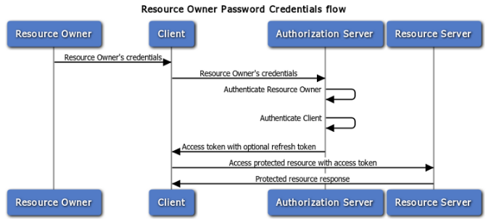
Resource Owner Flow

Slide 28
Client Credentials Flow
Scenario:
A Client application wants to access a resource on a Resource Server and sends only its own credentials to the Authorization Server.
Typical use:
An application want to access a resource, but cannot or does not want authenticate the user to do so.
Steps:
Client provides its own to Authentication Server
Authentication Server authenticates Client
Authorization Server sends answers Client with an Access Token.

Slide 29
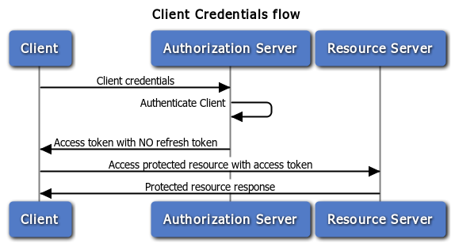
Client Credentials Flow

Slide 30
Authorization Code Flow
Scenario:
A Client application wants to delegate access a resource on a Resource Server to another application without further user interaction and the user can authenticate interactively with the Authorization Server
Typical use:
An application want to access a resource or wants to delegate access, and needs to authenticate the user to do so.
Steps:
Client redirects End-User to Authorization Server to authenticate and authorize the server to access data on their behalf.
Authorization Server Authenticates the End-User.
Client receives a callback with an authorization code.
Client passes back the authorization code to obtain an access token.
Authorization Server verifies the authorization code.
Authorization Server passes back a token response to Client.

Slide 31
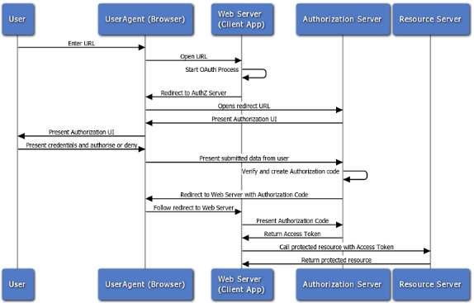
Authorization Code Flow

Slide 32
Refresh Token Flow
Scenario:
A Client application wants to access a resource on a Resource Server and sends its own credentials and a refresh token to the Authorization Server.
Typical use:
An application has a refresh token and want to access a resource.
Steps:
Client sends the refresh token to Authorization Server.
Authorization Server validates the refresh token.
Authorization Server passes back a token response to Client.

Slide 33
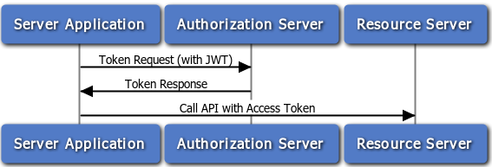
Refresh Token Flow

Slide 34
Hybrid Flow
Scenario:
A Client application wants to both delegate access a resource on a Resource Server to another application and authenticate the user interactively with the Authorization Server
Typical use:
An application needs both an access and/or an id token, and an authorization code.
Steps:
Client prepares an Authentication Request containing the desired request parameters.
Client sends the request to the Authorization Server.
Authorization Server Authenticates the End-User.
Authorization Server obtains End-User Consent/Authorization.
Authorization Server sends the End-User back to the Client with an Authorization Code and, depending on the Response Type, one or more additional parameters.
Client requests a response using the Authorization Code at the Token Endpoint.
Client receives a response that contains an ID Token and Access Token in the response body.
Client validates the ID Token and retrieves the End-User's Subject Identifier.

Slide 35
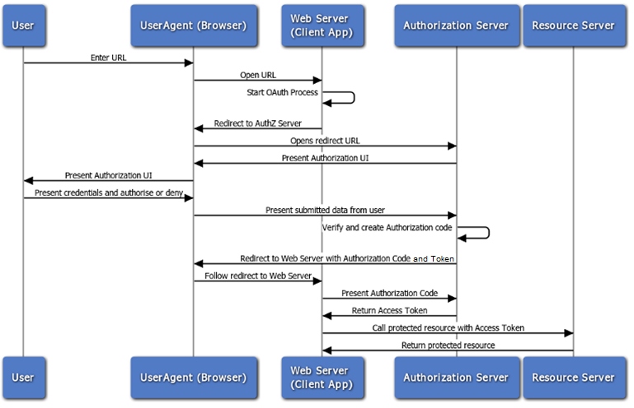
Hybrid Flow

Slide 36
.NET Core Authentication
Basic concepts
OAuth2 vs OpenID Connect
JSON Web Token (JWT)
Flows
Implicit Flow
Resource owner Flow
Client Credential Flow
Authorization Code Flow
Refresh Code Flow
Hybrid Flow
Bearer tokens

Slide 37
Bearer Tokens
Used to authorize access to a resource (for example an API)
Carried in the HTTP Authorize header using the "Bearer" scheme
Usually an OAuth2 JWT Access Token
Thing that are used to verify access:
Issuer
Signature
Validity (not before and expiry)
Audience (this is optional, but can be useful)
Scopes (requested by the user, confirmed by the authentication server)
POST /rsvp?eventId=123 HTTP/1.1 Host: events-organizer.com Authorization: Bearer AbCdEf123456 Content-Type: application/x-www-form-urlencoded User-Agent: Mozilla/5.0 (X11; Linux x86_64) AppleWebKit/1.0 (KHTML, like Gecko; Gmail Actions) rsvpStatus=YES

Slide 38
Any more questions?

