Slide 1


Yet Another Walking Dead of Active Directory
Nikos Vourdas, 2026
Adversary Village – DEF CON 34

Slide 2
Disclaimer
The opinions expressed in this presentation are my own and do not represent my current employer and any organization

Slide 3

$whoami
Senior Offensive Security Consultant
Adversary Simulation
Tiber-EU/iCAST Threat-Led
OSCE3, OSCP, OSWP, CRTL, CRTO && OASP
Supernova, COM-Hunter Author
00010011 == 19
@nickvourd

Slide 4
Today’s Agenda
Fast Forward So Far
The Dead Are Still Walking
Introduction to ADRB
Introduction to Necromancy
Credential Harvesting
Ghost Group Resurrection
SID History Necromancy
gMSA Graveyard
CS BOFs
Detections
Resources

Slide 5
Fast Forward So Far

Slide 6
Fast Forward So Far
The Walking Dead of AD
Disabled AD Objects
Lateral Movement
Priv Esc

Slide 7
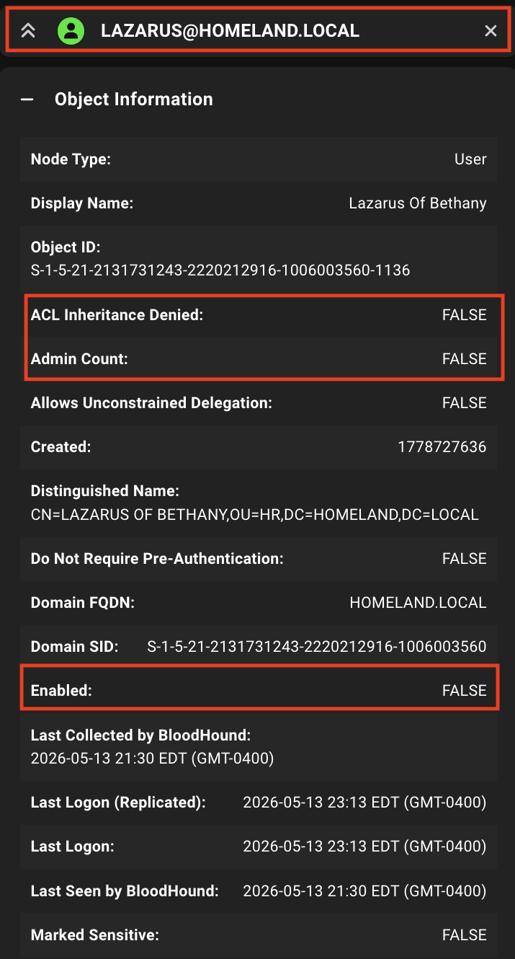
Fast Forward So Far

Slide 8
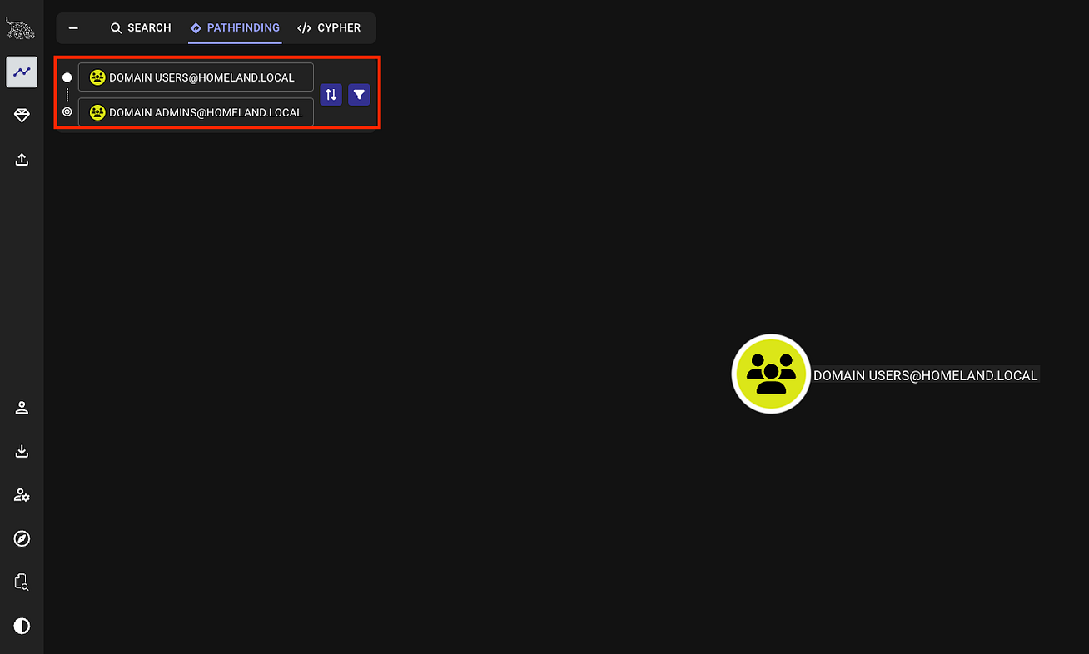
Fast Forward So Far
No Direct Path

Slide 9
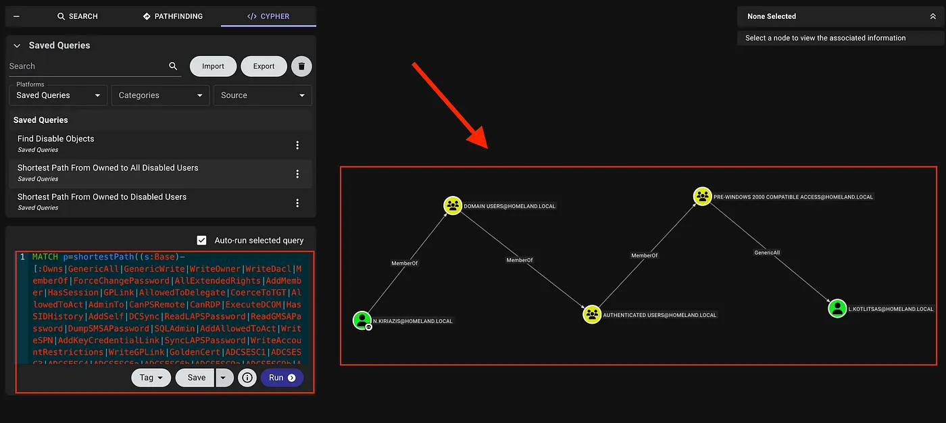
Fast Forward So Far

Slide 10
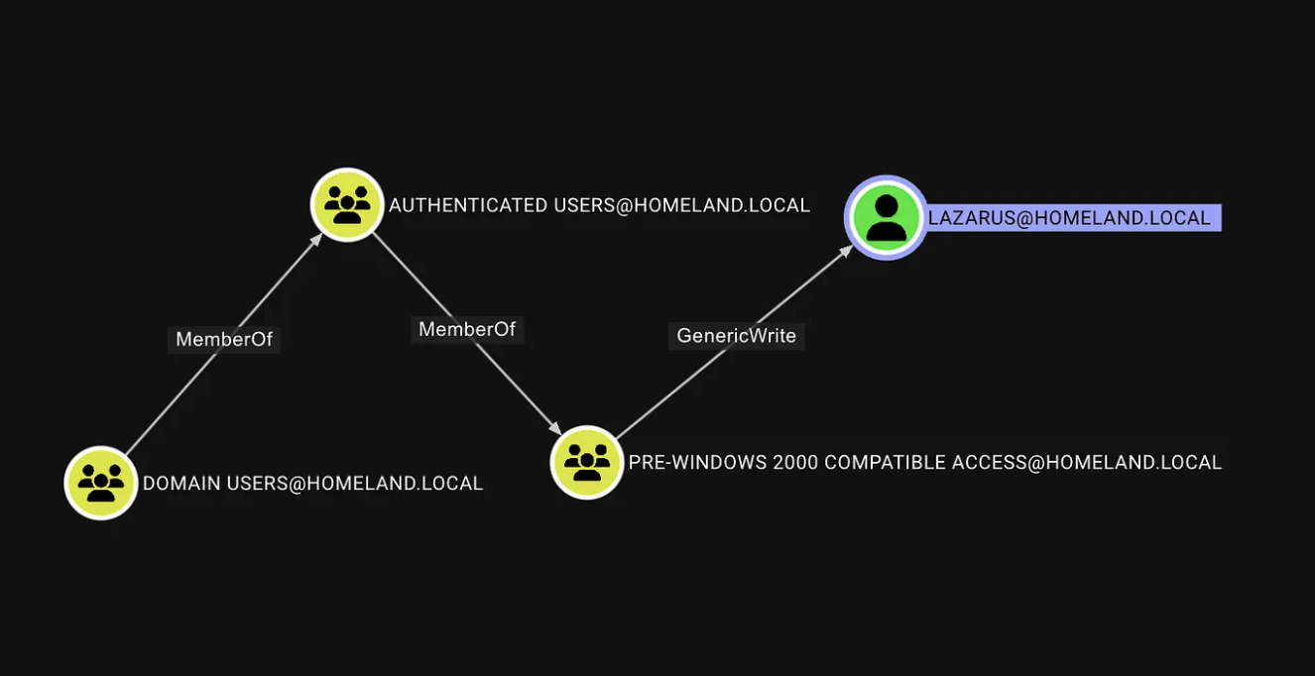
Fast Forward So Far

Slide 11
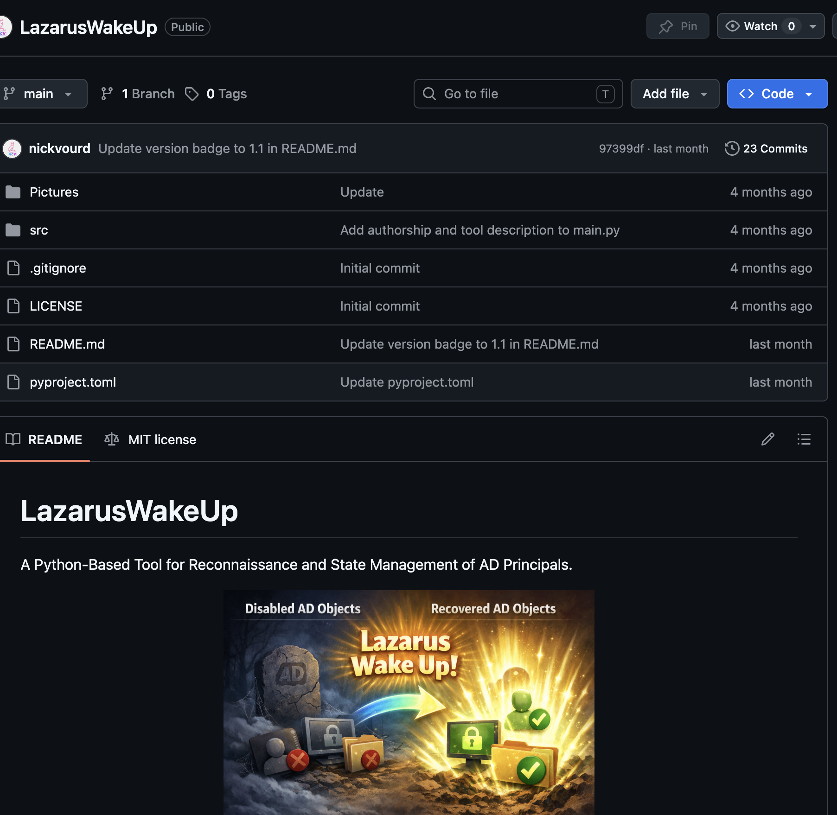
Fast Forward So Far

Slide 12
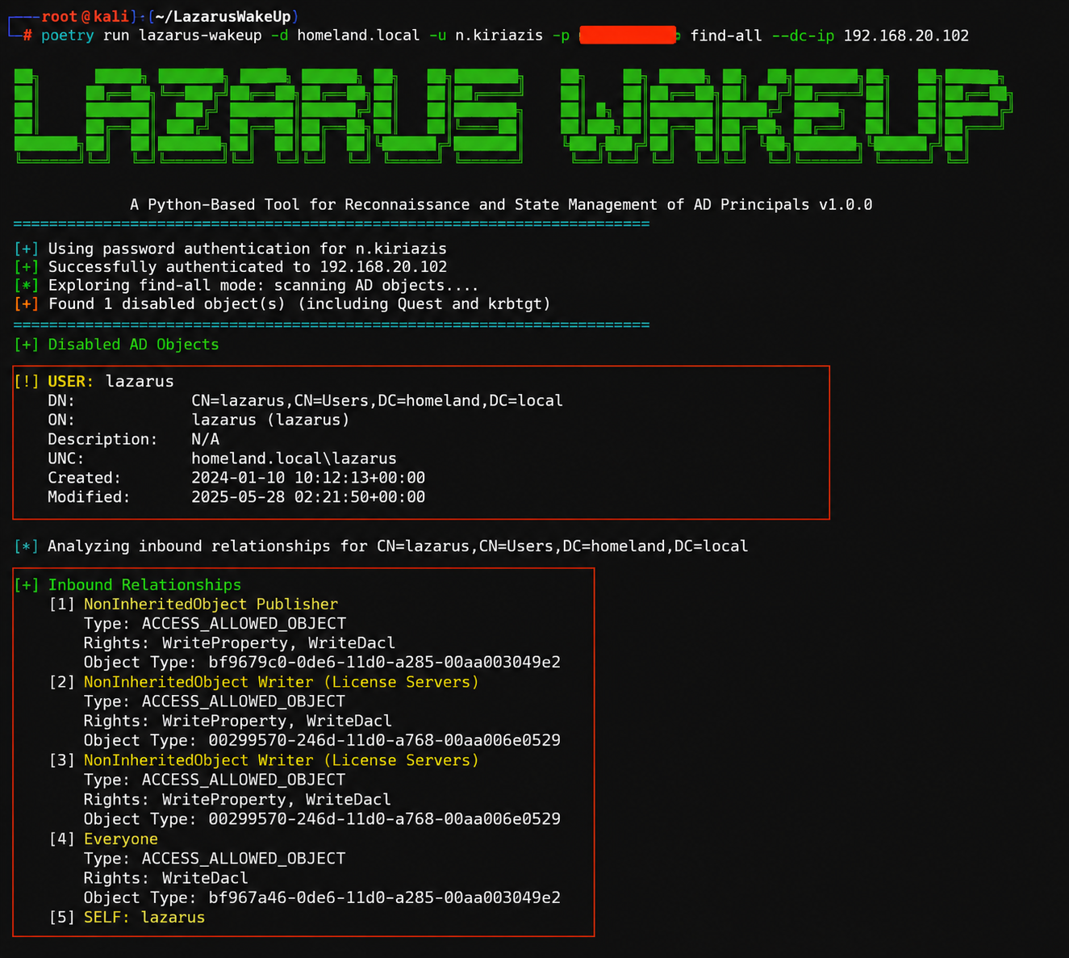
Fast Forward So Far

Slide 13
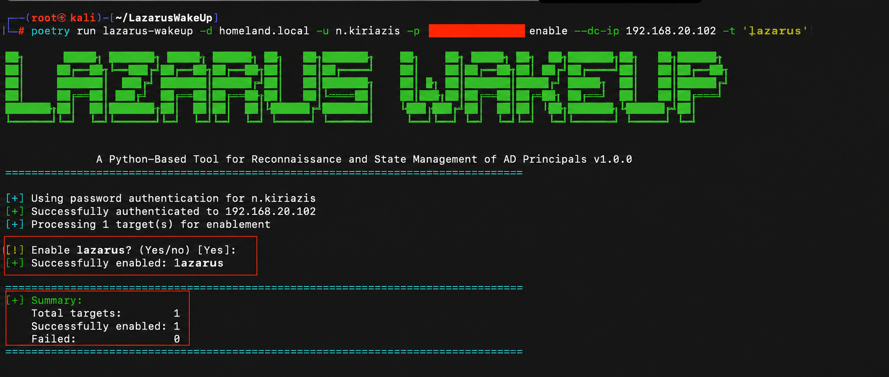
Fast Forward So Far

Slide 14
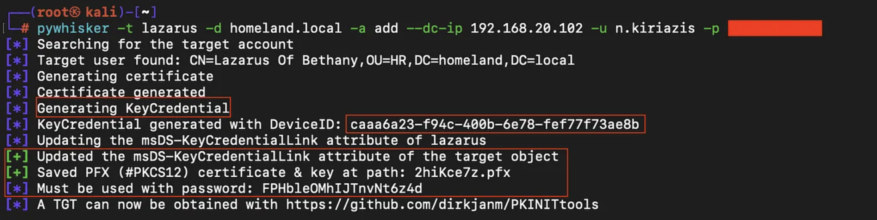
Fast Forward So Far

Slide 15
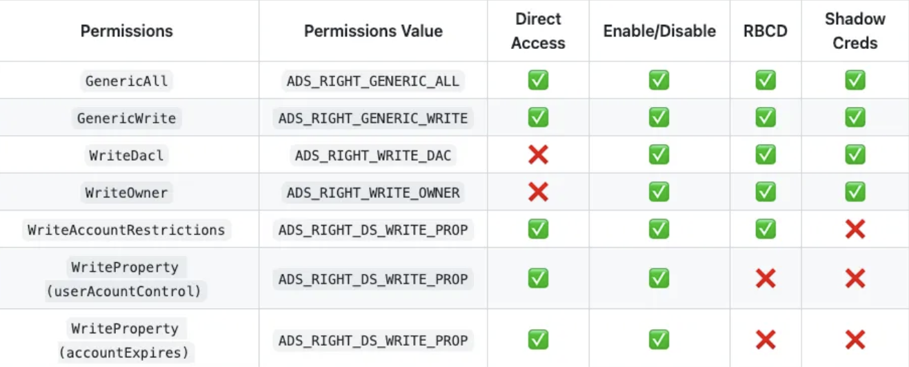
Fast Forward So Far

Slide 16
Fast Forward So Far
Object Type | Enable / Disable
User | ✓
Computer | ✓
gMSA / MSA | ✓
Group | ✗
OU | ✗
GPO | ✗
Container | ✗
Certificate Templates | ✓*
*Requires "Manage CA" privileges…

Slide 17
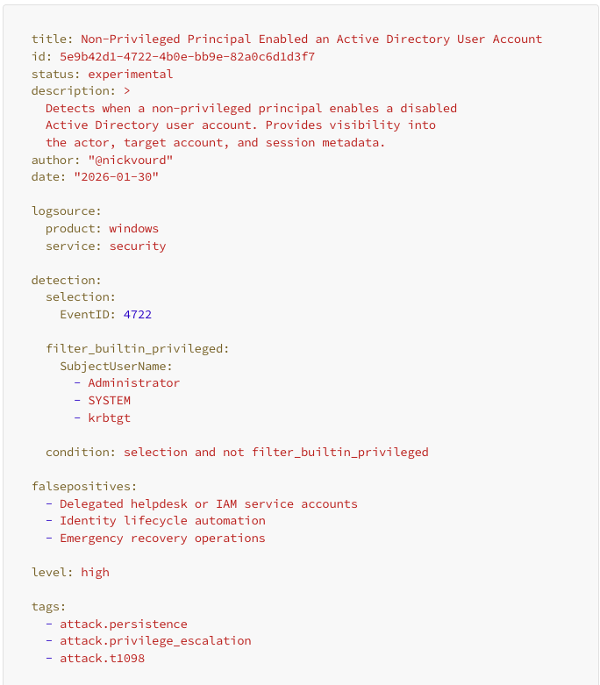
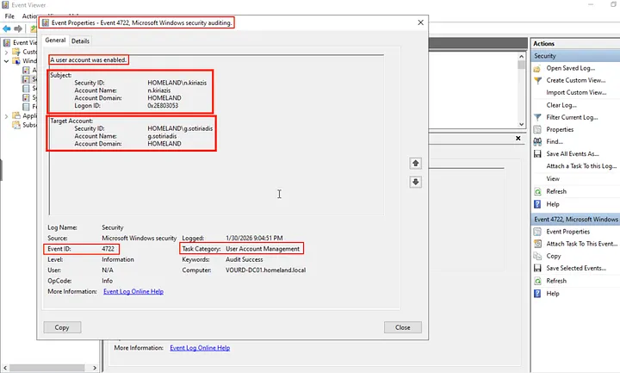
Fast Forward So Far

Slide 18
The Dead Are Still Walking

Slide 19
The Dead Are Still Walking
What's next after disabled AD objects?

Slide 20
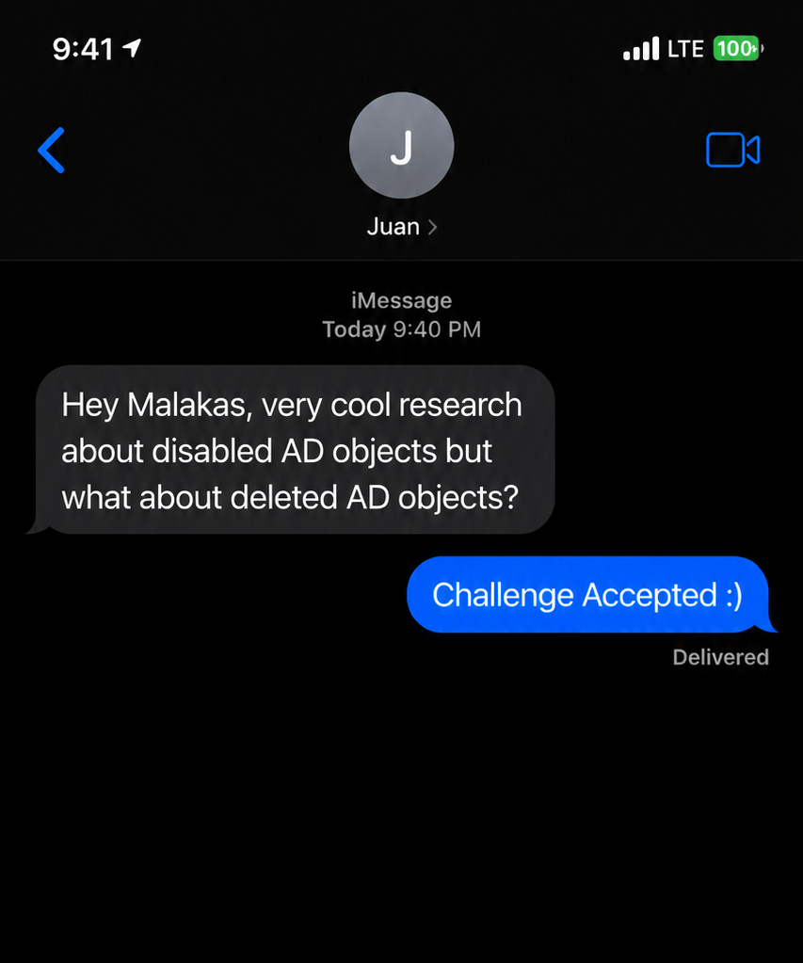
The Dead Are Still Walking
What's next after disabled AD objects?

Slide 21
Fast Forward So Far
The Walking Dead of AD
Disabled AD Objects
Deleted AD Objects
Lateral Movement
Priv Esc
Post-DA Activities
Persistence
Pivoting to other resource

Slide 22
Introduction to ADRB

Slide 23
Introduction to ADRB
Active Directory Recycling Bin (“ADRB”):
Introduced in Windows Server 2008 R2
Allows restoration of deleted Active Directory objects
Must be explicitly enabled (cannot be disabled afterward)
Requires Windows Server 2008 R2 Forest Functional Level or higher
The deleted objects moved to the hidden Deleted Objects container
The object retains important attributes such as:
Group memberships
SID
SID History
ACLs permissions
User properties (description, email, SPNs, etc.)

Slide 24
Introduction to ADRB
Required Permissions to Manage Active Directory Recycle Bin:
Domain Admins
Enterprise Admins
Built-in Administrators
Accounts with delegated permissions
Before the Active Directory Recycle Bin was introduced, deleted objects immediately became tombstoned objects, retaining only a minimal set of attributes and requiring complex recovery procedures.

Slide 25
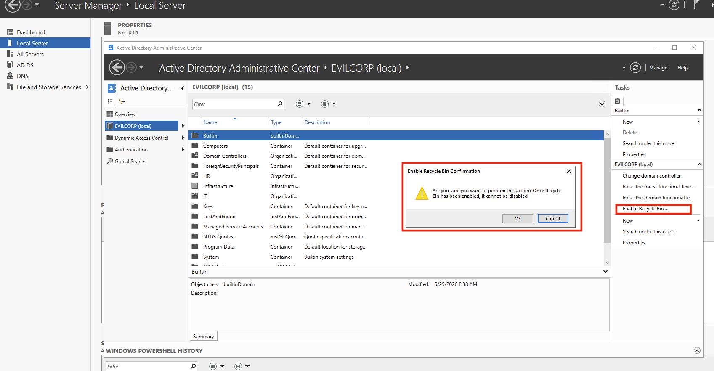
Introduction to ADRB

Slide 26
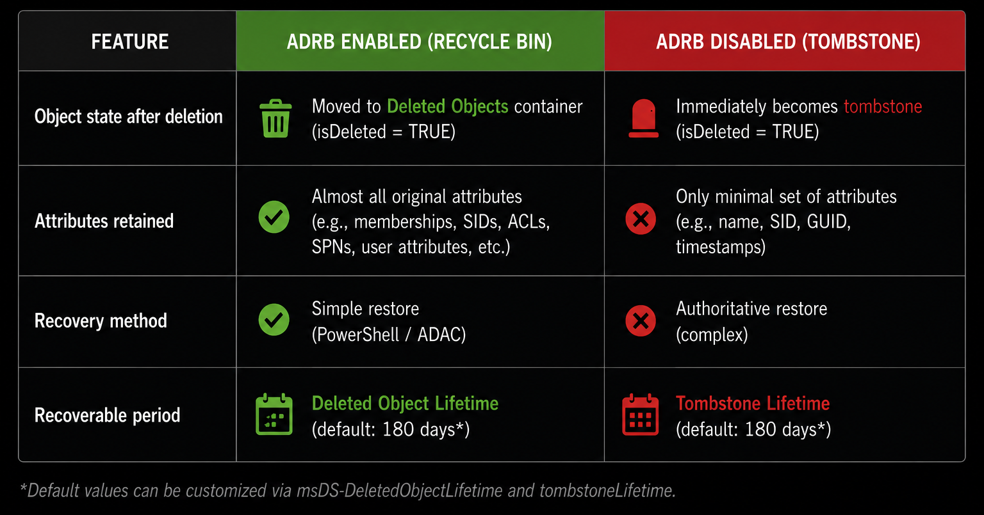
Introduction to ADRB

Slide 27
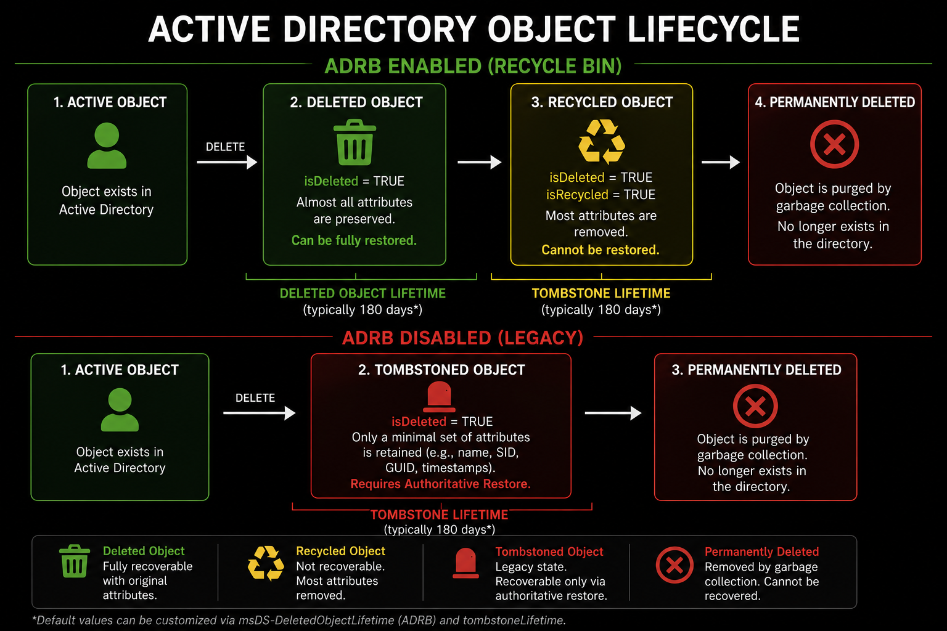
Introduction to ADRB

Slide 28
Introduction to Necromancy

Slide 29
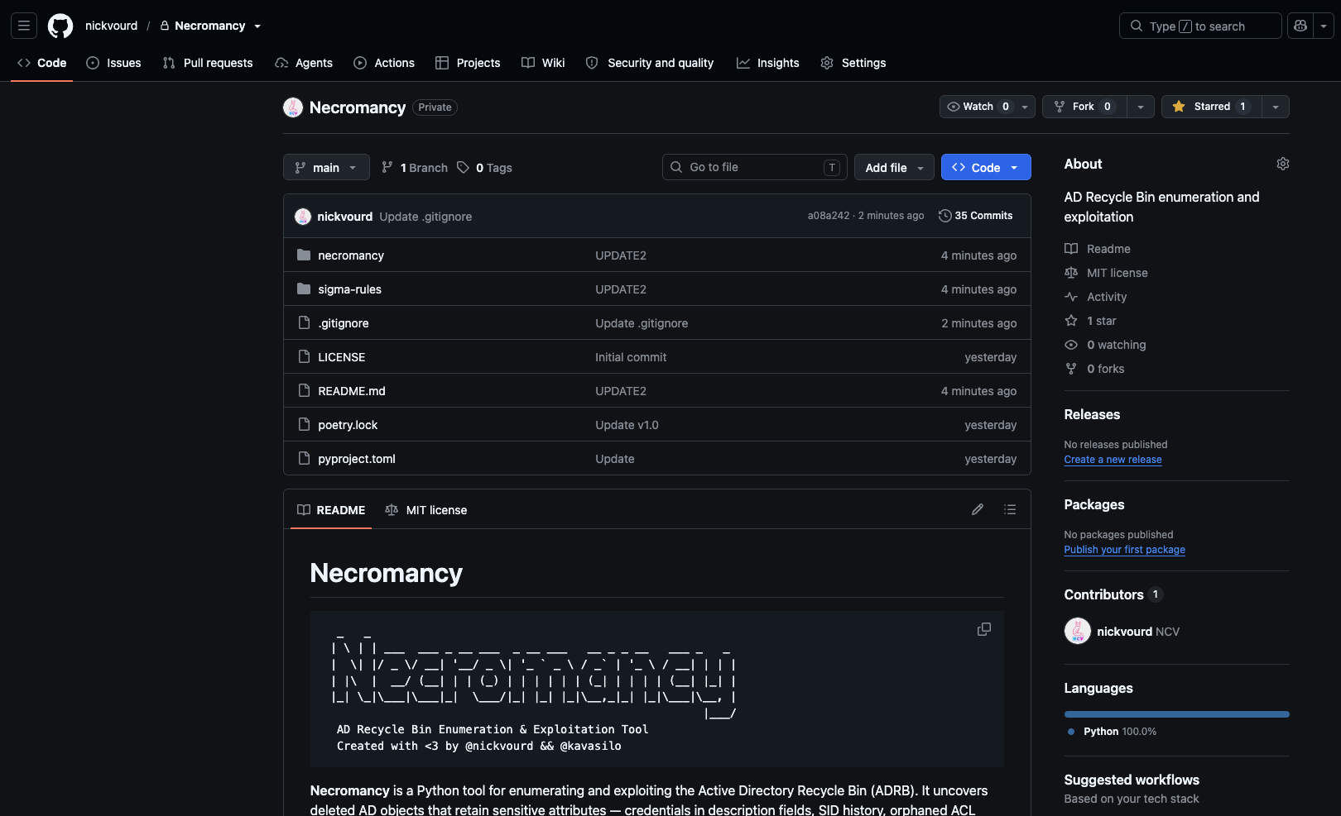
Introduction to Necromancy
Built with Python 3.x
Poetry framework
Identifies whether Active Directory Recycle Bin is enabled
Checks whether the current user can read the hidden Deleted Objects container
Restores users, computers, service accounts, and groups
Adds restored group members back to active groups
Reads and decodes encoded SIDs

Slide 30
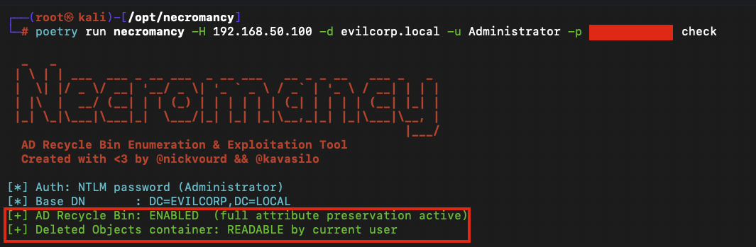
Introduction to Necromancy

Slide 31
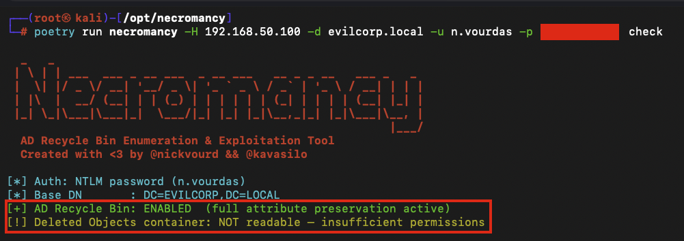
Introduction to Necromancy

Slide 32
Credential Harvesting

Slide 33
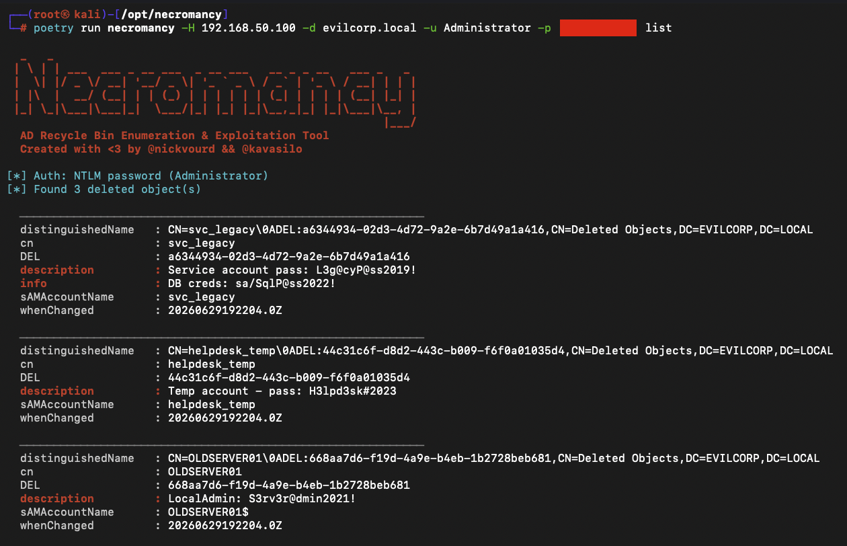
Credential Harvesting
Sensitive data in description, info, or custom attributes, including cleartext passwords

Slide 34
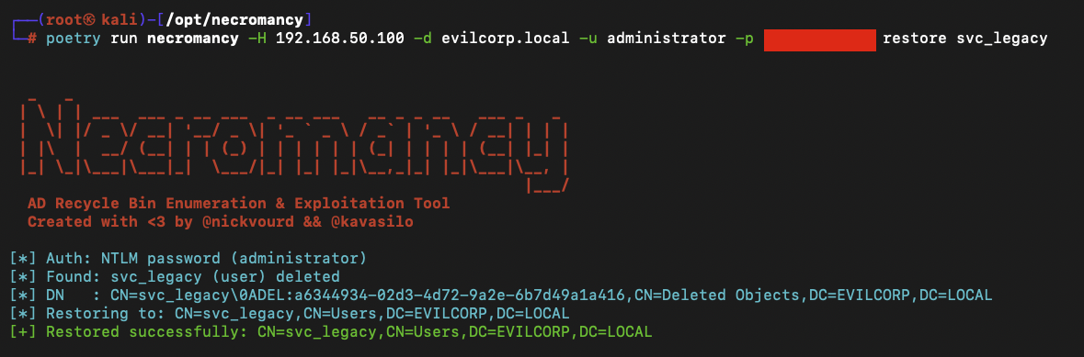
Credential Harvesting
The harvested credentials can be reused to perform password spraying across multiple services.
If the restored account's credentials remain valid, it can be used to regain and maintain persistent access.

Slide 35
Ghost Group Resurrection

Slide 36
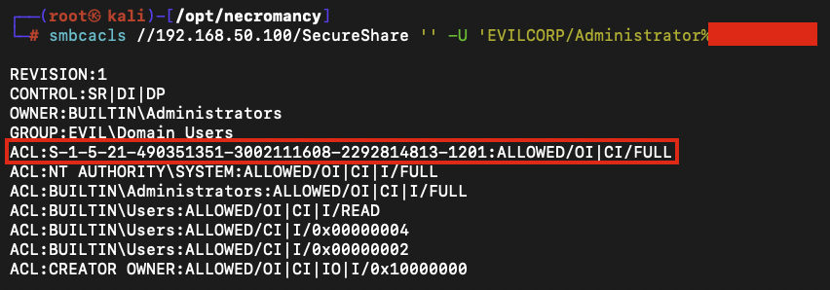
Ghost Group Resurrection
Deleted security groups leave their SID orphaned in every ACL
When the group is restored from the AD Recycle Bin, it reclaims the exact same SID and with it, every permission that was never cleaned up
Notes:
Applies also to AD CS attacks

Slide 37
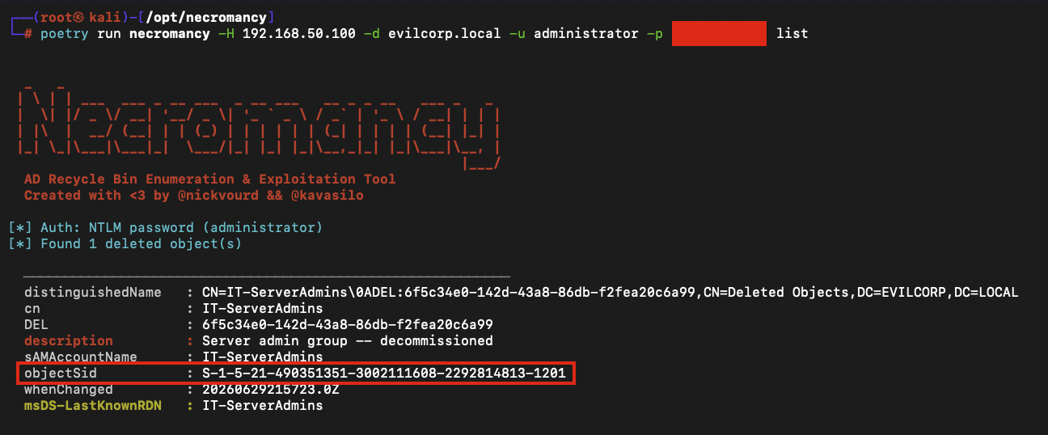
Ghost Group Resurrection
Locate the deleted group
Notes:
Applies also to AD CS attacks

Slide 38
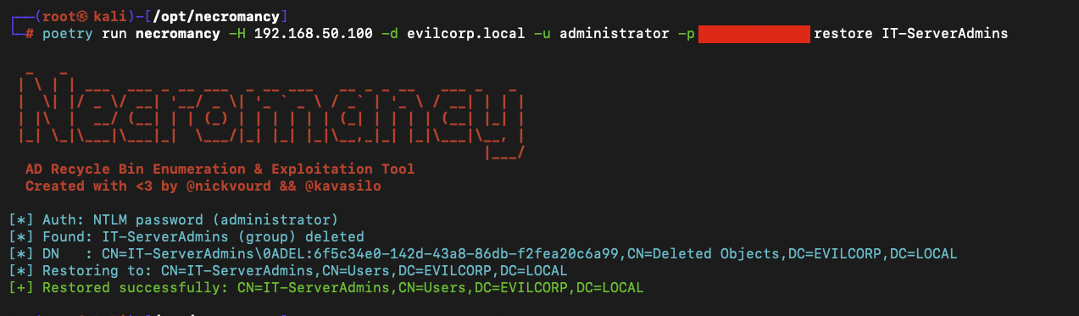
Ghost Group Resurrection
Locate the deleted group
Restore the deleted group
Notes:
Applies also to AD CS attacks

Slide 39
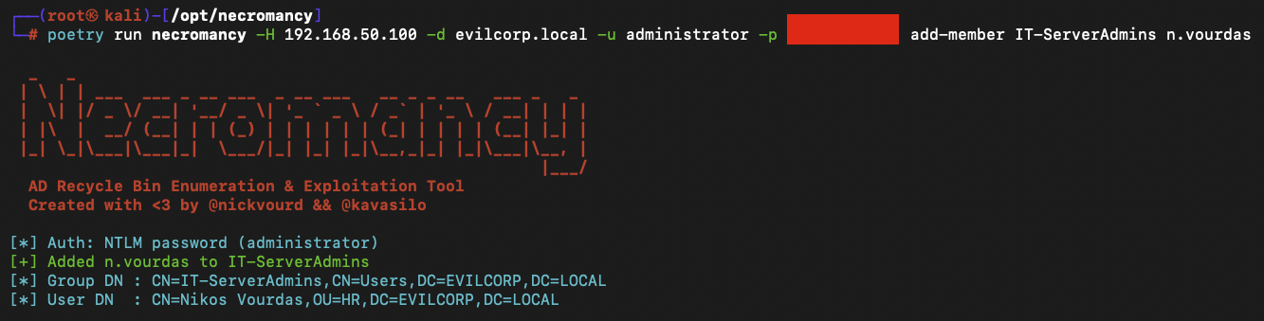
Ghost Group Resurrection
Locate the deleted group
Restore the deleted group
Add attacker account to the restored group
Notes:
Applies also to AD CS attacks

Slide 40
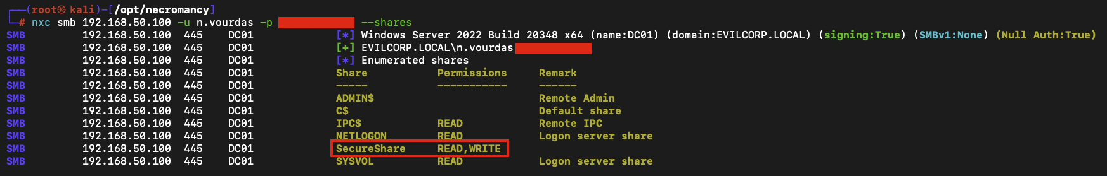
Ghost Group Resurrection

Slide 41
SID History Necromancy

Slide 42
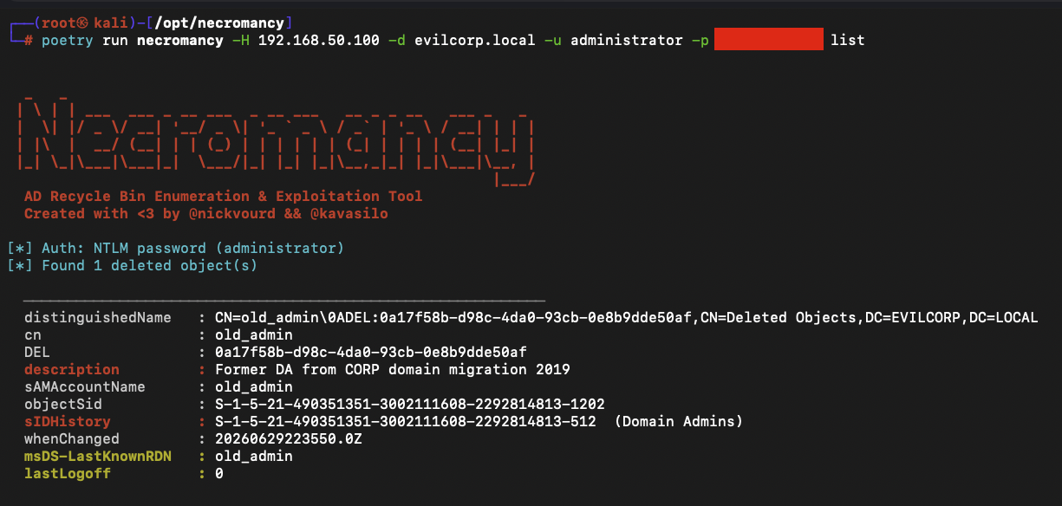
SID History Necromancy
Deleted objects may retain sIDHistory attributes

Slide 43
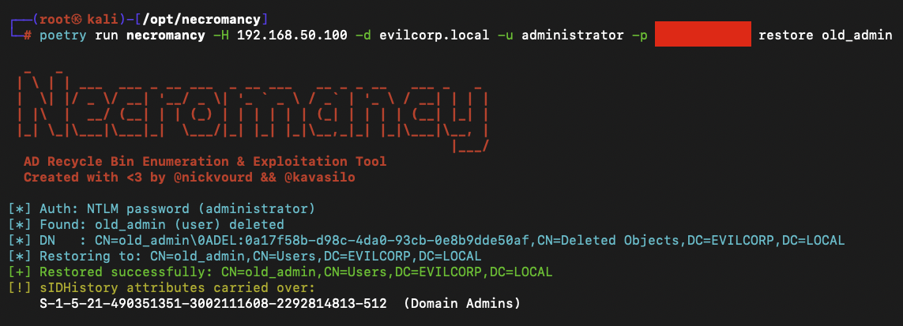
SID History Necromancy
Restore the deleted object

Slide 44
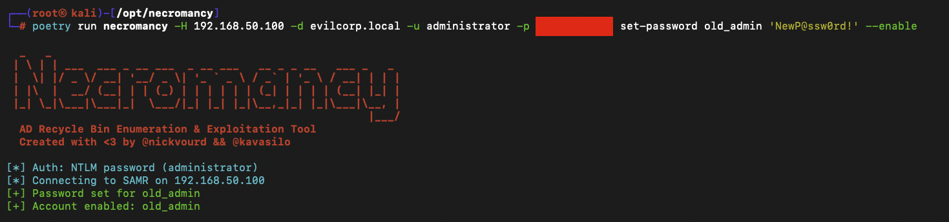
SID History Necromancy
Change the password of the restored account

Slide 45
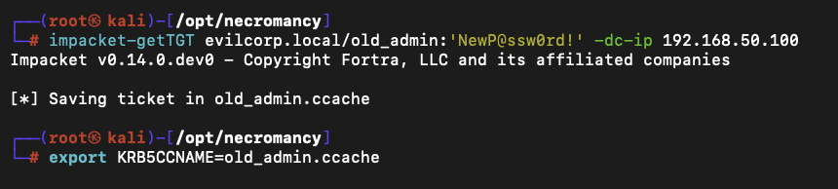
SID History Necromancy
Perform DCSync

Slide 46
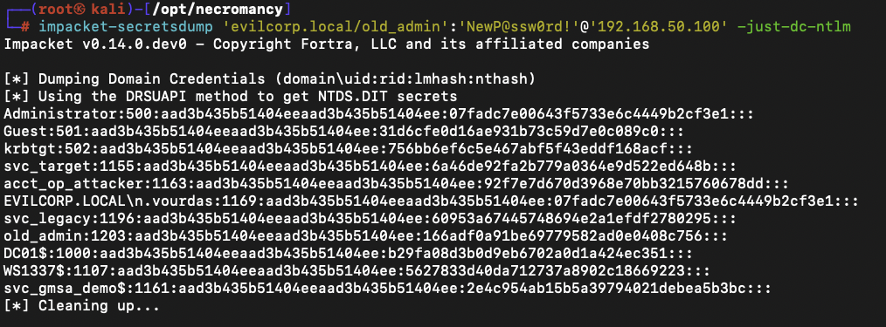
SID History Necromancy
Perform DCSync

Slide 47
gMSA Graveyard

Slide 48
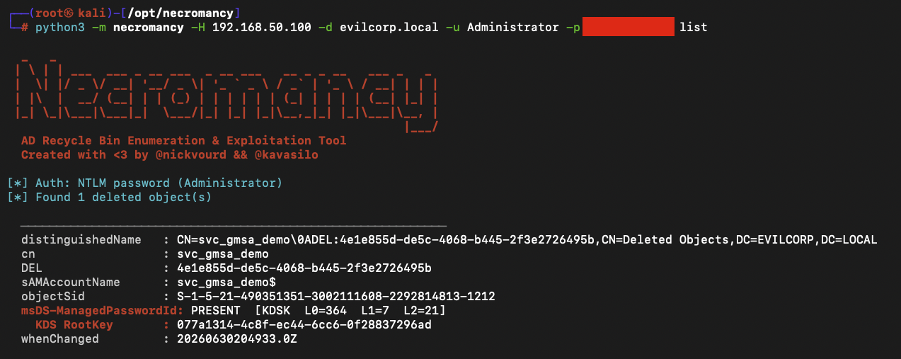
gMSA Graveyard
Spot the gMSA with preserved password descriptor

Slide 49
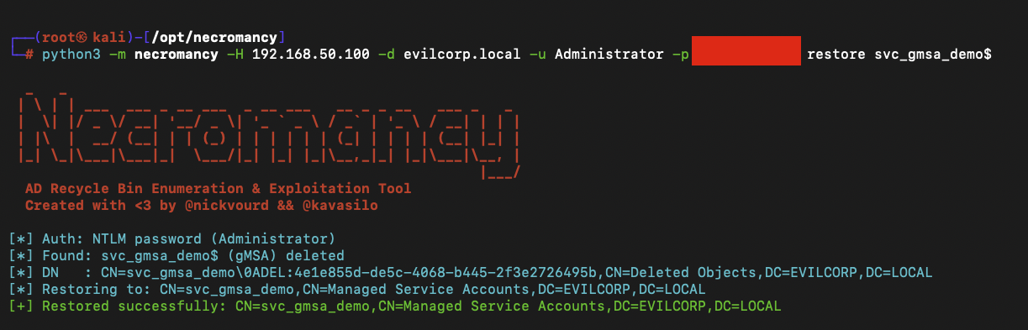
gMSA Graveyard
Restore the gMSA account

Slide 50
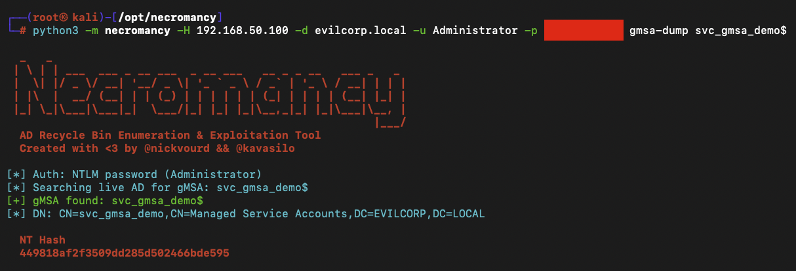
gMSA Graveyard
Read the gMSA password
Instead of DCSync

Slide 51
gMSA Graveyard 2

Slide 52
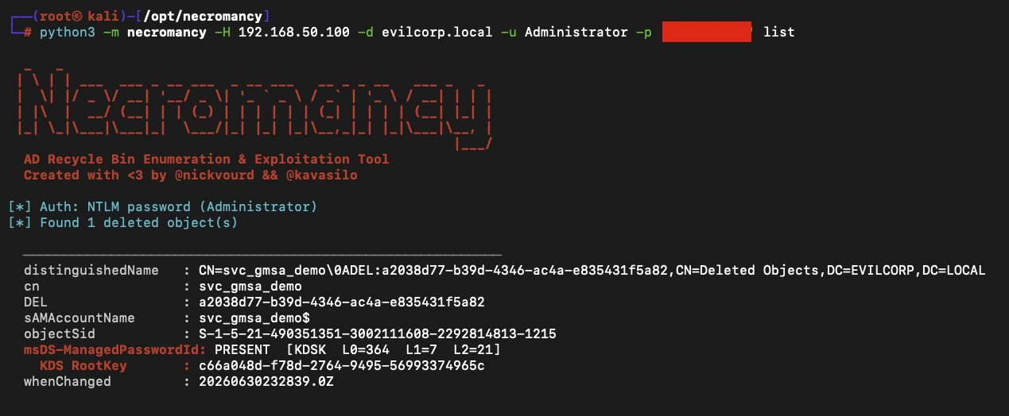
gMSA Graveyard 2
Spot the gMSA with preserved password descriptor

Slide 53
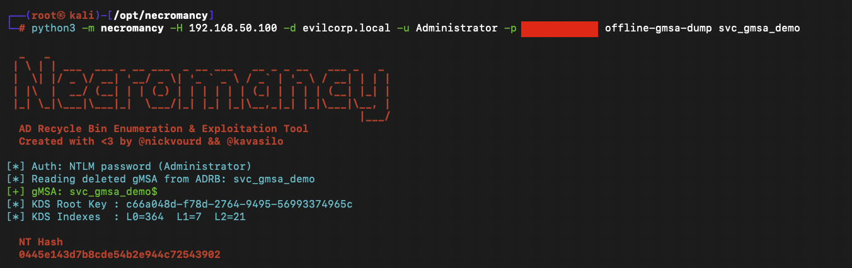
gMSA Graveyard 2
Derive the password offline without restoring
Recomputes the gMSA password from ADRB metadata and the domain's KDS root key
Based on Semperis research for Golden GMSA

Slide 54
CS BOFs

Slide 55
CS BOFs
Cobalt Strike Beacon Object Files
Based on TrustedSec’s BOF format
ADRB Status Enumeration
ADRB Current User Permissions
ADRB Content List

Slide 56
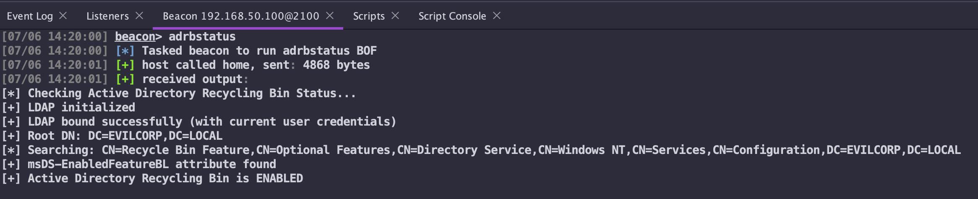
CS BOFs
Cobalt Strike Beacon Object Files
Based on TrustedSec’s BOF format
ADRB Status Enumeration
ADRB Current User Permissions
ADRB Content List

Slide 57
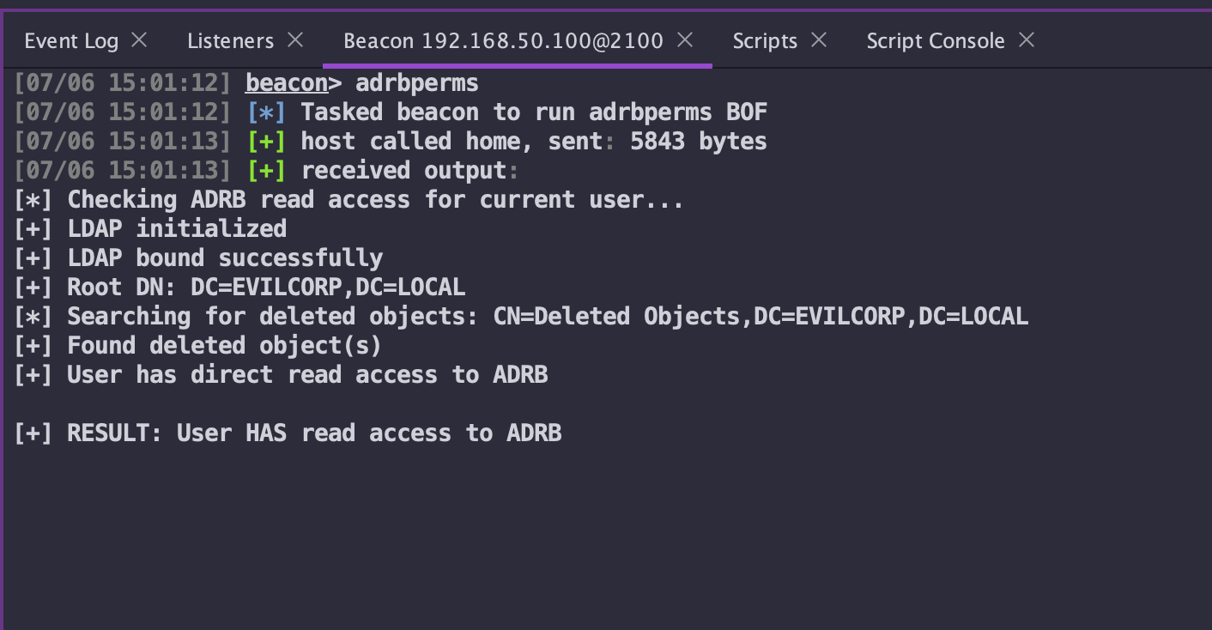
CS BOFs
Cobalt Strike Beacon Object Files
Based on TrustedSec’s BOF format
ADRB Status Enumeration
ADRB Current User Permissions
ADRB Content List

Slide 58
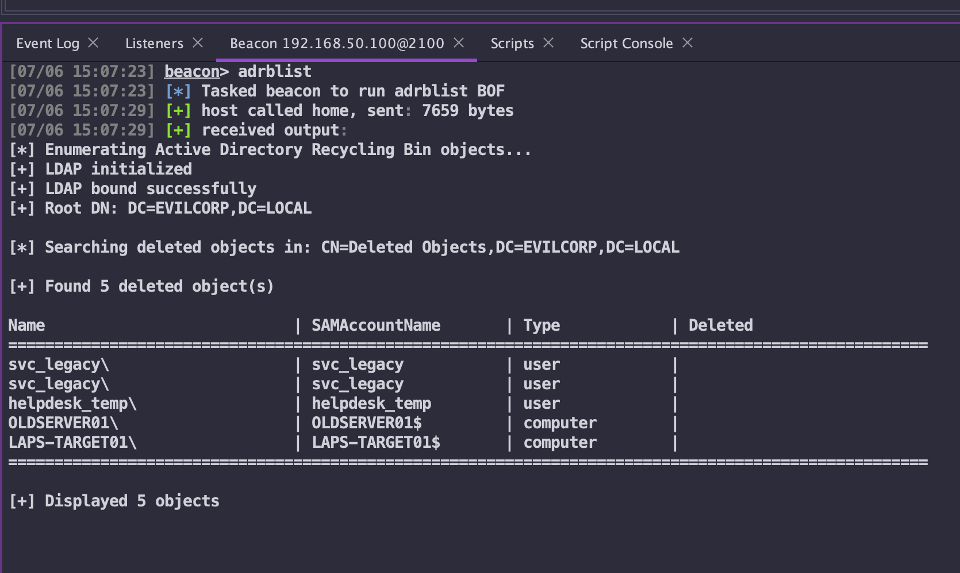
CS BOFs
Cobalt Strike Beacon Object Files
Based on TrustedSec’s BOF format
ADRB Status Enumeration
ADRB Current User Permissions
ADRB Content List

Slide 59
Detections

Slide 60
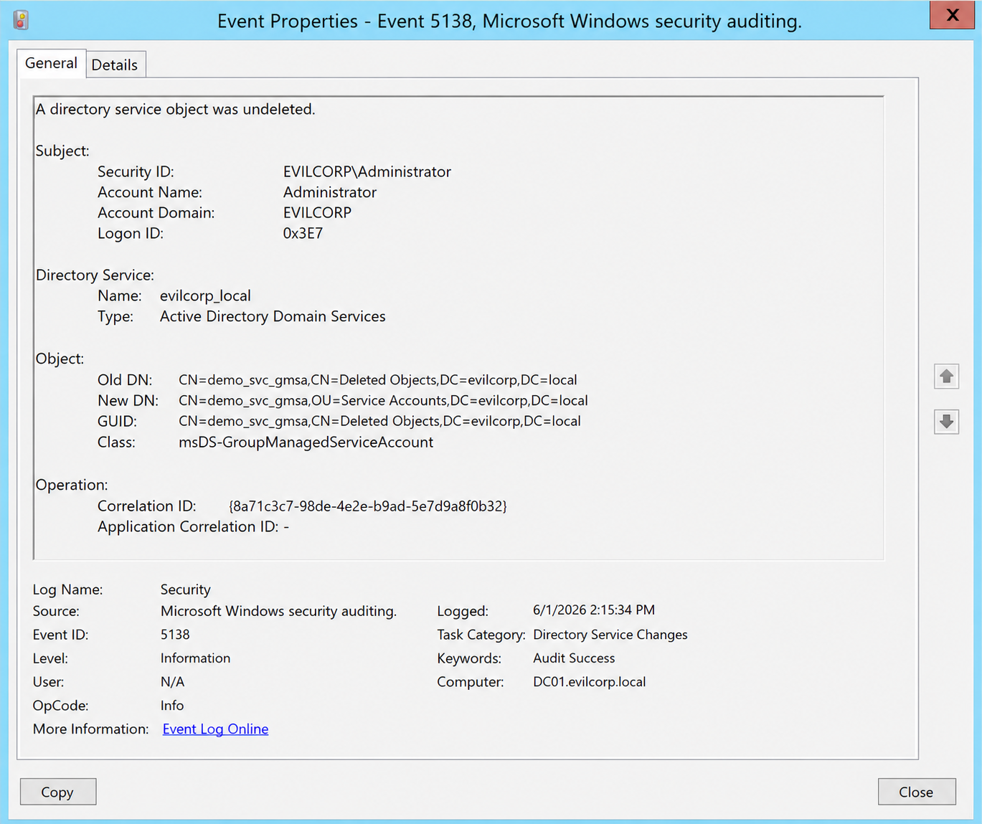
Detections
Event IDs:
5138: A directory service object was undeleted
5136: A directory service object was modified
5139: A directory service object was moved

Slide 61
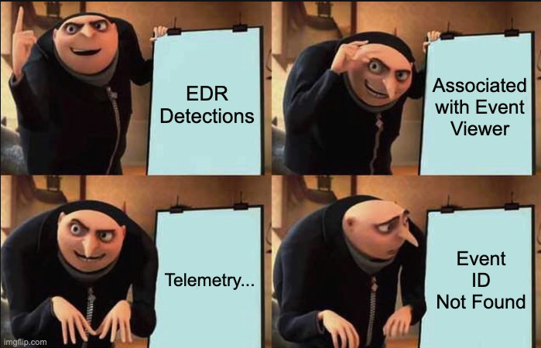
Detections
Directory Service Changes audit should be enabled:
Computer Configuration > Windows Settings > Security Settings > Advanced Audit Policy Configuration > System Audit Policies > DS Access > Audit Directory Service Changes

Slide 62
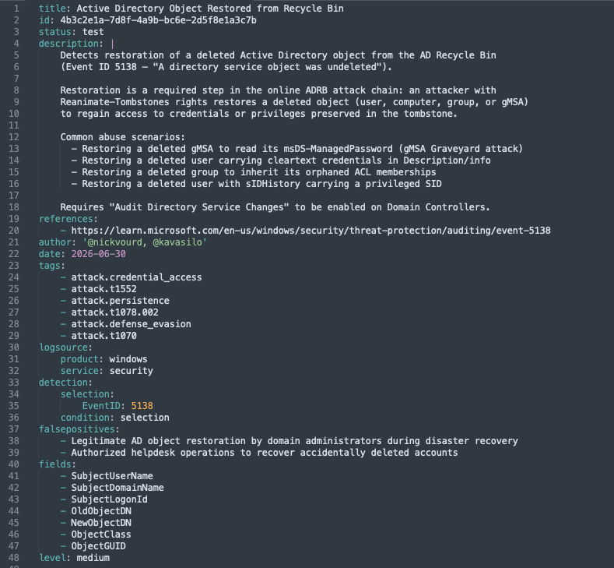
Detections

Slide 63
Resources

Slide 64
Resources
https://learn.microsoft.com/en-us/windows-server/identity/ad-ds/get-started/adac/active-directory-recycle-bin
https://netwrix.com/en/resources/blog/active-directory-object-recovery-recycle-bin/
https://www.semperis.com/blog/golden-gmsa-attack/
https://cravaterouge.com/articles/ad-bin/
https://adsecurity.org/?p=1906
https://hacktricks.wiki/en/windows-hardening/active-directory-methodology/privileged-groups-and-token-privileges.html#ad-recycle-bin
https://secureidentity.se/recover-laps-passwords/

Slide 65

Thank You

