Slide 1
Personal Financial Forecasting Model
Introduction and How-To
Nick V. Zorn
github.com/nickvzorn/spreading-sheet
## July 2017

Slide 2
Introduction to PFFM workbook
The Personal Financial Forecasting Model (PFFM) is a spreadsheet workbook I created to project my family’s current financial situation and behaviors forward through retirement and until death.
  Motivation: wanted a tool that could roughly gauge the impact of changing or losing a job by visualizing the effect such an event on one’s potential net worth and income during retirement
User is presented with one sheet of intuitive input parameters to characterize their salary/-ies as well as almost every imaginable type of account and debt that a person or couple could have:
  Mortgage, savings, 401(k), Roth & Traditional IRAs, social security, pensions, investments, expenses, credit card debt, childcare, college savings (e.g. 529) accounts and eventual college costs, etc.
  User enters their own assumptions about how these things will grow/change – offering freedom to compare conservative vs. aggressive scenarios

Slide 3
What you need to get started
A couple of hours
LibreOffice Calc or Microsoft Excel software
  Download the example workbook directly from one of these links:
    LibreOffice Calc Version
    Microsoft Excel 2013 version
    Microsoft Excel 2003 version
Current copies of (or numbers from) the following:
  Monthly pay stub(s)
  Mortgage loan statement(s)
  Credit card statement(s)
  Retirement account statement(s) – 401(k), Traditional IRA, and/or Roth IRA
  Any other investment (e.g. mutual fund) account statement(s)
  Any other loan (e.g. auto or student loan) statement(s)
  Social Security statement(s) (NOTE you can create an online account at this link)
  Pension statement(s), if applicable
  Estimates of total monthly expenses – either lazily summed into one number or broken down into categories
  Children’s average monthly daycare/aftercare/camp costs, if applicable
  Children’s college savings (e.g. 529) account statement(s), if applicable

Slide 4
General Guidelines
General information is summarized on the “README” sheet
The only sheet that can be modified is the “Input” sheet
  Green fields can be modified
  Yellow fields are fixed values or auto-calculated
  Enter any assets/investments as positive numbers
  Enter any debts/payments as negative numbers

Slide 5
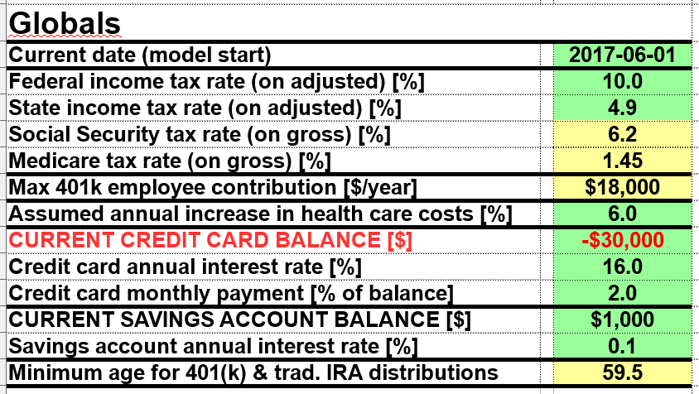
Input Sheet: Global Parameters
Using your latest pay stub, compute the federal/state income tax rate by dividing the amount of federal/state tax withheld by the gross pay minus retirement (e.g. 401k) and health insurance
A conservative number for “Assumed annual increase in health care costs” would be 5-6%
Enter any credit card balance that is being carried from month to month (enter zero if you pay it off every month). If a carried balance exists, enter the percentage you pay each month as well as the interest rate
Enter any plain-old savings account balance you currently have. This savings account is assumed to receive any discretionary income you may have left each month

Slide 6
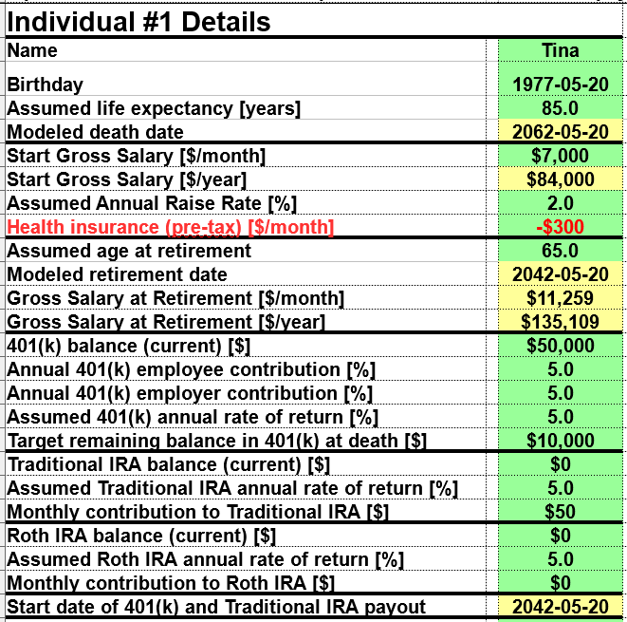
Input Sheet: Individual Details (part 1)

Slide 7
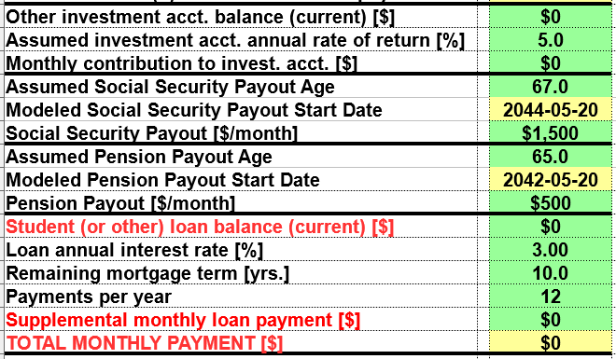
Input Sheet: Individual Details (part 2)

Slide 8
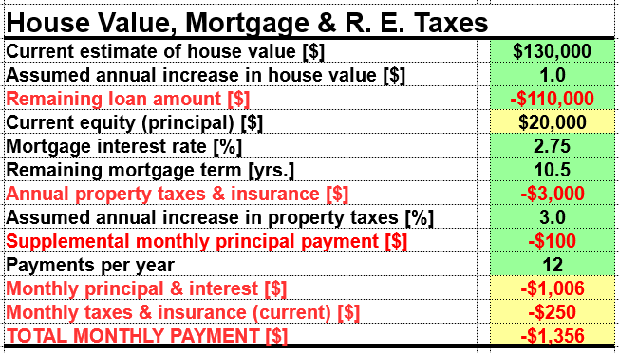
Input Sheet: Real Estate Mortgage & Taxes

Slide 9
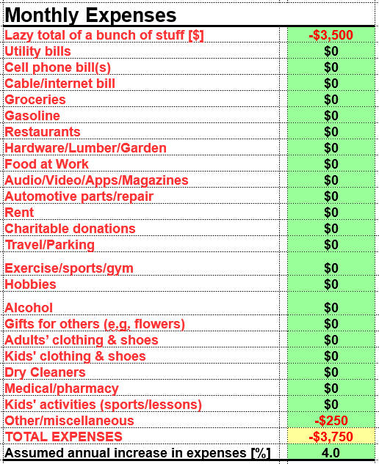
Input Sheet: Monthly Expenses

Slide 10
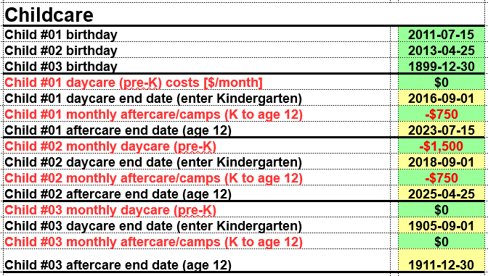
Input Sheet: Childcare Costs

Slide 11
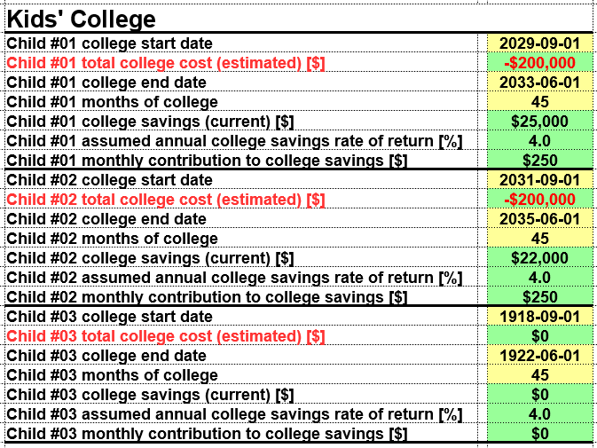
Input Sheet: College Savings & Costs

Slide 12
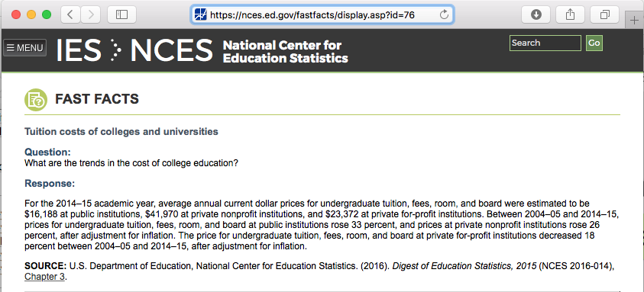
A Note About College Savings
“Between 2004–05 and 2014–15, prices for undergraduate tuition, fees, room, and board at public institutions rose 33 percent, and prices at private nonprofit institutions rose 26 percent, after adjustment for inflation.”
  In 2014-2015 dollars (as in, including inflation), this corresponded to an annual increase of 5.6% for public and 3.9% for private institutions
  Taken from: nces.ed.gov/fastfacts
Example: Total costs for UMass
(currently ~$27k/year)
could be ~$200k in 10 years
www.umass.edu/umfa/undergraduates/costs

