Slide 1
The Needle Drop Rating Predictor
Nicholas Farkas

Slide 2

Background on the Needle Drop
MC Anthony Fantano a YouTuber with over 5 million subscribers and 1.23 billion views across 3 YouTube Channels.
He is famous for his album reviews that always garner controversy.
He also has a series that looks at the new popular musical releases of the week on his series the “Weekly Track Roundup” where he rates singles in 3 categories Good, Meh, Not Good.
It is important to note that I don’t think his analysis means anything and I disagree with him all the time.

Slide 3
Objective
Compare different Machine Learning Techniques and Algorithms (Neural Networks, K-Nearest Neighborhood, Random Forest) using 13 numeric predictors to classify a single song as Good, Meh, or Not Good based on The Needle Drops previous ratings.

Slide 4
Data Collection
Get YouTube Playlist IDs
Get YouTube Playlist Items
https://www.googleapis.com/youtube/v3/playlistItems
Search Spotify
Next, we need to get the Spotify Song Identifier (URI) from Spotify. So, we use Song Name and Artist to search.
https://api.spotify.com/v1/search
After we have all the playlist items (videos) we must extract the song names and score form the video description. We combine Title, Artist, and Score into an object.
https://www.googleapis.com/youtube/v3/playlists
After we have all the playlist IDs and Titles. We have to find the playlist called “Weekly Track Roundup“ and return that Playlist ID
Get Spotify Audio Features
We get the audio features of the song using the URI and get 14 points of data and combine them with the score. Lastly, we write them all to a csv.
https://api.spotify.com/v1/audio-features
Data was acquired using two sources
YouTube
https://www.googleapis.com/youtube/v3/playlists
https://www.googleapis.com/youtube/v3/playlistItems
Spotify
https://api.spotify.com/v1/search
https://api.spotify.com/v1/audio-features
There were search failures which I logged and manually search using the Spotify Console
https://developer.spotify.com/console/

Slide 5
Data
Possible Predictors:
Acousticness number<float>
A confidence measure from 0.0 to 1.0 of whether the track is acoustic. 1.0 represents high confidence the track is acoustic.
Danceability number<float>
Danceability describes how suitable a track is for dancing based on a combination of musical elements including tempo, rhythm stability, beat strength, and overall regularity. A value of 0.0 is least danceable and 1.0 is most danceable.
duration_ms integer
The duration of the track in milliseconds.
Energy number<float>
Energy is a measure from 0.0 to 1.0 and represents a perceptual measure of intensity and activity. Typically, energetic tracks feel fast, loud, and noisy. For example, death metal has high energy, while a Bach prelude scores low on the scale. Perceptual features contributing to this attribute include dynamic range, perceived loudness, timbre, onset rate, and general entropy.
Instrumentalness number<float>
Predicts whether a track contains no vocals. "Ooh" and "aah" sounds are treated as instrumental in this context. Rap or spoken word tracks are clearly "vocal". The closer the instrumentalness value is to 1.0, the greater likelihood the track contains no vocal content. Values above 0.5 are intended to represent instrumental tracks, but confidence is higher as the value approaches 1.0.
Key integer
The key the track is in. Integers map to pitches using standard Pitch Class notation. E.g. 0 = C, 1 = C♯/D♭, 2 = D, and so on. If no key was detected, the value is -1.
Liveness number<float>
Detects the presence of an audience in the recording. Higher liveness values represent an increased probability that the track was performed live. A value above 0.8 provides strong likelihood that the track is live.
Loudness number<float>
The overall loudness of a track in decibels (dB). Loudness values are averaged across the entire track and are useful for comparing relative loudness of tracks. Loudness is the quality of a sound that is the primary psychological correlate of physical strength (amplitude). Values typically range between -60 and 0 db.
Mode integer
Mode indicates the modality (major or minor) of a track, the type of scale from which its melodic content is derived. Major is represented by 1 and minor is 0.
Speechiness number<float>
Speechiness detects the presence of spoken words in a track. The more exclusively speech-like the recording (e.g. talk show, audio book, poetry), the closer to 1.0 the attribute value. Values above 0.66 describe tracks that are probably made entirely of spoken words. Values between 0.33 and 0.66 describe tracks that may contain both music and speech, either in sections or layered, including such cases as rap music. Values below 0.33 most likely represent music and other non-speech-like tracks.
Tempo number<float>
The overall estimated tempo of a track in beats per minute (BPM). In musical terminology, tempo is the speed or pace of a given piece and derives directly from the average beat duration.
Valence number<float>
A measure from 0.0 to 1.0 describing the musical positiveness conveyed by a track. Tracks with high valence sound more positive (e.g. happy, cheerful, euphoric), while tracks with low valence sound more negative (e.g. sad, depressed, angry).
Response:
Rating factor<Good,Meh,Not Good>

Slide 6
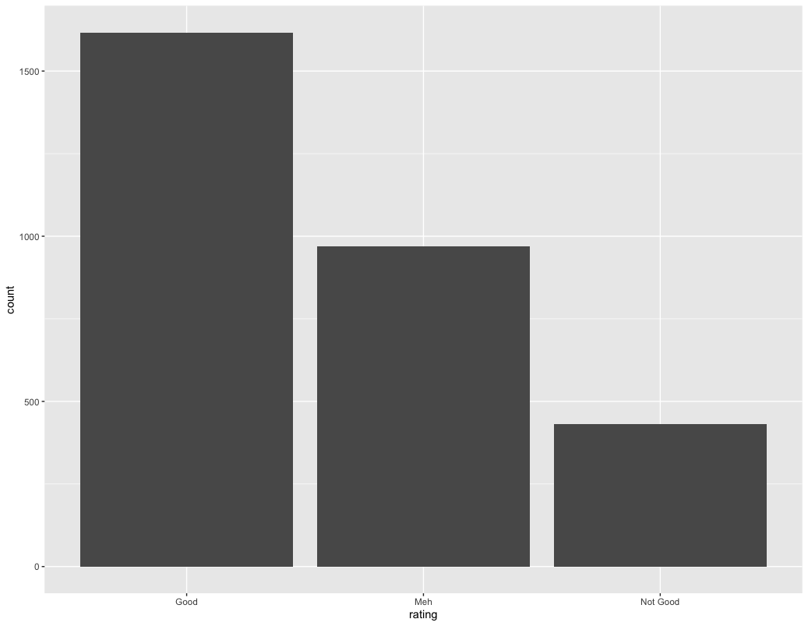
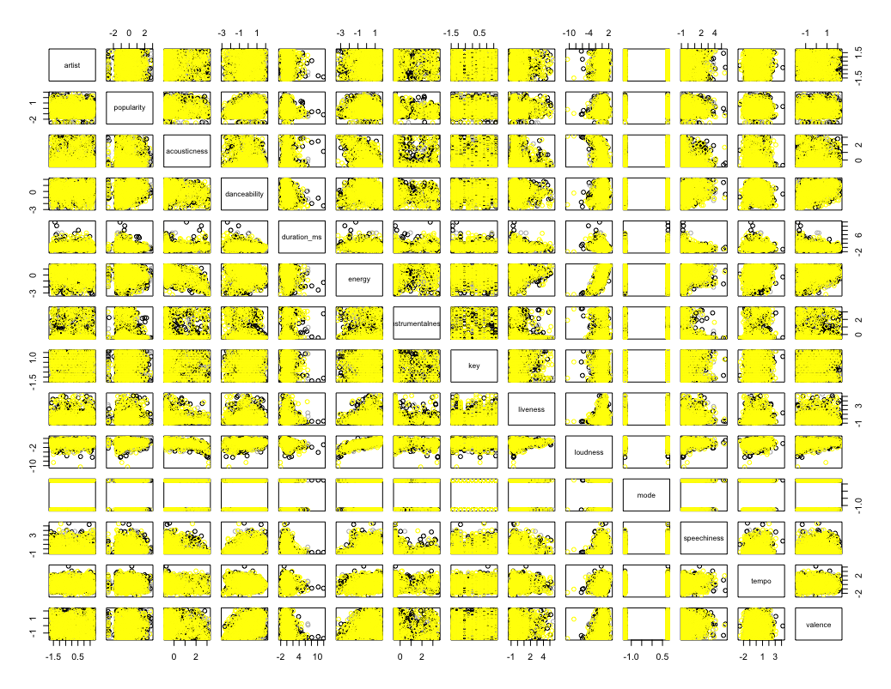
Data Cont.

Slide 7
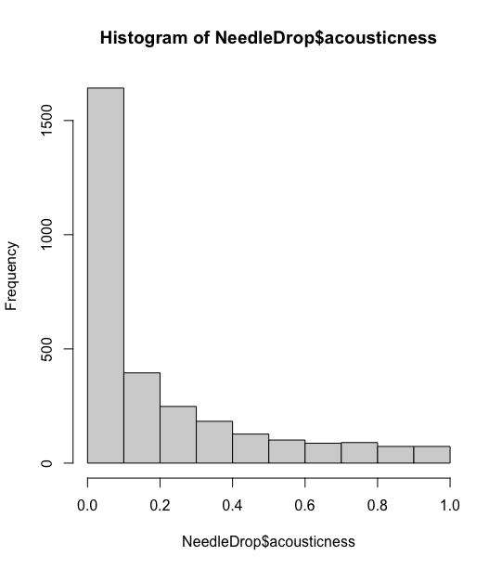
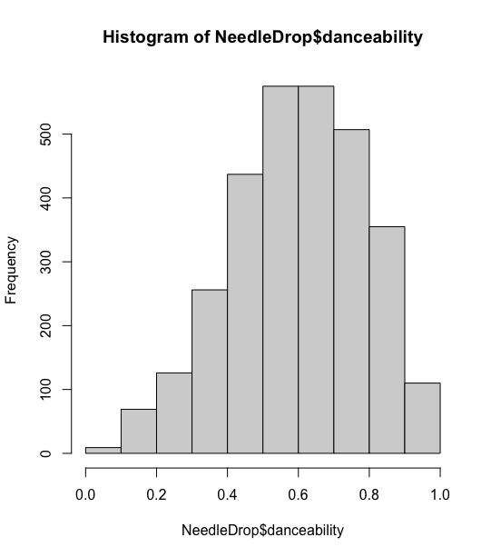
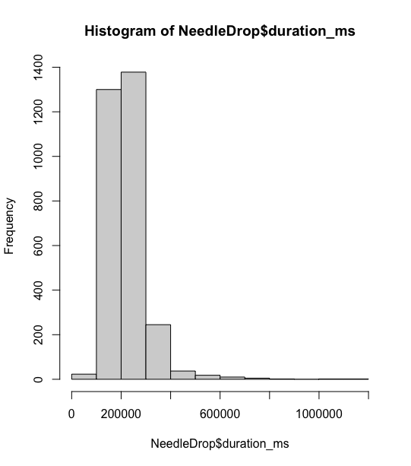
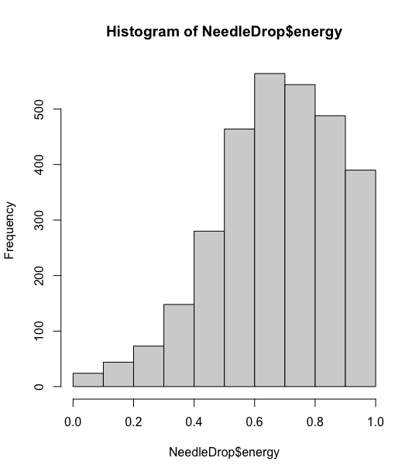
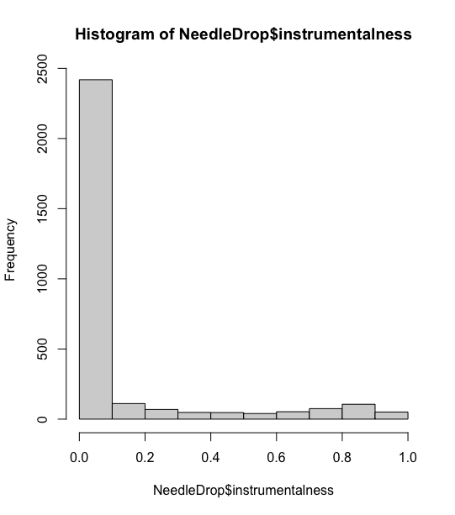
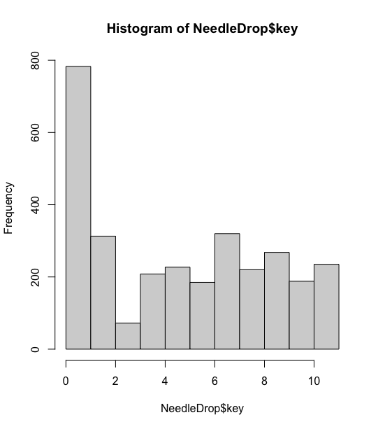
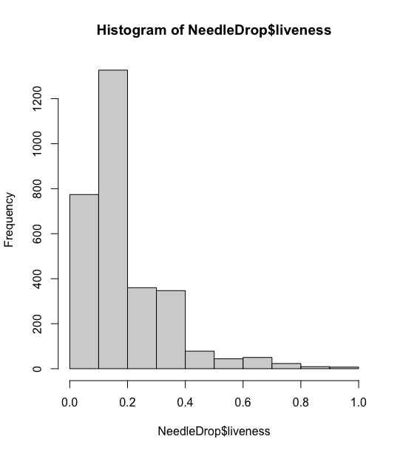
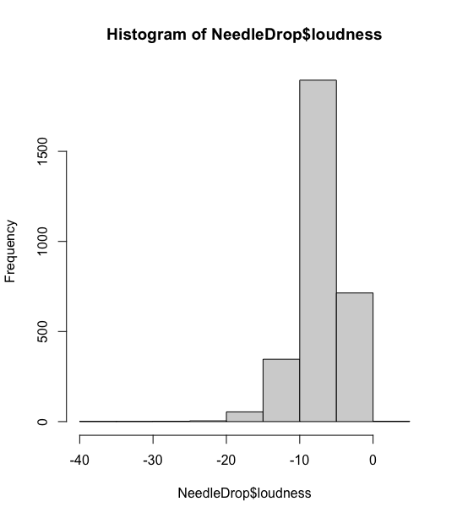
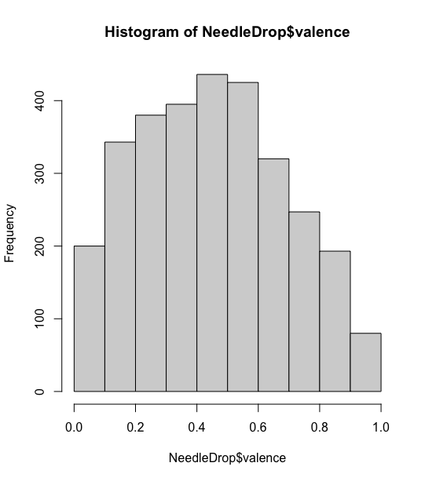
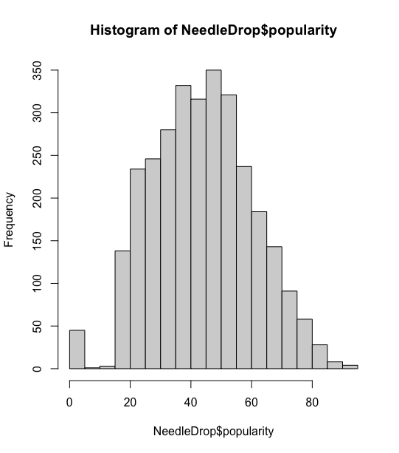
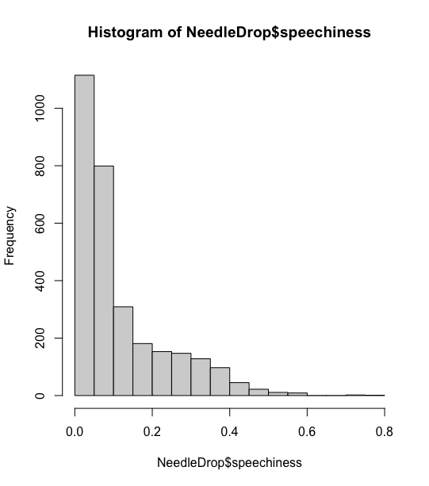
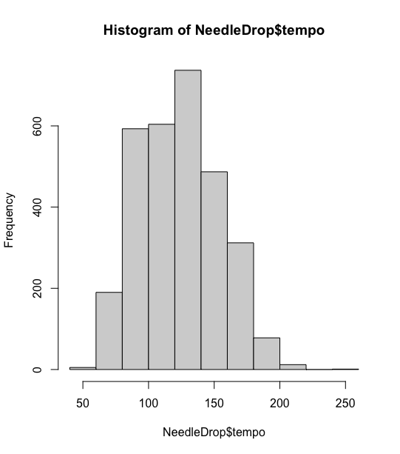
Data Cont.

Slide 8
Data Transformations
Data Needed to be Normalized.
Utilized of R “scale” function.
The scale function calculates a vectors mean and standard deviation, then scales each element by removing the mean and dividing by the deviation.
Scaled all predictors except the “mode” and not the response.

Slide 9
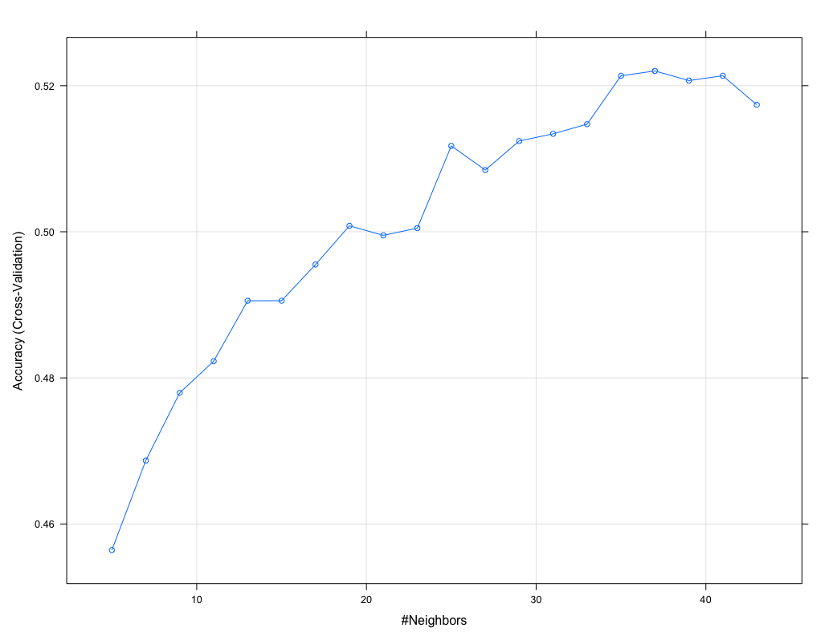
Model: K-Nearest Neighborhood
Overall Accuracy: 0.5386
Optimal K: 34
Prediction | Good | Meh | Not Good
Good | 453 | 257 | 115
Meh | 31 | 32 | 12
Not Good | 1 | 2 | 3
 | Good | Meh | Not Good
Sensitivity | .9340 | .1100 | .0231

Slide 10
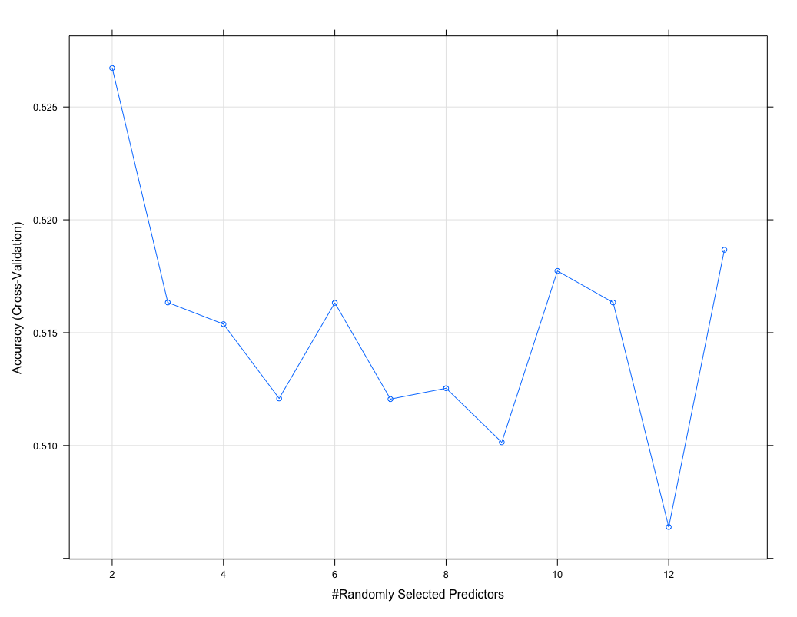
Model: Random Forest
Overall Accuracy: 0.5298
Optimal Split: 2
Prediction | Good | Meh | Not Good
Good | 446 | 259 | 108
Meh | 37 | 31 | 19
Not Good | 2 | 1 | 3
 | Good | Meh | Not Good
Sensitivity | .9196 | .1065 | .0231

Slide 11
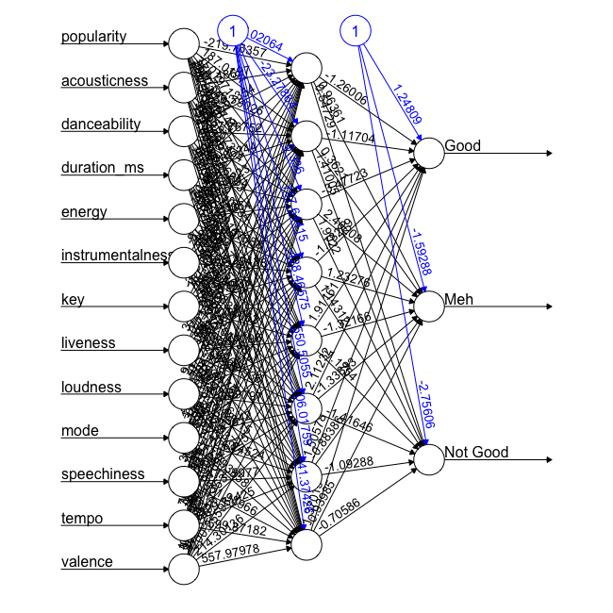
Model: Neural Network
Hidden Layers: 1
Neurons: 8
Repeated: 5
Prediction | Good | Meh | Not Good
Good | 354 | 205 | 93
Meh | 109 | 72 | 28
Not Good | 22 | 14 | 9

Slide 12
Comparison
Model Name | Validation Technique | Test Accuracy
K-Nearest Neighborhood | 10-Fold Cross Validation | 0.5386
Random Forest | 10-Fold Cross Validation | 0.5298
Neural Network | Confusion Matrix | 0.4801

Slide 13
What would I do different?
Spend more time training different neural network models.
Try to format the data into a binary classification or continuous regression.
Most importantly find different data like from the Spotify audio analysis endpoint.

Slide 14
Thank you Questions?

