Slide 1

Voice Activated Assignment Deadlines:
Nick Wu, Eddie Liu
https://github.com/nickwu241/ubc-canvas-hack

Slide 2



Objective:
Objective
App
Settings
Design
Demo

Slide 3
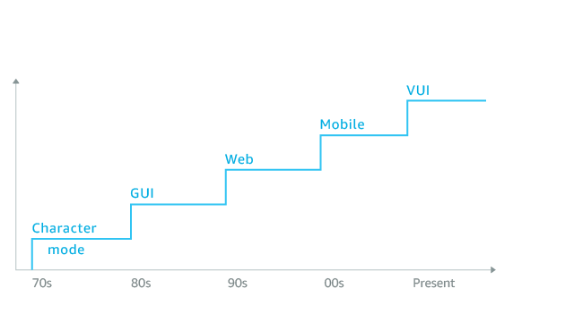
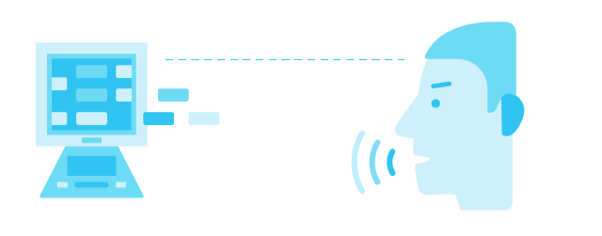
Objective:
Objective
App
Settings
Design
Demo

Slide 4
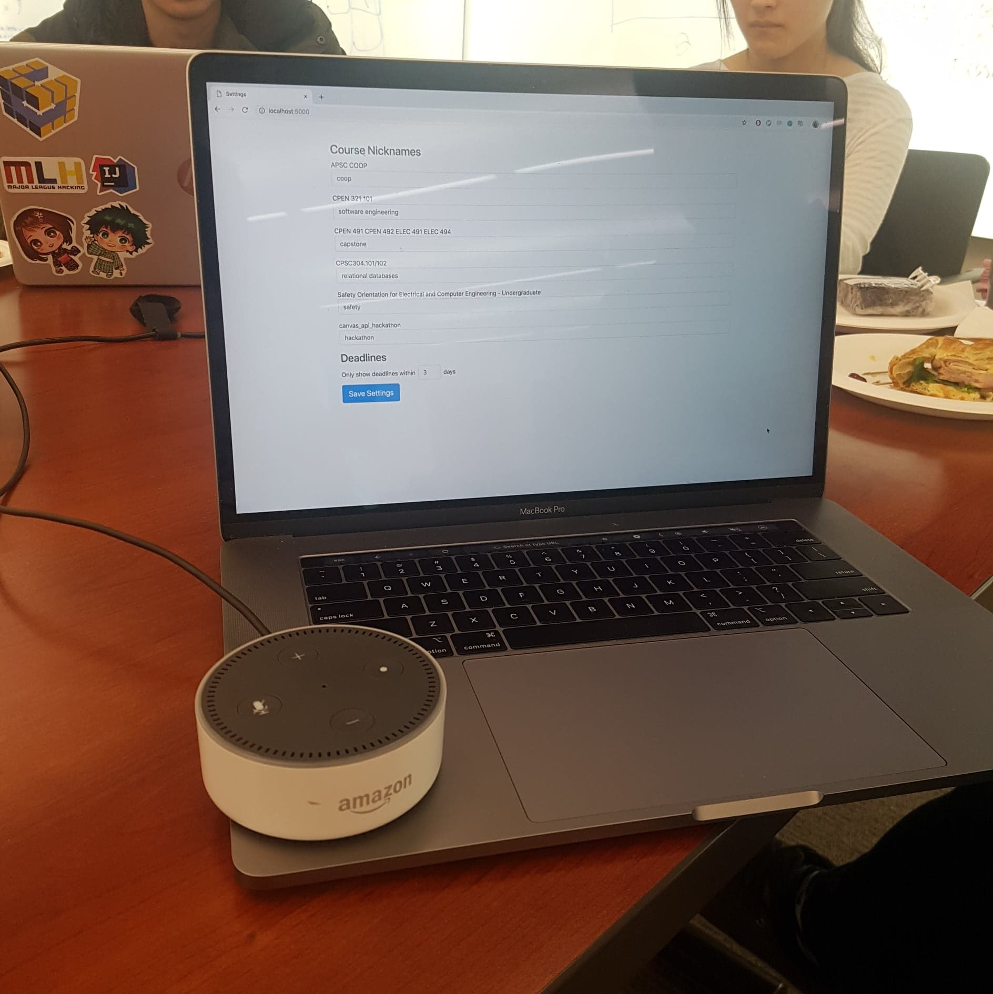
Application:
Voice Activation for Alexa
Settings on Web Interface
Objective
App
Settings
Design
Demo

Slide 5
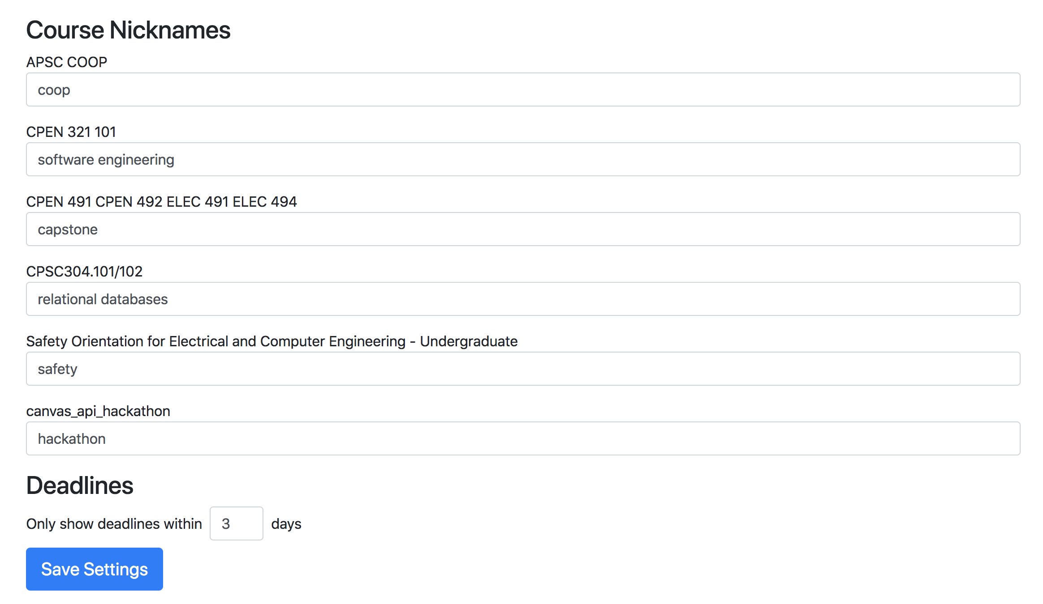
Settings:
Nicknames
Deadline Within Days
Objective
App
Settings
Design
Demo

Slide 6
Design Implementation:
Alexa
VueJS
Python (Flask)
CanvasAPI
Objective
App
Settings
Design
Demo

Slide 7
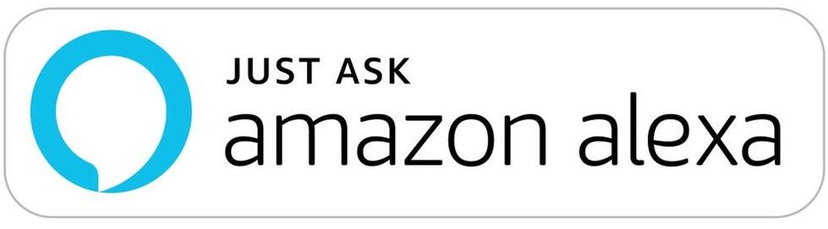
DEMO
“OPEN ASSIGNMENT DEADLINES”
Objective
App
Settings
Design
Demo

Slide 8
Thanks!
Any questions?
https://github.com/nickwu241/ubc-canvas-hack

