Slide 1
.35 s
.5 s
1.25 s
.5 s
2.0+ s
!!
+
DOG
+
Informed
Shoebox Judgment
!!
+
DOG
+
Uninformed
!!
+
DOG
+
Informed
Manmade
Judgment
!!
+
DOG
+
Uninformed

Slide 2
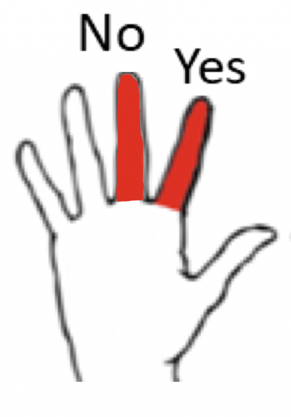
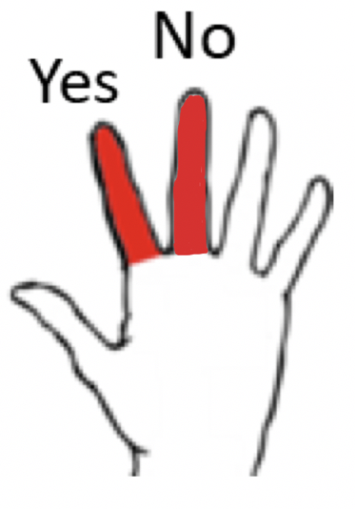
Shoebox Judgment
You will make the shoebox judgment for red words, or for words that appear in white but are preceded by a red circle.
For this judgment, we want you to tell us if the object denoted by the word fits inside a shoebox. You will respond ‘yes’ if you think the item would fit inside a shoebox, and ‘no’ if you think the item wouldn’t fit inside a shoebox. The yes and no responses will be made using your left index (‘f’ key) and middle (‘d’ key) finger.
Manmade Judgment
You will make the manmade judgment for blue words, or for words that appear in white but are preceded by a blue circle.
For this judgment, we want you to tell us if the word refers to a manmade object. You will respond ‘yes’ if you think the item is manmade, and ‘no’ if you think the item is natural. The yes and no responses will be made using your right index (‘j’ key) and middle (‘k’ key) finger.
!!
DOG
!!
DOG
!!
DOG
!!
DOG
Please enter your responses as quickly and accurately as possible after the word appears on the screen. Responding with the wrong hand is an incorrect response. Responses are not accepted before the word appears.
Do you have any questions?

Slide 3
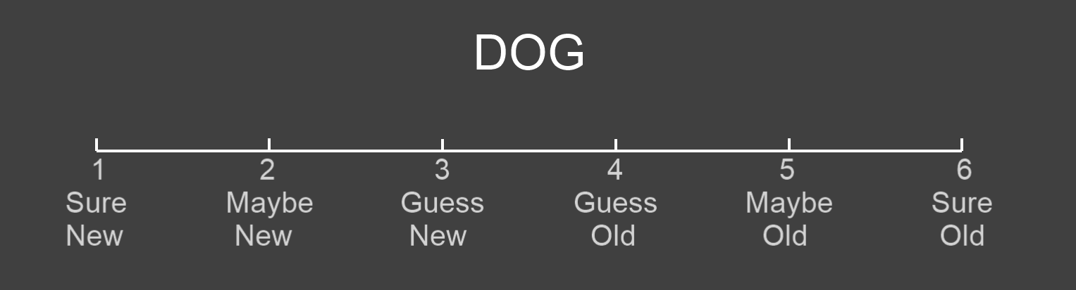
You will now take a memory test for the words you saw earlier. If you are shown a word that you believe you studied in the first part of this experiment, you should respond ‘old’. If the word is one you have not seen in the first part experiment today, you should respond ‘new’. Your responses should be entered using the following scale:
6 = sure that the word is old (“L” key)
5 = maybe the word is old (“K” key)
4 = guessing that the word is old (“J” key)
3 = guessing that the word is new (“F” key)
2 = maybe the word is new (“D” key)
1 = sure that the word is new (“S” key)
Please use the entire range of responses to accurately report your confidence. Responses are self-paced, and once entered, there will be a brief delay before the next trial beings.
Do you have any questions?

