Slide 1
Finding a needle in Haystack: Facebook’s photo storage
Nicky Advokaat
Tim van Dalen

Slide 2
Facebook Photo application
260 billion images
20 petabyte of data
60 terabyte uploaded each week

Slide 3
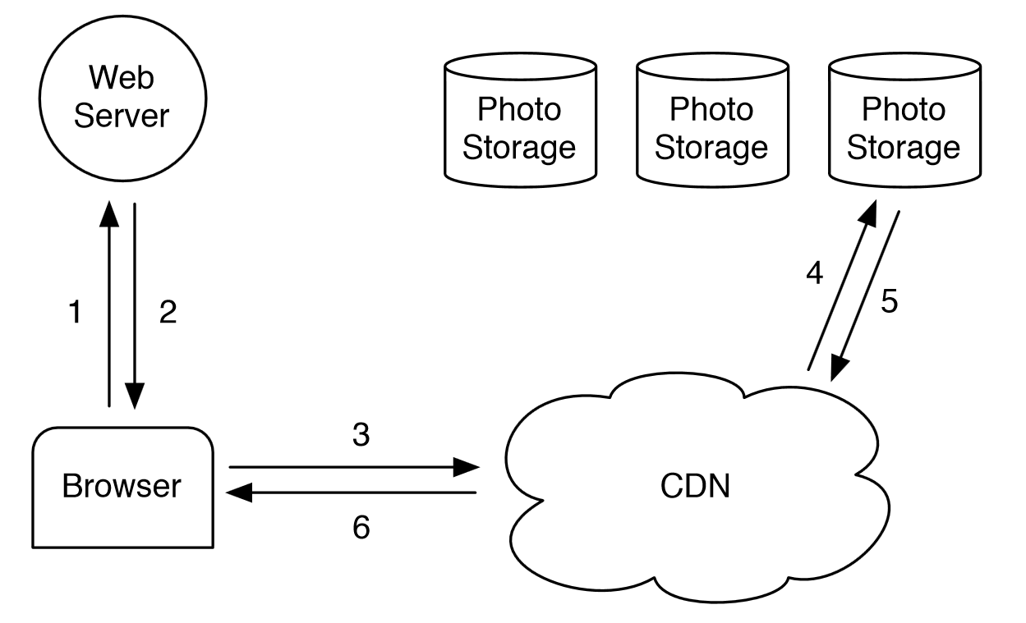
CDN

Slide 4
What’s wrong ?
A lot of data
Index doesn’t fit in memory ->
several disk operations per request
Not adapted to Facebook Photo’s characteristics
Write once – read many
Long tail
Expensive

Slide 5
Problem definition
Can we improve on the standard CDN architecture and create a system that:
Has high throughput and low latency
Is fault-tolerant
Is cost-effective
Is simple

Slide 6
Problem definition
Can we improve on the standard CDN architecture and create a system that:
Has high throughput and low latency
Is fault-tolerant
Is cost-effective
Is simple
-> Haystack
Notes:
Ik zet extra duidelijk problem definition, krijg je punten voor..

Slide 7
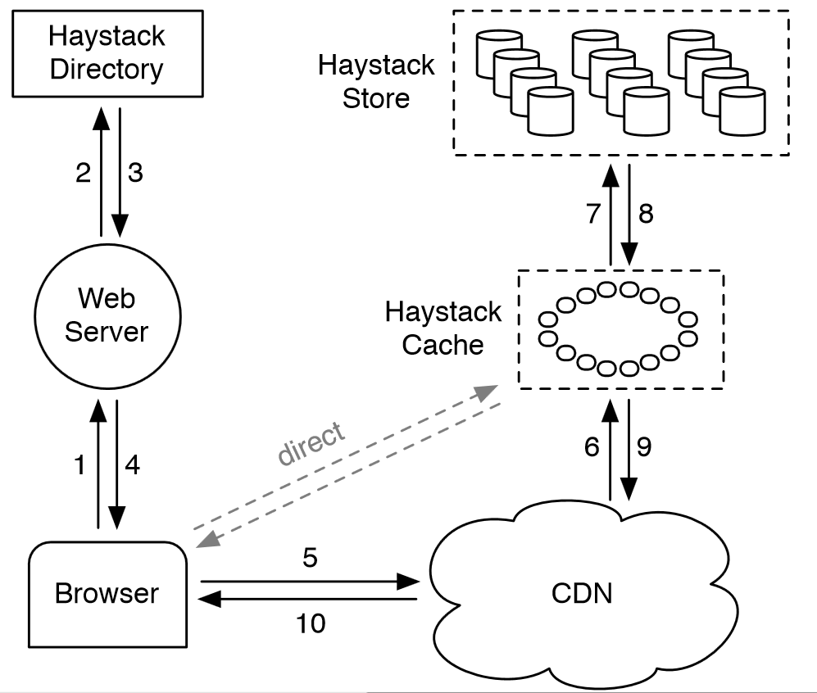
Haystack architecture

Slide 8
Todo

