Slide 1
Finding a needle in Haystack: Facebook’s photo storage
Nicky Advokaat
Tim van Dalen

Slide 2
Facebook Photo application
260 billion images
20 petabyte of data
60 terabyte uploaded each week

Slide 3
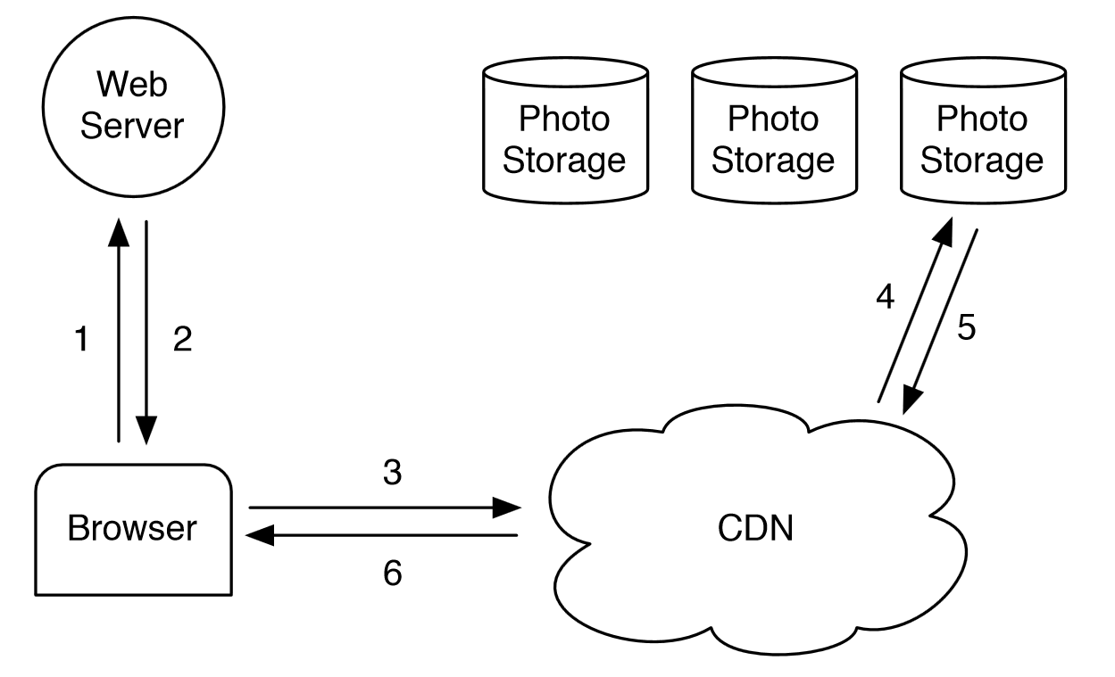
CDN

Slide 4
What’s wrong ?
A lot of data
Index doesn’t fit in memory ->
several disk operations per request
Not adapted to Facebook Photo’s characteristics
Write once – read many
Long tail
Expensive

Slide 5
Problem definition
Can we improve on the standard CDN architecture and create a system that:
Has high throughput and low latency
Is fault-tolerant
Is cost-effective
Is simple

Slide 6
Problem definition
Can we improve on the standard CDN architecture and create a system that:
Has high throughput and low latency
Is fault-tolerant
Is cost-effective
Is simple
-> Haystack
Notes:
Ik zet extra duidelijk problem definition, krijg je punten voor..

Slide 7
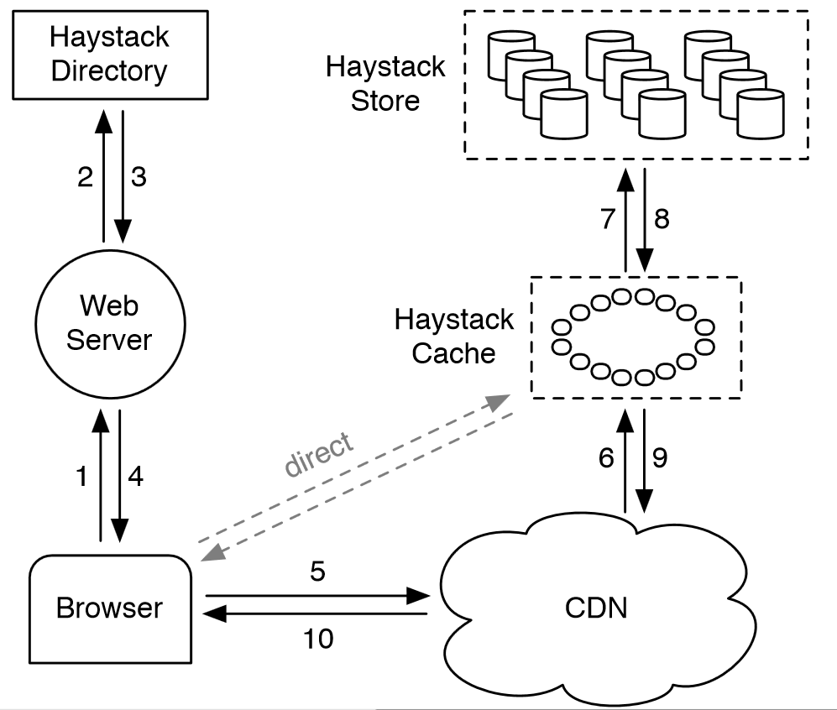
Haystack architecture

Slide 8
Haystack architecture
Directory
Provides mapping from logical to physical
Balances reads and writes
Decide CDN or cache
Manages read-only volumes
Notes:
Mapping from logical volumes to physical volumes
Balances writes across logical volumes and reads across physical volumes
Determines wheter the request should be handled by a CDN or by the cache
Read only logical volumes for some reason

Slide 9
Haystack architecture
Cache
Receives HTTP requests
CDNs
Browsers
Reads from store if not found
Only caches when:
From user, not CDN
Fetched from write-enabled store
Notes:
The caching rules are important here:
If a request misses in the CDN, why would it be in the cache?
Therefore, don’t cache requests from the CDN.
Photos are most heavily accessed soon after upload, filesystems work better when doing either reads or writes but not both.
Thus write-enabled store machines would see the most reads if it were not for the cache.

Slide 10
Haystack architecture
Store
Very basic
Specific requests asking for photo by id
Given logical volume and physical machine
Physical volumes are very large files
Find photo within file with the information already available
No extra I/O needed

Slide 11
Results

Slide 12
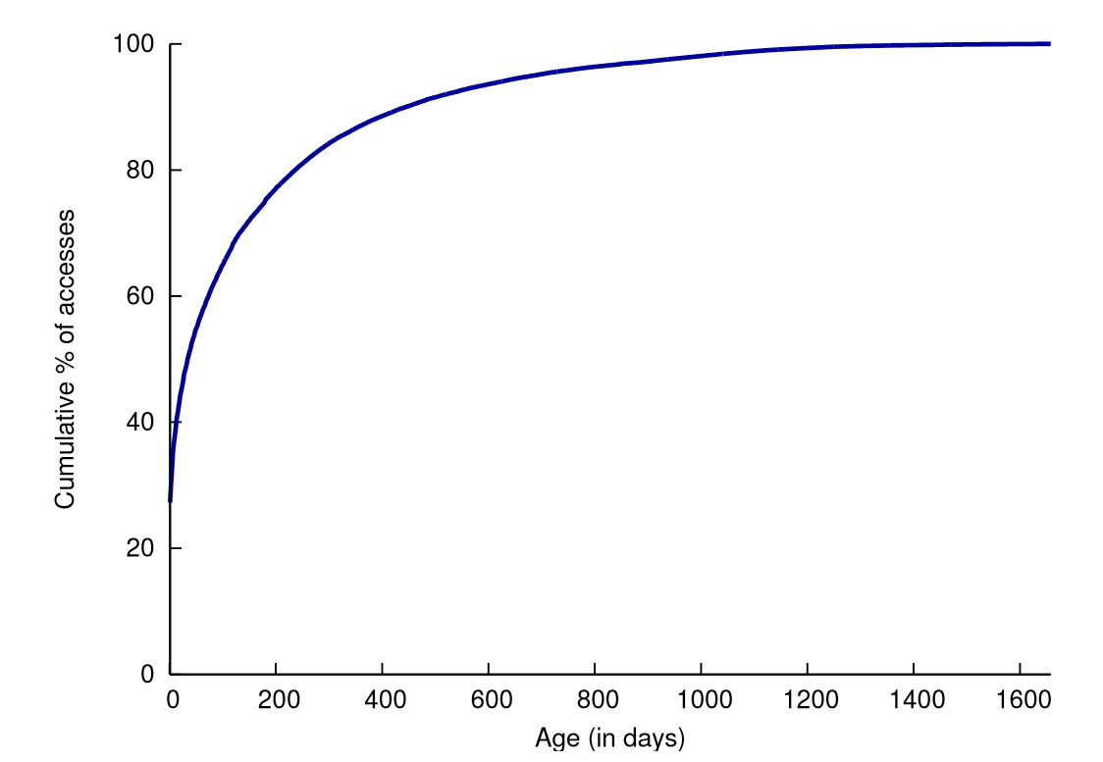
Features that drive photo requests
Cumulative distribution of photos requested by age
News Feed and Albums responsible for 98% of data
Notes:
Justification for the cache policy

Slide 13
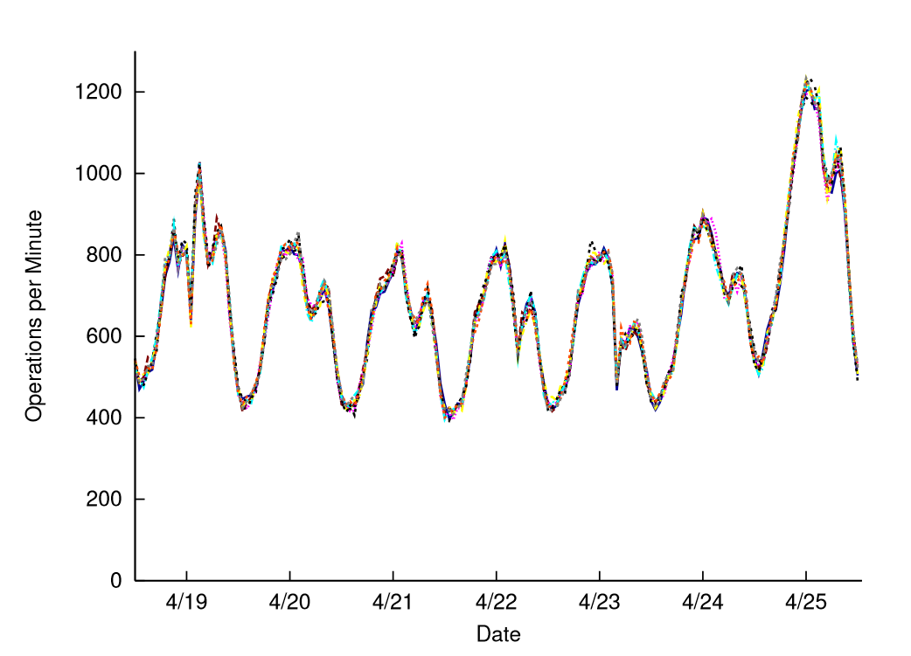
Load balancing
These are 9 different Haystack Store machines

Slide 14
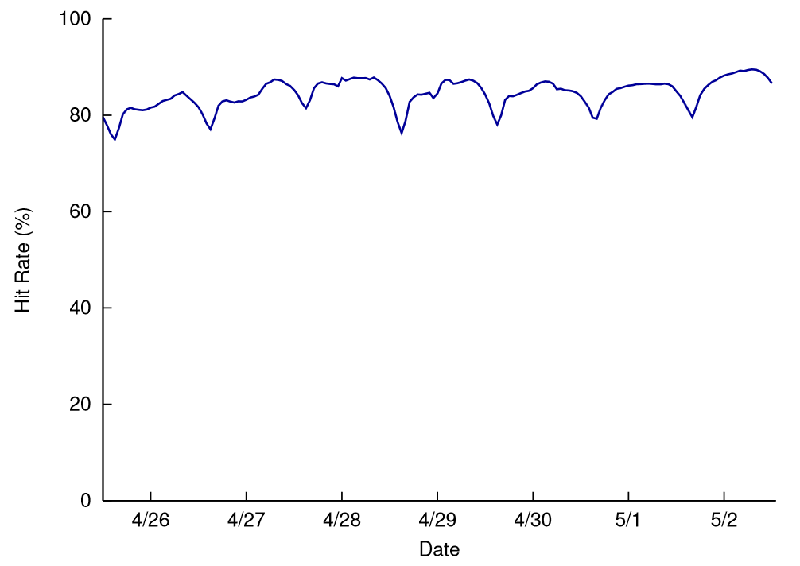
Haystack cache
Cache hit rate

Slide 15
Conclusion
New system greatly improves on old
More efficient use of CDNs
Battle-tested

