Slide 1






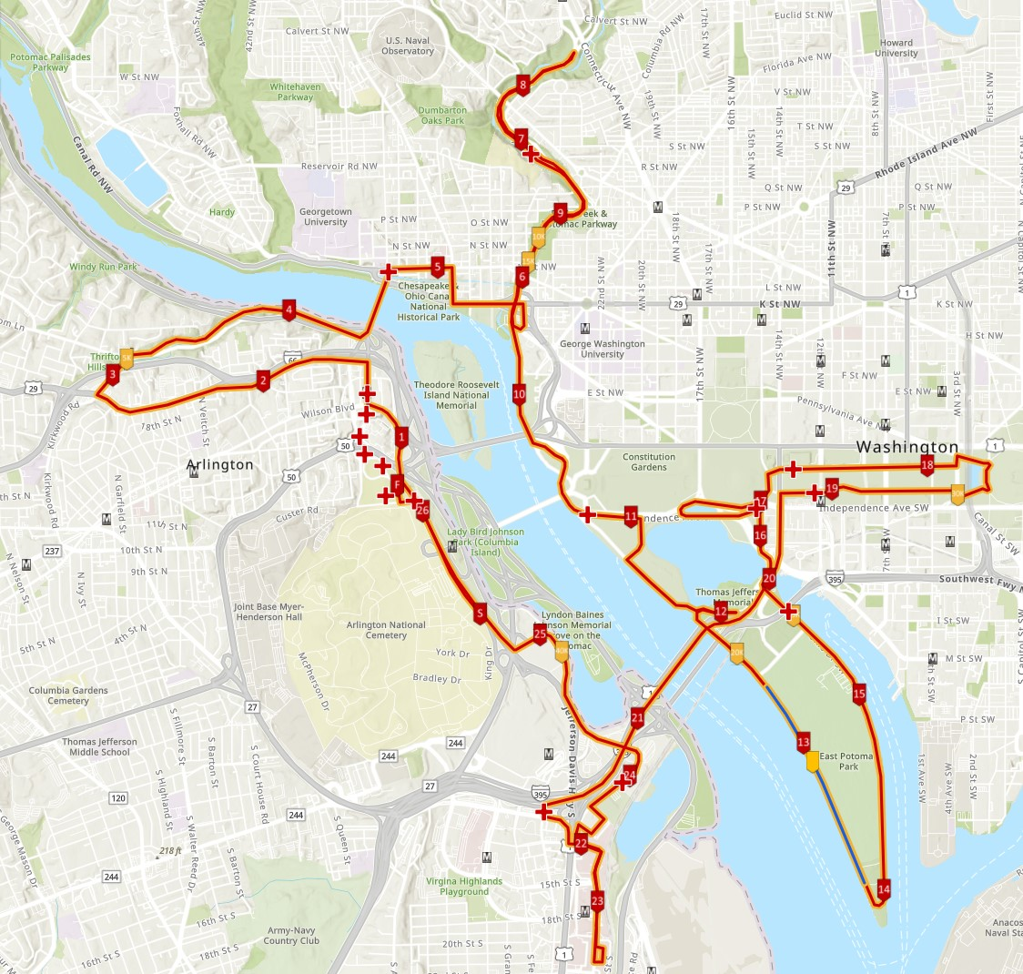
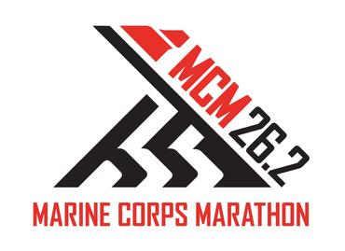
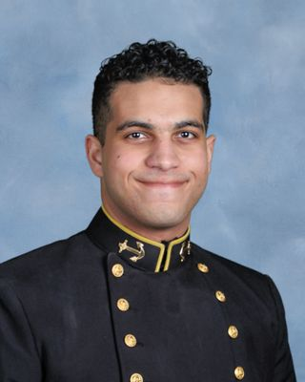
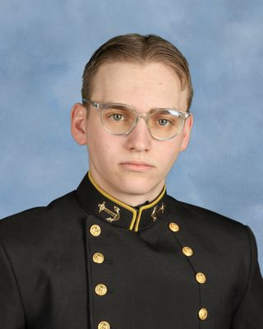

USMC Marathon Medical Communications System
MIDN 1/C Zeyad Elgendy, Nicholas Zayfman
Professor Dias, Cyber Operations
LCDR Downs, Computer Science
Importance
Solution
The Marine Corps Marathon is one of the most popular marathons in the U.S., attracting thousands of runners from around the world ear year. Known for its unique military atmosphere, scenic course, and strong community spirit, it has become a prestigious event for both elite athletes and everyday runners. The USMC Marathon Medical Communications System is essential for ensuring the safety and well-being of participants, providing real-time medical communication that helps respond swiftly to emergencies and enhances the overall race experience.
A Software-Defined Mesh Network interconnected by LoRa nodes, each hosting a localized User Interface for seamless management and communication.
Secure Communication
Secure Communication
Implement a barcode on the race bibs that can be scanned to automatically fill in the runner’s personal information in the medical forms, streamlining the data entry process.
Secure the network communications using HTTPS, upgrading from the current HTTP-based interface to protect the sensitive information being transmitted.
Mesh Network
Digital Medical Form
Deploy a software-defined mesh network with nodes connected to laptops place in the aid tents to replace use of HAM Radio and provide real-time data updates.
Create a script that automatically sends the filled medical forms to the runner’s email, eliminating the need for paper-based forms.
Current System
Paper Report
Network Design
HAM Radio System with two Antennas mounted in Downtown Roslyn.
HAM Radio Operators (that require Amateur Radio License) at each Medical Station.
Loop composed of writing a physical copy, voice transmission, then manually inserting the information into their User Interface.
Radio Transmission
Each laptop is equipped with LoRa technology such that each laptop acts as router in the network and can send and receive data which enables communication across multiple nodes in a decentralized fashion.
Input to Interface
User Interface
Account Generation
Live Tracking
PDF Compiler
Barcode Generator
Challenges
Administrator
Restricted and Urban Environment
The racecourse is characterized by a mix of natural and man-made obstacles including water features, hills, buildings, and bridges. These environmental factors present significant challenges in establishing a reliable network throughout the course.
Legal Issues
The project must comply with regulations surrounding the protection of personally identifiable information and medical data, requiring stringent measures to ensure privacy and security.
Encryption Restrictions
Current regulation prohibits amateur radio operators from transmitting encrypted data which restricts their capacity to safely relay sensitive medical information over the air wave.
Ease of Use
We assume that volunteers have limited technical expertise, particularly in setting up networks or utilizing complicated user interfaces. This requires a user-friendly design and straightforward system to facilitate smooth operation for non-technical personnel.
Log In
Virtual Medical Report
Search/Edit
Autofill based on scanning barcode
Automated Email to patient
Secure Log In
Password Change
Automated Initial Login Email
Volunteer
GitHub
Repository
Our Team

Slide 2
USMC Marathon Medical Communications System
MIDN 1/C Zeyad Elgendy, Nicholas Zayfman
Professor Dias, Cyber Operations
LCDR Downs, Computer Science
Importance
Network Design
The Marine Corps Marathon is one of the most popular marathons in the U.S., attracting thousands of runners from around the world ear year. Known for its unique military atmosphere, scenic course, and strong community spirit, it has become a prestigious event for both elite athletes and everyday runners. The USMC Marathon Medical Communications System is essential for ensuring the safety and well-being of participants, providing real-time medical communication that helps respond swiftly to emergencies and enhances the overall race experience.
Each laptop is equipped with LoRa technology such that each laptop acts as router in the network and can send and receive data which enables communication across multiple nodes in a decentralized fashion.
User Interface
Account Generation
Live Tracking
PDF Compiler
Barcode Generator
Current System
Administrator
HAM Radio System with two Antennas mounted in Downtown Roslyn.
HAM Radio Operators (that require Amateur Radio License) at each Medical Station.
Loop composed of writing a physical copy, voice transmission, then manually inserting the information into their User Interface.
Paper Report
Log In
Virtual Medical Report
Search/Edit
Autofill based on scanning barcode
Automated Email to patient
Secure Log In
Password Change
Automated Initial Login Email
Volunteer
Radio Transmission
Challenges
Results
Input to Interface
Restricted and Urban Environment: The racecourse is characterized by a mix of natural and man-made obstacles including water features, hills, buildings, and bridges. These environmental factors present significant challenges in establishing a reliable network throughout the course.
Legal Issues: The project must comply with regulations surrounding the protection of personally identifiable information and medical data, requiring stringent measures to ensure privacy and security.
Encryption Restrictions: Current regulation prohibits amateur radio operators from transmitting encrypted data which restricts their capacity to safely relay sensitive medical information over the air wave.
Ease of Use: We assume that volunteers have limited technical expertise, particularly in setting up networks or utilizing complicated user interfaces. This requires a user-friendly design and straightforward system to facilitate smooth operation for non-technical personnel.
Solution
A Software-Defined Mesh Network interconnected by LoRa nodes, each hosting a localized User Interface for seamless management and communication.
Secure Communication
Secure Communication
Mesh Network
Digital Medical Form
GitHub
Repository
Our Team
Implement a barcode on the race bibs that can be scanned to automatically fill in the runner’s personal information in the medical forms, streamlining the data entry process.
Secure the network communications using HTTPS, upgrading from the current HTTP-based interface to protect the sensitive information being transmitted.
Deploy a software-defined mesh network with nodes connected to laptops place in the aid tents to replace use of HAM Radio and provide real-time data updates.
Create a script that automatically sends the filled medical forms to the runner’s email, eliminating the need for paper-based forms.
Figure

Slide 3

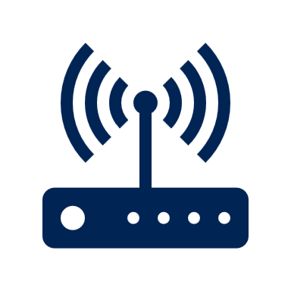


USMC Marathon Medical Communications System
MIDN 1/C Nicholas Zayfman, Zeyad Elgendy
Professor Dias, Cyber Operations
LCDR Downs, Computer Science
Importance
System Design
The Marine Corps Marathon is one of the most popular marathons in the U.S., attracting thousands of runners from around the world ear year. Known for its unique military atmosphere, scenic course, and strong community spirit, it has become a prestigious event for both elite athletes and everyday runners. The USMC Marathon Medical Communications System is essential for ensuring the safety and well-being of participants, providing real-time medical communication that helps respond swiftly to emergencies and enhances the overall race experience.
Node is connected directly to Laptop using Micro-USB to USB cable.
LoRaWAN Gateway: Connects different nodes to the locally deployed Web Server.
Medical Volunteer’s Personal Laptop
Utilizes 915 MHz LoRa Bands
Medical Station
Medical Station
Node are powered locally through the laptop
Each LoRaWAN Gateway has a range of 8 – 11 km in even terrain.
Command Center
Medical Station
Current System
End-Device (Node): Collects data and
transmits it wireless using LoRa radio modulation technique.
Certain medical stations will contain LoRaWAN gateways in order to increase the range of the LAN.
Paper Report
Medical Station
HAM Radio System with two Antennas mounted in Downtown Roslyn.
HAM Radio Operators (that require Amateur Radio License) at each Medical Station.
Loop composed of writing a physical copy, voice transmission, then manually inserting the information into their User Interface.
Medical Station
User Interface
Radio Transmission
Account Generation
Live Tracking
PDF Compiler
Barcode Generator
Radio Transmission
Administrator
Input to Interface
Log In
Virtual Medical Report
Report Search/Edit
Autofill based on scanning barcode
Automated Email to patient
Challenges
Secure Log In
Password Change
Automated Initial Login Email
Volunteer
Restricted and Urban Environment: The racecourse is characterized by a mix of natural and man-made obstacles including water features, hills, buildings, and bridges. These environmental factors present significant challenges in establishing a reliable network throughout the course.
Legal Issues: The project must comply with regulations surrounding the protection of personally identifiable information and medical data, requiring stringent measures to ensure privacy and security.
Encryption Restrictions: Current regulation prohibits amateur radio operators from transmitting encrypted data which restricts their capacity to safely relay sensitive medical information over the air wave.
Ease of Use: We assume that volunteers have limited technical expertise, particularly in setting up networks or utilizing complicated user interfaces. This requires a user-friendly design and straightforward system to facilitate smooth operation for non-technical personnel.
Results
Solution
A LoraWAN Network interconnected by LoRaWAN nodes, each hosting a localized User Interface for seamless management and communication.
Secure Communication
Secure Communication
Mesh Network
Digital Medical Form
Picture of the set up
GitHub
Repository
Our Team
Implement a barcode on the race bibs that can be scanned to automatically fill in the runner’s personal information in the medical forms, streamlining the data entry process.
Secure the network communications using HTTPS, upgrading from the current HTTP-based interface to protect the sensitive information being transmitted.
Deploy a software-defined mesh network with nodes connected to laptops place in the aid tents to replace use of HAM Radio and provide real-time data updates.
Create a script that automatically sends the filled medical forms to the runner’s email, eliminating the need for paper-based forms.

