Slide 1
Autonomous Free Space Optical Architecture for Interplanetary Communication Networks
Key Words: Free Space Optical Communication, Interplanetary Networks, Lagrange Point Controllers, Autonomous Network Coordination, Earth-Mars Communication
Nicholas Zayfman
Notes:
Tip: If you want to update this template with your division or center logo, navigate to View > Slide Master and edit the template from there.

Slide 2

Overview of the Presentation
Complete Architecture Overview
Theoretical Background
Model Overview and Simulation Framework
Results and Performance Analysis

Slide 3
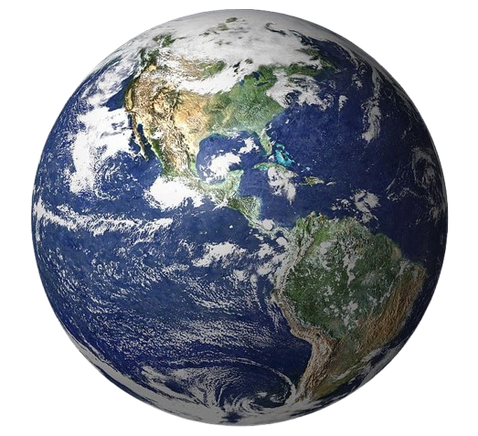
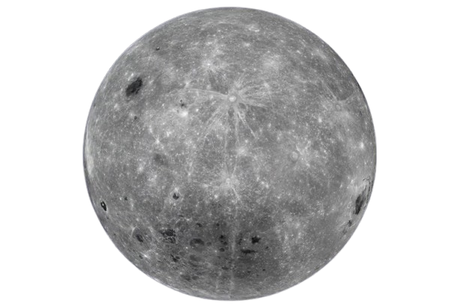


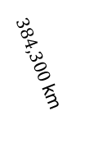


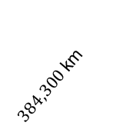









$$L_{4}$$
$384,300$ km
$384,300$ km
Earth
$$L_{3}$$
$$60°$$
$$L_{1}$$
$$60°$$
$$L_{2}$$
$$60°$$
$$60°$$
Moon
$\text{384,700}$km
$326,200$ km
$58,200$ km
$64,700$ km
$$L_{5}$$

Slide 4
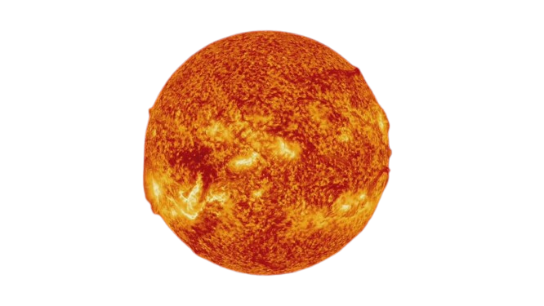



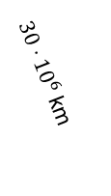
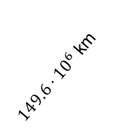



$$L_{4}$$
$149.6⋅{10}^{6}$ km
Sun
$30⋅{10}^{6}$ km
Moon
$$L_{3}$$
$$60°$$
$$L_{1}$$
$$L_{2}$$
$$60°$$
$$60°$$
Earth
$$60°$$
$149.6⋅{10}^{6}$ km
$148.1⋅{10}^{6}$km
$1.5⋅{10}^{6}$ km
$1.5⋅{10}^{6}$ km
$$L_{5}$$

Slide 5
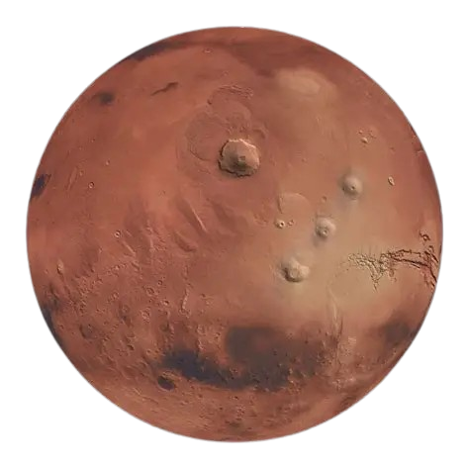


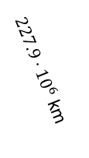
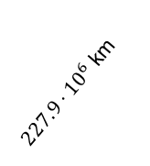


$$L_{4}$$
$227.9⋅{10}^{6}$ km
Sun
$227.9⋅{10}^{6}$ km
$$L_{3}$$
$$60°$$
$$L_{1}$$
$$L_{2}$$
$$60°$$
$$60°$$
Mars
$$60°$$
$227.9⋅{10}^{6}$ km
$226.9⋅{10}^{6}$km
$1.08⋅{10}^{6}$ km
$1.08⋅{10}^{6}$ km
$$L_{5}$$

Slide 6
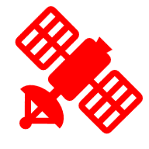

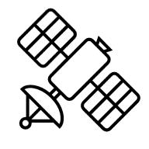











$$L_{4}$$
$$L_{4}$$
$$L_{4}$$
$$L_{1}$$
$$L_{2}$$
$$L_{1}$$
$$L_{2}$$
$$L_{5}$$
$$L_{3}$$
Figures
$$L_{5}$$
$$L_{5}$$

Slide 7
Complete Architecture Overview

Slide 8
Free Space Optical (FSO) Communication
Uses laser beams to transmit data through air/space
  Essentially a wireless fiber optic that does not need physical cables between transmitters and receivers.
Advantages (in comparison with Radio Frequency (RF)):
  Offer extremely high bandwidth – potentially terabits per second
  Immune to electromagnetic interference – which challenges radio frequencies
  No frequency licenses – which challenges radio frequencies (bandwidth utilization)
  Requires less power for signal
Disadvantage:
  Requires precise alignment between transmitter and receiver which makes it sensitive to swaying and vibrations.

Slide 9
Lagrange Points (Simplified)
Gravitationally stable positions where spacecraft can maintain fixed positions relative to two celestial bodies.
Natural positioning eliminates need for complex orbital mechanics while providing optimal coverage geometry.
They are natural “parking spaces” in Space however are susceptible to slight movement – they are not perfectly still however they do not follow planetary orbits

Slide 10
SDN Controllers
Centralized software applications that act as the "brain" of a software-defined network, maintaining a global view of the entire network topology and making intelligent routing decisions by programming forwarding rules
Advantages:

Slide 11
Satellite Relays
Satellites that receive signals, amplify them, and then retransmits to another location
Conceptually similar to routers, as they act as intermediary nodes that receive, process, and forward communication signals to an extended network that is beyond reach of a direct connection path.

Slide 12
Hierarchal Architecture
What are Lagrange Points?
Gravitationally stable positions where spacecraft can maintain fixed positions relative to two celestial bodies.
There exists Lagrange Points in the following three systems: Earth-Moon, Earth-Sun, and Mars-Sun.
Application
Natural positioning eliminates need for complex orbital mechanics while providing optimal coverage geometry.

Slide 13
Quality of Service
What are Lagrange Points?
Gravitationally stable positions where spacecraft can maintain fixed positions relative to two celestial bodies.
There exists Lagrange Points in the following three systems: Earth-Moon, Earth-Sun, and Mars-Sun.
Application
Natural positioning eliminates need for complex orbital mechanics while providing optimal coverage geometry.

Slide 14
Proposed FSO Interplanetary Architecture
Earth Relays at Earth-Sun Lagrange Points
Controllers at Earth-Moon Lagrange Points
L4
Mars Relays at Mars-Sun Lagrange Points
Earth GEO Satellites
Mars Satellites
L4
L4
L2
L3
L1
SUN
Earth
Mars
L2
L1
L5
L5
L5

Slide 15
Theoretical Background

Slide 16
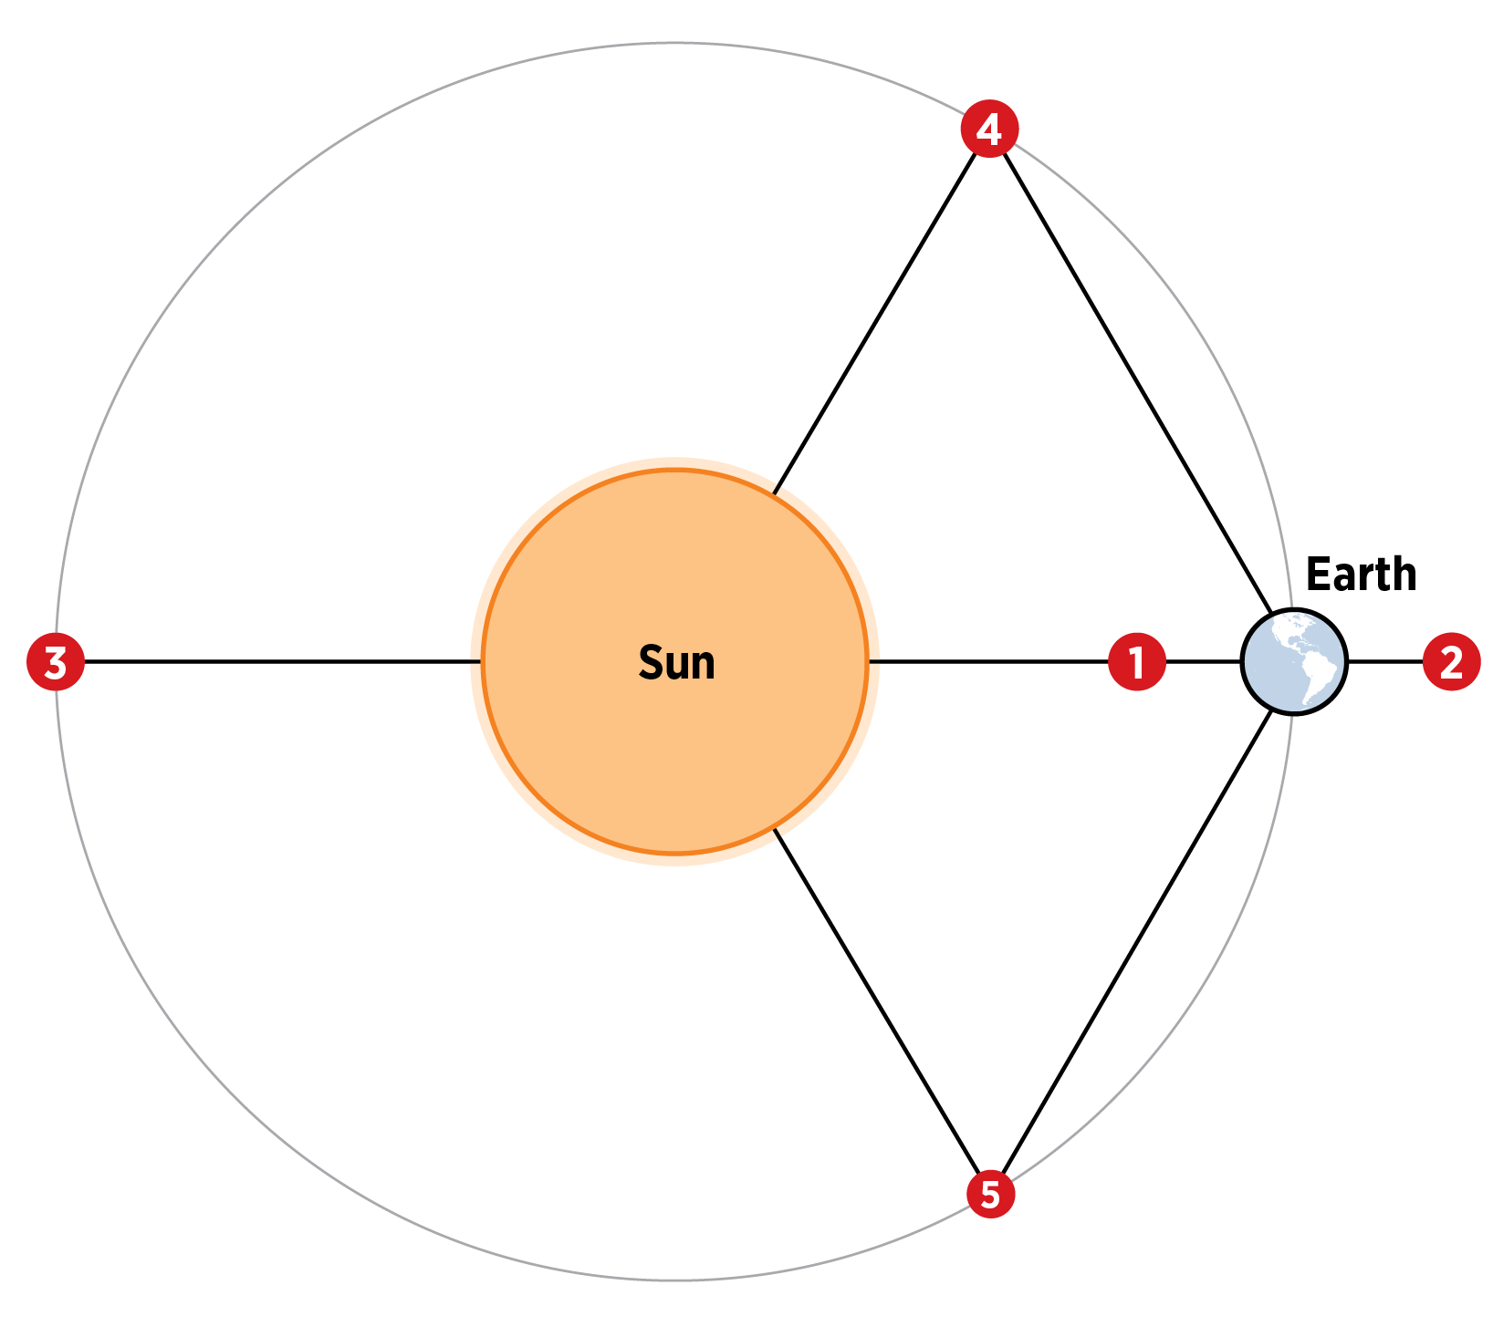
Lagrange Points
What are Lagrange Points?
Gravitationally stable positions where spacecraft can maintain fixed positions relative to two celestial bodies.
There exists Lagrange Points in the following three systems: Earth-Moon, Earth-Sun, and Mars-Sun.
Application
Natural positioning eliminates need for complex orbital mechanics while providing optimal coverage geometry.

Slide 17
Lagrange Point Station Keeping
What are Lagrange Points?
Gravitationally stable positions where spacecraft can maintain fixed positions relative to two celestial bodies.
There exists Lagrange Points in the following three systems: Earth-Moon, Earth-Sun, and Mars-Sun.
Application
Natural positioning eliminates need for complex orbital mechanics while providing optimal coverage geometry.

Slide 18
J2 Perturbation Acceleration
What are Lagrange Points?
Gravitationally stable positions where spacecraft can maintain fixed positions relative to two celestial bodies.
There exists Lagrange Points in the following three systems: Earth-Moon, Earth-Sun, and Mars-Sun.
Application
Natural positioning eliminates need for complex orbital mechanics while providing optimal coverage geometry.

Slide 19
Solar Radiation Pressure
What are Lagrange Points?
Gravitationally stable positions where spacecraft can maintain fixed positions relative to two celestial bodies.
There exists Lagrange Points in the following three systems: Earth-Moon, Earth-Sun, and Mars-Sun.
Application
Natural positioning eliminates need for complex orbital mechanics while providing optimal coverage geometry.

Slide 20
FSO Link Budget
What are Lagrange Points?
Gravitationally stable positions where spacecraft can maintain fixed positions relative to two celestial bodies.
There exists Lagrange Points in the following three systems: Earth-Moon, Earth-Sun, and Mars-Sun.
Application
Natural positioning eliminates need for complex orbital mechanics while providing optimal coverage geometry.

Slide 21
Free-Space Path Loss
What are Lagrange Points?
Gravitationally stable positions where spacecraft can maintain fixed positions relative to two celestial bodies.
There exists Lagrange Points in the following three systems: Earth-Moon, Earth-Sun, and Mars-Sun.
Application
Natural positioning eliminates need for complex orbital mechanics while providing optimal coverage geometry.

Slide 22
Geometric Spreading Loss
What are Lagrange Points?
Gravitationally stable positions where spacecraft can maintain fixed positions relative to two celestial bodies.
There exists Lagrange Points in the following three systems: Earth-Moon, Earth-Sun, and Mars-Sun.
Application
Natural positioning eliminates need for complex orbital mechanics while providing optimal coverage geometry.

Slide 23
Pointing Loss Model
What are Lagrange Points?
Gravitationally stable positions where spacecraft can maintain fixed positions relative to two celestial bodies.
There exists Lagrange Points in the following three systems: Earth-Moon, Earth-Sun, and Mars-Sun.
Application
Natural positioning eliminates need for complex orbital mechanics while providing optimal coverage geometry.

Slide 24
Modulation and Detection Theory
What are Lagrange Points?
Gravitationally stable positions where spacecraft can maintain fixed positions relative to two celestial bodies.
There exists Lagrange Points in the following three systems: Earth-Moon, Earth-Sun, and Mars-Sun.
Application
Natural positioning eliminates need for complex orbital mechanics while providing optimal coverage geometry.

Slide 25
On-Off Keying (OOK) Performance
What are Lagrange Points?
Gravitationally stable positions where spacecraft can maintain fixed positions relative to two celestial bodies.
There exists Lagrange Points in the following three systems: Earth-Moon, Earth-Sun, and Mars-Sun.
Application
Natural positioning eliminates need for complex orbital mechanics while providing optimal coverage geometry.

Slide 26
Pulse Position Modulation (PPM))
What are Lagrange Points?
Gravitationally stable positions where spacecraft can maintain fixed positions relative to two celestial bodies.
There exists Lagrange Points in the following three systems: Earth-Moon, Earth-Sun, and Mars-Sun.
Application
Natural positioning eliminates need for complex orbital mechanics while providing optimal coverage geometry.

Slide 27
Photon-Counting Channel Capacity
What are Lagrange Points?
Gravitationally stable positions where spacecraft can maintain fixed positions relative to two celestial bodies.
There exists Lagrange Points in the following three systems: Earth-Moon, Earth-Sun, and Mars-Sun.
Application
Natural positioning eliminates need for complex orbital mechanics while providing optimal coverage geometry.

Slide 28
Network Optimization Mathematics
What are Lagrange Points?
Gravitationally stable positions where spacecraft can maintain fixed positions relative to two celestial bodies.
There exists Lagrange Points in the following three systems: Earth-Moon, Earth-Sun, and Mars-Sun.
Application
Natural positioning eliminates need for complex orbital mechanics while providing optimal coverage geometry.

Slide 29
Traffic Schedule Optimization
What are Lagrange Points?
Gravitationally stable positions where spacecraft can maintain fixed positions relative to two celestial bodies.
There exists Lagrange Points in the following three systems: Earth-Moon, Earth-Sun, and Mars-Sun.
Application
Natural positioning eliminates need for complex orbital mechanics while providing optimal coverage geometry.

Slide 30
Third-Body Perturbations
What are Lagrange Points?
Gravitationally stable positions where spacecraft can maintain fixed positions relative to two celestial bodies.
There exists Lagrange Points in the following three systems: Earth-Moon, Earth-Sun, and Mars-Sun.
Application
Natural positioning eliminates need for complex orbital mechanics while providing optimal coverage geometry.

Slide 31
Relativistic Corrections
What are Lagrange Points?
Gravitationally stable positions where spacecraft can maintain fixed positions relative to two celestial bodies.
There exists Lagrange Points in the following three systems: Earth-Moon, Earth-Sun, and Mars-Sun.
Application
Natural positioning eliminates need for complex orbital mechanics while providing optimal coverage geometry.

Slide 32
Eclipse Shadow Function
What are Lagrange Points?
Gravitationally stable positions where spacecraft can maintain fixed positions relative to two celestial bodies.
There exists Lagrange Points in the following three systems: Earth-Moon, Earth-Sun, and Mars-Sun.
Application
Natural positioning eliminates need for complex orbital mechanics while providing optimal coverage geometry.

Slide 33
Complete Model Overview

Slide 34
Environment - libraries
What are Lagrange Points?
Gravitationally stable positions where spacecraft can maintain fixed positions relative to two celestial bodies.
There exists Lagrange Points in the following three systems: Earth-Moon, Earth-Sun, and Mars-Sun.
Application
Natural positioning eliminates need for complex orbital mechanics while providing optimal coverage geometry.

Slide 35
Constants
What are Lagrange Points?
Gravitationally stable positions where spacecraft can maintain fixed positions relative to two celestial bodies.
There exists Lagrange Points in the following three systems: Earth-Moon, Earth-Sun, and Mars-Sun.
Application
Natural positioning eliminates need for complex orbital mechanics while providing optimal coverage geometry.

Slide 36
FSO Terminal Configuration
What are Lagrange Points?
Gravitationally stable positions where spacecraft can maintain fixed positions relative to two celestial bodies.
There exists Lagrange Points in the following three systems: Earth-Moon, Earth-Sun, and Mars-Sun.
Application
Natural positioning eliminates need for complex orbital mechanics while providing optimal coverage geometry.

Slide 37
Link Quality and Performance Parameters
What are Lagrange Points?
Gravitationally stable positions where spacecraft can maintain fixed positions relative to two celestial bodies.
There exists Lagrange Points in the following three systems: Earth-Moon, Earth-Sun, and Mars-Sun.
Application
Natural positioning eliminates need for complex orbital mechanics while providing optimal coverage geometry.

Slide 38
Traffic Management Paramters
What are Lagrange Points?
Gravitationally stable positions where spacecraft can maintain fixed positions relative to two celestial bodies.
There exists Lagrange Points in the following three systems: Earth-Moon, Earth-Sun, and Mars-Sun.
Application
Natural positioning eliminates need for complex orbital mechanics while providing optimal coverage geometry.

Slide 39
Navigation-Assisted Coordination Protocol
What are Lagrange Points?
Gravitationally stable positions where spacecraft can maintain fixed positions relative to two celestial bodies.
There exists Lagrange Points in the following three systems: Earth-Moon, Earth-Sun, and Mars-Sun.
Application
Natural positioning eliminates need for complex orbital mechanics while providing optimal coverage geometry.

Slide 40
Navigation-Assisted Coordination Update
What are Lagrange Points?
Gravitationally stable positions where spacecraft can maintain fixed positions relative to two celestial bodies.
There exists Lagrange Points in the following three systems: Earth-Moon, Earth-Sun, and Mars-Sun.
Application
Natural positioning eliminates need for complex orbital mechanics while providing optimal coverage geometry.

Slide 41
Navigation-Assisted Coordination Optimal Relay Selection
What are Lagrange Points?
Gravitationally stable positions where spacecraft can maintain fixed positions relative to two celestial bodies.
There exists Lagrange Points in the following three systems: Earth-Moon, Earth-Sun, and Mars-Sun.
Application
Natural positioning eliminates need for complex orbital mechanics while providing optimal coverage geometry.

Slide 42
Traffic Coordination
What are Lagrange Points?
Gravitationally stable positions where spacecraft can maintain fixed positions relative to two celestial bodies.
There exists Lagrange Points in the following three systems: Earth-Moon, Earth-Sun, and Mars-Sun.
Application
Natural positioning eliminates need for complex orbital mechanics while providing optimal coverage geometry.

Slide 43
Validation Test
What are Lagrange Points?
Gravitationally stable positions where spacecraft can maintain fixed positions relative to two celestial bodies.
There exists Lagrange Points in the following three systems: Earth-Moon, Earth-Sun, and Mars-Sun.
Application
Natural positioning eliminates need for complex orbital mechanics while providing optimal coverage geometry.

Slide 44
Validation Test
What are Lagrange Points?
Gravitationally stable positions where spacecraft can maintain fixed positions relative to two celestial bodies.
There exists Lagrange Points in the following three systems: Earth-Moon, Earth-Sun, and Mars-Sun.
Application
Natural positioning eliminates need for complex orbital mechanics while providing optimal coverage geometry.

Slide 45
Validation Test
What are Lagrange Points?
Gravitationally stable positions where spacecraft can maintain fixed positions relative to two celestial bodies.
There exists Lagrange Points in the following three systems: Earth-Moon, Earth-Sun, and Mars-Sun.
Application
Natural positioning eliminates need for complex orbital mechanics while providing optimal coverage geometry.

Slide 46
Validation Test
What are Lagrange Points?
Gravitationally stable positions where spacecraft can maintain fixed positions relative to two celestial bodies.
There exists Lagrange Points in the following three systems: Earth-Moon, Earth-Sun, and Mars-Sun.
Application
Natural positioning eliminates need for complex orbital mechanics while providing optimal coverage geometry.

Slide 47
Results

Slide 48
Graph
What are Lagrange Points?
Gravitationally stable positions where spacecraft can maintain fixed positions relative to two celestial bodies.
There exists Lagrange Points in the following three systems: Earth-Moon, Earth-Sun, and Mars-Sun.
Application
Natural positioning eliminates need for complex orbital mechanics while providing optimal coverage geometry.

Slide 49
Graph
What are Lagrange Points?
Gravitationally stable positions where spacecraft can maintain fixed positions relative to two celestial bodies.
There exists Lagrange Points in the following three systems: Earth-Moon, Earth-Sun, and Mars-Sun.
Application
Natural positioning eliminates need for complex orbital mechanics while providing optimal coverage geometry.

Slide 50
Graph
What are Lagrange Points?
Gravitationally stable positions where spacecraft can maintain fixed positions relative to two celestial bodies.
There exists Lagrange Points in the following three systems: Earth-Moon, Earth-Sun, and Mars-Sun.
Application
Natural positioning eliminates need for complex orbital mechanics while providing optimal coverage geometry.

Slide 51
Graph
What are Lagrange Points?
Gravitationally stable positions where spacecraft can maintain fixed positions relative to two celestial bodies.
There exists Lagrange Points in the following three systems: Earth-Moon, Earth-Sun, and Mars-Sun.
Application
Natural positioning eliminates need for complex orbital mechanics while providing optimal coverage geometry.

Slide 52
Thank You!
Nicholas Zayfman
nzayfma1@jh.edu
(917)-775-1175
Notes:
Tip: There’s no need to include WWW or HTTPS in front of your URL.

