Slide 1

2014
Knowledge Planet
Library Management System

Slide 2
1.1 library’s background
Knowledge Planet Library is a library of “Knowledge Planet Academy”, a private learning center founded in the year 2004 and is located in Yangon, Myanmar. The library was officially opened in the year 2005 for the purpose of getting more references, knowledge and information for the students of this school. The library was rather a small one when it was founded. Now, over the past 9 years, the size of the library is getting bigger because the library’s officials have been buying many new kinds of books to become a better library and the students’ knowledge center point.

Slide 3
1.2 current system and problem background
Since the library was founded, the staffs have been doing all the works manually. That is, the librarians have to record everyday transactions manually on the paper- based system. He or she has to write down every detail in the books daily. It’s really a time consuming and data inconsistency is also very high. Below are the problems that current system is facing with.
Slow Retrieval of Data - The information is stored in different parts of the site and it may take a long time to retrieve or update the data. Sometimes, it can take up to 15 or 20 minutes finding the relevant information.
Paper Wastage - Much paper is waste due to the number of records daily and number of library members. Duplication of data can be occurred by repeating the same thing over and over.
Unproductive use of storage space - Paper takes up a massive amount of room in the site.
Poor Customer Service - Sometimes, the information may be unavailable.
No reliable database system - The records on paper can be lost or damaged at any time. Since there is no backup for the data, the lost or damaged documents cannot be regained at all.
No security system – Writing on paper is totally lack of security system. Any unauthorized person may see, update or even the data can be stolen.
These are the weak points that the current system is facing with.

Slide 4
1.3 objectives
The main purpose of the new system is to handle all the problems that the old system is currently facing with. With the newly implemented system, the records can be easily created. There will be no duplication of data records because all the data records are controlled by a primary key called ID. There is also an error checking method to detect the data type error (e.g. the record cannot be stored when user types the alphabet character for the maximum loan items, a numeric value must be typed in). For retrieval of the records, it is much faster and easier than the previous system. Editing and deleting also can be easily and quickly performed. The records are to be stored in the security enabled database system which can store many lines of data records. There will be no store room at all to store the documents and no paper wastage at all. So, all the current problems will be solved with this single “Library Management System”. The staff will only need to sit at the workstation just to perform all these tasks.
These are the advantages of the new “Library Management System”.

Slide 5
2.1 structure chart
MEMBER INFORMATION
BOOK INFORMATION
MAIN PAGE
CATEGORY INFORMATION
PUBLISHER INFORMATION
RENTAL INFORMATION

Slide 6


Slide 7
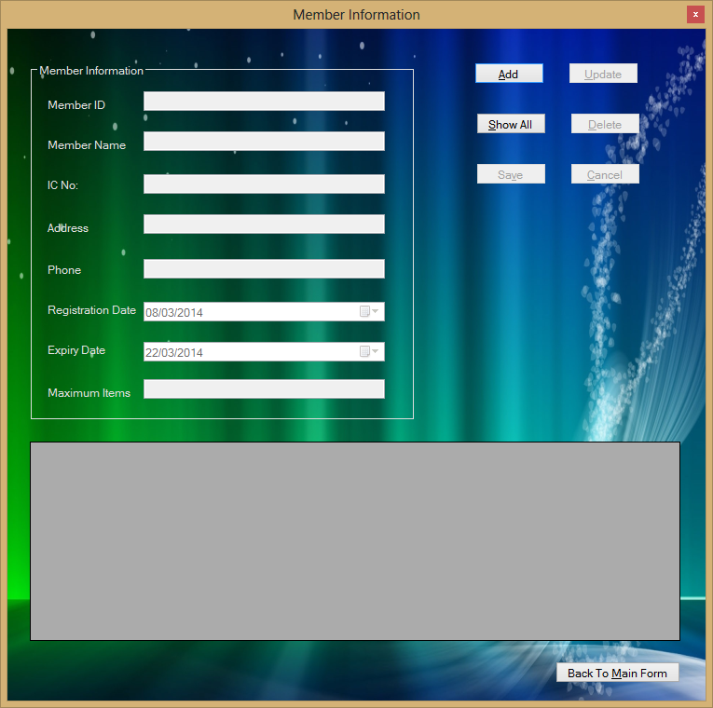

Slide 8
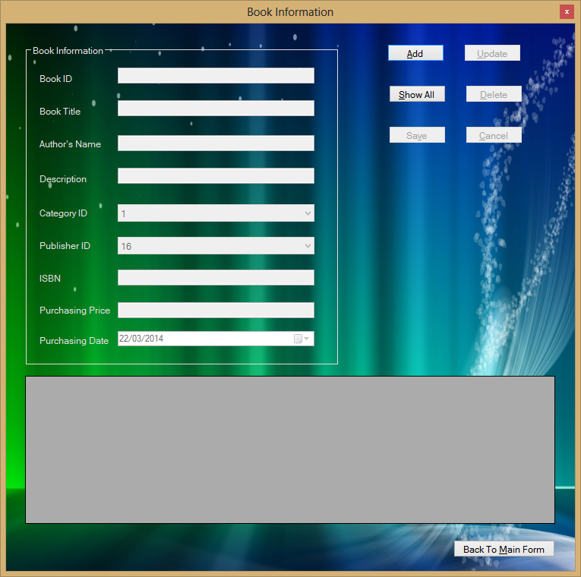

Slide 9
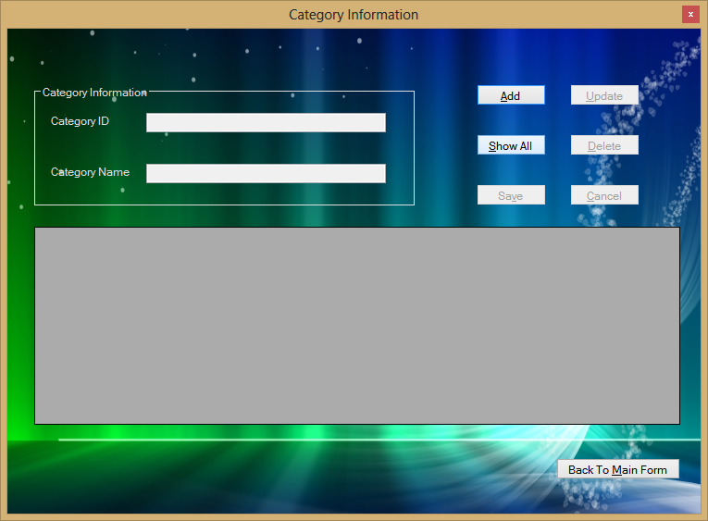

Slide 10
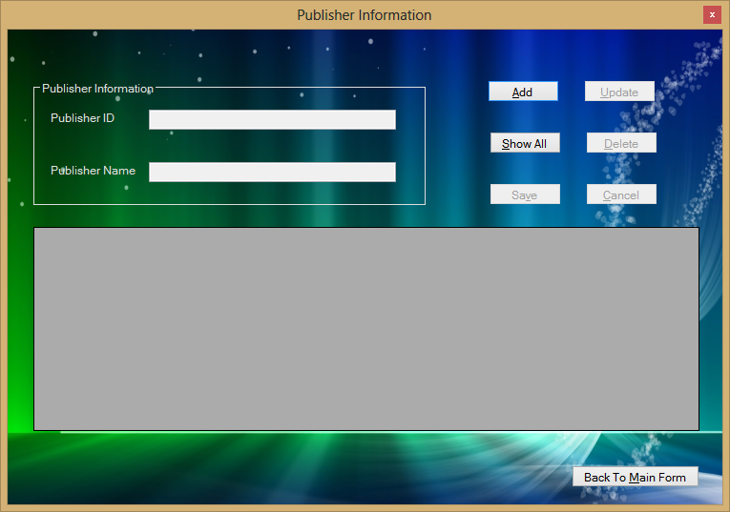

Slide 11
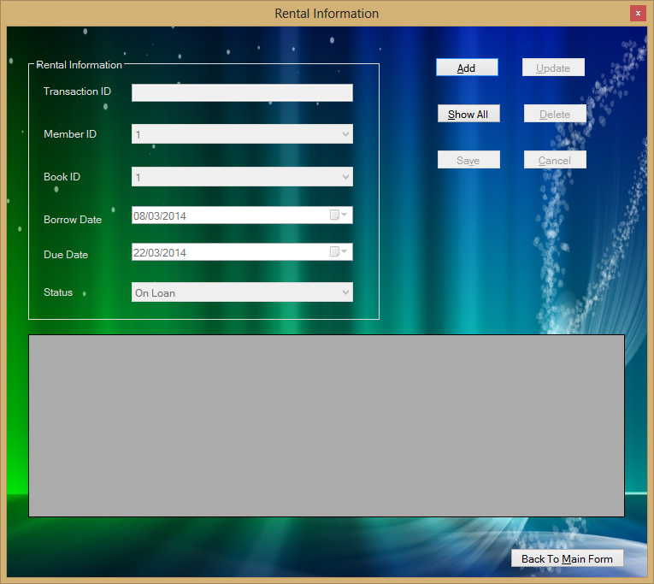

Slide 12
6.1 program strenghts
The simple and easy-to-understand user interface allows user able to manage the program without training.
All the database tables are strongly organized and can provide data consistency efficiently.
It is a program that can use without internet connection so it is more stable and more speedy to run.
Every task of this program can perform just as simple as one click so it is very user-friendly.
The colour used in this program is not extremely bright and can provide smooth vision to users.

Slide 13
6.2 program weaknesses
Log in page is not included for the system.
Need to press ‘Show All’ button before performing delete or update.
Data validation check is not very strict.

Slide 14
6.3 program enhancement
System log in page can be enhanced for better security.
Renewal service can be enhanced.
Reservation service can be included.
Data validation check can be improved.

