Slide 1
Fundamentals of Remote Sensing
Software tools
for remote sensing specialists

Slide 2
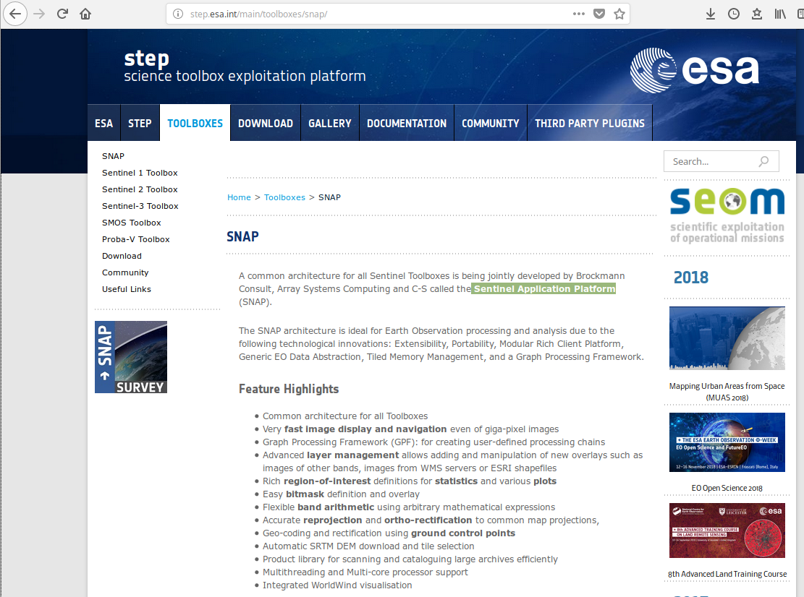
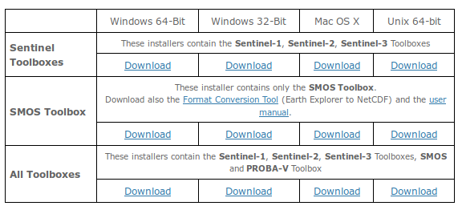
SNAP
Sentinel Application Platform
http://step.esa.int/main/toolboxes/snap/

Slide 3
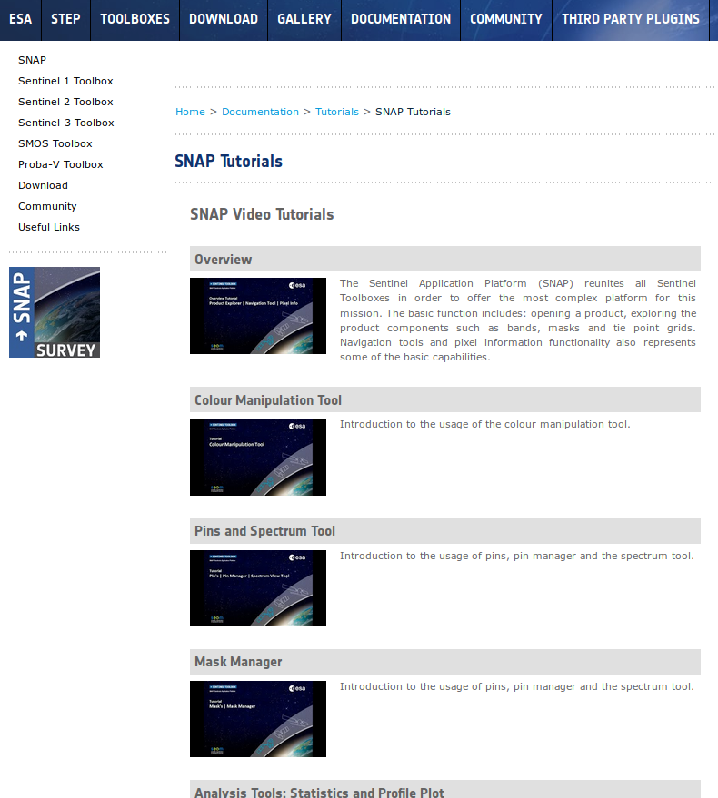
SNAP Tutorials
http://step.esa.int/main/doc/tutorials/snap-tutorials/
Exploring Sentinel-2 multi-spectral band combinations in SNAP
https://www.youtube.com/watch?v=vtlN5MXYGaY
Data archive links:
https://ladsweb.modaps.eosdis.nasa.gov/search/
https://scihub.copernicus.eu/dhus/

Slide 4
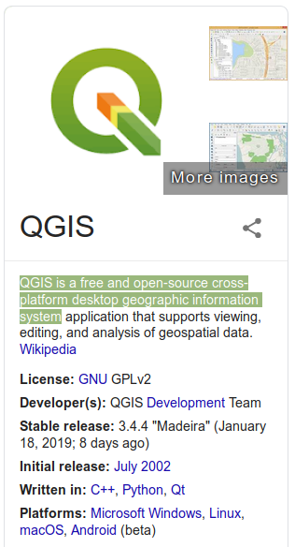
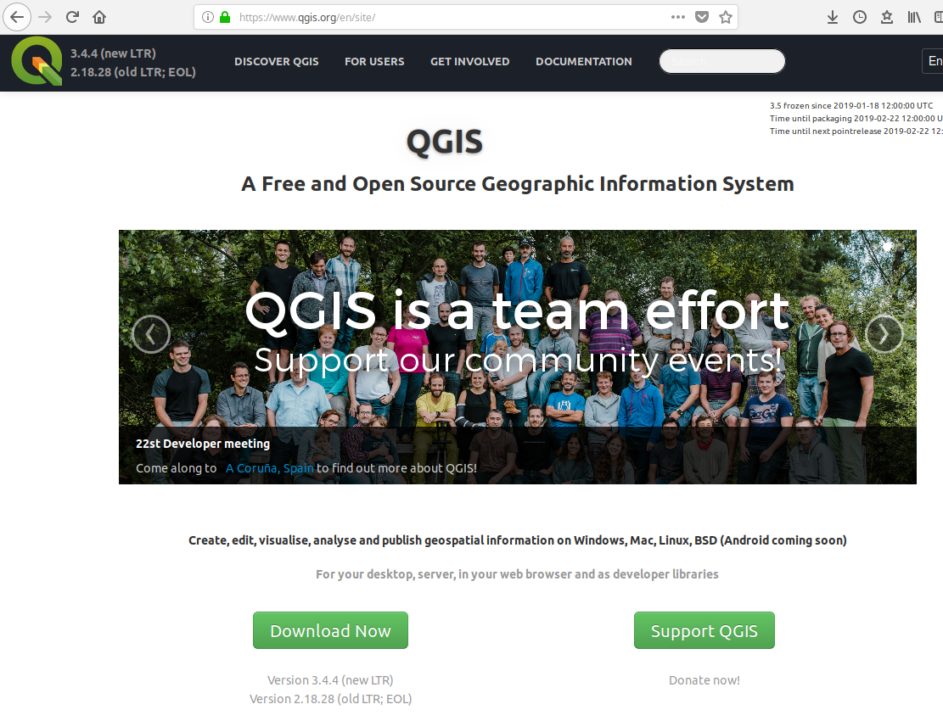
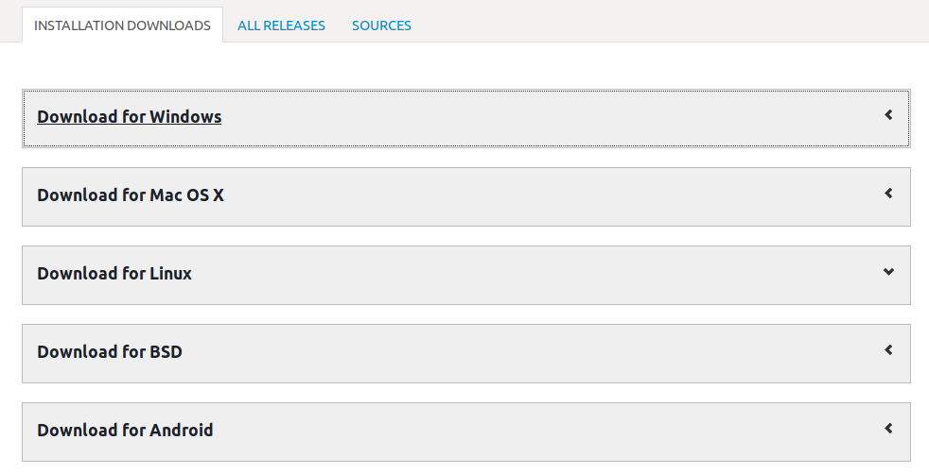
QGIS
QGIS is a free and open-source cross-platform
desktop geographic information system
https://www.qgis.org/

