Slide 1
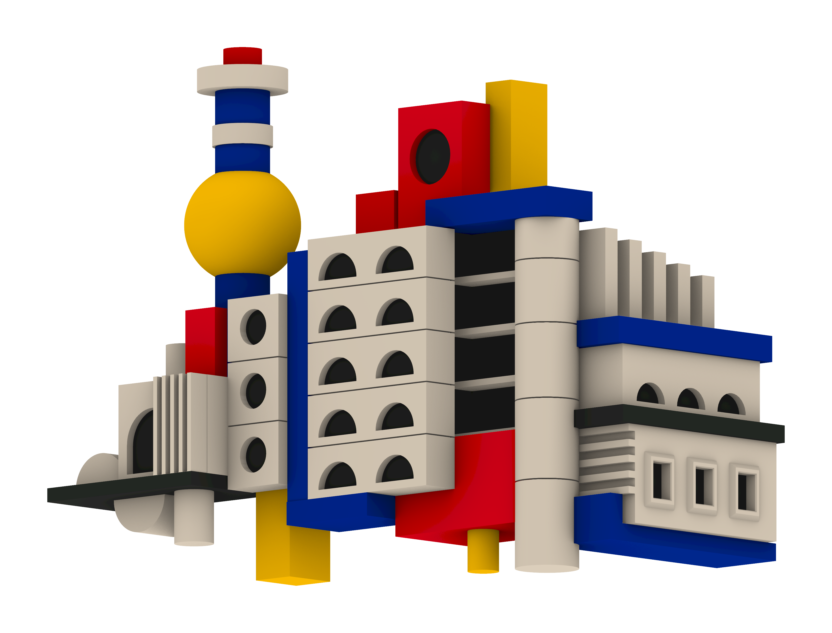
Modular Metropolis
Niclas Wehe - 03822918
GEOMETRY DESCRIPTION
An abstract Bauhaus-style cityscape with a distinctive tower and varied façades is formed by Blocks, cylinders, a sphere and repeating arches
PARAMETERS
1 - right assembly extension
2 - tower element scale
3 - tower height
4 - middle assembly stories
5 - accent coloured geometry scale
6 - left assembly extension
Notes:
If we let each parameter run over its allowed range, f produces a whole family of shapes. That family is the design space.

Slide 2
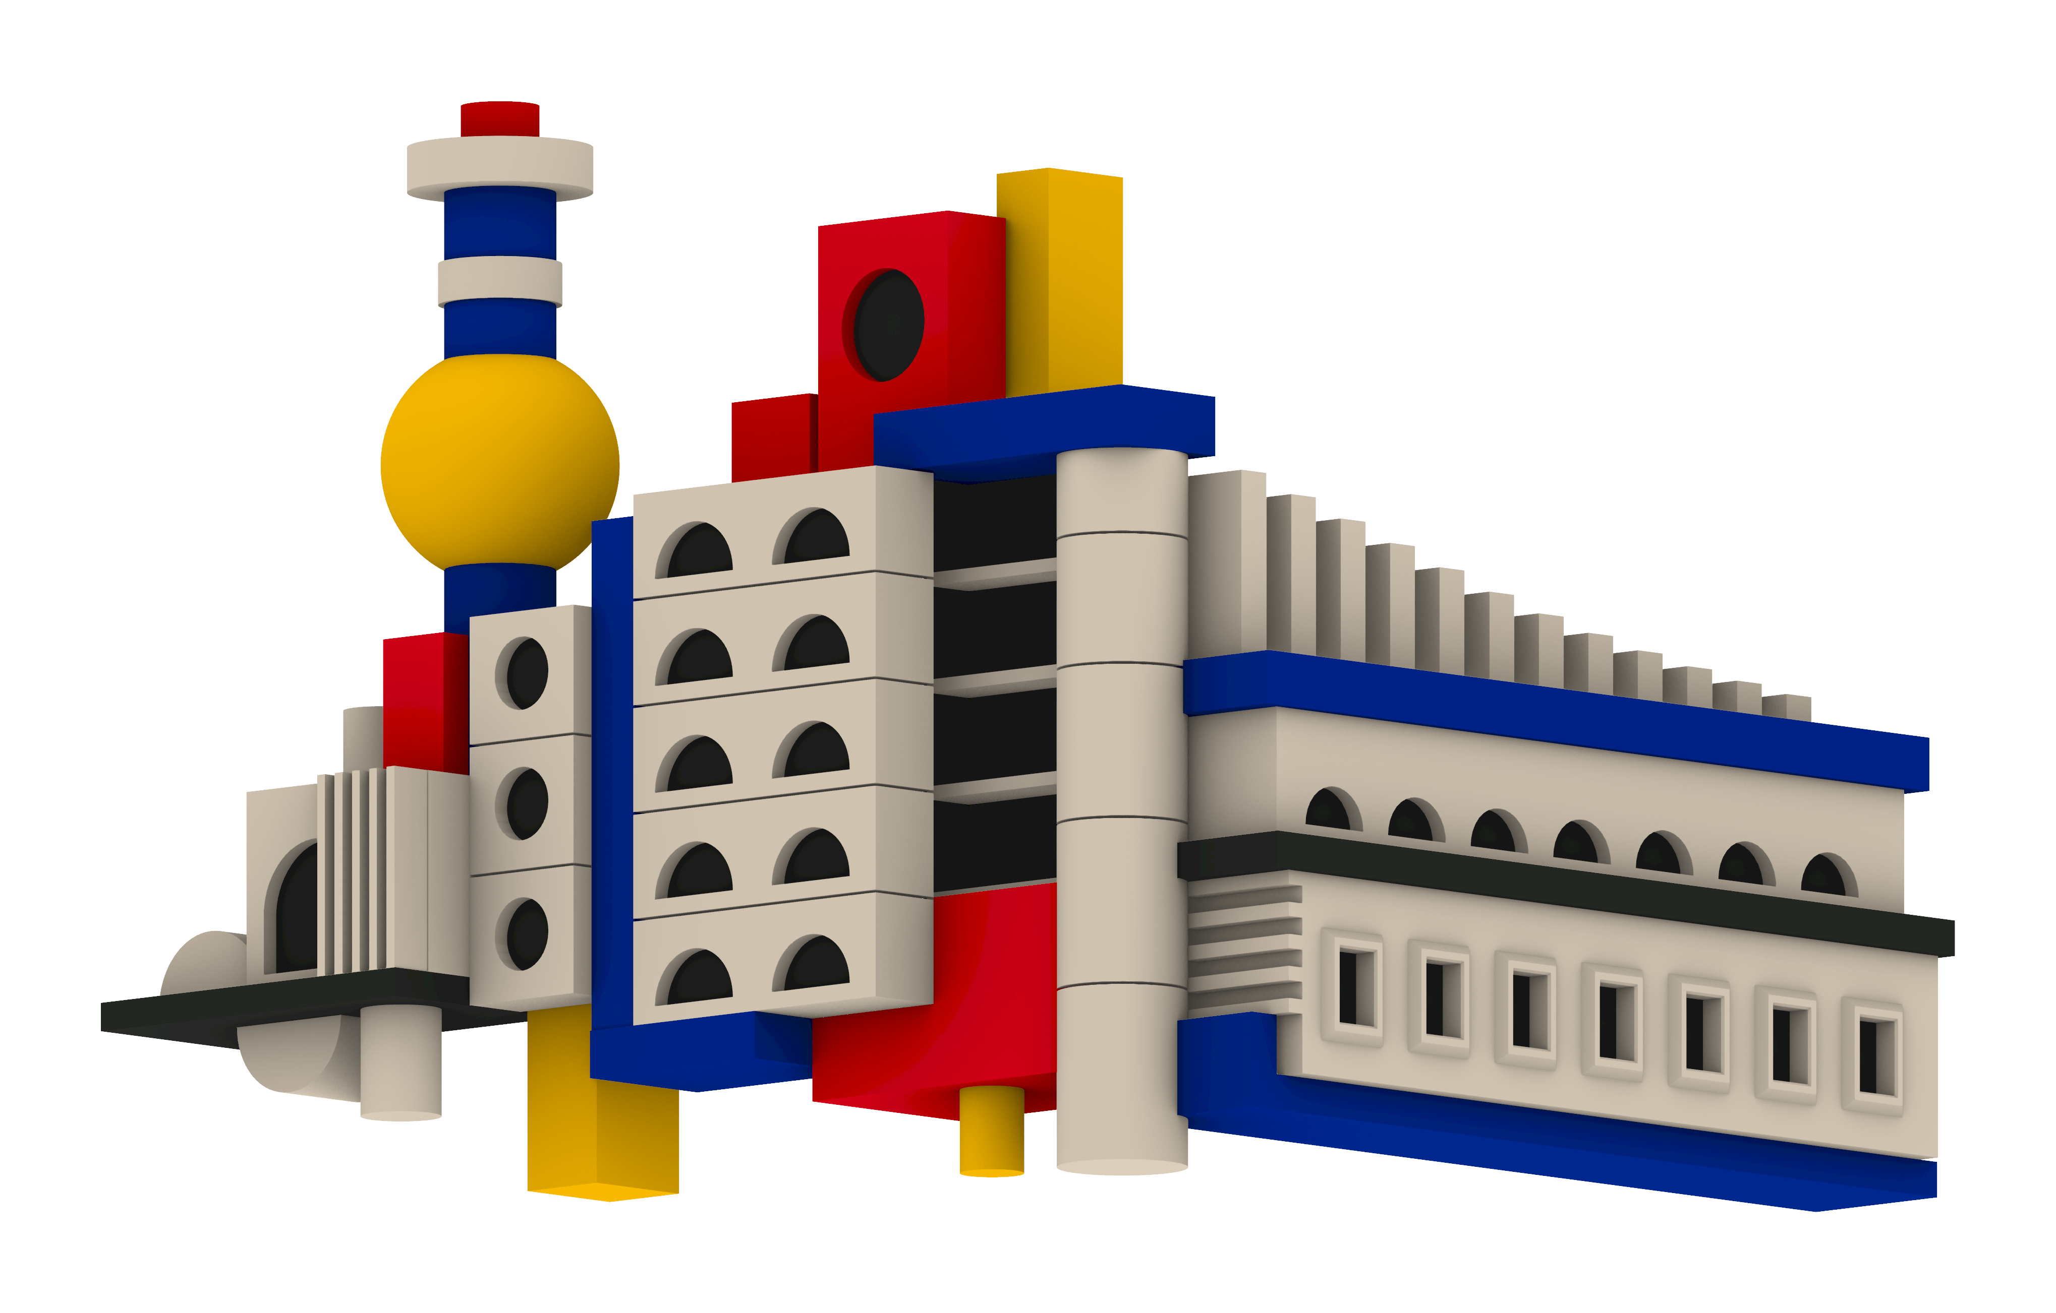
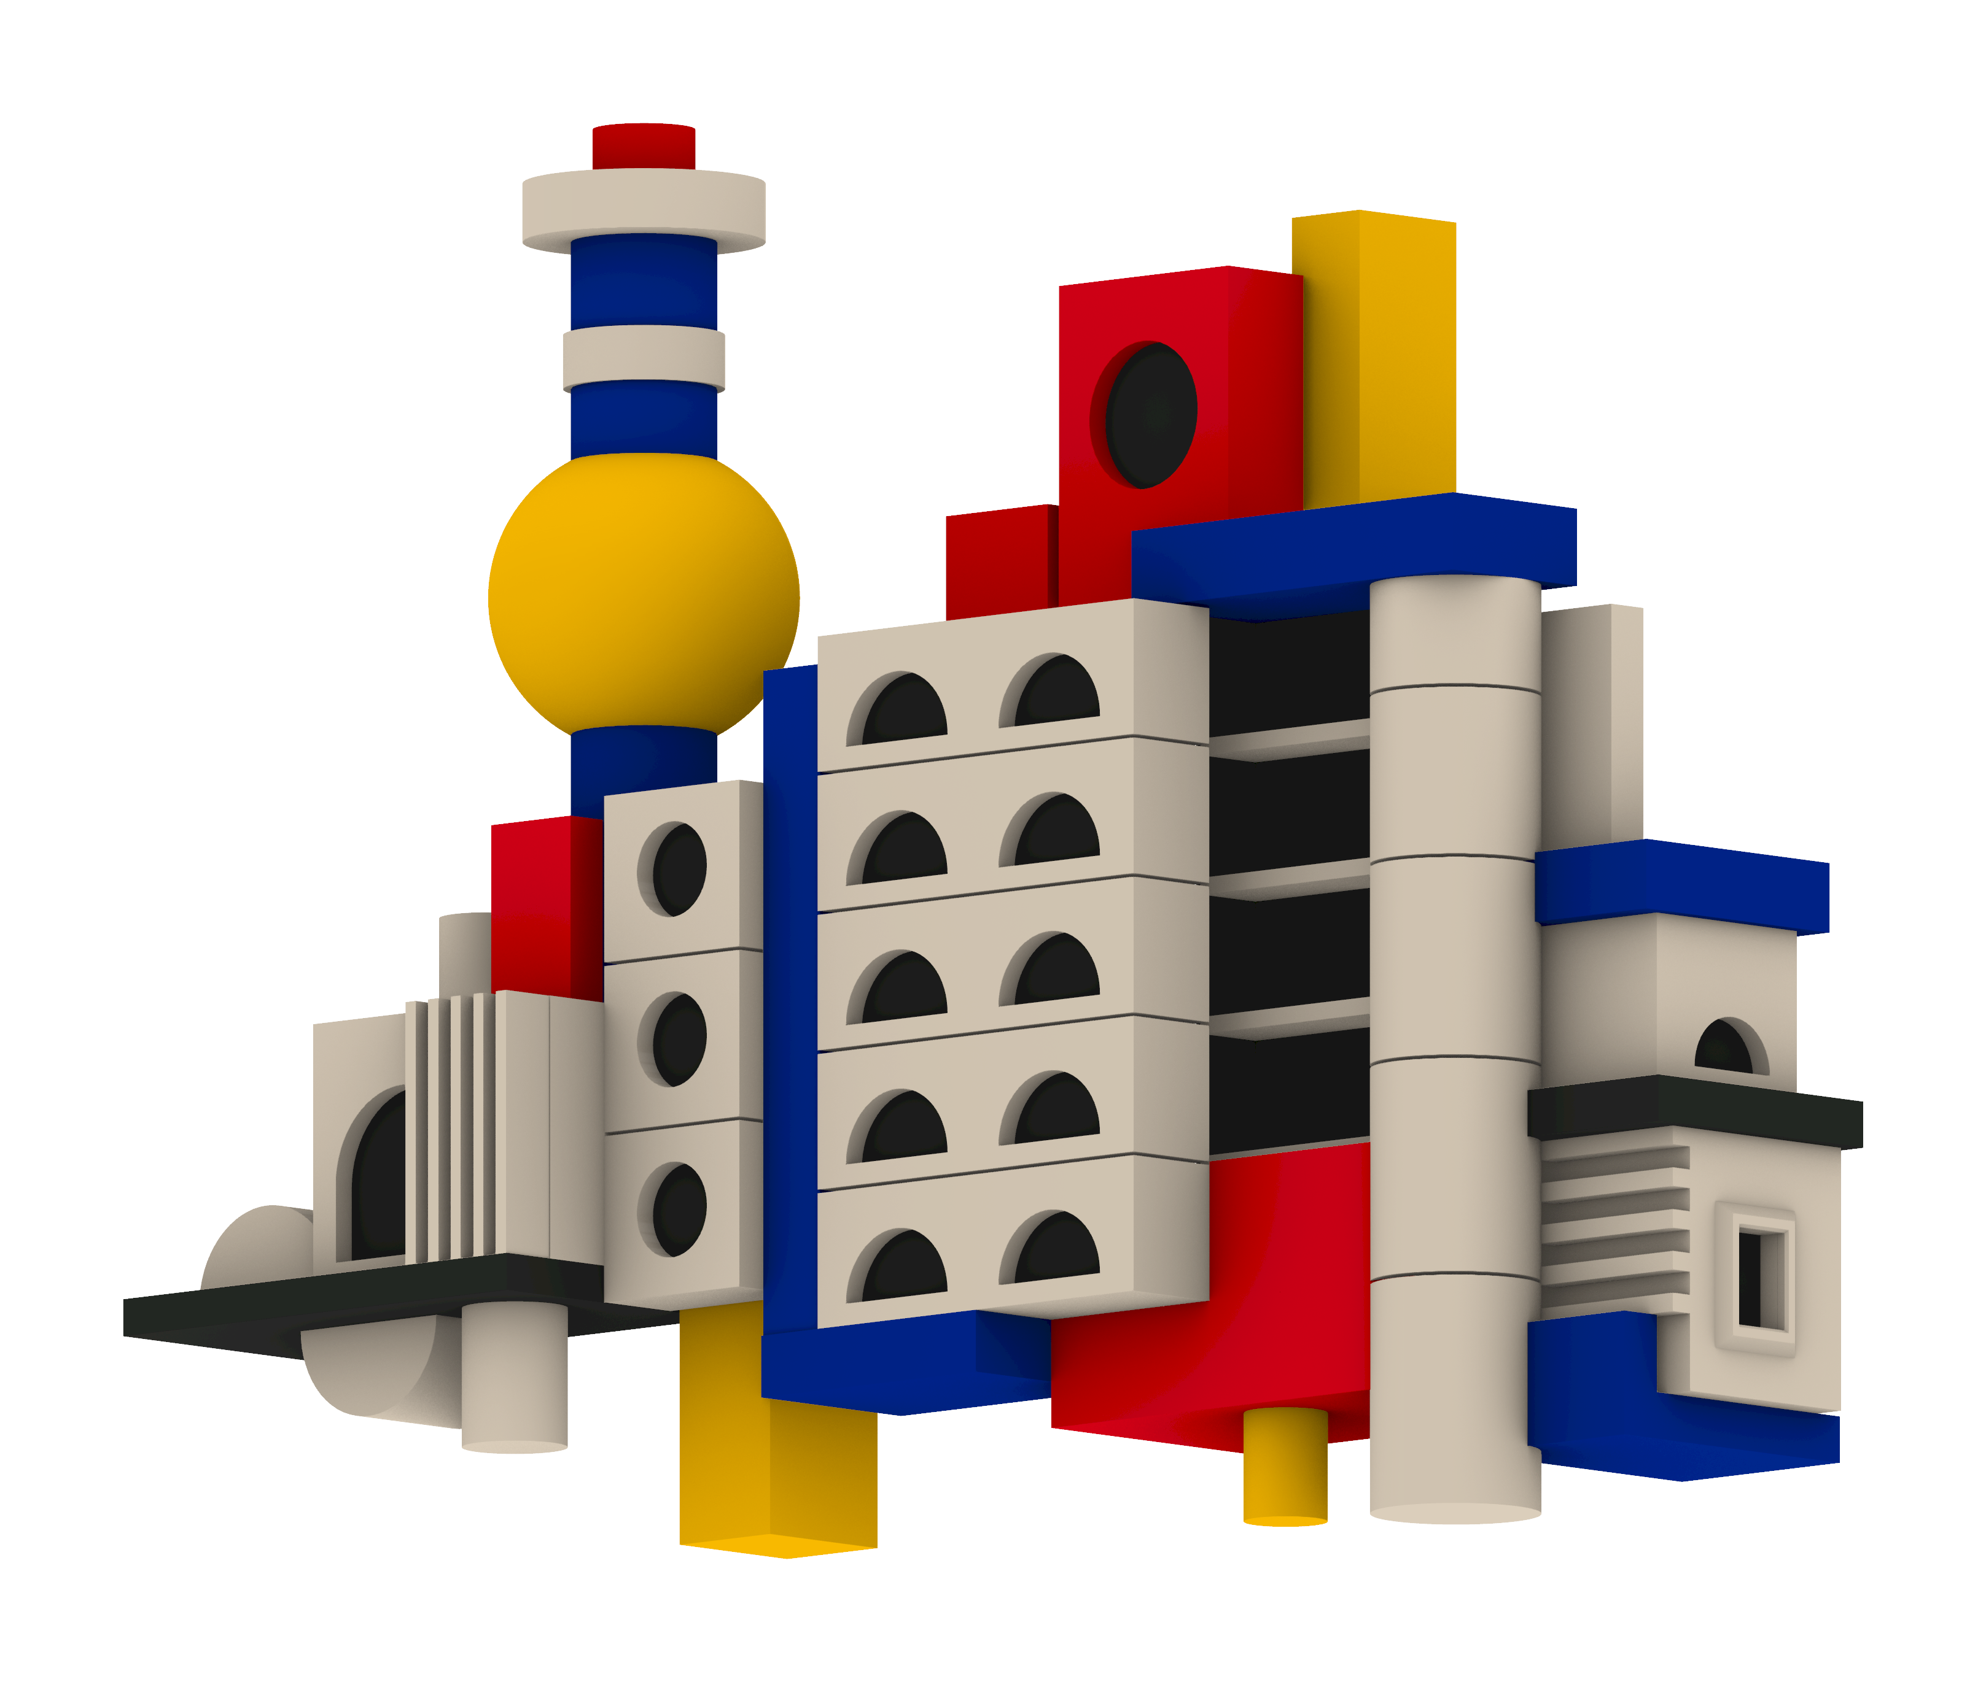
Modular Metropolis
Niclas Wehe - 03822918
PARAMETERS
1 - right assembly extension
2 - tower element scale
3 - tower height
4 - middle assembly stories
5 - accent coloured geometry scale
6 - left assembly extension
RELATIONSHIPS
block size
↔ window count
↔ stepped block count
Notes:
If we let each parameter run over its allowed range, f produces a whole family of shapes. That family is the design space.

Slide 3
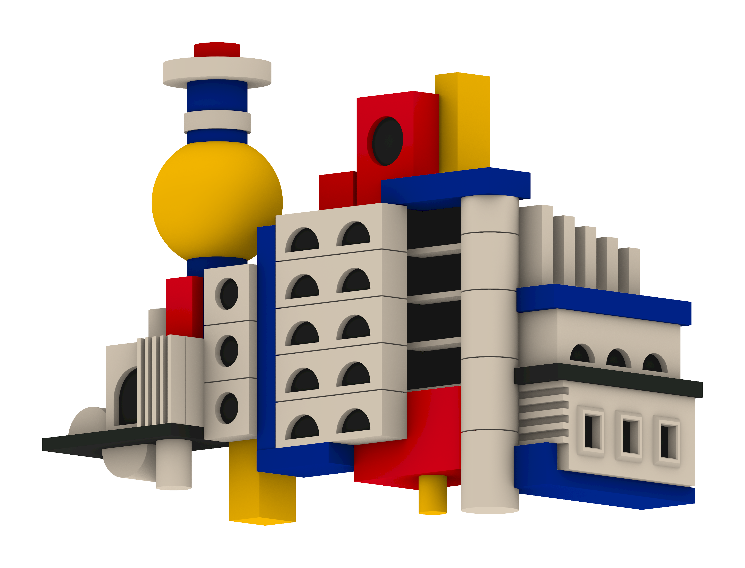
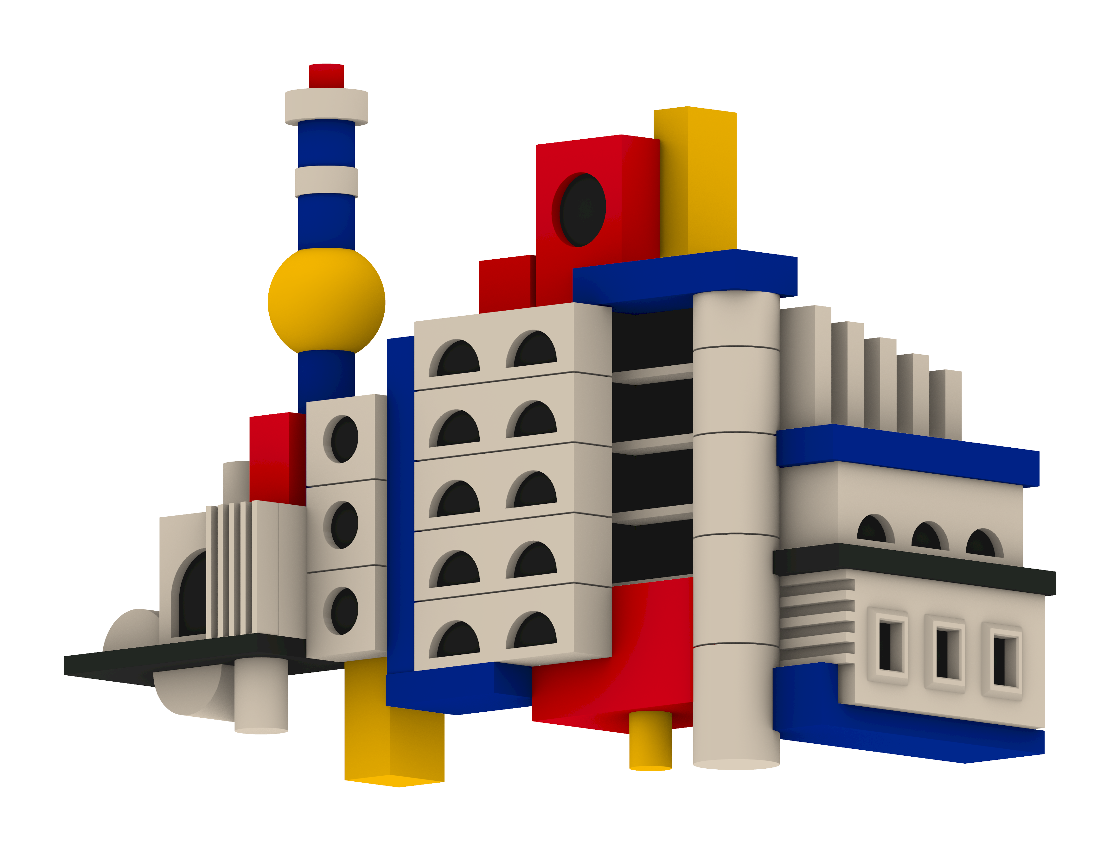
Modular Metropolis
Niclas Wehe - 03822918
PARAMETERS
1 - right assembly extension
2 - tower element scale
3 - tower height
4 - middle assembly stories
5 - accent coloured geometry scale
6 - left assembly extension
RELATIONSHIPS
cylinder diameter ↔ sphere diameter
Notes:
If we let each parameter run over its allowed range, f produces a whole family of shapes. That family is the design space.

Slide 4

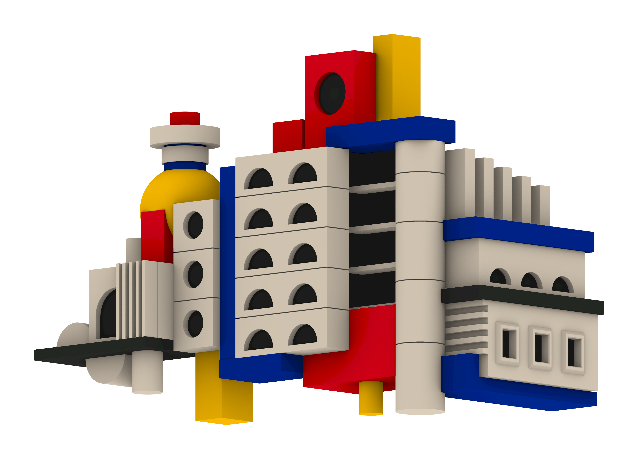
Modular Metropolis
Niclas Wehe - 03822918
PARAMETERS
1 - right assembly extension
2 - tower element scale
3 - tower height
4 - middle assembly stories
5 - accent coloured geometry scale
6 - left assembly extension
RELATIONSHIPS
tower height ↔ tower element spacing
Notes:
If we let each parameter run over its allowed range, f produces a whole family of shapes. That family is the design space.

Slide 5
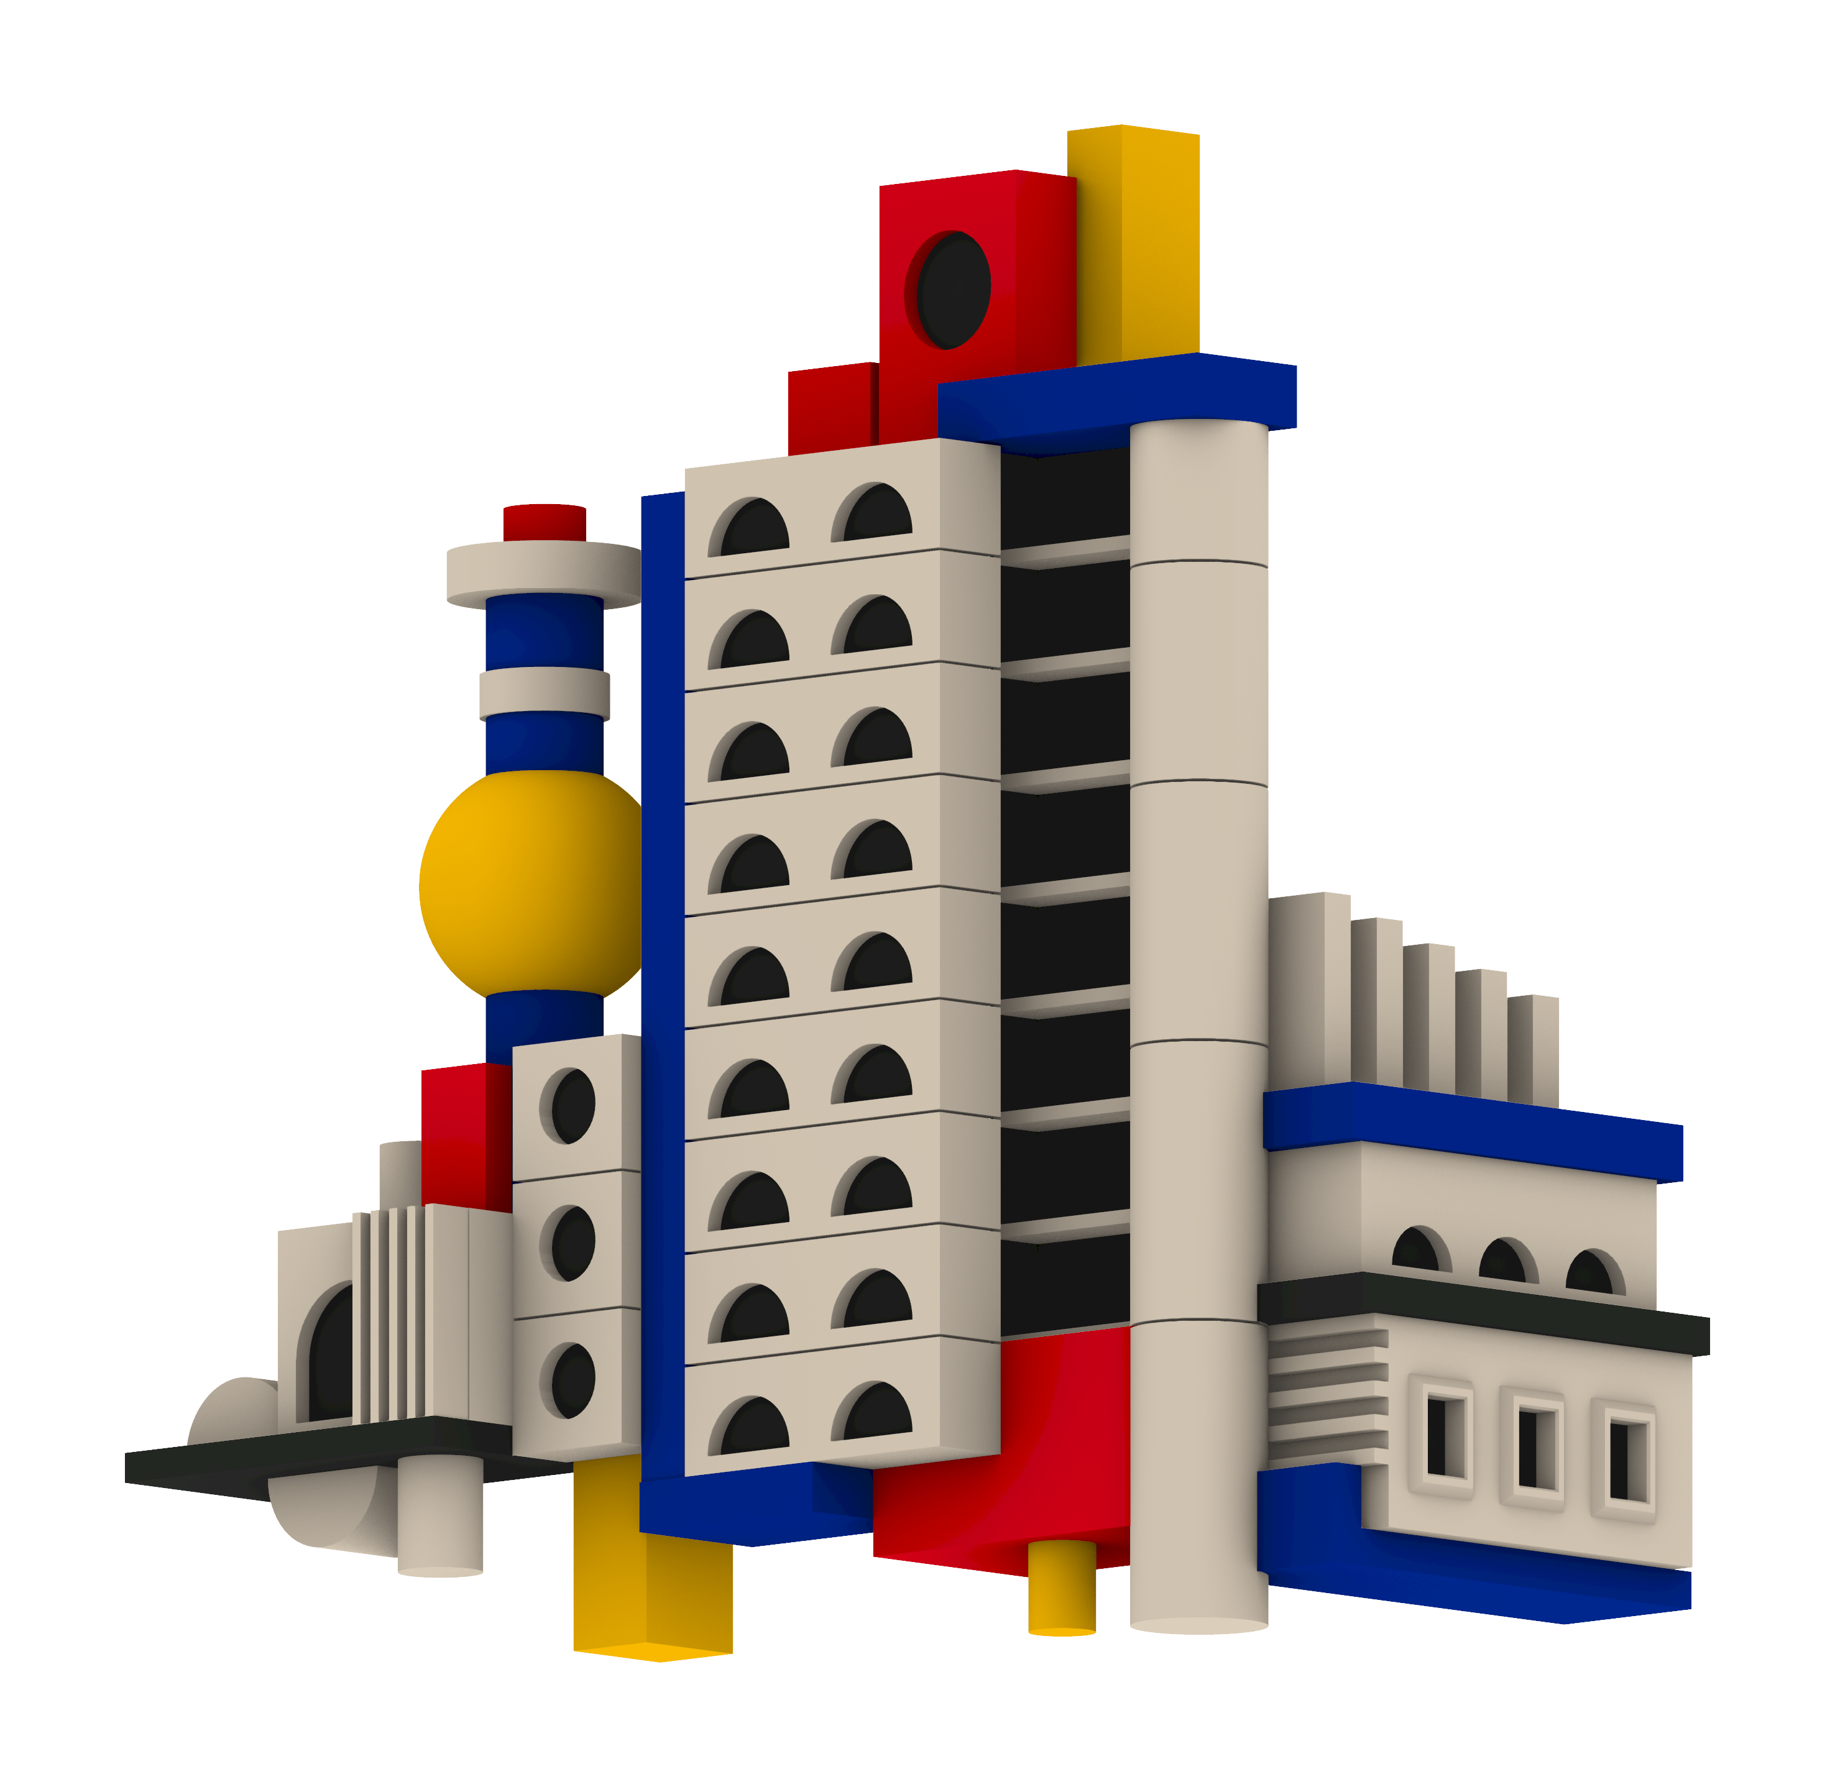
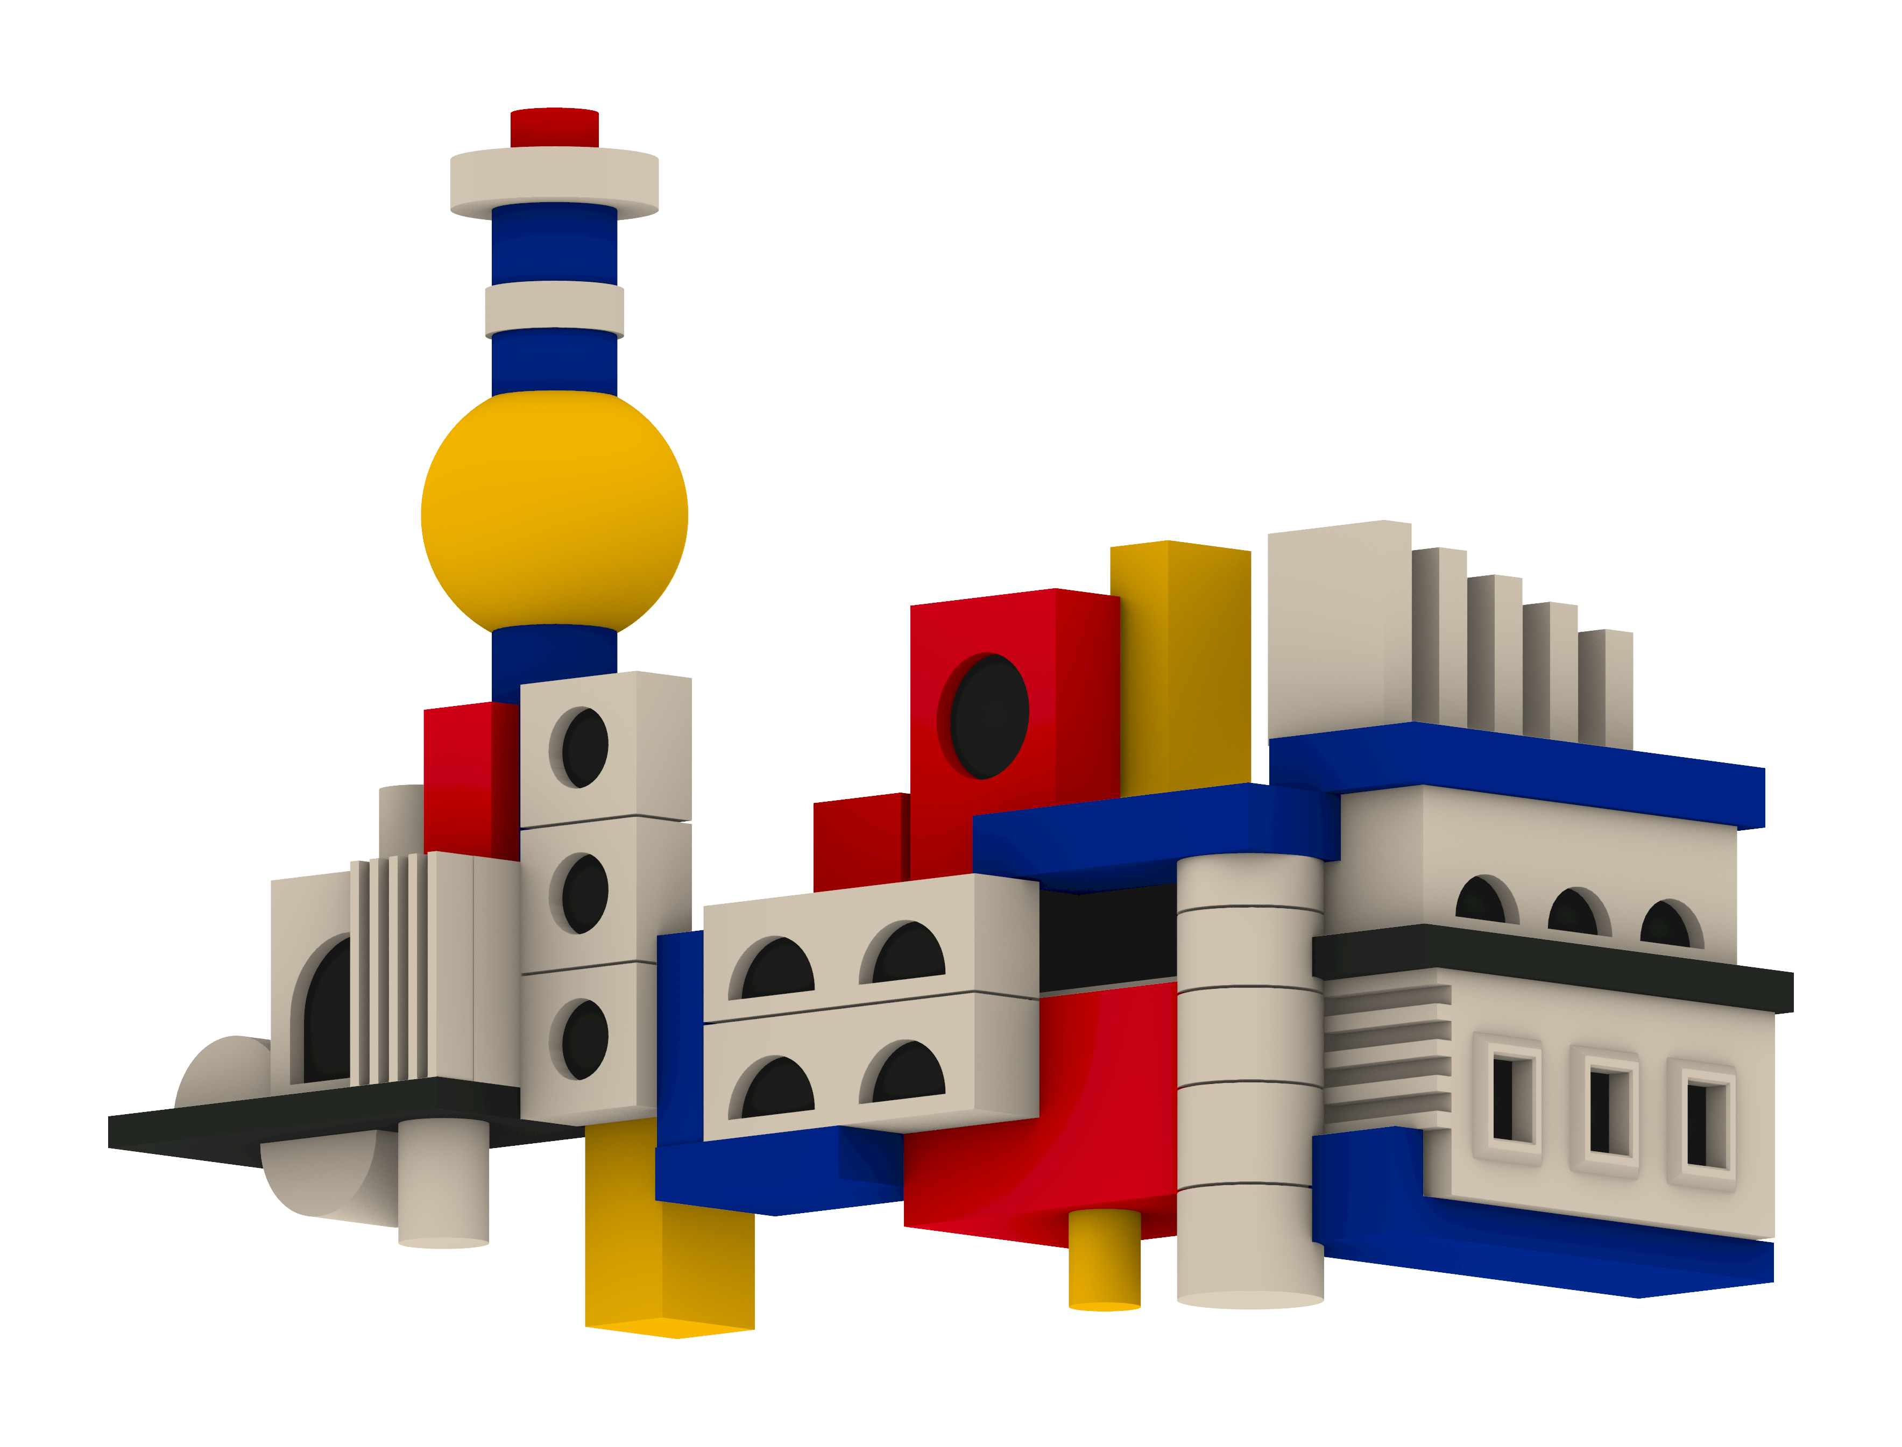
Modular Metropolis
Niclas Wehe - 03822918
PARAMETERS
1 - right assembly extension
2 - tower element scale
3 - tower height
4 - middle assembly stories
5 - accent coloured geometry scale
6 - left assembly extension
RELATIONSHIPS
story count
↔ cylinder height / spacing
↔ position of the top elements
Notes:
If we let each parameter run over its allowed range, f produces a whole family of shapes. That family is the design space.

Slide 6
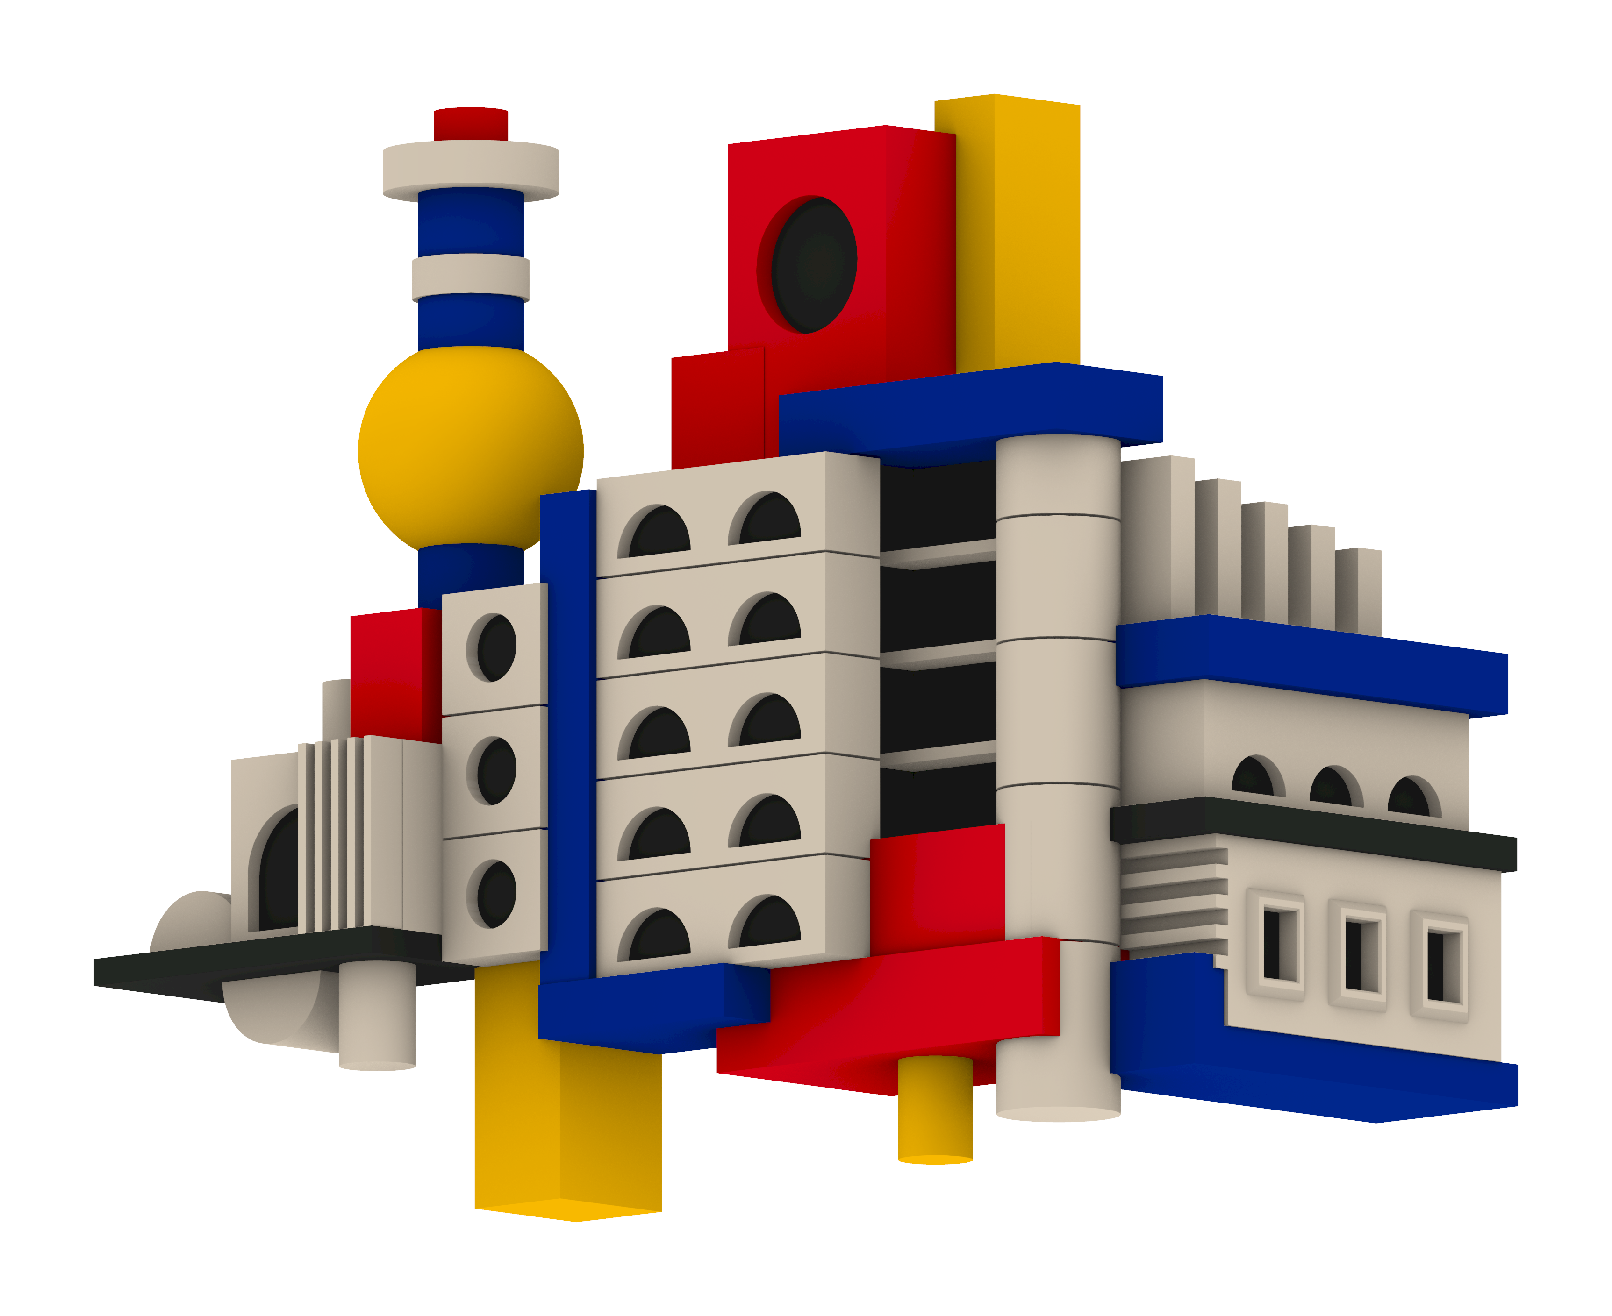
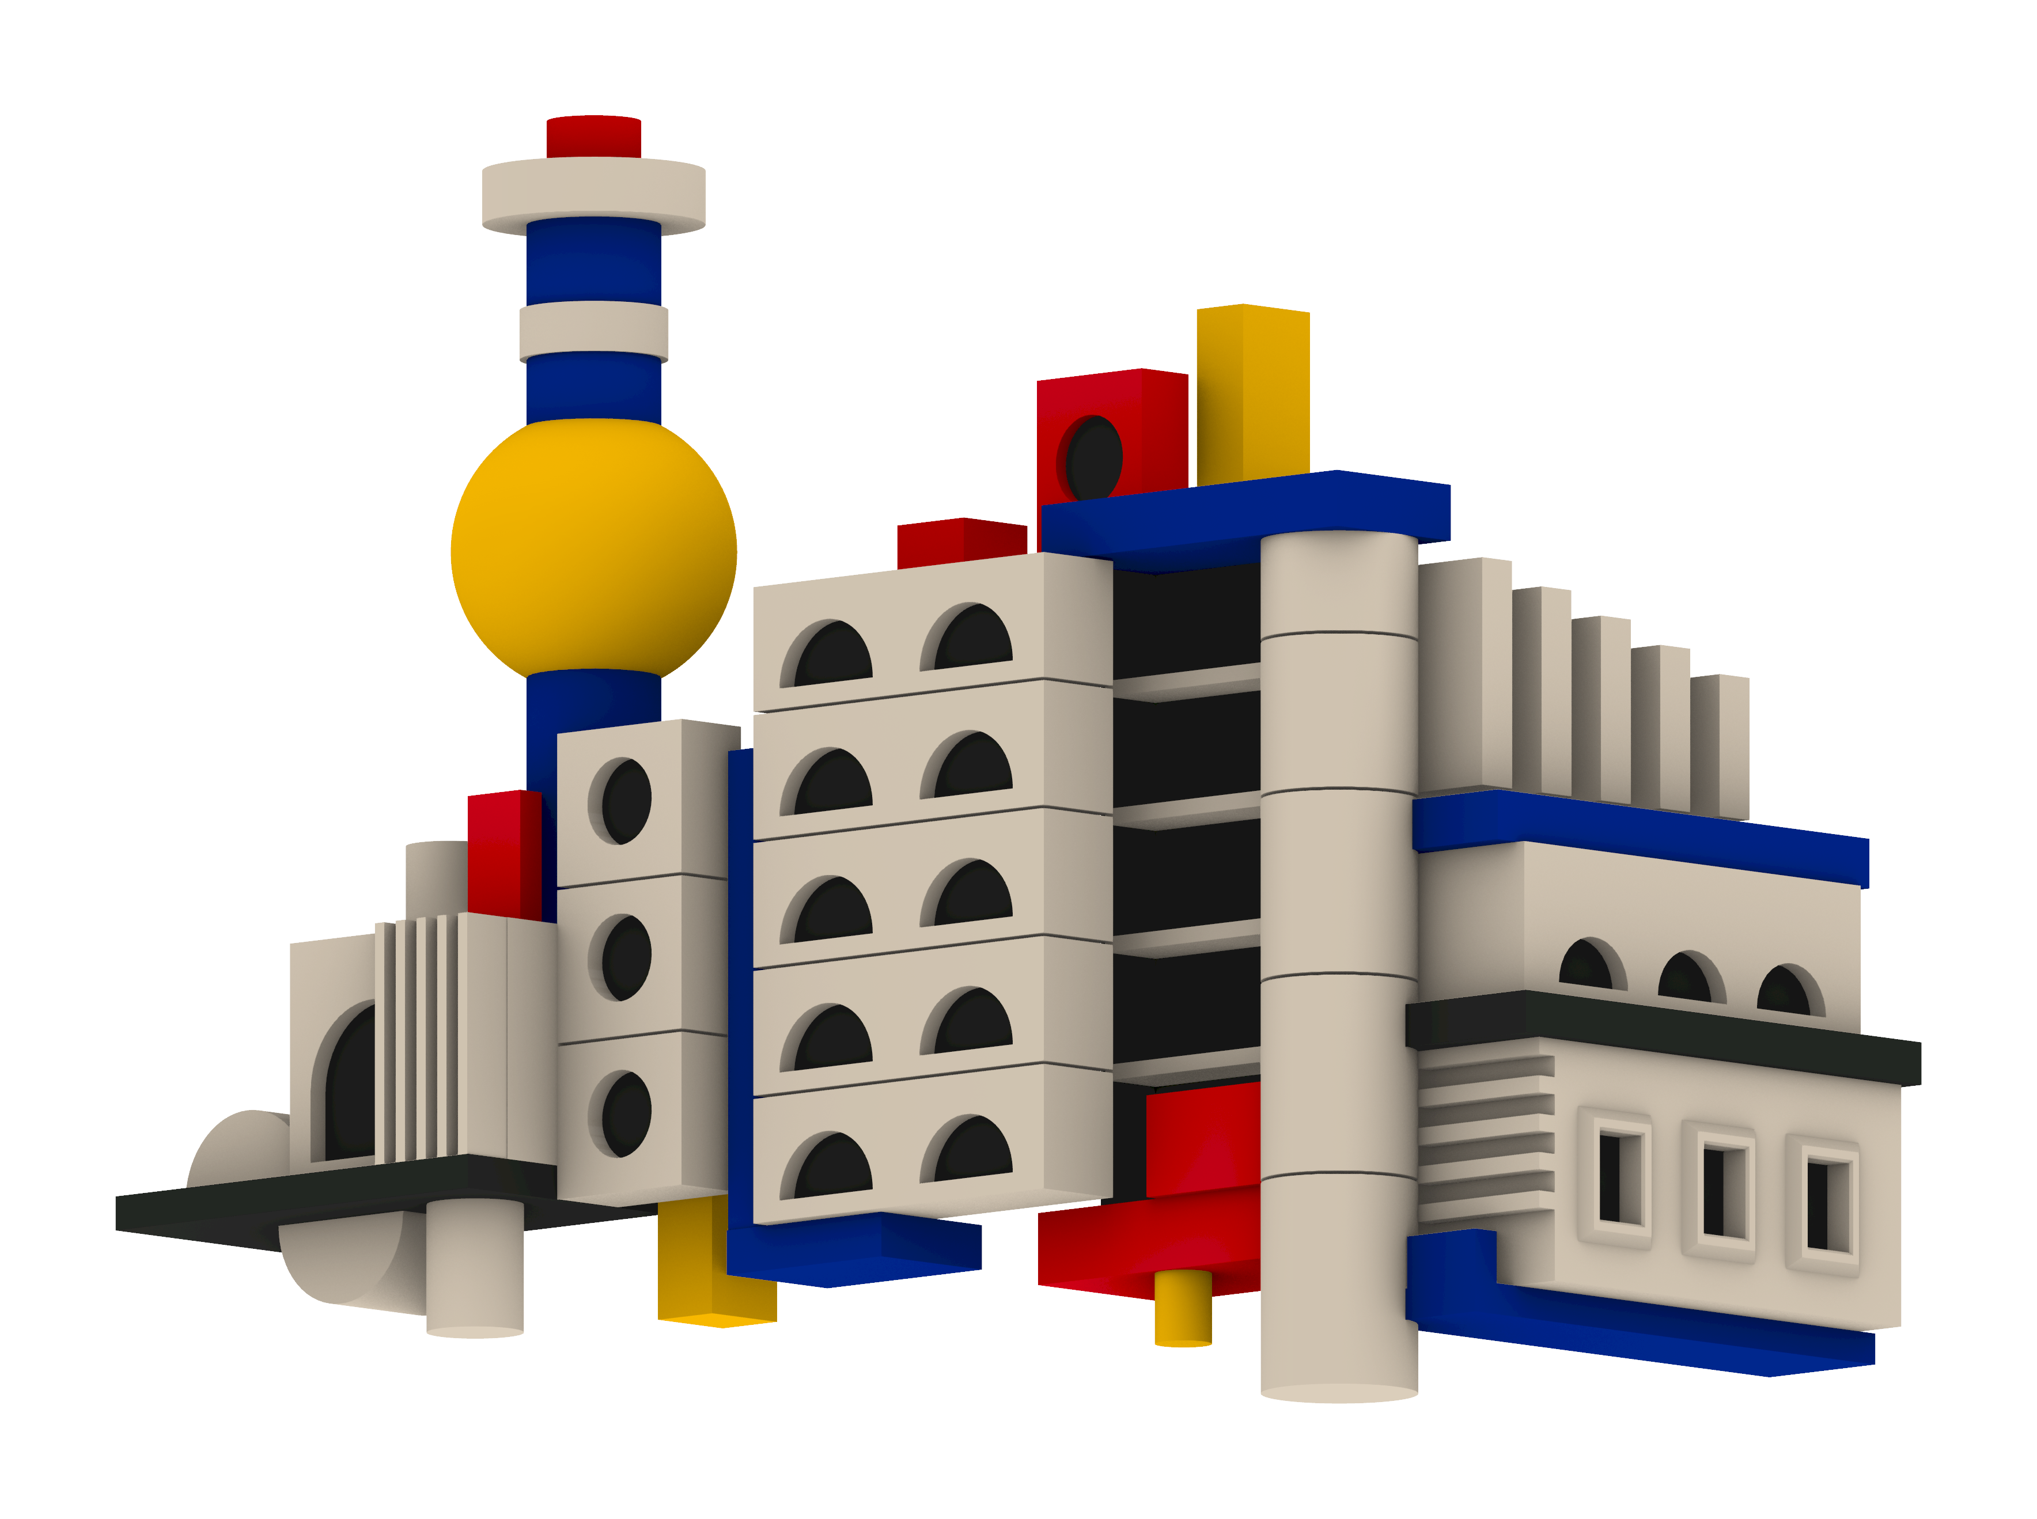
Modular Metropolis
Niclas Wehe - 03822918
PARAMETERS
1 - right assembly extension
2 - tower element scale
3 - tower height
4 - middle assembly stories
5 - accent coloured geometry scale
6 - left assembly extension
RELATIONSHIPS
scaling of blocks and cylinders
↔ size and position of the round window
Notes:
If we let each parameter run over its allowed range, f produces a whole family of shapes. That family is the design space.

Slide 7
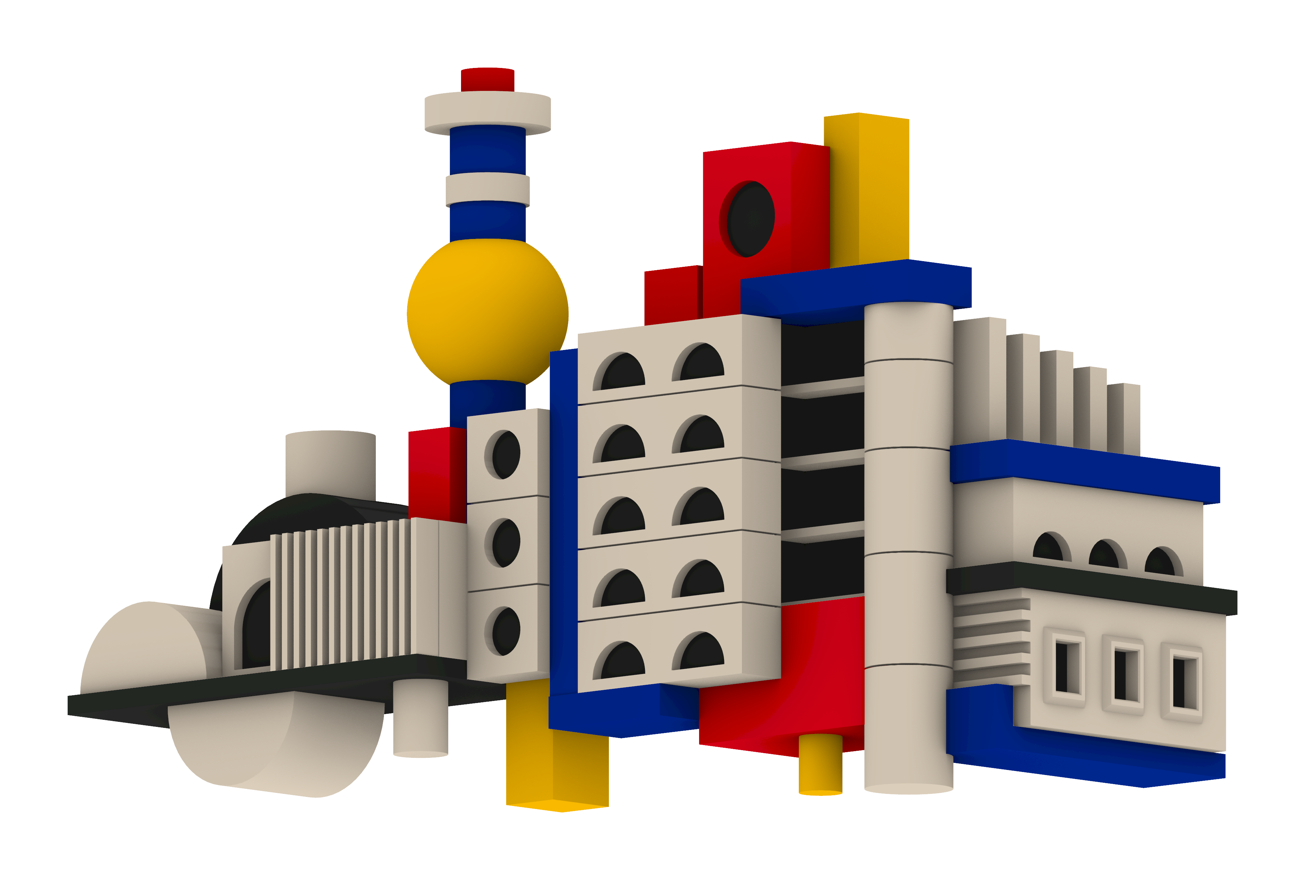
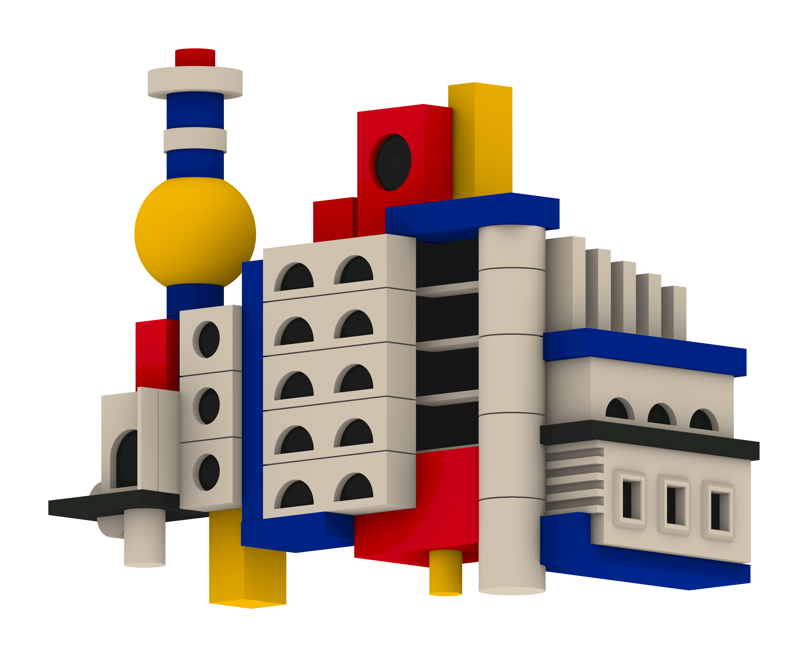
Modular Metropolis
Niclas Wehe - 03822918
PARAMETERS
1 - right assembly extension
2 - tower element scale
3 - tower height
4 - middle assembly stories
5 - accent coloured geometry scale
6 - left assembly extension
RELATIONSHIPS
base plate size
↔ vertical slat count
↔ size and position of half-cylinders
Notes:
If we let each parameter run over its allowed range, f produces a whole family of shapes. That family is the design space.

Slide 8
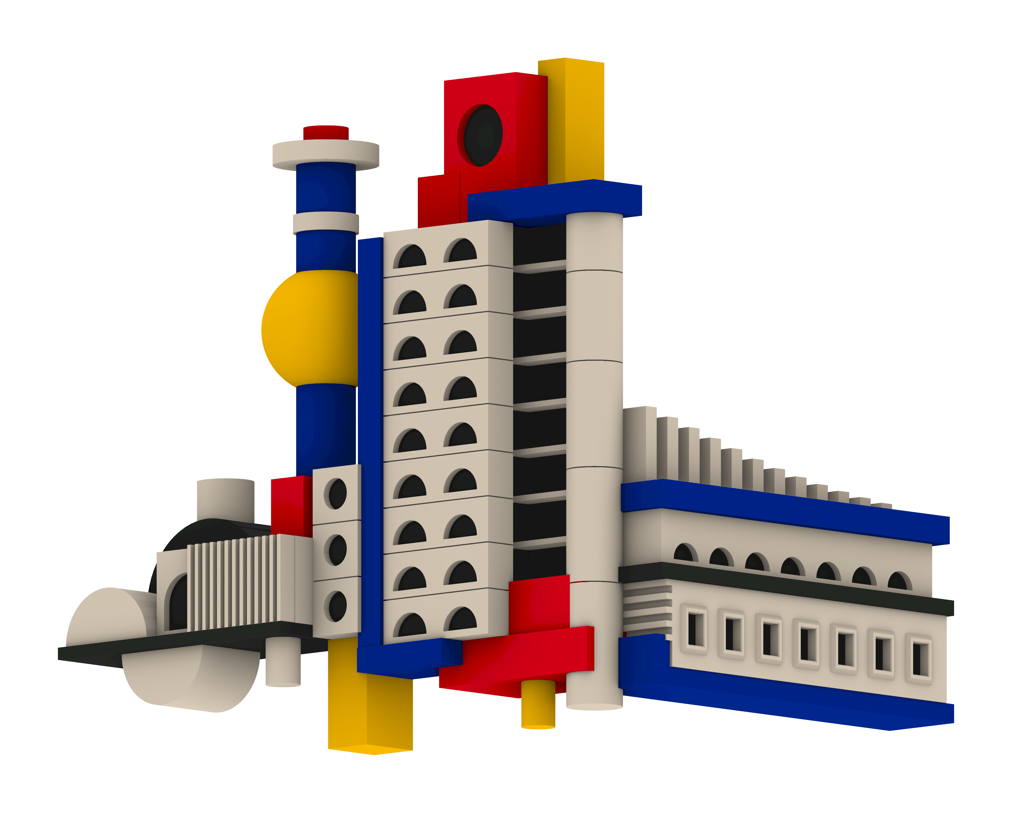
Modular Metropolis
Niclas Wehe - 03822918
PARAMETERS
1 - right assembly extension
2 - tower element scale
3 - tower height
4 - middle assembly stories
5 - accent coloured geometry scale
6 - left assembly extension
Notes:
If we let each parameter run over its allowed range, f produces a whole family of shapes. That family is the design space.

