Slide 1
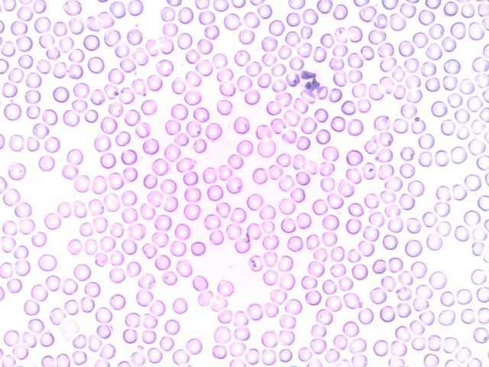


Segmentation of White Blood Cells Fanny Monori, RHUL & Niclas Hedam, ITU
Segmentation of White Blood Cells
Using multiple OpenCV operations to isolate white blood cells from red ones
Threshold
Dilate
Erode
Example input and output
Our biggest challenge was understanding the flow of Vitis
Handling build errors
Inclusion of libraries
Sharing a workspace over Git
Utilisation & Runtime

