Slide 1
Java
Reasoning About Code

Slide 2
Announcements
You should have access to your repositories and hw0
Mistake in Grade Breakdown I posted with hw0
  RandomHello is included in the grade!
  RandomHello: 3pts
  Problem 3 questions: 3pts
  Problem 4 questions: 7pts
Always check the Announcements page!
Fall 15 CSCI 2600, A Milanova

Slide 3
Outline
Java
  Types and type checking, type safety
  Interpretation vs. compilation
Reasoning about code
Fall 15 CSCI 2600, A Milanova

Slide 4
Java: Differences with C++
Model for variables
  Java uses the reference model for class types
    No explicit pointers. All references _are_ pointers
    Must explicitly create object: Foo f = new Foo();
    Two equalities: == and equals.
    Remember: when comparing strings, use equals!
Types and type checking, type safety
Interpretation vs. Compilation
Other: interfaces, inheritance, etc.
Fall 15 CSCI 2600, A Milanova

Slide 5
Types and Type Checking, Type Safety
What is the role of types?
  Data abstraction
  Safety!
Types and type checking prevent the program from going wrong. Disallow operations on objects that do not support those operations
  E.g., a+b where a and b are 2DPoints is rejected by the type checker
  E.g., a.substring(0,10)where a is an int is rejected too

Slide 6
Type Safety
Type safety: no operation is ever applied on object of the wrong type (i.e., object that does not support that operation)
Java is type safe while C/C++ is type unsafe
  In Java, the type system never allows operations on objects of the wrong type (i.e., in no execution, such erroneous operations occur)
  In C++, the type system prevents most errors, but it is possible to write a program where operation on object of the wrong type occurs
Goal: catch errors as early as possible!

Slide 7
Types and Type Checking
Java and C/C++ are statically typed
  A statically typed language typically requires type annotations; performs substantial amount of type checking before runtime
  Expressions have static (compile-time) types
  Objects have dynamic (run-time) types
Alternative is dynamically typed
  Perform substantial type checking during runtime
Fall 15 CSCI 2600, A Milanova
Notes:
A statically typed languages associates types with expressions and performs substantial type checking at before program execution.
The point of type checking is to catch as many erroneous operations as possible and prevent them from happening at runtime.
Statically-typed languages do a lot of type checking at compile time.

Slide 8
C++ is Type Unsafe
// C++:
void* x = (void *) new A;
B* q = (B*) x; //a safe downcast?
int case1 = q->foo(1);//what happens?
// Java:
Object x = new A();
B q = (B) x; //a safe downcast?
int case1 = q.foo(1); //what happens?
Note: In Java, all methods are virtual;
use final keyword to force non-virtual
A
virtual foo()
B
virtual foo()
virtual foo(int)
Throws ClassCastException here!
Runtime never reaches bad call.
Fall 15 CSCI 2600, A Milanova
Notes:
In C++ this is undefined behavior! The compiler may well generate code which calls foo(int) of B and apply foo(int) on a wrong type, type A. This is erroneous behavior that may or may not cause problems at runtime. It usually does cause problems!
The Java snippet compiles, but fails at runtime. The Java runtime system checks whether x holds a B (or a subtype of B). It does not, so it throws an exception. The point is, execution NEVER reaches q.foo(1), so foo(int) will never be applied on the wrong type.

Slide 9
C++ is Type Unsafe
Java: B q; … q.foo(1);
  Java “honors” its promise that at q.foo(1) if q is not null, q is a B (or subclass of B).
C++: B* q; … q->foo(1);
  C++ does not “honor” its promise. q can be a B or an A or a Duck or whatever
Fall 15 CSCI 2600, A Milanova

Slide 10
Type Safety
Java ensures type safety with a combination of compile-time (static) and runtime (dynamic) type checking
  Compiler rejects plenty of programs. E.g., String s = 1 is rejected, String s = new Integer(1) is rejected
  Some checks are left for runtime. Why?
    E.g., at B b = (B) x; the Java runtime checks if x refers to a B, and throws an Exception if it doesn’t
Is Python type safe?
Fall 15 CSCI 2600, A Milanova

Slide 11
Java Throws Lots of Exceptions!
E.g.:
ArrayIndexOutOfBounds at x[i]=0; if i is out of bounds for array x
ClassCastException at B q = (B) x; if the runtime type of x is not a B
NullPointerException at x.f=0; if x is null

Slide 12
Java Throws Lots of Exceptions
Exceptions are a good thing!
  Tell us what went wrong
  Prevent application of operation on wrong type --- stop program from doing harm down the road
Object x = new A();
B q = (B) x; // ClassCastException
// because A is not a B
… int case1 = q.foo(1);
Exception prevents execution from reaching
q.foo(1) and applying foo(1) on an object
(A) that does not support foo(int)

Slide 13
Compilation vs. Interpretation
Compilation
  A “high-level” program is translated into executable machine code
  Compiler. C++ uses compilation
Pure interpretation
  A program is translated and executed one statement at a time
  Interpreter
Hybrid interpretation
  A program is “compiled” into intermediate code; intermediate code is “interpreted”
  Both a compiler and an interpreter. Java
Fall 15 CSCI 2600, A Milanova

Slide 14
Compilation
COMPILER
character stream
Scanner (lexical analysis)
Machine-independent
code improvement
token stream
Parser (syntax analysis)
parse tree
modified
intermediate form
Semantic analysis and
intermediate code generation
Code Generation
target language
(assember)
abstract syntax tree
and/or intermediate form
Machine-dependent
code improvement
modified
target language
Fall 15 CSCI 2600, A Milanova
Notes:
The compiler is a sequence of phases (passes) where the output
of each phase is the input to the next phase.
The Scanner takes as input a character stream (the program code)
and outputs a token stream. The Parser takes the token stream and
outputs a parse tree. The Semantic analysis and intermediate code
generation phase takes the parse tree and outputs the abstract
syntax tree or another intermediate form. And so on.
In our course, we will discuss in detail the Scanner, the Parser and
the Semantic Analysis.
Last, the left side of this picture, namely the Scanner, Parser,
Semantic analyzer and intermediate code generator form the
FRONT END (or machine-independent part) of the COMPILER.
The optimizer and code generator form the BACK END
(machine-dependent part) of the COMPILER.

Slide 15
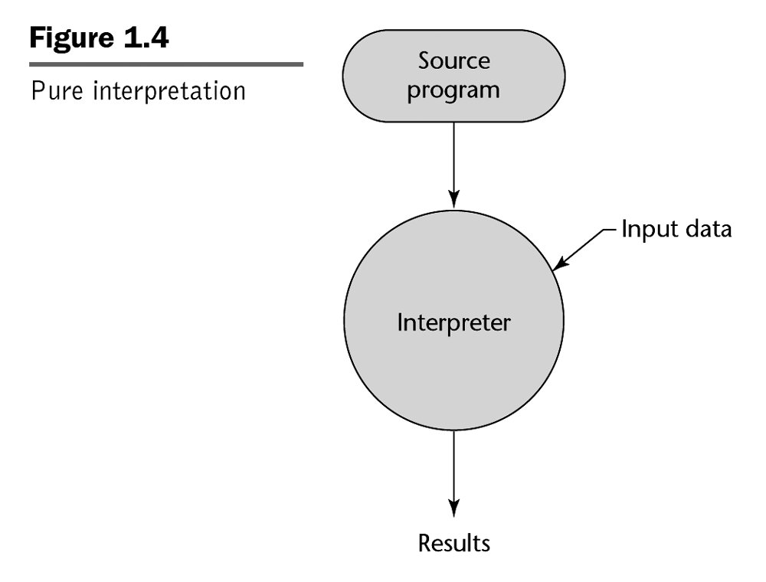
Pure Interpretation
e.g. BASIC
REM COMMENT
LET X = 5
LET Y = 8
PRINT X
PRINT Y
LET Z = X
PRINT Z
...
Fall 15 CSCI 2600, A Milanova

Slide 16
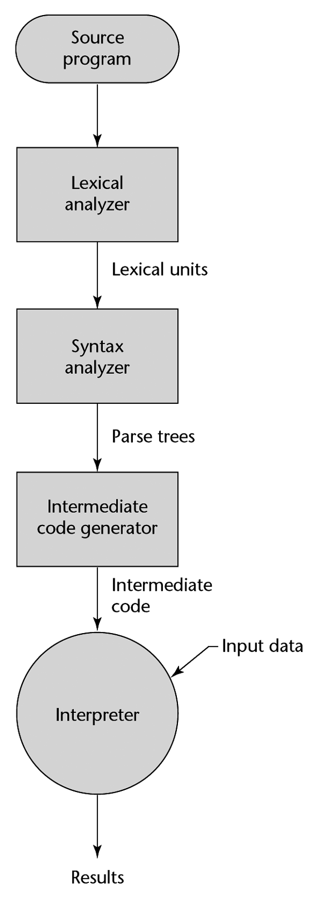
Hybrid Interpretation
09 AB 19 29 99 73 09 AB 19 29 99 73 09 AB 19 29 99 73 09 AB 19 29 99 73 09 AB 19 29 99 73 09
Compiler
e.g. Java byte code
e.g. Java Virtual Machine (JVM)
Fall 15 CSCI 2600, A Milanova
Also Perl....
Notes:
Note that Lexical analyzer is another term (often used in texts) for Scanner.
Similarly, Syntax analyzer is another term for Parser.

Slide 17
Compiling and Running Java
Command line:
  javac HelloWorld.java produces HelloWorld.class
  java HelloWorld // runs the interpreter
Eclipse:
  Compiles automatically when you save!
  Run -> Run runs the interpreter
Fall 15 CSCI 2600, A Milanova

Slide 18
Compilation vs. Interpretation
Advantages of compilation?
  Faster execution
Advantages of interpretation?
  Greater flexibility
    Portability, sandboxing, dynamic semantic (i.e., type) checks, other dynamic features are much easier
Fall 15 CSCI 2600, A Milanova

Slide 19
Some Terminology
C++: Base class and derived class
Java: Superclass and subclass
C++: Member variable, member function
Java: field (instance or static), method (again instance or static)
Java has interfaces (collections of method signatures)
  Single class inheritance (class B extends A {…),
  Multiple interface inheritance (class A implements I,J,K {…)
  class B extends A implements I,J,K {…
Notes:
I use the terms superclass and subclass.

Slide 20
Outline
Java
Intro to reasoning about code
  Specifications
  Preconditions and postconditions
  Forward reasoning and backward reasoning
Reasoning about code, formally; Hoare logic
  Hoare Triples
  Rules for assignment, sequence, if-then-else
Fall 15 CSCI 2600, A Milanova

Slide 21
Reasoning About Code
Determines what facts hold during program execution
0 <= index < names.length
x > 0
array names is sorted
x > y
Fall 15 CSCI 2600, A Milanova
Notes:
Determine (before program execution!) what facts hold during execution.

Slide 22
Why Reason About Code
Remember, our goal is to produce correct code! Two ways to ensure correctness
  Testing
  Reasoning about code. Known as verification
Reasoning about code
  Verifies that code works correctly
  Finds errors in code
  Helps understand errors
    E.g., what input caused division by zero?
Fall 15 CSCI 2600, A Milanova (based on slide by Michael Ernst, UW)
Notes:
Fascinating areas.s

Slide 23
Specifications
What does it mean for code to be correct?
  (Informally) Code is correct if it conforms to its specification
A specification consists of a precondition and a postcondition
  Precondition: conditions that must hold before code executes
  Postcondition: conditions that must hold after code finishes execution (if precondition held!)
Fall 15 CSCI 2600, A Milanova
Notes:
conditions: logical constraints on values

Slide 24
Specifications
Notation:
&& denotes logical AND
|| denotes logical OR
Precondition: arr.length = len && len >= 0
Postcondition: result = arr[0]+…+arr[arr.length-1]
int sum(int[] arr, int len) {
int result = 0;
int i = 0;
while (i < len) {
result = result + arr[i];
i = i+1;
}
return result;
}
To prove that sum is correct, we must prove that the
implementation meets the specification. In other words,
we must prove that if the precondition held, after code
finishes execution, the postcondition holds.
To do this, we must reason about code.
Fall 15 CSCI 2600, A Milanova
Notes:
If len > arr.length, “sum” will bomb with an ArrayIndexOutOfBounds exception.
If len < 0 or len < arr.length, sum will terminate but compute incorrect result

Slide 25
Specifications
The specification is a contract between the function and its caller. Both caller and function have obligations:
  Caller must pass arguments that obey the precondition. If not, all bets are off --- function can break or return wrong result!
  Function “promises” the postcondition
  In sum, how can the caller violate spec?
  How can sum violate spec?

Slide 26
Aside: Type Signature is a Form of Specification
Type signature is a contract too!
E.g., int sum(int[] arr, int len) {…}
Precondition: arguments are an array of ints and an int
Postcondition: result is a int
We need more than type signatures! Why?
  We need reasoning about behavior and effects (deeper properties)
Fall 15 CSCI 2600, A Milanova

Slide 27
Aside: Type Signature is a Specification
Type checker (among other things) verifies that the parties meet the contract
If language is type safe we can “trust” the type checker
But if language is type unsafe we it would be possible for a caller to pass an argument of the wrong type!
Fall 15 CSCI 2600, A Milanova

Slide 28
Why Reason About Code
Ensure code works correctly
  Ensure that code meets the specification
  E.g., we can prove that sum is correct by proving that sum meets its specification
Find errors in code
Understand errors
Fall 15 CSCI 2600, A Milanova

Slide 29
What is Wrong With this Code?
class NameList {
int index;
String[] names;
…
// Precondition: 0 ≤ index < names.length
// Postcondition: 0 ≤ index < names.length
void addName(String name) {
index++;
if (index < names.length)
names[index] = name;
}
}
Fall 15 CSCI 2600, A Milanova (example modified from Michael Ernst)

Slide 30
What Inputs Cause Wrong Output?
String[] parseName(String name) {
int comma = name.indexOf(“,”);
String firstName = name.substring(0,comma);
String lastName = name.substring(comma+2);
return new String[] { lastName, firstName };
}
What input produces array [“Doe”,”Jane”]?
What input produces array [“oe”,”Jane”]?
What input produces StringIndexOutOfBoundsException?
Fall 15 CSCI 2600, A Milanova (example due to Michael Ernst)
Notes:
The programmer did not write a specification for this code. We know the expected output is [“Doe”,”John”]. But what must the caller do to produce this correct output? What is the condition on the input “name”?
name should be a String “FirstName, LastName” // A character string LastName, followed by comma, followed by space, followed by character string FirstName”

Slide 31
Types of Reasoning
Forward reasoning: given a precondition, what is the postcondition?
  Verify that code works correctly
Backward reasoning: given a postcondition, what is the precondition?
  Again, verify that code works correctly
  What input caused an error
Fall 15 CSCI 2600, A Milanova (based on slide by Michael Ernst)

Slide 32
Forward Reasoning
We know what is true before running the code. What is true after running the code?
// precondition: x is even
x = x + 3;
y = 2x;
x = 5;
// What is the postcondition here?
Fall 15 CSCI 2600, A Milanova (based on slide by Michael Ernst)

Slide 33
Strongest Postcondition
Many postconditions hold from this precondition and code!
// precondition: x is even
x = x + 3;
y = 2x;
x = 5;
// postcondition: x = 5 && y % 4 = 2
// postcondition: x = 5 && y is even
// postcondition: x > 0 && y is even
x=5 && y%4 = 2 is the strongest postcondition.
It implies all other postconditions. More on stronger
and weaker conditions later.
Notes:
Strongest postcondition is the most specific postcondition. It gives most specific information about the behavior of the code.

Slide 34
Forward Reasoning Example
// precondition: x>y
z = x;
x = y;
y = z;
// What is the postcondition ??
One postcondition: z = x₀ && x = y₀ && y = z && x₀ > y₀
(here x₀ denotes the initial value of x)
This postcondition implies y > x
Fall 15 CSCI 2600, A Milanova
Notes:
The interesting postcondition: y > x.
We can derive many postconditions!
Postcondition: z = y AND y > x
Postcondition: x = y_o AND y = x_o AND x_o > y_o (Here x_o and y_o denote the starting values of x and y).
All of these imply the interesting postcondition: y > x.

Slide 35
Backward Reasoning
We know what we want to be true after running the code. What must be true beforehand to ensure that?
// precondition: ??
x = x + 3;
y = 2x;
x = 5;
// postcondition: y > x
Fall 15 CSCI 2600, A Milanova (based on a slide by Michael Ernst)
Notes:
2(x+3) > 5 equiv. to 2x > -1 equiv. x > -1/2
2x > 5
y > 5
y > x

Slide 36
Forward vs. Backward Reasoning
Forward reasoning is more intuitive, just simulates the code
  Introduces facts that may be irrelevant to the goal
  Takes longer to prove task or realize task is hopeless
Backward reasoning is usually more helpful
  Given a specific goal, shows what must hold beforehand in order to achieve this goal
  Given an error, gives input that exposes error
Fall 15 CSCI 2600, A Milanova (based on a slide by Michael Ernst)

Slide 37
Forward Reasoning: Putting Statements Together
Does the postcondition hold?
Precondition: x >= 0;
z = 0;
if (x != 0) {
z = x;
} else {
z = z+1
}
Postcondition: z > 0;
{ x >=0 && z = 0 }
{ x > 0 && z = 0 }
{ x > 0 && z = x }
_x0016_
{ x = 0 && z = 0 }
{ x = 0 && z = 1 }
_x0016_
Therefore, postcondition holds!
Fall 15 CSCI 2600, A Milanova (example due to Michael Ernst)

Slide 38
Forward Reasoning With a Loop
Does the postcondition hold?
Precondition: x >= 0;
i = x;
z = 0;
while (i != 0) {
z = z+1;
i = i-1;
}
Postcondition: x = z;
{ x >=0 && i = x }
{ x >= 0 && i=x && z = 0 }
???
Yes. The key is to guess the
loop invariant. Then prove
by induction over the number
of iterations of the loop.
???
???
Fall 15 CSCI 2600, A Milanova (based on slide by Michael Ernst)
Notes:
Invariant: i + z = x

Slide 39
Outline
Intro to reasoning about code
  Specifications
  Preconditions and postconditions
  Invariants
  Forward reasoning and backward reasoning
Reasoning about code, formally: Hoare Logic
  Hoare Triples
  Rules for assignment, sequence, if-then-else
Fall 15 CSCI 2600, A Milanova
Notes:
Can we formalize (and mechanize) the process of reasoning?

Slide 40
Hoare Logic
Formal framework for reasoning about code
Sir Anthony Hoare (Sir Tony Hoare or Sir C.A.R. Hoare)
  Hoare logic
  Quicksort algorithm
  Other contributions to programming languages
  Turing Award in 1980
Fall 15 CSCI 2600, A Milanova
Notes:
Framework allows us to formalize and mechanize the process of reasoning about code.

Slide 41
Hoare Triples
A Hoare Triple: { P } code { Q }
  P and Q are logical statements about program values, and code is program code (in our case, Java code)
“{ P } code { Q }” means “if P is true and we execute code, then Q is true afterword”
  “{ P } code { Q }” is a logical formula, just like “0≤index”
Fall 15 CSCI 2600, A Milanova (based on slide by Michael Ernst)

Slide 42
Examples of Hoare Triples
{ x>0 } x++ { x>1 } is true
{ x>0 } x++ { x>-1 } is true
{ x≥0 } x++ { x>1 } is false. Why?
{x>0} x++ {x>0} is ??
{x<0} x=x+1 {x<0} is ??
{x=a} if (x < 0) x=-x { x = | a | } is ??
{x=y} x=x+3 {x=y} is ??
Fall 15 CSCI 2600, A Milanova
Notes:
{ x≥0 } x++ { x>1 } is a logical formula, just like “x+y = z” or “1 + 2 = 3”. The meaning of “{ x≥0 } x++ { x>1 }” is “If x>=0 and we execute x++, then x>1 will hold”. But this statement is false because when x=1, x++ will be 1 (and hence x>1 won’t hold).

Slide 43
Summary So Far
Intro to reasoning about code. Concepts
  Specifications, preconditions and postconditions, invariants, forward and backward reasoning
Hoare triples
Fall 15 CSCI 2600, A Milanova

Slide 44
Next time
Hoare logic
Rules for backward reasoning
  Assignment, sequence, if-the-else, method call
Dafny lab at the end of class
Fall 15 CSCI 2600, A Milanova

