Slide 1
Representation Invariants and Abstraction Functions

Slide 2
Announcements
Exam 1 on Tuesday Oct. 6th
  Closed book/phone/laptop, 2 cheat pages allowed
  Reasoning about code, Specifications, ADTs
  I will post Review slides and practice tests off Announcements page by Tuesday
HW2 due today
HW3 out today and due on Fri, before test
Quiz 3 today, end of class
Fall 15 CSCI 2600, A Milanova

Slide 3
Outline
Reasoning about ADTs
  Representation invariants (rep invariants)
  Representation exposure
  Checking rep invariants
  Abstraction functions
Fall 15 CSCI 2600, A Milanova

Slide 4
Designing Data Structures
From domain concept
  E.g., the math concept of a polynomial, an integer set, the concept of a library item, etc.
through ADT
  Describes domain concept in terms specification fields and abstract operations
to implementation
  Implements ADT with representation fields and concrete operations
Fall 15 CSCI 2600, A Milanova

Slide 5
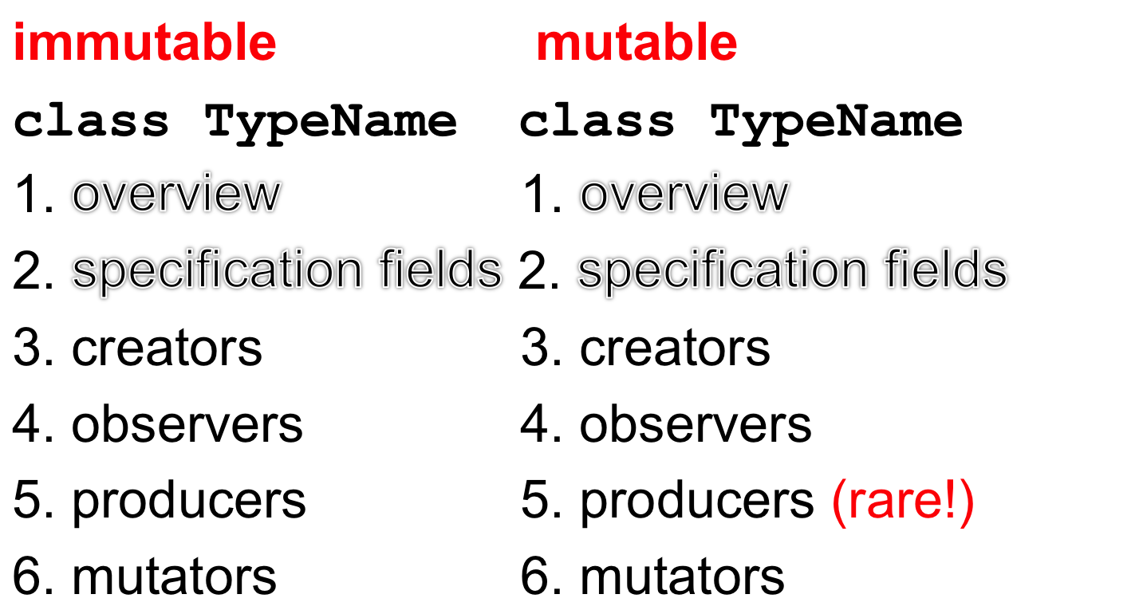
Specifying an ADT
Fall 15 CSCI 2600, A Milanova (slide by Michael Ernst)

Slide 6
Example: Python Datatypes
Tuples (e.g., (1,”John”)) Lists (e.g., [1,2])
are immutable are mutable
[j] [j]
len(t) len(l)
[j:k] [j:k]
+ +
* *
l.append(e)
l.reverse()
Fall 15 CSCI 2600, A Milanova

Slide 7
Why ADTs?
Bridges gap between domain concept and implementation
Formalizes domain concept. We can reason about correctness of the implementation
Shields client from implementation. Imple-mentation can vary without affecting client!
Fall 15 CSCI 2600, A Milanova

Slide 8
Reasoning About ADTs
ADT is a specification, a set of operations
  E.g., contains(int i), add(int i), etc., (the IntSet ADT)
  add(Poly q), mul(Poly q), etc., (the Poly ADT)
When specifying ADTs, there is no mention of data representation!
When implementing the ADT, we must select a specific data representation
Fall 15 CSCI 2600, A Milanova
Notes:
So far our main concern was to SPECIFY THE ADT.

Slide 9
Implementation of an ADT is Provided by a Class
To implement the ADT
  We must select the representation, the rep
  Implement operations in terms of that rep
  E.g., the rep of our Poly can be
  a) int[] coeffs or
  b) List<Term> terms
Choose representation such that
  It is possible to implement all operations
  Most frequently used operations are efficient
Fall 15 CSCI 2600, A Milanova (modified from Michael Ernst, UW)
Notes:
But which ones will those most frequently used operations be???

Slide 10
Connecting Implementation to Specification
Representation invariant: Object → boolean
  Indicates whether data representation is well-formed. Only well-formed representations are meaningful
  Defines the set of valid values
Abstraction function: Object → abstract value
  What the data structure really means
    E.g., array [2, 3, -1] represents –x² + 3x + 2
  How the data structure is to be interpreted
Fall 15 CSCI 2600, A Milanova (based on slides by Michael Ernst)
Notes:
But how do we know that our implementation is correct?

Slide 11
IntSet ADT
/** Overview: An IntSet is a mutable set
* of integers. E.g., { x₁, x₂ , … x_{n} }, {}.
* There are no duplicates.
*/
// effects: makes a new empty IntSet
public IntSet();
// modifies: this
// effects: this_{post} = this_{pre} U { x }
public void add(int x);
// modifies: this
// effects: this_{post} = this_{pre} - { x }
public void remove(int x)
// returns: (x in this)
public boolean contains(int x)
// reruns: cardinality of this
public int size()

Slide 12
One Possible Implementation
The representation (the rep)
class IntSet {
private List<Integer> data
= new ArrayList<Integer>();
public void add(int x) { data.add(x); }
public void remove(int x) {
data.remove(new Integer(x));
}
public boolean contains(int x) {
return data.contains(x);
}
public int size() { return data.size(); }
}
Notes:
NOTE: What can go wrong with this implementation?

Slide 13
The Representation Invariant
s = new IntSet();
s.add(1); s.add(1); s.remove(1);
The representation invariant tells us what’s wrong with this code:
  class IntSet {
  // Rep invariant:
  // data has no nulls and no duplicates
  private List<Integer> data; …
Fall 15 CSCI 2600, A Milanova

Slide 14
The Representation Invariant
States data structure well-formedness
  E.g., IntSet objects, whose data array contains duplicates, e.g., [1,1], are not well-formed
Must hold before and after every concrete operation!
Correctness of implementation depends on it
Fall 15 CSCI 2600, A Milanova

Slide 15
The Representation Invariant
class IntSet {
// Rep invariant:
// data has no nulls and no duplicates
private List<Integer> data
= new ArrayList<Integer>();
public void add(int x) {
data.add(x);
}
// Rep invariant may not hold after add!
}
Fall 15 CSCI 2600, A Milanova
Notes:
NOTE: How can we fix it?

Slide 16
The Representation Invariant
class IntSet {
// Rep invariant:
// data has no nulls and no duplicates
private List<Integer> data
= new ArrayList<Integer>();
public void add(int x) {
if (!contains(x))
data.add(x);
}
// If rep invariant holds before add, it
// holds after add too
}
Fall 15 CSCI 2600, A Milanova

Slide 17
The Representation Invariant
Rep invariant excludes ill-formed concrete values
  class LineSegment {
  // Rep invariant: !(x1 = x2 && y1 = y2)
  float x1, y1; // start point
  float x2, y2; // end point
  Conceptually, a line segment is defined by two distinct points. Thus, values with same start and end point (e.g., x1=x2=1, y1=y2=2), are meaningless. Rep invariant excludes them
Fall 15 CSCI 2600, A Milanova

Slide 18
The Representation Invariant
Rep invariant excludes ill-formed concrete values
  class RightTriangle {
  // Rep invariant: 0º < angle < 90º &&
  // base > 0 && base = hypot * cos(toRadians(angle))
  float base, hypot, angle;
  // Objects that don’t meet the above constraints are
  // not right triangles
Fall 15 CSCI 2600, A Milanova

Slide 19
Additionally…
Rep invariant states constraints imposed by specific data structures and algorithms
  E.g., Tree has no cycles, array must be sorted
Rep invariant states constraints between fields that are synchronized with each other
  E.g., degree and coeffs fields in Poly (if we choose the array data representation)
In general, rep invariant states correctness constraints --- if not met, things can go into terrible mess
Notes:
In addition…

Slide 20
Rep Invariant Example
class Account {
// Rep invariant:
// transactions != null
// no nulls in transactions
// balance >= 0
// balance = Σ_{i}transactions.get(i).amount
private int balance;
// history of transactions
private List<Transaction> transactions;
…
}
Fall 15 CSCI 2600, A Milanova (example due to Michael Ernst)
Notes:
These are correctness constraints.

Slide 21
Another Rep Invariant Example
class NameList {
//Rep invariant: 0 ≤ index < names.length
int index;
String[] names;
…
void addName(String name) {
index++;
if (index < names.length)
names[index] = name;
}
}
Where is the bug?
Fall 15 CSCI 2600, A Milanova (example due to Michael Ernst, UW)
Notes:
Think about the specific correctness property specified by the rep. invariant. (Actually, we have no other way of thinking about correctness, but specification and to lesser extent test cases!!!)
addName is wrong because it violates its specification, it does not preserve the rep. invariant.
Intuitively, we must show that if rep. invariant holds before addName, it holds after addName.

Slide 22
More Rep Invariant Examples
class Poly {
//Rep. invariant: degree = coeffs.length-1
// … and more …
private int degree;
private int[] coeffs;
// operations add, sub, mul, eval, etc.
}
_x0016_
class Poly {
//Rep. invariant:
//E(terms.get(i)) > E(terms.get(i+1)) …
private List<Term> terms;
// operations add, sub, mul, eval, etc.
}
_x0016_
Notes:
A Term is an object which contains the Rational coefficient and the int power.
The first abstraction function is: polynomial is the sum of coeffs[i]x^i for i ranging from 0 to degree-1.
The second abstraction function is: polynomial is the sum of the terms.
Each has advantages and disadvantages. What are they?
Advantage of first: easy to code polynomial arithmetic. Disadvantage: if polynomial has many zero terms in the middle, we will waste a lot of space. E.g., we will need an array of size 100 to represent the single term polynomial x^99.
Advantage of second: space efficient in the above case. Disadvantage: for “dense” polynomials, it is less space efficient. Also, implementing polynomial arithmetic is less trivial.

Slide 23
Representation Exposure
Suppose we add this operation to our IntSet ADT
// returns: a List containing the elements
public List<Integer> getElements();
Suppose we decide on the following implementation
public List<Integer> getElements() {
return data;
}
What can go wrong with this implementation?
Fall 15 CSCI 2600, A Milanova

Slide 24
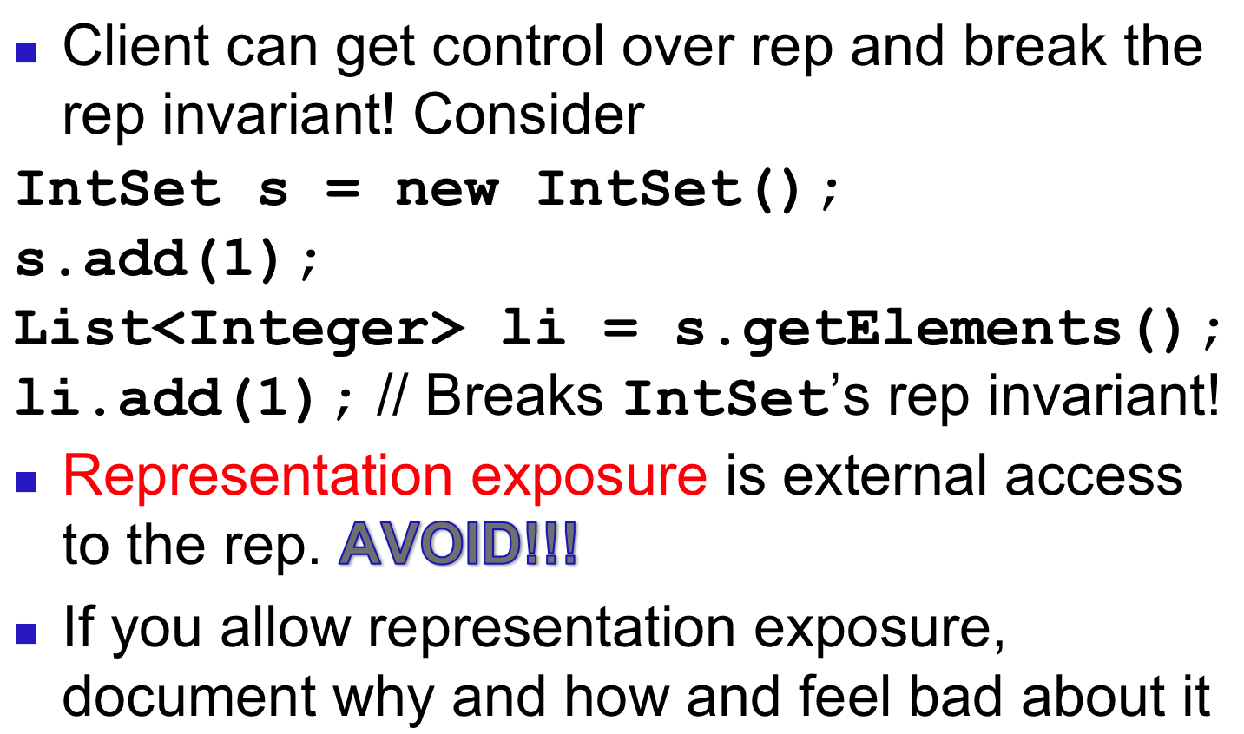
Representation Exposure

Slide 25
Representation Exposure
Make a copy on the way out:
public List<Integer> getElements() {
return new ArrayList<Integer>(data);
}
Mutating a copy does not affect IntSet’s rep
IntSet s = new IntSet();
s.add(1);
List<Integer> li = s.getElements();
li.add(1); //mutates new copy, not IntSet’s rep
Fall 15 CSCI 2600, A Milanova

Slide 26
Representation Exposure
Make a copy on the way in too:
public IntSet(ArrayList<Integer> elts) {
data = new ArrayList<Integer>(elts);
…
}
Why?
Fall 15 CSCI 2600, A Milanova

Slide 27
Representation Exposure
How about this:
class Movie {
private String title;
…
public String getTitle() {
return title;
}
}
Technically, there is representation exposure
Representation exposure is dangerous when the rep is mutable
  If the rep is immutable, it’s ok

Slide 28
Immutability, again
Suppose we add an iterator
// returns: an Iterator over the IntSet
public Iterator iterator();
Suppose the following implementation:
public Iterator iterator() {
return new Iterator(data);
}
Fall 15 CSCI 2600, A Milanova

Slide 29
Immutability, again
class Iterator {
private List<Integer> theData;
private int next;
public Iterator(List<Integer> data) {
theData = data;
next = 0; _x0018__x0013_
}
public boolean hasNext() {
return (next < theData.size());
}
public int next() {
return theData.get(next++);
}
}
Fall 15 CSCI 2600, A Milanova

Slide 30
Checking Rep Invariant
checkRep() or repOK()
Always check if rep invariant holds when debugging
Leave checks anyway, if they are inexpensive
Checking rep invariant of IntSet
private void checkRep() {
for (int i=0; i<data.size; i++)
if (data.indexOf(data.elementAt(i)) != i)
throw RuntimeException(“duplicates!”);
}
Fall 15 CSCI 2600, A Milanova

Slide 31
Practice Defensive Programming
Assume that you will make mistakes
Write code to catch them
  On method entry
    Check rep invariant (i.e., call checkRep())
    Check preconditions (requires clause)
  On method exit
    Check rep invariant (call checkRep())
    Check postconditions
Checking rep invariant helps find bugs
Reasoning about rep invariant helps avoid bugs
Fall 15 CSCI 2600, A Milanova (based on notes by Michael Ernst)

Slide 32
Connecting Implementation to Specification
Representation invariant: Object → boolean
  Indicates whether data representation is well-formed. Only well-formed representations are meaningful
  Defines the set of valid values
Abstraction function: Object → abstract value
  What the data representation really means
    E.g., array [2, 3, -1] represents –x² + 3x + 2
  How the data structure is to be interpreted
Fall 15 CSCI 2600, A Milanova (based on slides by Michael Ernst)

