Slide 1
Chrome Concrete Architecture
uBlock Origin
CMPE 322 Assignment #2
Notes:
Dan

Slide 2
Introduction
Using Understand to analyze source code combined with our research on Chrome and our derived Conceptual Architecture for Chrome, we derived a Concrete Architecture for Chrome
In this presentation, we will:
Describe our Concrete Architecture and explain how it differs from our Conceptual Architecture
Review the concrete breakdown of a subsystem (& compare to conceptual)
Review the sequence diagram for a user logging in and saving their password (& compare to conceptual)
Briefly introduce our proposed feature for Chrome
Notes:
Dan 1. Good afternoon everyone. We're uBlock Origin, and we're here to present and discuss our proposed concrete architecture of Google Chrome.
2. (Introductions)
3. In this presentation, we will discuss how we used Undertand to analyze the source code of Chrome, compared these findings to what
was derived earlier in our conceptual architecture, and what was done to create our concrete architecture diagram you will be looking in the next 2 slides.
Other points of discussion will be:
-The differences between our Concrete and Conceptual Architecture,
-Reviewing the breakdown of a Concrete Architecture subsystem,
-Assessing a sequence diagram for a user logging in and saving their password
-And briefly introducing our proposed feature for Chrome

Slide 3
Derivation Process
We each downloaded the Understand file that Dayi provided
We split up our 6 subsystems and each group member analyzed which files they thought belonged in their subsystem
We then got together and compared our choices and philosophies
We decided there were two main ways to derive our concrete architecture
Add subsystems in attempts to match the dependencies in our conceptual architecture
Add files to match the intended purpose of each subsystem in our conceptual
We decided on the second option and re-iterated each subsystem and compiled into one architecture
Notes:
Zach

Slide 4
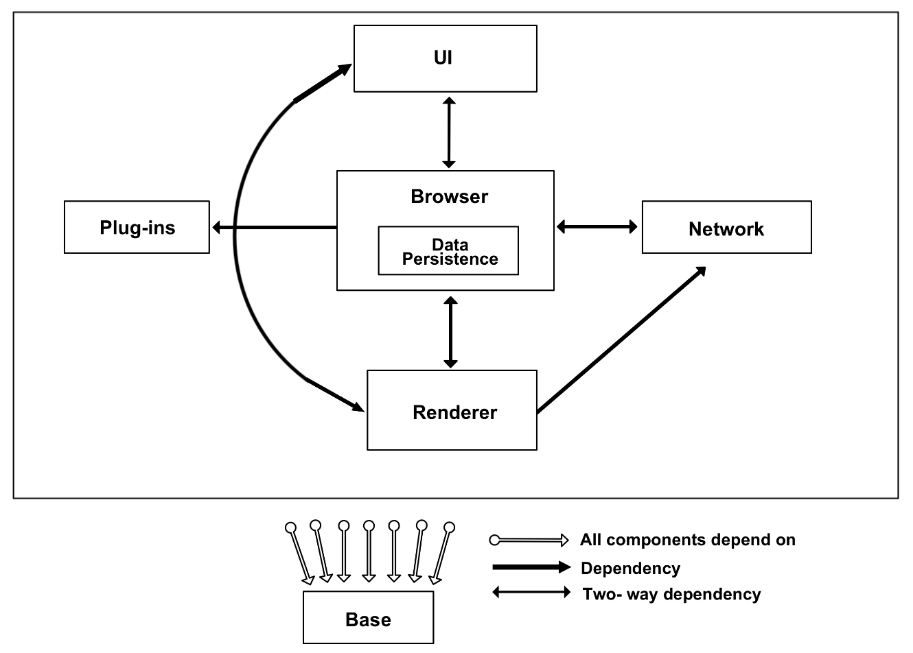
Concrete Architecture
Notes:
Heather
Derivation: We saw there were some with only 10 calls so we delved more into those to see what the calls were and whether we needed them
Object-Oriented & Implicit Invocation - after analyzing the source code, we no longer have a Layered structure
We grouped our

Slide 5
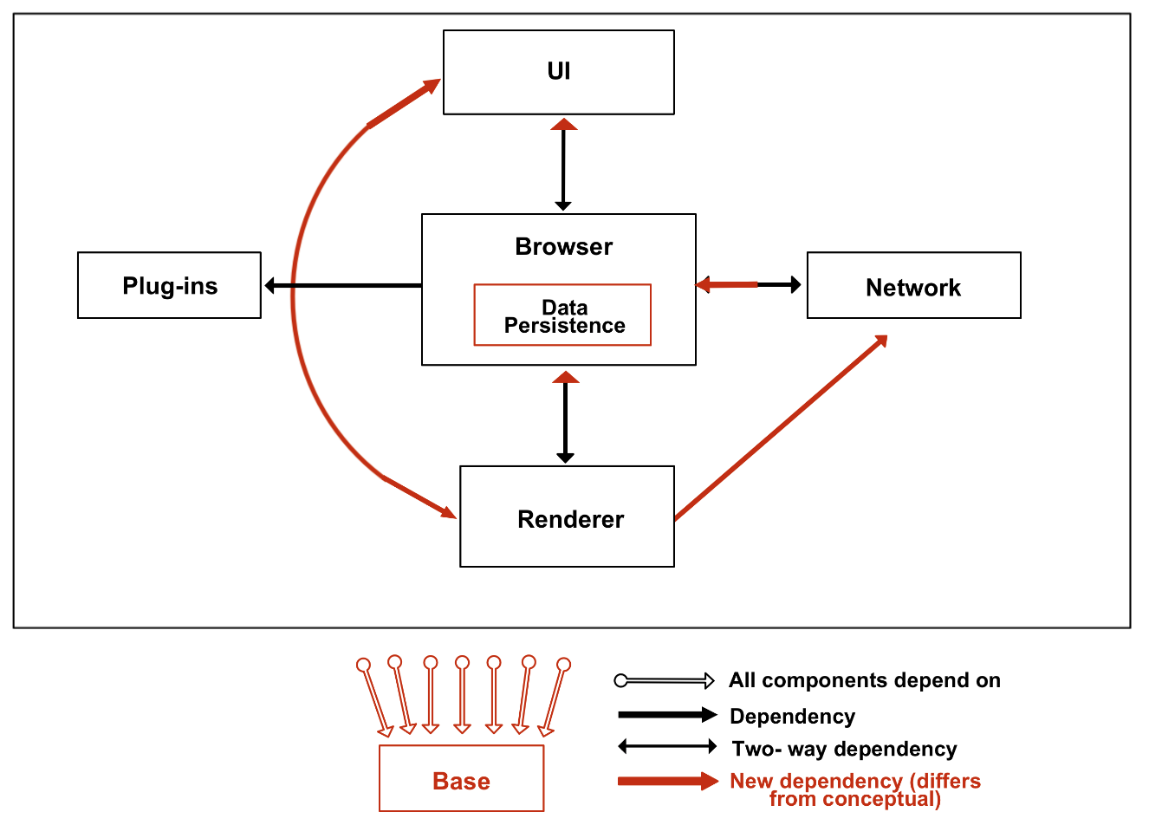
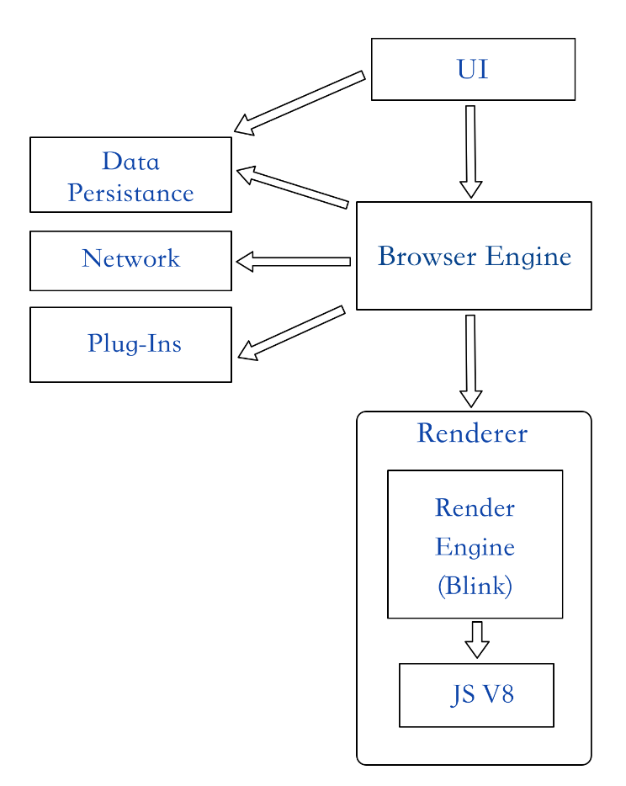

Compare Concrete and Conceptual
Notes:
Heather

Slide 6
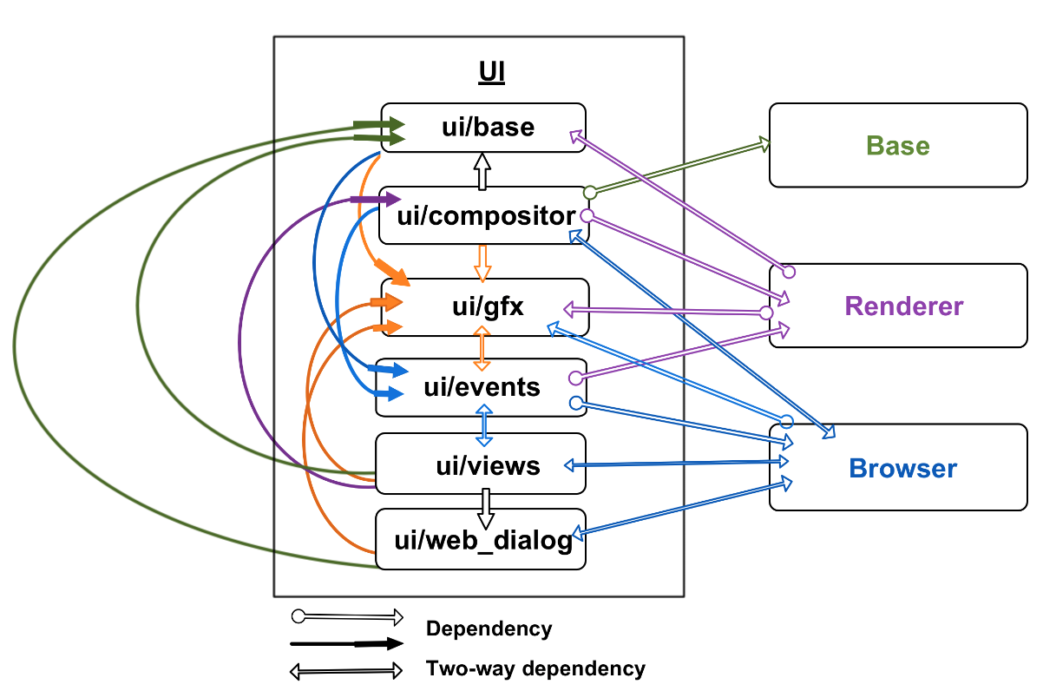
Concrete Subsystem Breakdown - UI
Notes:
In our UI architecture, modules were stacked to save space. However, it’s not layered as you can see internal 2 way dependencies between components within the UI. The whole UI has a dependency with the on the separate base entity. And it has 2 way dependencies with the renderer and the browser.
At the top of the UI arch we have ui/base which has a bunch of base classes implemented in every window such as layout, fullscreen and base_window.
Next is the ui/compositor which is a compositing window manager that provides applications with an offscreen data buffer for each window.
Next is ui/gfx which has a lot of code related to rendering graphics on the screen such as canvas, font, the animation folder.
Next is ui/events which contain files for handling events such as the event_handler and the event_dispatcher. Similar to the event entities we had in our conceptual which you’ll see in the next slide.
Next is the ui/views. Views is responsible for rendering, event handling and the screen layout.
Finally we have ui/web_dialoge which is responsible for for displaying the URL contents in a web modal dialogue.
And as you can see there is many internal dependencies within the UI.
Other submodules exist in the UI, but we selected to show one’s with main external dependencies(most function calls) to Browser and Renderer, and those which provide “key” UI functionality

Slide 7
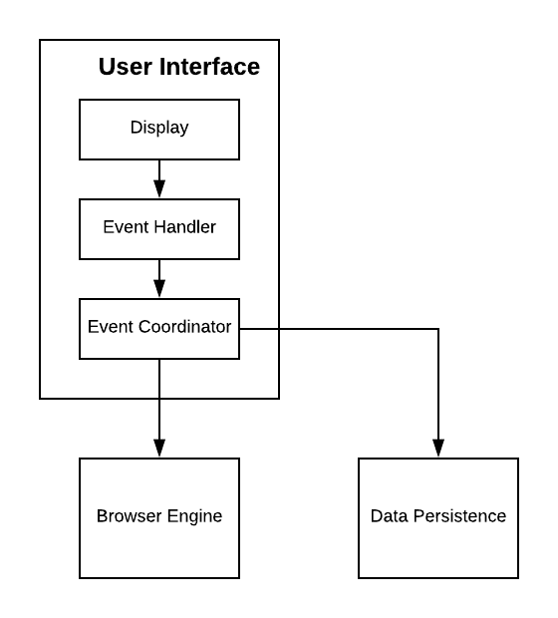

Compare Subsystem Breakdowns
Conceptual UI
Concrete UI
Notes:
Comparing it to our conceptual you can see it’s a lot more complex of a diagram. Conceptual relies on Display which would be similar to ui/views and then our event handler and event coordinator would be the ui/events. Our conceptual architecture implies that the event coordinator would outsource the events and tasks to the browser.

Slide 8
Compare Concurrency - Conceptual and Concrete
Services are divided into separate processes
Browser is responsible for spawning instances of renderer
Sites are divided using Site Isolation
Threads are used to split I/O and main processing
Sequences used instead of locking mechanisms
Notes:
Nic
-Previous concurrency model has remained the same even after delving into the concrete architecture.
-All of Chrome’s services are separated into sandboxed processes to limit and control their communication for robustness and security
-The browser-renderer relationship is a one-to-many, with browser spawning renderers for groupings of tabs using a model called Site Isolation
-The Site Isolation model enforces that only tabs on the same site can be grouped together within the same process. However, tabs on the same site can be grouped in different tabs as long as pages that can script each other are grouped in the same process
-Threads are used to split I/O and processing operations. The rationale is that if expensive processing and I/O is being done on the same thread, that processing can block the I/O from occuring, making it unresponsive
-Finally, sequences are used to manage shared resources. A sequence is a set of tasks that are run one-by-one in posting order. These are preferred to locking mechanisms, as locking mechanisms could potentially hog important resources if they are being used for expensive computation

Slide 9
Concrete Concurrency Breakdown - Mojo and IPC
Mojo is a small suite of low-level IPC primitives
Used in Browser and Renderer but also in most sandboxed processes
Statically link against embedder target as embedders
Message pipes - spawned in browser and children, established using hash table
Track messages using IDs so they can be responded to later - can be handled by an interface
Use ServiceRegistry to expose services
Notes:
Nic
-However, looking into the concrete architecture has revealed a lot about the actual systems used to support this concurrency model
-One of these systems is Mojo. Mojo is the library that Google has developed to facilitate inter-process communication, and there’s an ongoing effort to replace any legacy IPC in Chrome with this system
-The main purpose of this library is to provide IPC primitives, an interface description language, and a bindings generator that uses this IDL
-This set of primitives consists of message pipes, data pipes, and shared buffers, and Google has built a higher level API on top of these to simplify their usage, and these are used extensively in the browser and renderer
-Many of Chrome’s processes are linked statically to an “embedder” target within the mojo library and call Mojo’s init() method to initialize the Mojo Core
-Once processes have initialized the Mojo core, they can instantiate interfaces to other processes using code created by the IDL and bindings generator, and their endpoints are stored in a hash table, which is quite low cost memory and time wise
-Messages are also assigned IDs so that incoming messages can be queued and referenced and responded to later on
-Finally, the ServiceRegistry provides primitives service registration and connection interfaces

Slide 10
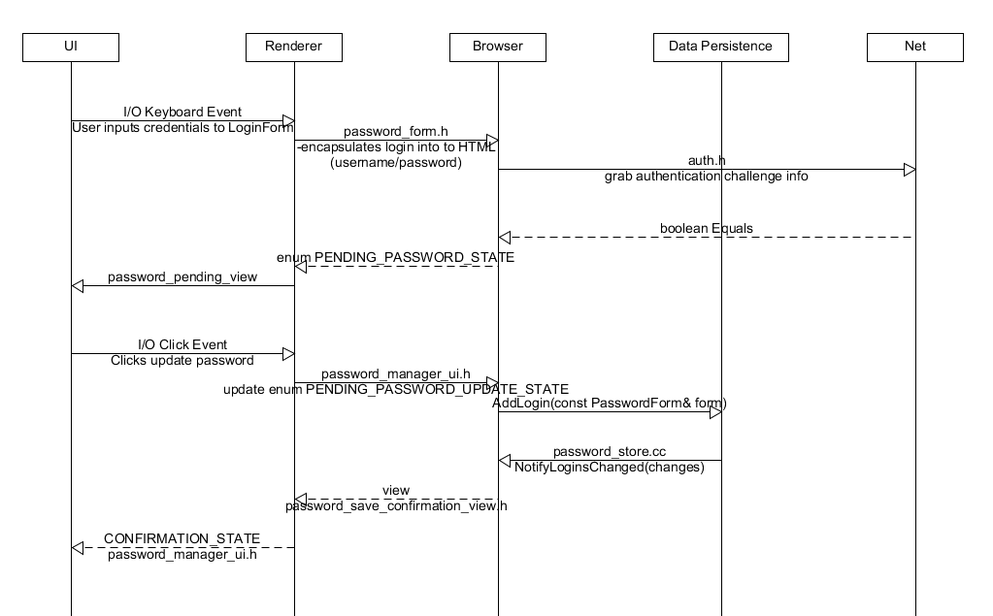
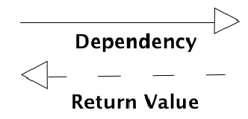
Concrete Sequence Diagram - User login/password save
Notes:
Zach/Darrien
Here we have the updated use case sequence diagram for a simple login that we traced using the google chrome code browser.
As soon as the user inputs their credentials into the field, it triggers the keyboard I/O and the renderer encapsulates the information to be understood by the rest of the browser
Through the login handler living in the browser, a call is made to the network stack to authenticate the info and an equals method returns true if the credentials are correct
If the user wants to save their password for the future, the browser will update to pending_password_state and the renderer will lay out the pending view to the UI
When the user confirms the update, the update state is triggered in the password manager and the credentials are stored on the disk using Add login method.
The return notifies the manager of the changes made and a view is displayed by the renderer onto the UI to indicate confirmation.

Slide 11
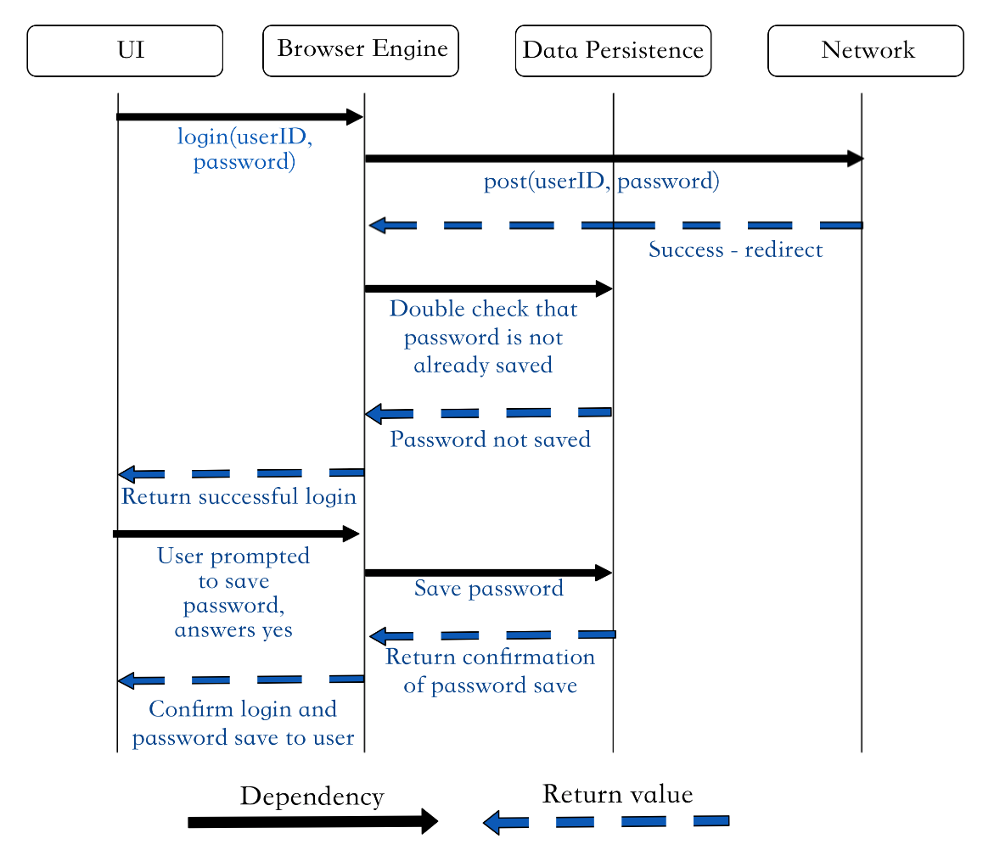
Compare Sequence Diagram - User login/password save
Notes:
Zach/Darrien
Access to the source code allows for us to get a more in depth look at the individual function calls and variables being used by password manager
Allowed us to see the role of renderer,

Slide 12
Proposed Feature for Assignment #3
Chrome Night Mode:
Subsystems involved: UI, Renderer, Browser (Data Persistence)
Allow the user to toggle the Chrome window theme and page content colours between the standard light mode, and a new dark mode
Invert Chrome’s application window colours (toolbar, windows, etc) - UI
Invert Webpage colours while user browsing - Renderer (changes colour formatting)
User’s can save night mode as a preference for certain sites or for schedule for a certain times of day, using Data Persistence
Notes:
Zach

Slide 13
Lessons Learned + Limitations
Learning to use Understand
Difficult to verify one-way dependencies when actual architecture has few subsystems with many two-way dependencies
Limited processing power of machines resulting in program crashes
Team communication for mapping architecture changes
Understanding Chromium’s codebase
Time constraints with research + deriving concrete architecture
Large (mature) software systems are hard to keep organized as updates are applied
Notes:
Dan
When we were learning to use, or "Understand" Understand, we found it was difficult to
verify any one-way dependencies claimed in our conceptual architecture, due to the staggering amount of two-way dependencies
from the subsystems in the minimized chrome directory.
The limited processing power of our own machines caused hardware limitations when assessing Chrome's codebase. The program hanged for virtually all
significant actions, such as viewing a butterfly dependency diagram of a particular subsystem, and often crashed when trying to
expand upon dependencies of architecture subsystems.
Expanding upon our group looking into Chrome, time constraints were a major limitation for the project, due to the massive size of the Chrome codebase
What we implemented to remedy this issue was being consistent in labelling and mapping of the files we were working with. We iterated through a single
Understand file, and group members verified the subdirectory contents of each assigned subsystem before moving forward
with deriving the concrete architecture. Relevant files and function calls were delegated to a sub-team for further inspection and iteration prior to generating the sequence diagram.

Slide 14
Conclusions
Source code revealed discrepancies from the conceptual arch.
Exploring concrete subsystems uncovered various overlooked dependencies.
Concurrency model allows single browser process to spawn multiple renderer processes.
Uses the Mojo library to facilitate IPC.
UI is responsible for the layout of browser windows.
The subsystem interacts with the Browser, Renderer and Base modules.
Biggest Limitations:
Hardware
Understanding the vast codebase
Learned: Hard to conclude unidirectional dependencies and hard to organize code efficiently
Notes:
Darrien

