Slide 1
Chrome’s Proposed Feature
uBlock Origin
CMPE 322 Assignment #3
Notes:
Dan

Slide 2
Presentation Overview
Introduction
Proposed Feature
Feature Derivation Process & Proposed Alternatives
Implementation Considerations
Implementation Approach
SAAM Analysis
Quality Requirements
Testing and Assessing Feature Success
Stakeholder & Architecture Impacts
Use Case/Sequence Diagram
Risks and Limitations
Team Issues Concurrency
Lessons Learned & Limitations
Conclusion
Notes:
Dan

Slide 3
Introduction
In our previous presentation, our team lightly discussed a proposed feature concept for Chrome
Today, we will review our proposed feature (along with alternative concepts), while evaluating potential implementation approaches, architectural impacts, and use cases of the feature
Other points of discussion include Chrome development team issues and impacts on the concurrency model
Notes:
Dan
-In our previous presentation, we briefly mentioned our plan to discuss a possible implementation of Night Mode for Chrome.
-In this presentation, we will be reviewing our proposed feature, alternative approaches that we discussed (through SAAM Analysis and Architecture/Stakeholder Impacts) and why we chose our particular implementation approach.
-Other points of discussion include current Chrome development team issues on their own implementation of Night Mode, Impacts on the concurrency model of Chrome, and our lessons learned from working on A3.

Slide 4
Proposed Feature - Night Mode
In MacOS Mojave, Apple introduced support for system-wide application dark modes
When the operating system toggles the dark mode on/off, all supported applications transition between light mode and dark mode automatically
Currently, Chrome’s default theme uses a bright, light colour palette
Our team proposes the following:
That Chrome’s UI be adapted to support MacOS’ new native dark mode
That Chrome implement support for a “smart invert” feature when rendering a website, to provide night mode support on websites that use a light theme
Notes:
Zach

Slide 5
Feature Derivation Process & Proposed Alternatives
The team spent a meeting brainstorming potential feature concepts that could be the focus of Assignment 3
Other feature concepts that were considered included:
Tab suspension
Browsing continuity between devices
Automatic cache clearing
These feature concepts either were already implemented natively in Chrome, or were experimental features
Upon discovering this, the team decided to move forward with the night mode concept
Notes:
Nic
-Team met up and brainstormed different possible features, drawing from our own experiences with Chrome to come up with features we’d like to see
-The three we initially came up with were tab suspension, browsing continuity between devices, and automatic cache clearing
-All of these were implemented or experimental features
-Tab suspension already exists, and can be enabled/disabled by setting a flag
-Browser continuity exists by syncing using a google account
-Automatic cache clearing does not exist, but can be set to clear the cache on closing Chrome
-Because of this, the team decided to go ahead with our 4th option, which is a night-mode. While this is partly an experimental feature, as the chrome team is trying to integrate with Operating System’s dark modes such as the MacOS dark-mode, our proposed feature also works standalone

Slide 6
Implementation Considerations
Extension was considered
Two source code-modifying options
Options differ in how they modify websites’ colours
The first will modify render methods to apply a colour filter
The second will use a dark-theme-compatible CSS provided by websites
One will make changes to the UI, Browser, and Renderer, while the other makes changes to the UI and Browser
Notes:
Zach
-Thought about extension, but does not touch source code
-Final two plausible ones were google tag thingy and having dynamic colour replacement in renderer

Slide 7
Implementation Approach
Modify UI/Browser to add in a toggle (UI) for turning Night Mode on/off
When the toggle is flipped, UI updates the user’s profile flag (Data Persistence and Browser) to Night Mode, and assuming they are logged into their Google account, the user’s preferences are updated and synced (Network) to make Night Mode default
When a web page is loaded, Renderer parses the page’s CSS and changes the site’s colours via a HEX inversion
Notes:
Zach
User’s toggles on night mode
Change Profile flag to Night Mode and save in the user’s preferences (in Browser)
Renderer parses the CSS code and changing webpage hex colours

Slide 8
SAAM Analysis of Implementation Approaches
Derived Non-Functional Requirements and Quality Attributes that would make Night Mode a success
Compared advantages and disadvantages of both implementation approaches
Propose some testing opportunities that prove Night Mode’s success
Discuss impacts on Shareholders
Notes:
Heather (SAAM Overview)
The main activities involved in the SAAM are enumerated below.
Characterize a canonical functional partitioning for the domain.
Map the functional partitioning onto the architecture’s structural decomposition.
Choose a set of quality attributes with which to assess the architecture.
Choose a set of concrete tasks which test the desired quality attributes.
Evaluate the degree to which each architecture provides support for each task.

Slide 9
Quality Requirements for Night Mode
Performance : Chrome Night Mode should load web pages within 90% of regular load speed
Stability : Enabling Night Mode should not sacrifice Chrome’s stability and should not cause it to crash for any reason
Availability : Night Mode should have automatic failure detection and restart while browsing data is recoverable from Browsing History. 100% available during the hours of 4pm-7am
Maintainability: Tests and Updates should run when necessary during off-peak time of 7am-9am to maintain optimal performance
Notes:
Heather
We need storage for popular webpages so we don’t re-parse the code every time and do the colour inversion

Slide 10
SAAM compare implementation impact on requirements
Chosen Implementation
Advantages:
Better ability to test and optimize Performance
More Portable as web page source code changes consider all OS functionality
Guaranteed Availability between 4pm and 7am.
Disadvantages
More invasive source code modification which could have Stability ramifications
No developer input on site appearance
Could cause inconsistencies, loss of text/image visibility, etc.
Alternative Implementation
Advantages:
More Modifiable because no regular updates required by the Chrome team
Likely favoured by site owners and developers as they can choose their own Night Mode features & degree of adoption
Disadvantages
Heavily reliant on website developers to implement Night Mode on their sites which means:
No way to monitor Maintainability
No guarantee on Availability
Notes:
Heather

Slide 11
Testing and Assessing Night Mode Success
Compare our native Night Mode implementation to current Chrome using User A/B testing
Examine effects on eye strain
Survey for preference of using Night Mode feature
Run general timing test for Performance of Night Mode feature addition then compare to current Chrome
Navigate to webpage and compare timing test for loading the page
Try using in parallel with other applications/extensions and compare its performance
Notes:
Heather

Slide 12
Stakeholders Impacts
Pros:
Stakeholders include users who are in favour of the night mode optionality
Seeing as the implementation would be a unique feature for browsers, the feature would probably bring more users, more ad revenue, more browsing action and maybe intangible assets to the company’s balance sheet which is beneficial for Google executives and Google shareholders.
Cons:
Would be challenging and time-intensive for Chrome developers to better support the Night Mode implementation
Advertising and marketing design products specifically to tick various boxes in human psychology and aesthetics and dark mode could force them to change this balance
Notes:
Darrien

Slide 13
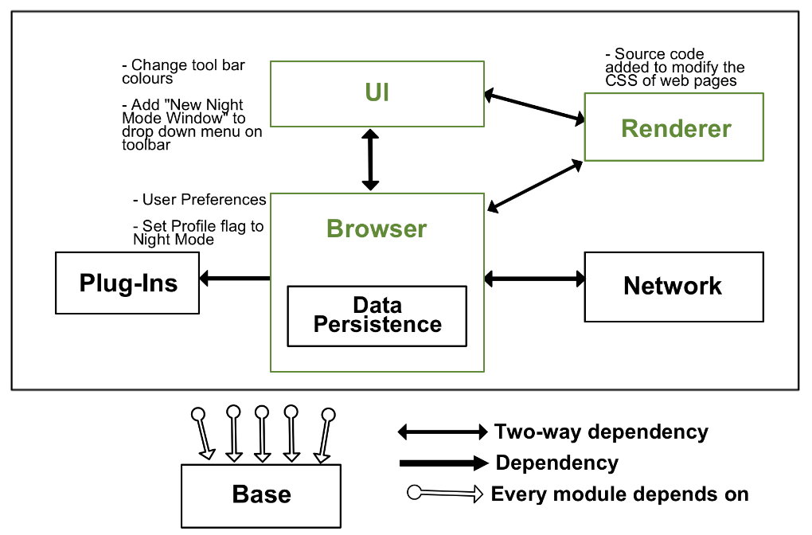
Impacted Architecture Subsystems
Notes:
Nic (UI)
Heather (Browser)
Overview (Nic)
The impacted subsystems from our revised conceptual architecture are the UI, Browser and Renderer, and the architecture remains object-oriented and implicit invocation, as we did not add any additional modules or introduce new dependencies.
UI (Nic)
-One of the main files that would need to be edited is app_menu_model.cc, as this is the file responsible for generating the “More Options” menu. A label for toggling night mode must be added to this, and a command_id assigned to that label.
-browser_frame.cc must be modified, as this has the check for incognito to select the NativeThemeDarkAura. This is where the check for our profile flag will be made.
Heather (Browser):
The Browser handles user preferences in the Data Persistence sub-sub-system as well as tracks the user profile flags
Account_id_traits and account_id would need to be modified to
Kurt (Renderer)
In our Renderer: cc/layers is where we would make some alterations in order to implement our feature. We will implement a colour transform in layers which parses the css to do a hex inversion for the web page colour. Layers also contains the function: setBackgroundColour() which would use the new colour transform function in order to alter web pages.

Slide 14
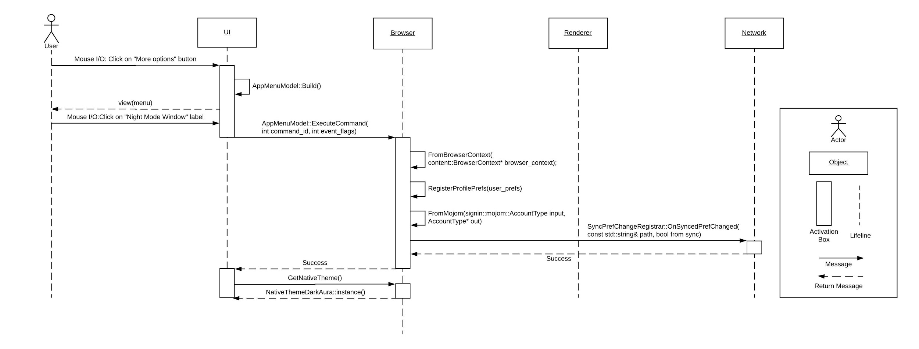
Use Case and Sequence Diagram - Toggle Feature On
Notes:
Nic
-This is a sequence diagram for the user toggling on night mode, assuming they are logged into a google account and they are not currently viewing any webpage
-The user clicks on the “More options” button. Within the UI, AppMenuModel::Build() is called to construct the menu and this is returned
-From this app menu, the user click the Night Mode Window label to toggle the feature
-Execute command is called from UI to Browser, passing the command_id of the night mode toggle
-The Browser context is retrieved using FromBrowserContent, which includes various user information such as their preferences.
-The preferences are modified and then saved locally using RegisterProfilePrefs. FromMojom check whether or not the user is signed into a google account. If they are, SyncPrefChangeRegistrar is called to the network stack to sync the preference change to that account
-Finally, GetNativeTheme is called, and since the night mode flag has been set, NativeThemeDarkAura is returned

Slide 15
Risks and Limitations of the Approach
Performance concerns
Additional code introduced in the render pipeline may inadvertently slow down the browser (similar to adblock)
Security concerns
Any additions to Chrome that deal with handling source code from a website must be vetted extensively for security purposes
May not work for every website
Not ever website is developed the same, and some websites may not be compatible with the approach used by the team to invert a website’s theme colours
Notes:
Kurt
A large risk that our team will face by implementing the new feature is the risk of compromising Chrome’s performance. By modifying a page before rendering we are adding work to be done by the browser, which can inevitably cause the chrome to load the webpage page slower than it would without Nightmode.
Another risk we will face by implementing our new feature is Security risk. When changing any source code in chrome we face the risk of being hacked or accidentally leaving google chrome vulnerable to cyber attacks.
A limitation our new feature is not being able to work on every website. Due to the many different kinds of webpages on the internet, our new feature may not be able to work with all of them. Some sites may intentionally not allow it’s web pages to be altered, which would leave our new feature useless. Basically, some sites just may not be compatible with our feature and thus our feature won't work on those sites.

Slide 16
Team Issues and Concurrency
Night Mode windows currently are too difficult to distinguish from Incognito Mode windows
Keeping up with rapid, daily releases of Chrome versions
Extension icons currently aren’t allowed to provide night or light mode modifications
Our feature is compatible with Chrome’s concurrency
Does not modify existing sandbox and IPC structure
However, the change to renderer will affect all instances of renderer
Notes:
Dan
-Incognito Mode window being too similar to Mojave Dark mode creates issues from a UX and Privacy standpoint
-Chrome team tried to get Dark Mode working for Chrome M70, but now have to push for a M71 release
Concurrency: Tab instance rendering is maintained (sandboxing), can concurrently browse on a night mode window and a regular window (due to Open New Night Mode Window entry)
Concurrency
-Does not affect Site Isolation, threading, or the sandboxing of processes, as our feature does not at all modify the fundamental structure of chrome and opts to try and use existing mechanics as much as possible
-However, since the dynamic colour replacing is a change to renderer, if there is a bug in our code it will affect all instances of renderer, so if this causes a fatal crash it has the capability of crashing all tabs

Slide 17
Lessons Learned & Limitations
Many considerations for color adjustment such as:
invert grayscale
invert all colors based on color wheel
Many different ways to implement the same feature:
Causes different impacts on NFRs
Uncovered in SAAM analysis
Team limited by busy schedules affecting meeting availability
Vast amount of source code to examine and modify
Notes:
Kurt
We learned that there are many ways to implement Nightmode in our browser - in terms of how we will alter the page. We considered inverting the greyscale which would only alter the whites and blacks of the webpage, leaving the colours alone.
Another approach was to invert all colours based on colour wheel which would affect every colour, not just the white and black.
Our team had to evaluate both approaches and decide which one would make a more effective Nightmode feature.
Another lesson we learned is that there are many different ways to implement the same feature - as in the functionality is the same, but with different ways to implement. Our team had to evaluate the implementations in a SAAM analysis and decide which implementation would be best in terms of how the systems Non-Functional Requirements would be affected from each implementation.
A limitation our team faced was the busy schedules of our team members in which we had to work around to schedule meetings. Due to heavy workload from other courses, there were few opportunities when everyone was available to meet.
Another limitation was the vast amount of source code we needed to examine and modify in order to implement the feature. We had to dig around a lot of source code to figure out how we would implement the feature. Due to the amount of chrome source code, we feel like there could have been other ways out there to implement the feature, however reading every line of source code is unrealistic in terms of our teams

Slide 18
Conclusion
Proposed Feature: Night mode with smart colour inversion features
Implementation options:
Apply a night mode filter to dynamically change CSS for all webpages
Utilize established CSS from dark theme enabled websites
The use of flags in the final implementation will allow for hybrid approach
Quality requirements: Performance, Stability, Availability, Maintainability
Impacted systems: UI, Browser, Renderer
Notes:
Darrien

