Slide 1


Chrome’s Conceptual Architecture
UBlock Origin
CISC/CMPE 322/326 Assignment #1

Slide 2
Table of Contents
Introduction
Proposed Architecture
Derivation Process
Subsystem Breakdown
Concurrency
Pros and Cons
Sequence Diagram (User logs in successfully, saves password)
Chrome Team Development Issues
Limitations
Conclusions
Notes:
Proposed slides:
Intro
Derivation process
Alternatives
Actual architeture
Walkthrough actual architecture
Subsystem
Concurrency
Team issues
Lessons learned
Conclusions

Slide 3
Introduction
Chrome is a free web browser created by Google for desktop and mobile devices
The Chrome browser is powered by Chromium, an open-source web browser project published maintained by employees at Google, and volunteer developers
Initially released in 2010, Chrome has gone through a number of functional and visual updates throughout the years
Presentation will focus on outlining the conceptual architecture behind the Chromium project
Notes:
Proposed slides:
Intro
Derivation process
Alternatives
Actual architeture
Walkthrough actual architecture
Subsystem
Concurrency
Team issues
Lessons learned
Conclusions

Slide 4
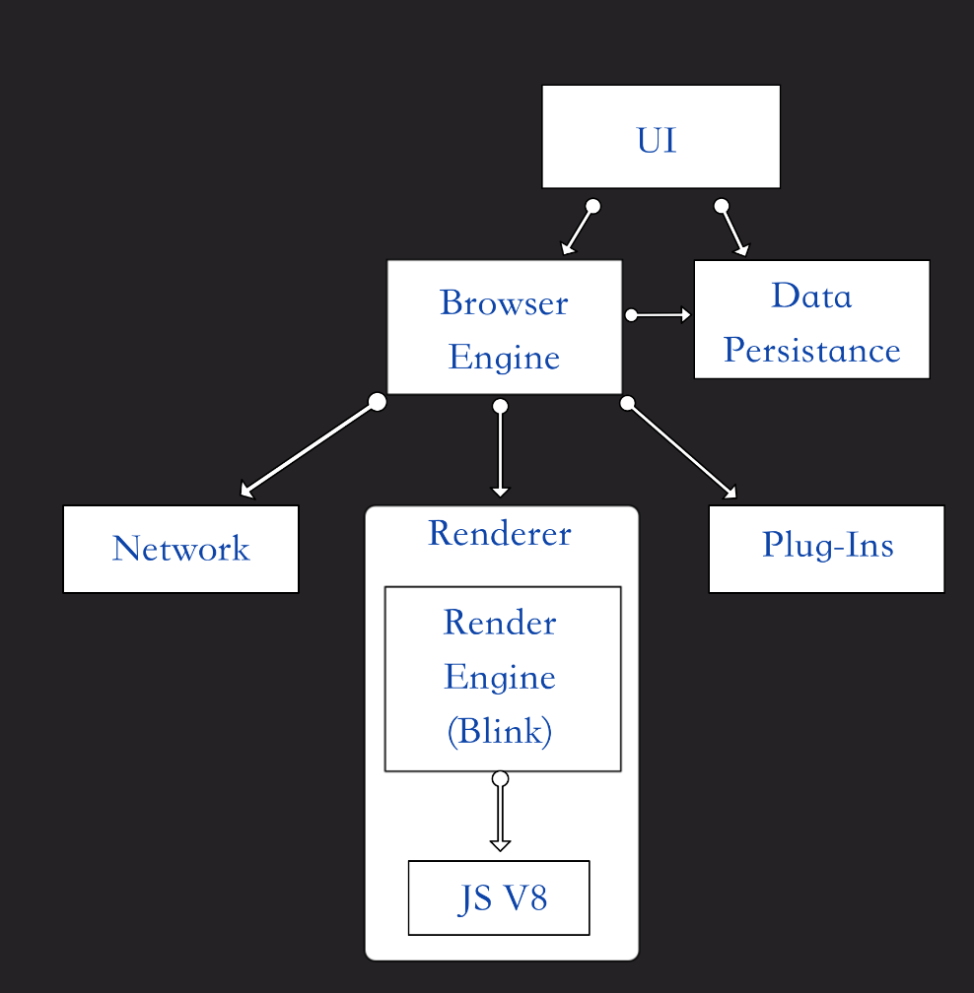
Proposed Architecture
Layered, Object-Oriented, and Implicit Invocation::
Layered
Structured dependencies
Listed in the documentation as layered
Object Oriented
Subsystems are encapsulated and invisible to other subsystems
Modules make explicit calls to other subsystems
Implicit Invocation
Any instance of a render process can receive routed messages by registering itself with the route
Notes:
Heather

Slide 5
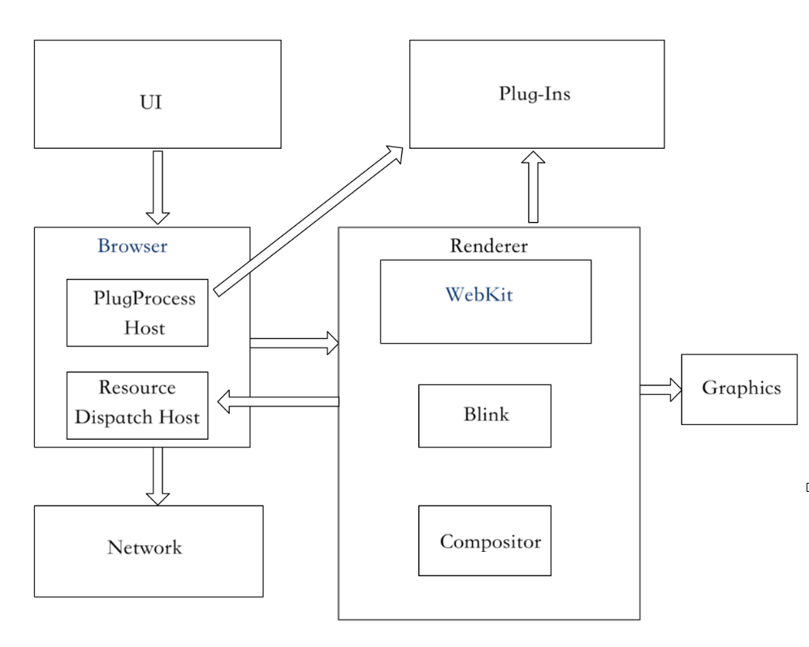
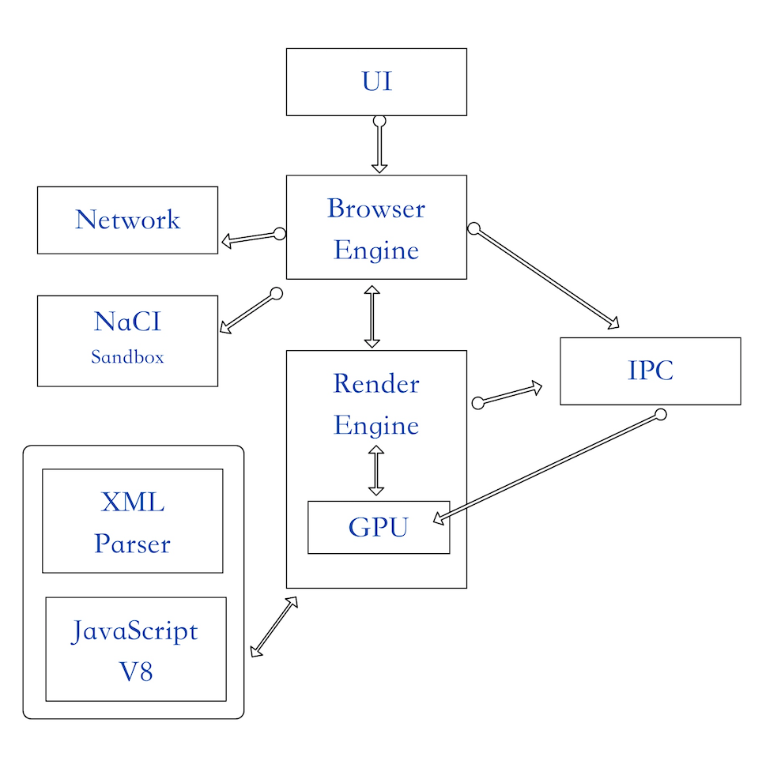
Derivation Process
Other architecture diagrams and subsystems considered:
Including a separate IPC module
Including graphics as a key module
Getting too granular
Renderer subsystems
Blink is the WebKit now & Blink handles XML parsing in the creation of the DOM tree process
Notes:
Heather
We thought of including a separate IPC subsystems, but upon further research, we decided to omit the IPC as a subsystems. We interpreted the IPC as a process controller invoked within each individual sub-system and it’s a form of transfer between systems. Therefore, it would more likely be represented as an arrow labelled by IPC.

Slide 6
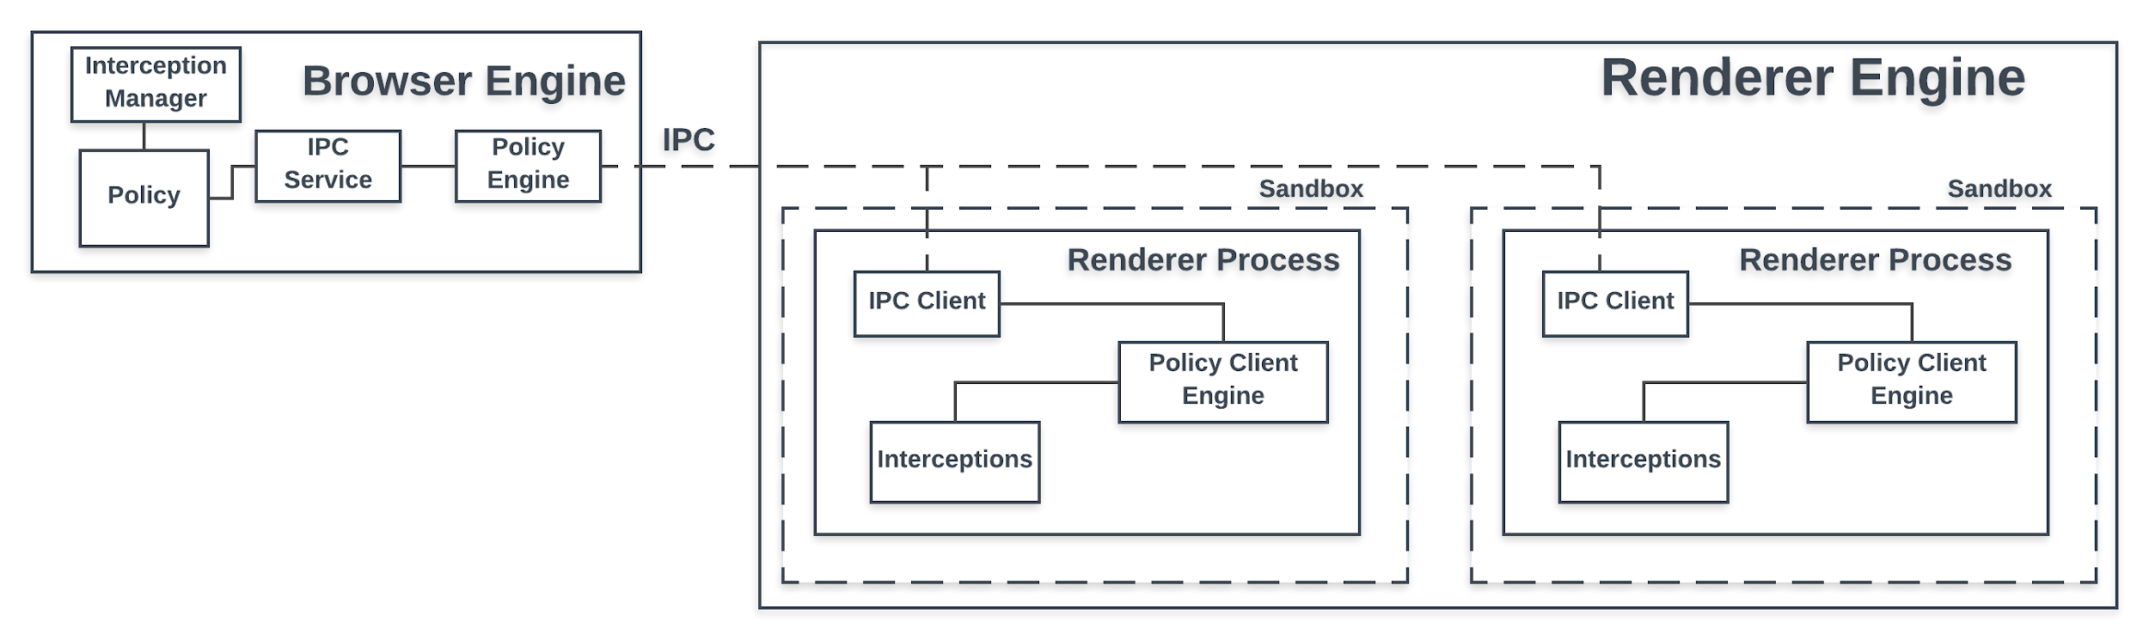
Subsystem Breakdown
Notes:
Dan and Kurt
IPC:
IPC facilitates communication between the browser and sandboxed processes in the render engine, which Kurt will provide an overview for
-IPC Uses a main I/O thread, with messages to/from the broker and target processes being proxied back to this main thread.
-rationale: resource requests and performance-critical processses can just be handled on this thread without negatively affecting the user interface
Each renderer process has thread that manages IPC communication to the browser engine. A named pipe is allocated for each renderer process,ran in asynchronous mode to ensure that neither end of the pipe is waiting for a response from broker or target.
Primary message types that are used in IPC are labelled "control" or "routed" messages.
Control messages are handled by the class that created the pipe,
Because the browser engine allocates pipes to the renderer processes, the browser engine naturally handles these types of messages.
an example of a control message is a request to modify the user's clipboard when copy-pasting.
Routing messages can either be communications between browser to renderer, or renderer to browser.
so either the browser or renderer engine can handle the message. An example of a routed message is a request for a view to paint a region of the user interface.
Sandboxing:
-Sandboxing is a security method used by our chrome browser
-Aim is to protect against malware from stealing sensitive information such as passwords
-Sandboxing works by keeping each website/tab as a separate process, isolating each process/tab from each other in their own “sandbox”
-Sandboxing is a layer of protection around each process running
-The design is to build a restricted environment around each process so that the sandbox can prevent malicious code on the unsafe website from causing further damage to your computer
-By containing the malicious code in the sandbox it doesn’t affect other processes running (tabs open) or affecting your machine/files
-It makes dealing with malware on sites very easy, since all you need is close the tab to get rid of the malware
-Sandboxing is a security feature that will be used on all web pages in our browser. As in each tab/process will get its own sandbox

Slide 7
Concurrency
Use multiple instances of renderer spawned by browser
Divided using Site Isolation (previously process-site-per-instance)
Same sites in one tab
Site Instances
Threading allows for an I/O thread and main processing thread
Keep from blocking UI
I/O threads generally used for IPC
Sequences used to avoid locking mechanisms
Notes:
Nic
-(As previously discussed?), Chrome built like OS in that its components are divided into separate processes. Browser spawns multiple, sandboxed instances of renderer, one for each grouping of tabs.
-The model used to group these tabs is called Site Isolation. This is a recent development to Chrome, replacing it’s previously long-standing process-site-per-instance model, although they are similar in many ways. This is a strict rule that maintains that only tabs on the same site can be grouped in the same process. However, tabs on the same site may be in separate processes, as long as pages that have the ability to script each other are grouped together (for instance, if clicking a link in one page opened a new tab on the same site using Javascript). These groups are known as Site Instances.
-Chrome is multithreaded; each chrome process has a main thread and I/O thread as well as few more special/general purpose threads. Separating out I/O and processing operations ensures that the UI thread is not blocked with any expensive processing operations and remains responsive. In the case of the browser and renderer processes, the browser has a main thread that updates the UI and an I/O thread for IPC and network requests, whereas the renderer has a main thread that runs most of blink and an I/O thread also for IPC.
-Developers are encouraged to use sequences. Sequences are a set of tasks that run one at a time in posting order, on whatever thread is available. These are preferred as they inherently provide thread-safety without having to use locking mechanisms, which could hog important resources if they are being used for expensive computation.

Slide 8
Chrome’s Concurrency: Pros and Cons
Pros
Improved Robustness
Improved Security
Cons
Memory overhead
Implementation complexity
Notes:
Nic
-Pros:
-Improved Robustness: Crashes and errors are isolated. Traditionally, browsers were one process, and one tab crashing would take down the whole browser. But on Chrome, for instance, you could be running a web application one one tab and reading a news article on another. The webapp crashes, but chrome stays open and you can continue reading the article. Additionally, if you go to the same site but in different instances, the site crashing one one page will keep the site open on another
-Improved Security: You go on a malicious site, and it tries to steal cookies or HTML5 data from another site open in your browser. Since sites are isolated from each other in different processes, the one site does not have enough access to other sites to steal this kind of data.
Cons:
-Memory overhead: Memory usage increased by 10-13% in Chrome 67 when Site Isolation was enabled by default. Even before this model, the process-per-site-instance still has more overhead than a single-process browser (interestingly enough, Chrome can be run as a single process browser by using a command-line flag, which is used to measure this overhead)
-Implementation complexity: Implementing this model is much more complicated than a single-process or a process-per-tab system. Fairly complex Logic is needed to switch a tab out of a process if the site is changed, and methods to implement some cross-site communication (such as cross-process Javascript) must be supported

Slide 9
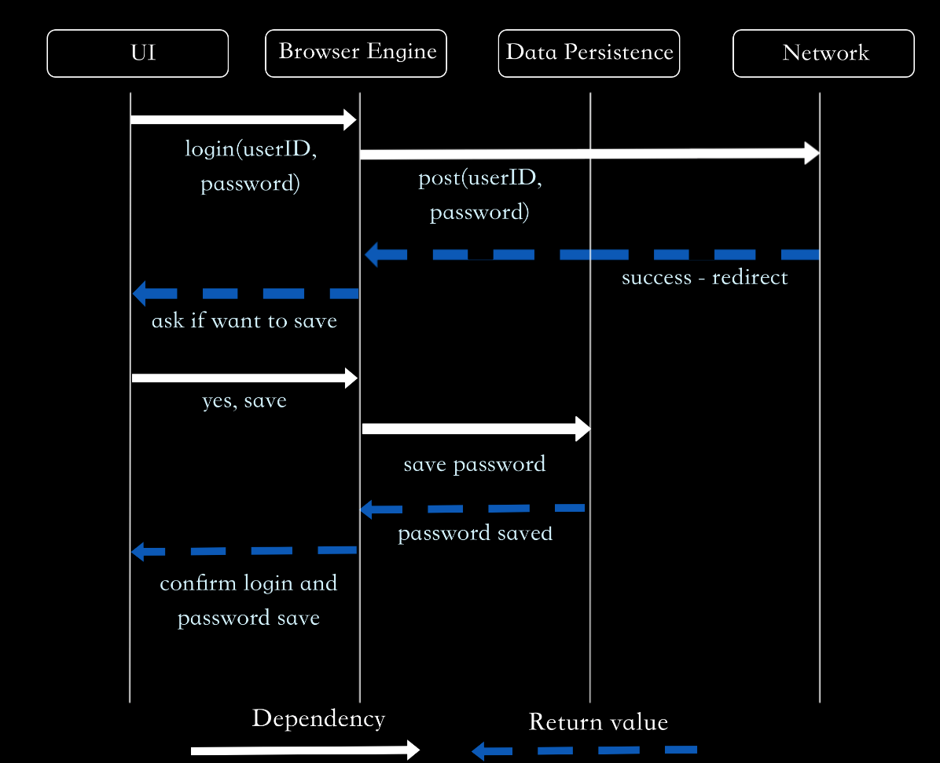
Sequence Diagram - User Logs in, Saves Password
User begins by interacting with the UI to enter their password
Browser Engine authenticates their login
User confirms they want to save their credentials on UI
Password is saved on the user’s machine through Data Persistence
Notes:
Zach

Slide 10
Chrome Team Development Issues
Chrome’s official documentation shows 10 subteams, but amount of top-level projects suggest more
Engineers can make changes to modules not under their assigned team
Chrome team doesn’t branch their code, only develops on trunk
As a consequence of this, teams are always working on most-current source
Because of all of the different subteams, integration tests get very complicated
All development happening on trunk means that code you are responsible for is more likely to be affected by changes pushed by other subteams
Notes:
Dan - Team Issues:
-Background for Development Issues
-Chromium team is divided into 10 subteams (https://www.chromium.org/teams)
Considering there are more than 20 top-level projects for chromium, and that there are no more than 5 people per team on the website... take w/ a grain of salt
Other engineers are allowed to make other changes in the chromium system that may or may not be outside of the team that they are assigned to, just have to ask for permission
-Chromium development doesn't actually branch its source code during development
Chromium releases every day
-any branches that would be merged into chromium would make for painful integration testing, due to the how different trunk would be at the time of merging
-only makes short-lived maintenance branches before a beta release
(Former Chrome Engineer - https://medium.com/@aboodman/in-march-2011-i-drafted-an-article-explaining-how-the-team-responsible-for-google-chrome-ships-c479ba623a1b)
-While there are different teams that work on different components of the project,hey are always working on the most recent version.
-Some issues with development given division of responsibilities: Having so many different subteams, and with people making different changes to the codebase of such a large,
acynchronous multi-process architecture mean that integration tests get very complicated.
-Tests with even a 1% failure rate can cause multiple failures a day due to the complexity and scale of Chrome
-Because of everything being on trunk, this means that changes outside of your team's responsibilities are easily affected by changes from others working on different modules

Slide 11
Limitations
Limited by the amount of publicly available information
Dated information - a large amount of the Chrome/Chromium documentation hasn’t been updated for 5+ years
Lack of first hand information - many papers and documentations are interpretations
Few Chrome developers have publicly published the Chrome development process
Restricted by only reading documentation - deeper understanding of the software can be obtained upon reading source code.
Notes:
Darrien

Slide 12
Conclusions
Chrome is a layered, object-oriented, and implicit invocation architecture scheme
Site isolation and threading allows concurrency
Sandboxed renderer processes communicate with the browser engine via IPC
Several limitations in the derivation process
Outdated documentation
Lack of first hand information
Surface level analysis of the software (no code)
Notes:
Darrien
Layered because of the distinct hierarchical dependencies (also listed in documentation)
Object oriented because encapsulated subsystems and modules make explicit calls to each other.
Most documentation from 2013/2014
Lack of first hand information because devs do not publish process and requirements are high to be a dev: 10-20 non trivial commits and reviewed to be approved
IPC handles multiple Chromium processes communicating with each other, and is how sandboxed processes in the renderer engine can communicate with the browser engine
Sandboxing is a security feature that isolates processes from each other so security threats can’t affect other processes or the computer

