Slide 1
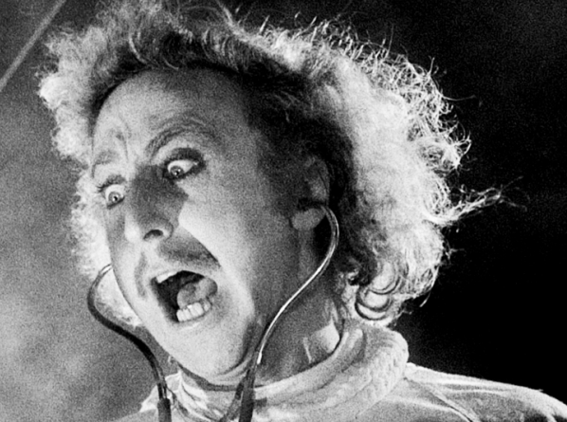

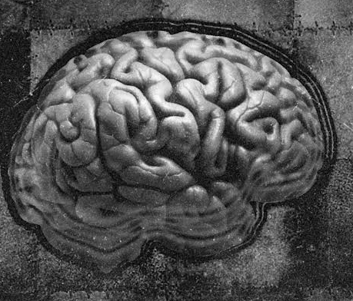
Method or Madness?
The Science of Psychology
Dr Kelsey Zimmermann

Slide 2
Who is taking this unit?
Psychology students
Non-psychology students
Students in Year 1, Year 2, and Year 3
There will be something for everyone!

Slide 3
Why take this unit?
Learn about the fun stuff!
Improve your scientific literacy
Critically evaluate current topics in “Pop Psychology”

Slide 4
Who is teaching this unit?
Dr Kelsey Zimmermann (coordinator)
A/Prof Simon Boag
A/Prof Ian Johnston
A/Prof Celine Van Golde
Dr Caleb Owens
Dr Daniel Costa
Mr James Brown
A/Prof Rebecca Pinkus
A/Prof Micah Goldwater

Slide 5
Unit Structure
Online content (lectures, readings, recorded interviews, debates, etc)
  Content (including access to assessments) will be released each Monday on Canvas
In-person tutorials
  Navigating and exploring scientific literature
  Discussing weekly content
Attendance requirement!
You must attend >50% of the tutorials! (Minimum of 6 out of 11)

Slide 6
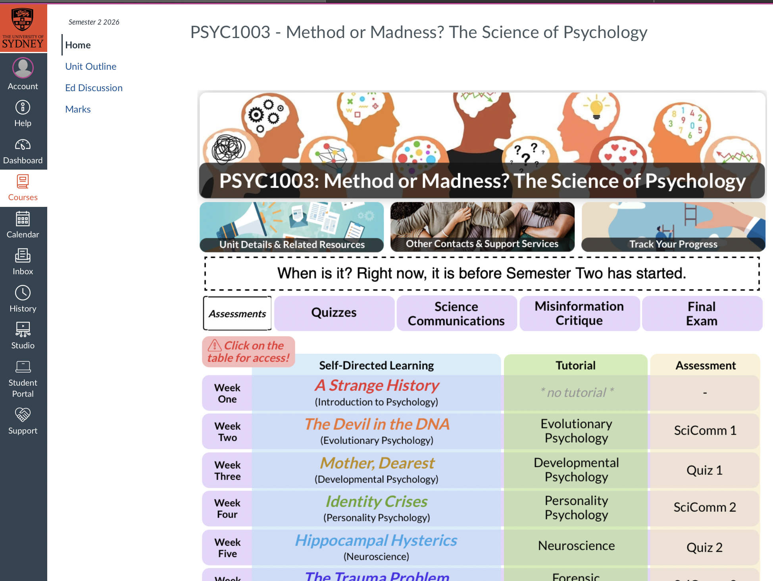
Accessing Content on Canvas

Slide 7
Assessments
Small weekly assessments due each week except Week 1, Week 9, and Week 13
  Multiple Choice Quizzes (3% each)
  Discussion Forums (2% each)
Two major assessments
  Misinformation Critique (25%) – Week 9
  Final Exam (50%) – Exams Period

Slide 8
Accessing Content on Canvas

Slide 9
Ed Discussion!

Slide 10
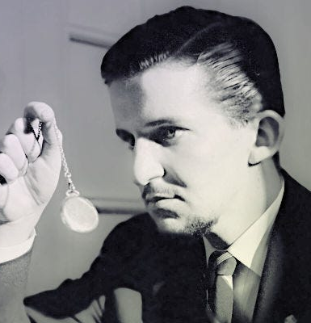
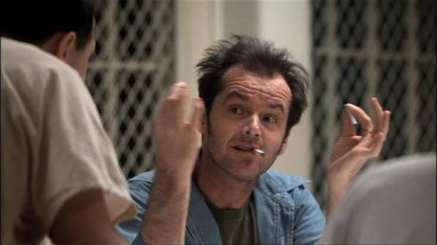
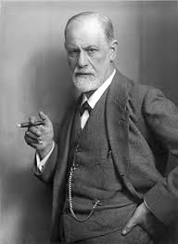
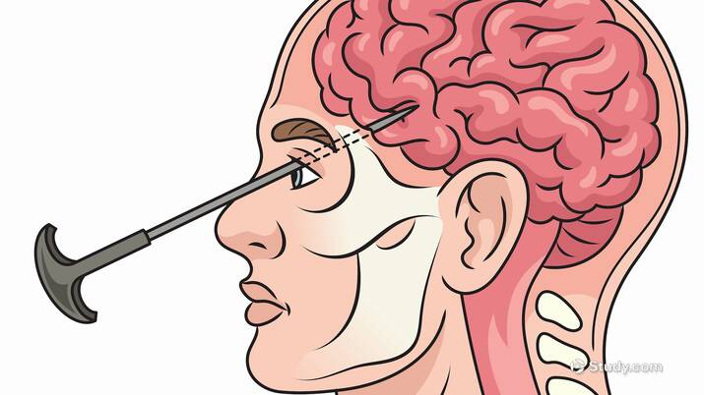
Week 1
A Strange History:
Ice Picks and Hysterics

Slide 11
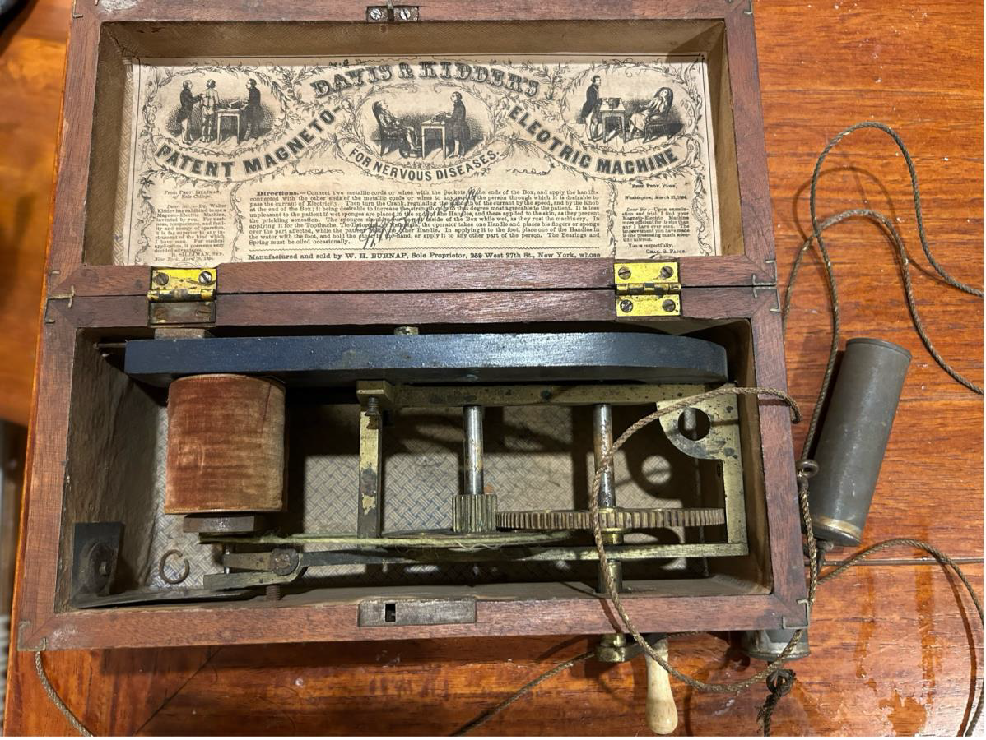
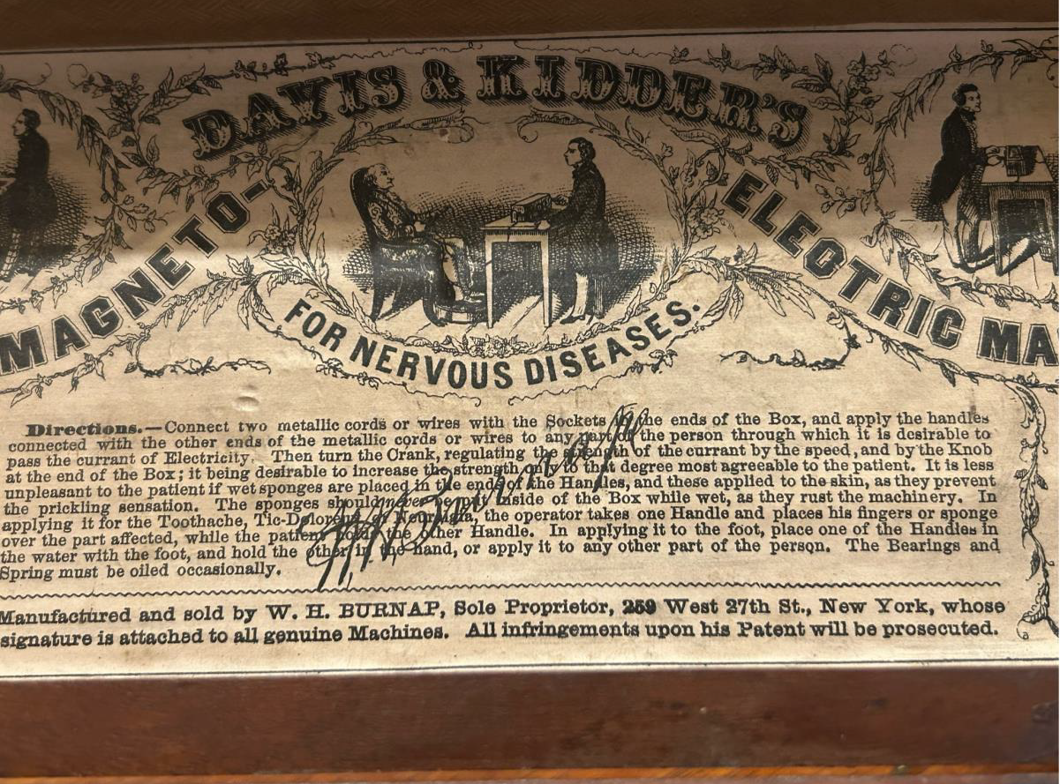
Dangerous Methods (a brief introduction)
Magneto-Electric Machine
  Portable electroshock!
  Patented 1854 for treatment of “nervous disorders”
  Featured in the Australian War Memorial as a treatment for shell shock in WWI

Slide 12
Dangerous Methods (a brief introduction)
Lobotomies
  Surgical removal of small pieces of the brain to “calm” psychological distress
  “Worked” by damaging the connections between the prefrontal cortex and deeper brain structures involved in emotion and cognitive processing

Slide 13
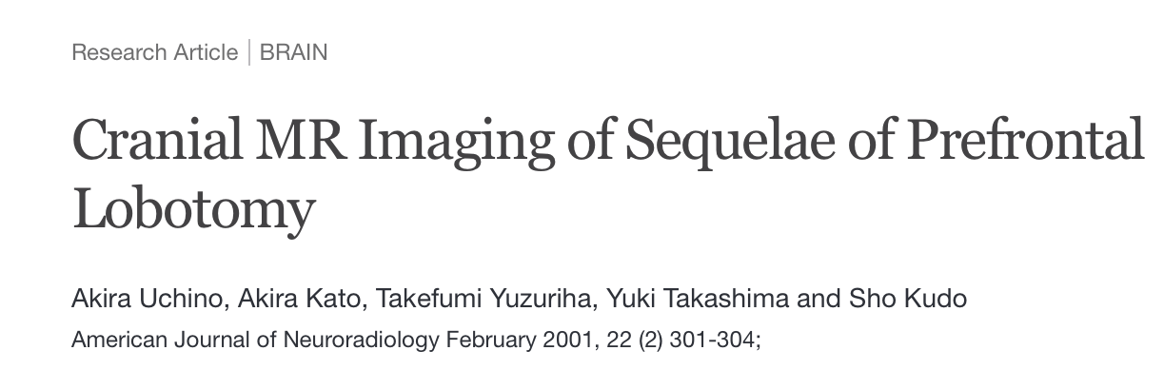
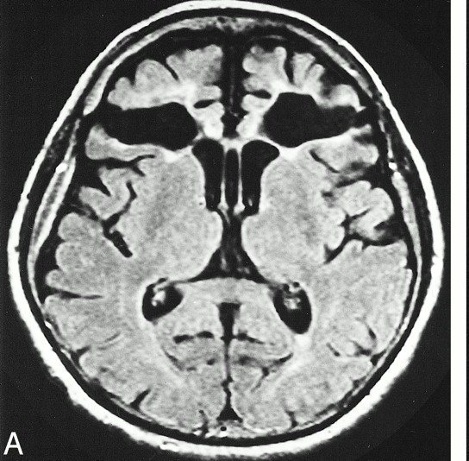
Dangerous Methods (a brief introduction)

Slide 14
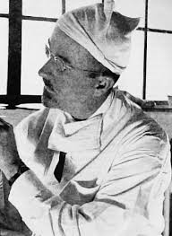
Dangerous Methods (a brief introduction)
Transorbital Lobotomies
  Popularised by Walter Freeman in 1946
  “Ice Pick Lobotomies”
  Quick and easy! Took ~10min, no need for a neurosurgeon or proper anaesthesia

Slide 15
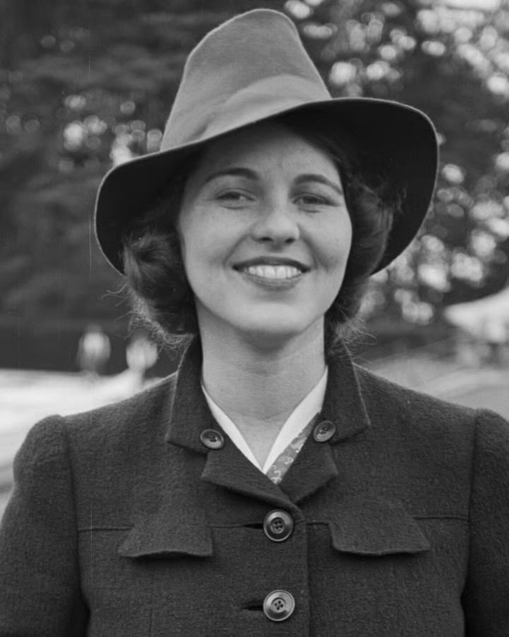
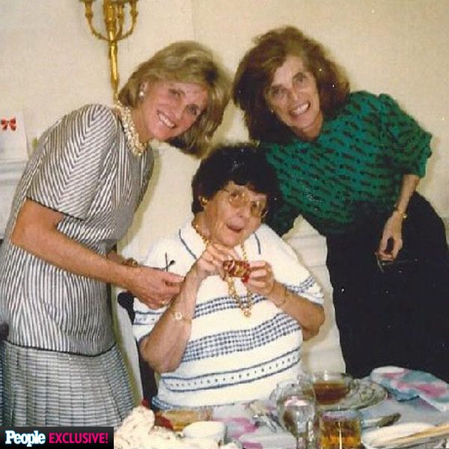
Dangerous Methods (a brief introduction)

Slide 16
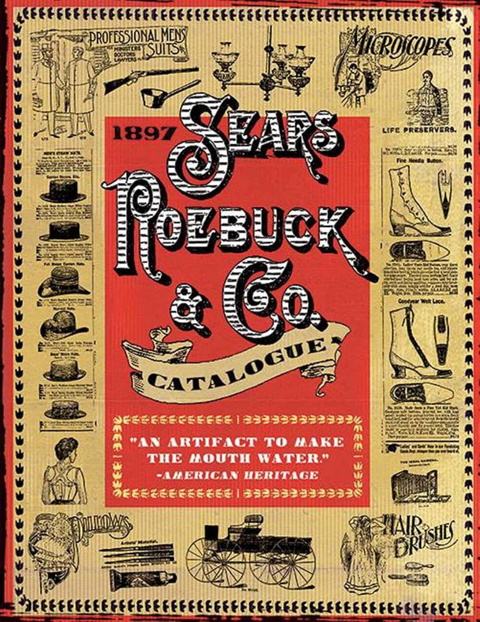
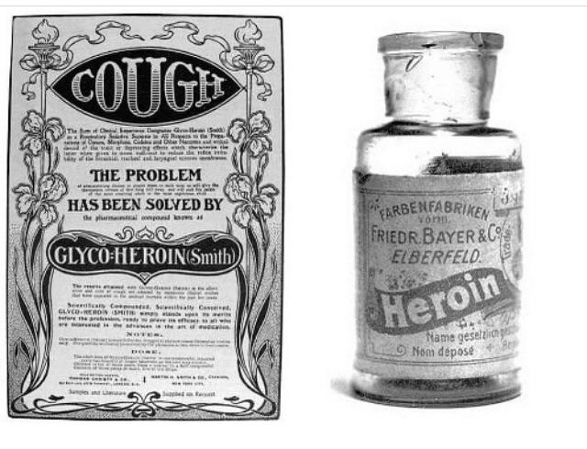
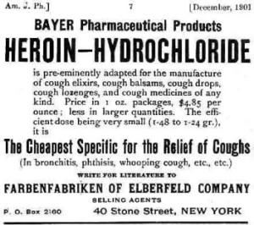
Lobotomies too pricey? Help is on the way.

Slide 17
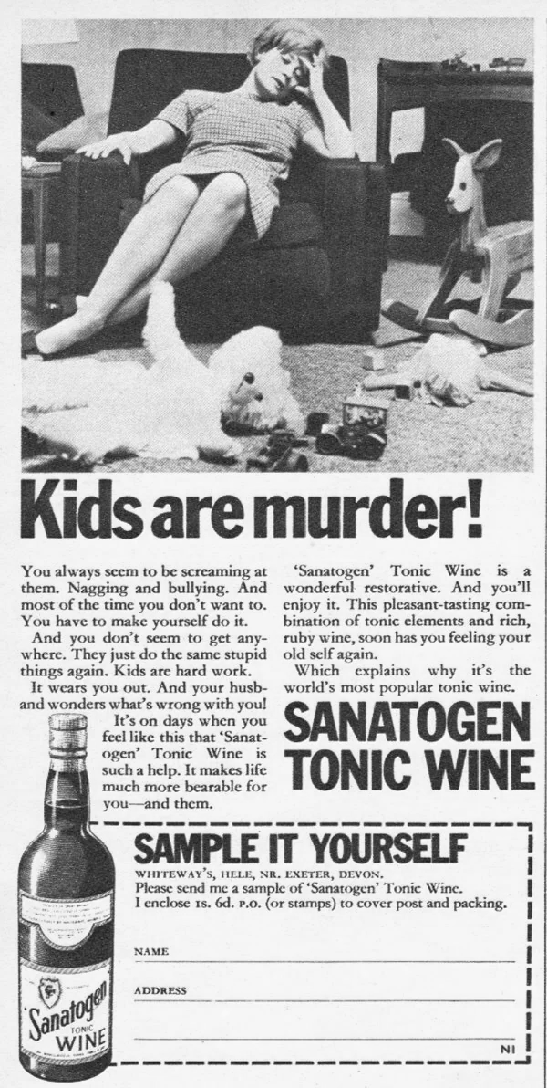
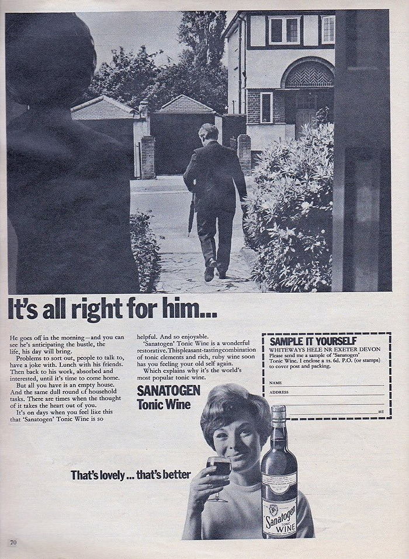
Lobotomies too pricey? Help is on the way.
“That’s lovely…that’s better”

Slide 18

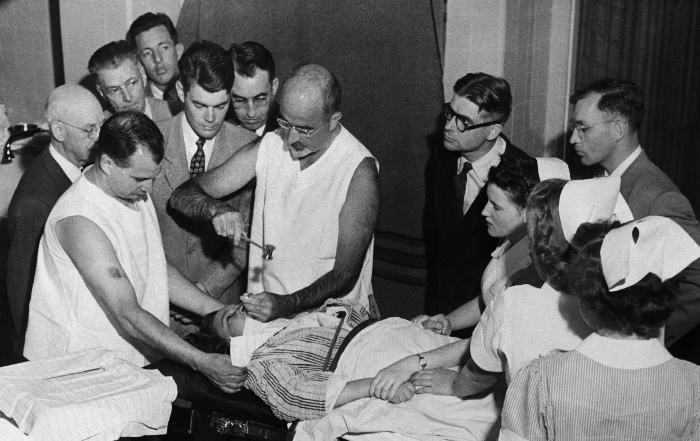
What does a good psychological treatment do?
Improve the lives of people struggling with mental health conditions?
or…
Make everyone else around them more comfortable?

Slide 19
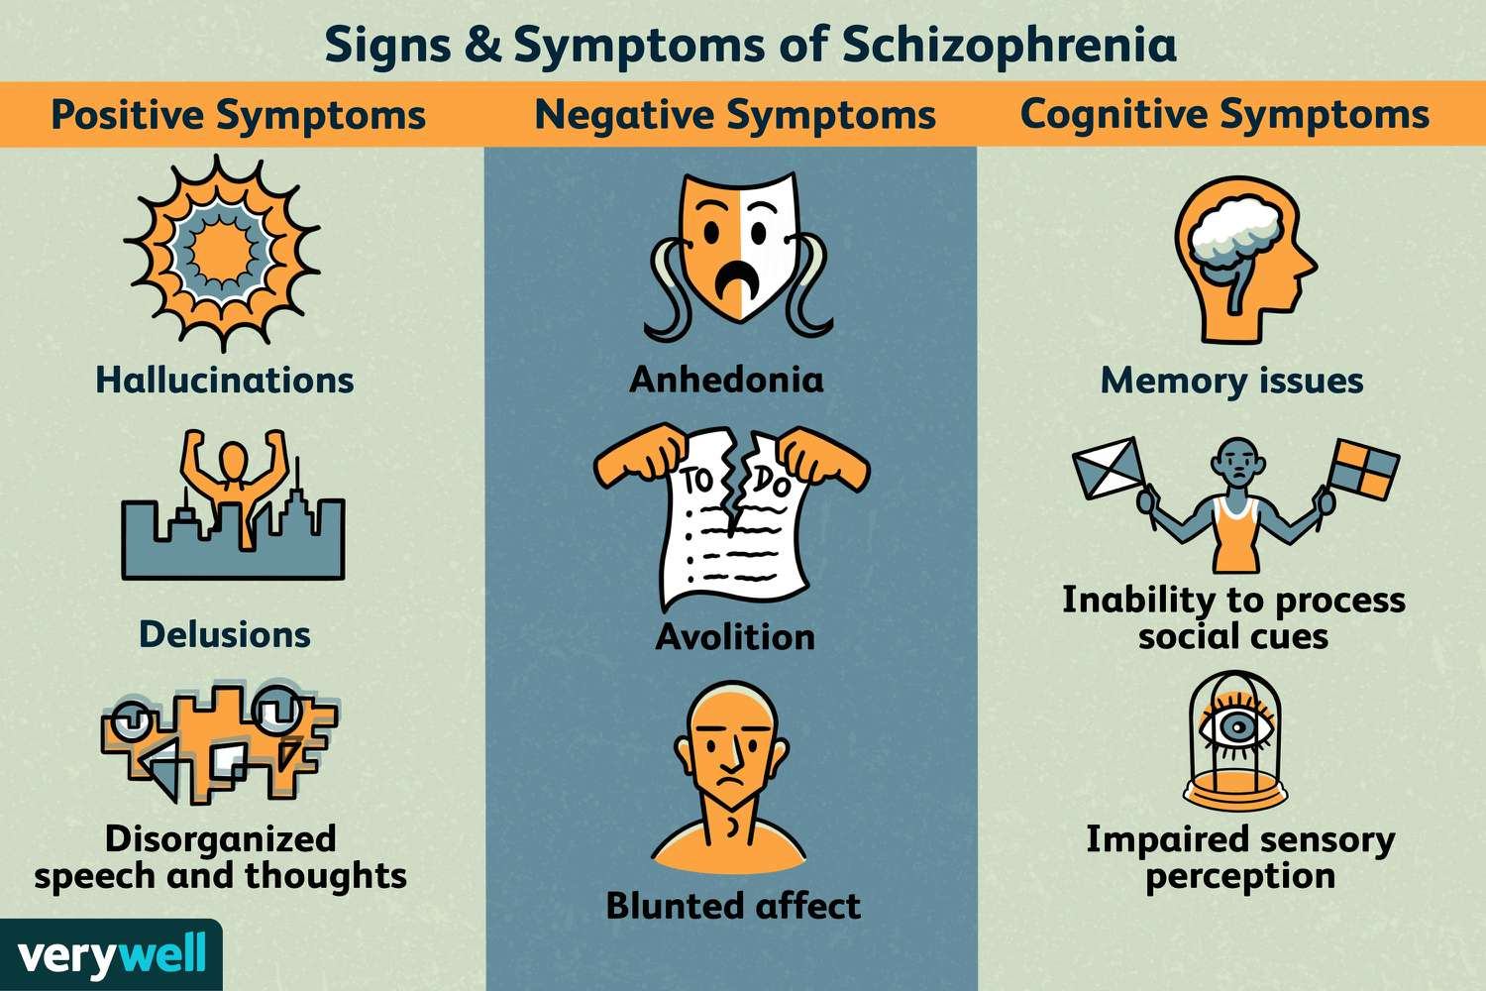
What does a good psychological treatment do?
A modern example: Treating schizophrenia

Slide 20
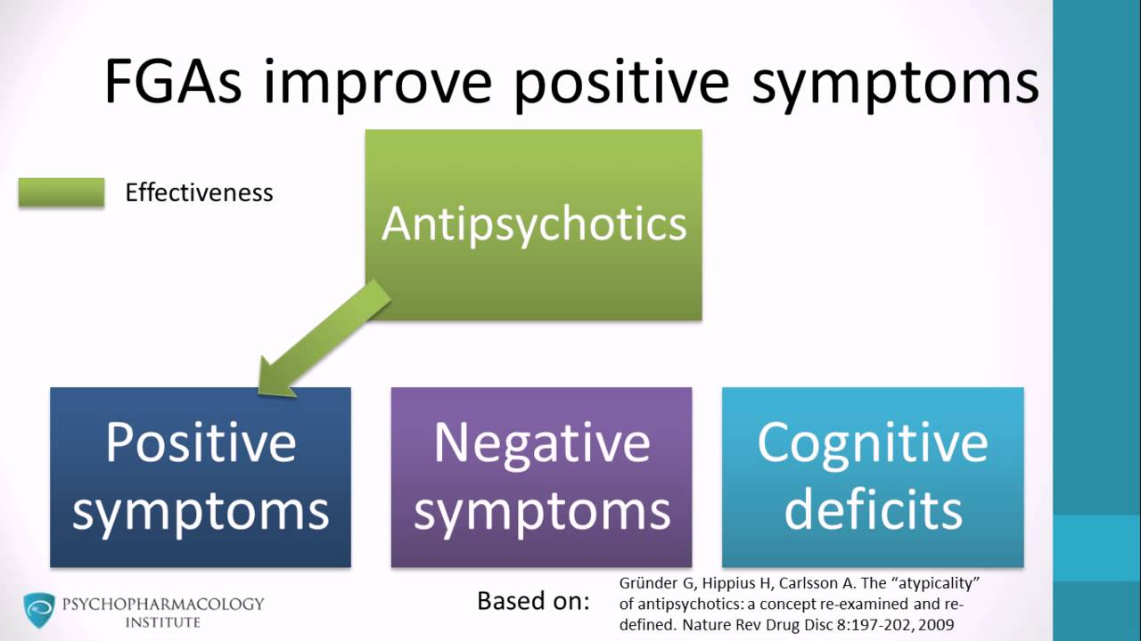
What does a good psychological treatment do?
Antipsychotics are the 1st line treatment for schizophrenia
Only effective at lessening the “positive” symptoms (i.e., symptoms most noticeable/distressing to observers)

