Slide 1
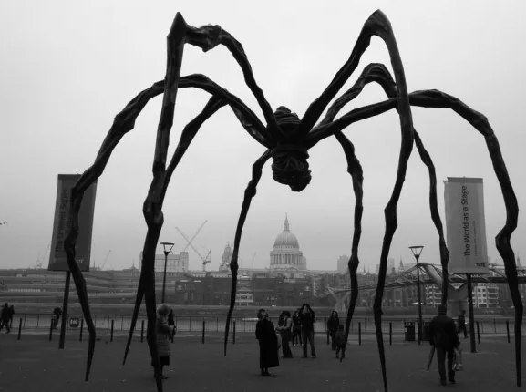
Week 3
Mother, Dearest
(Developmental Psychology)
Lecture 2: The Dark Side

Slide 2

Of Blood and Ice Cream…

Slide 3

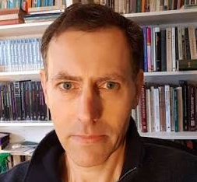
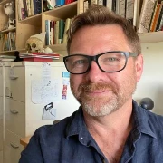
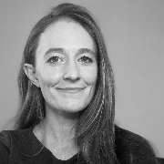
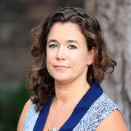


Social Psychology
Personality Psychology
Biological Psychology
Forensic Psychology
Cognitive Psychology
Cultural Psychology

Slide 4
How are you ruining your child?

Slide 5


You’re doing that wrong.

Slide 6
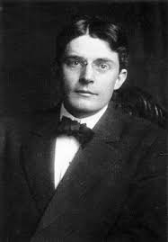
John Watson
“Give me a dozen healthy infants, well-formed, and my own specified world to bring them up in and I’ll guarantee to take any one at random and train him to become any type of specialist I might select—doctor, lawyer, artist, merchant-chief and, yes, even beggar-man and thief, regardless of his talents, penchants, tendencies, abilities, vocations, and race of his ancestors.”

Slide 7
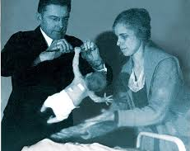
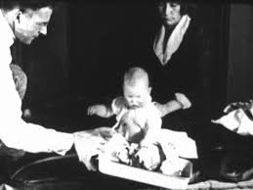
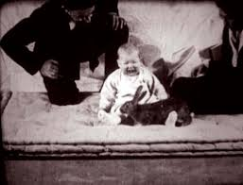
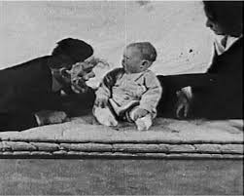

Slide 8
Watson Baby Albert experiment was designed to test (or compete with) Freud’s theory of unconscious emotional transference
“The Freudians twenty years from now, unless their hypotheses change, when they come to analyze Albert’s fear of a seal skin coat – assuming that he comes to analysis at that age – will probably tease from him the recital of a dream which upon their analysis will show that Albert at three years of age attempted to play with the pubic hair of the mother and was scolded violently for it.”
– Watson and Rayner, 1920

Slide 9
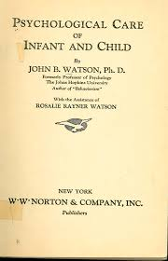
Psychological Care of Infant and Child
John Watson (1928)
Hugely popular parenting book
Massively damaging

Slide 10
“Never hug and kiss them, never let them sit in your lap. If you must, kiss them once on the forehead when they say good night. Shake hands with them in the morning.”
-J. Watson, 1928
“Psychological Care of Infant and Child”

Slide 11
“[Mother love is] a dangerous instrument which may inflict a never-healing wound, a wound which may make infancy unhappy, adolescence a nightmare, an instrument which may wreck your adult son or daughter’s vocational future and their chances for marital happiness.”
-J. Watson, 1928
“Psychological Care of Infant and Child”

Slide 12
“No matter how much [the mother] may love her husband, he is away all day; her heart is full of love which she must express in some way. She expresses it by showering love and kisses upon her children— and thinks the world should laud her for it. And it does. Not long ago, I went motoring with two boys, aged four and two, their mother, grandmother and nurse. In the course of the two-hour ride, one of the children was kissed thirty-two times—four by his mother, eight by the nurse and twenty times by the grandmother. The other child was almost equally smothered in love.”
-J. Watson, 1928
“Psychological Care of Infant and Child”

Slide 13
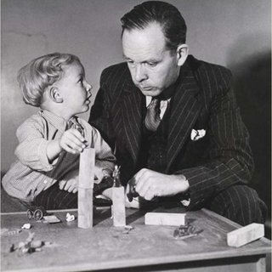
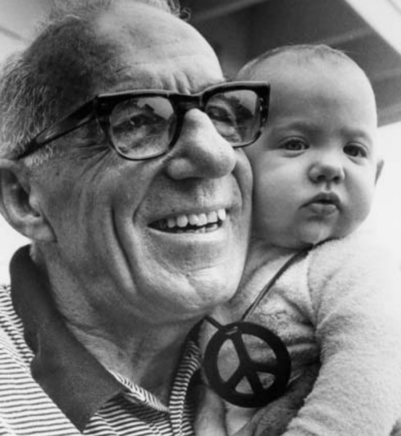
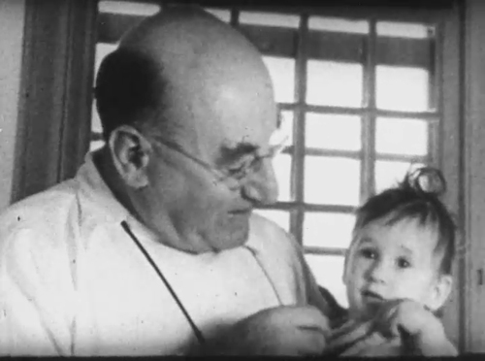
WHO Report on Maternal Care and Mental Health
(1951)
“Common Sense approach to Child Rearing” 1946
John Bowlby
Benjamin Spock
Studied institutionalized infants starting in 1945. Film “Psychogenic Disease in Infancy” (1952) showed his recorded research.
Rene Spitz

Slide 14
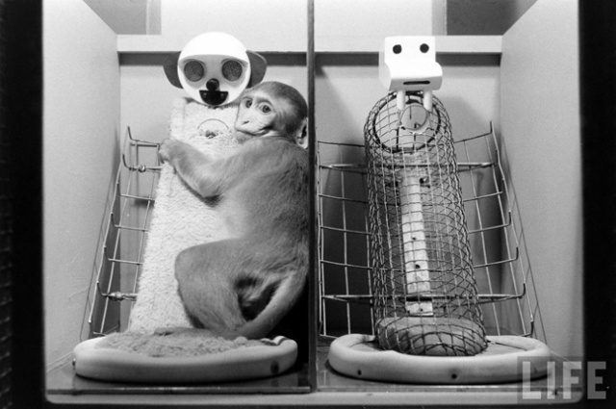
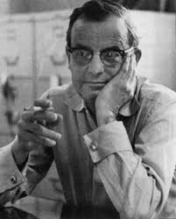
Along Came Harlow…
Harry Harlow
The Nature of Love
Harry Harlow (1958)
  30 years after Watson
Described his work with monkeys and the importance of the mother-infant bond

Slide 15
Motherhood after Harlow: all good now?
The Age of Maternal Anxiety

Slide 16
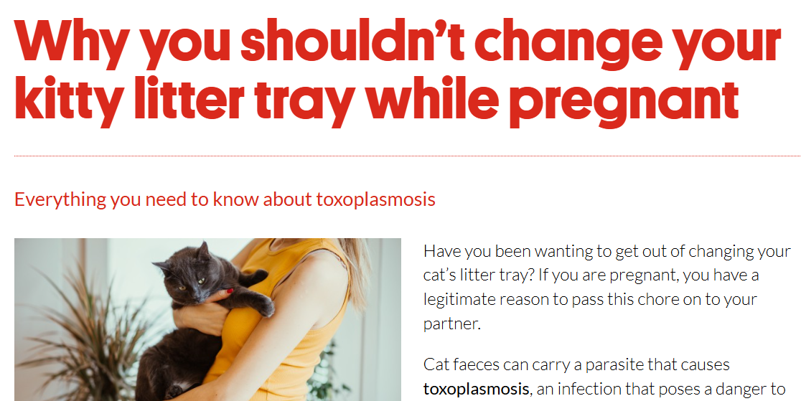
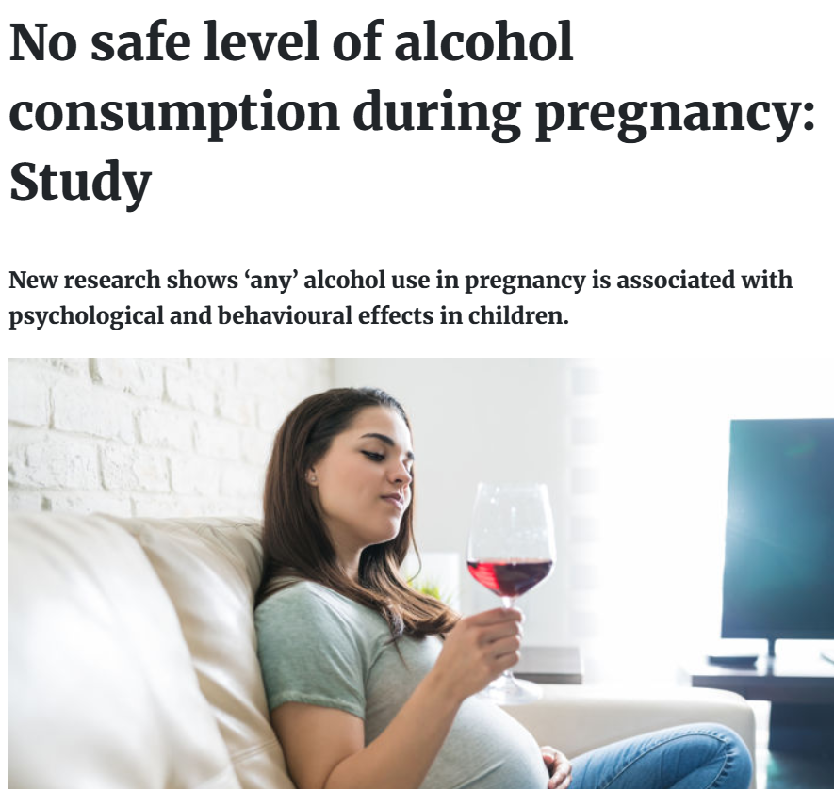
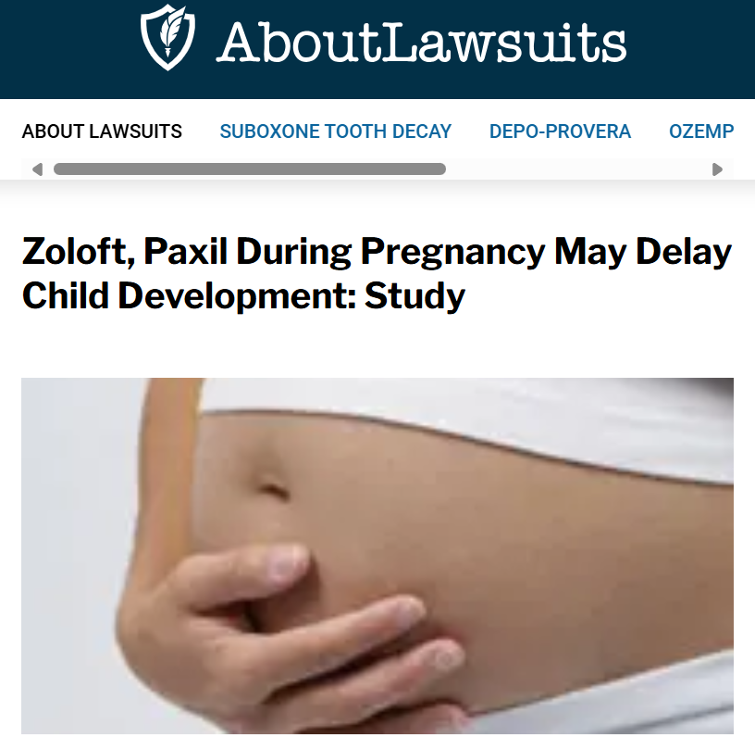
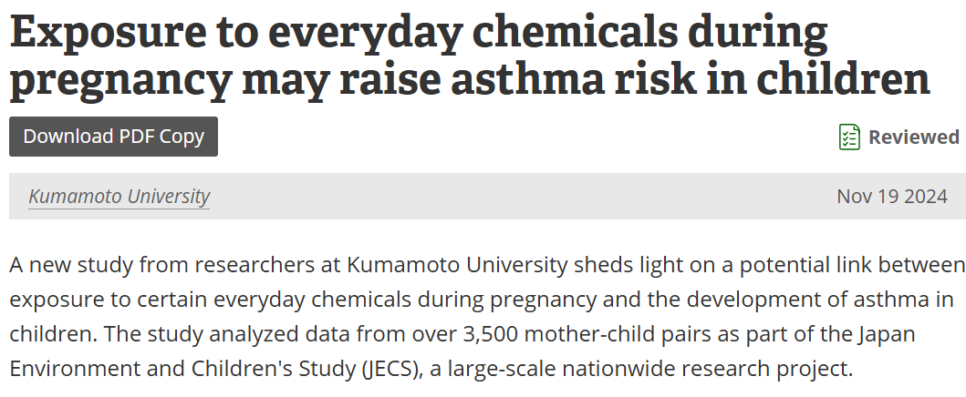
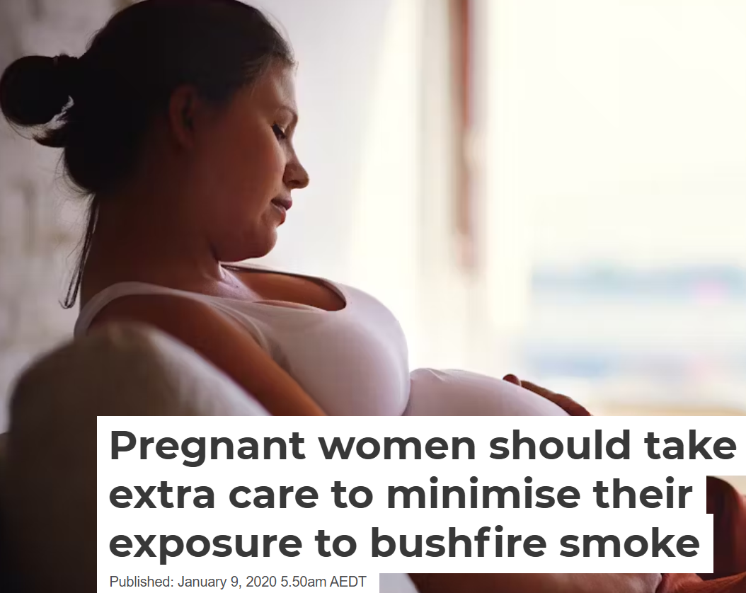
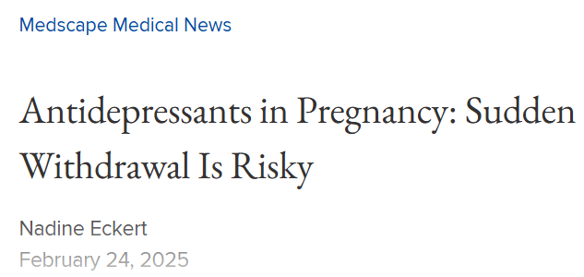

Slide 17
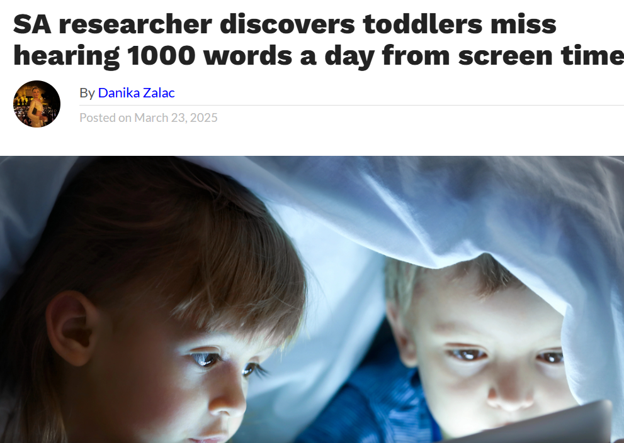
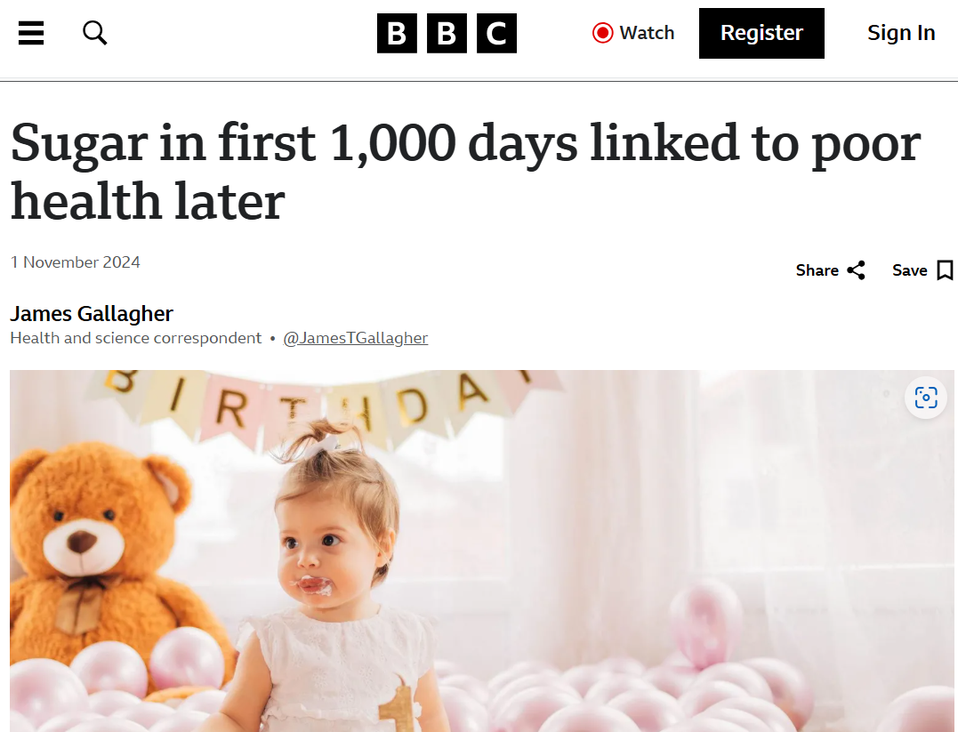
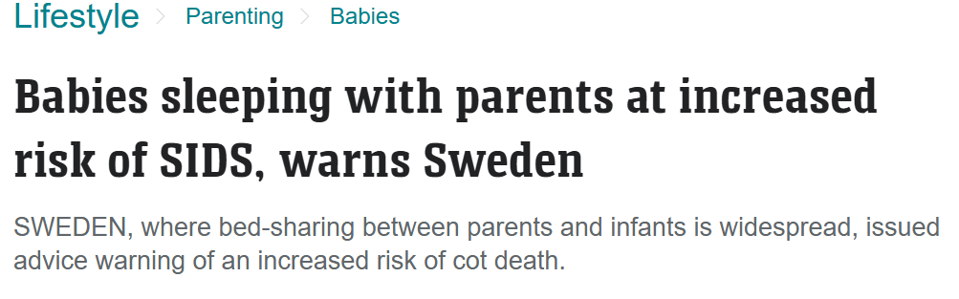
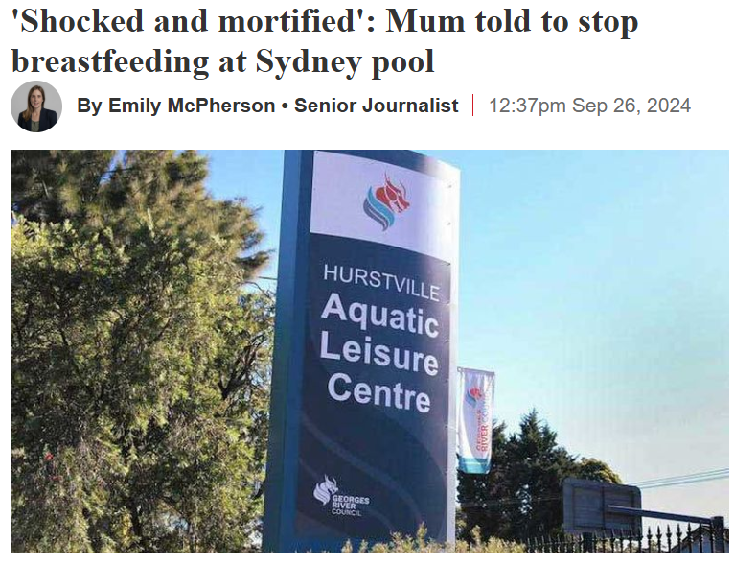
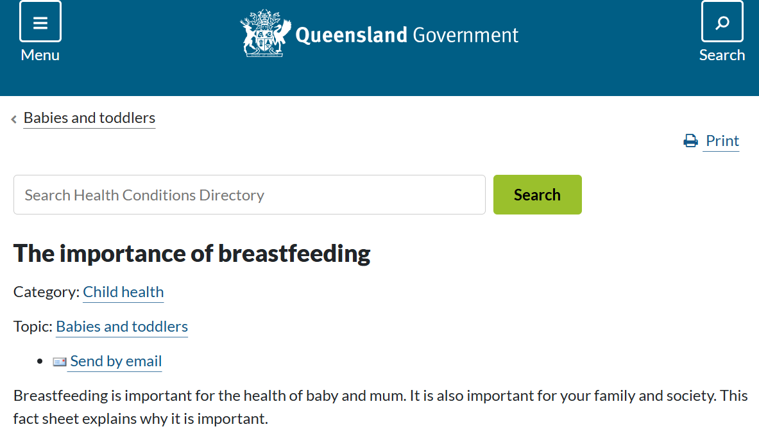

Slide 18
