Slide 1
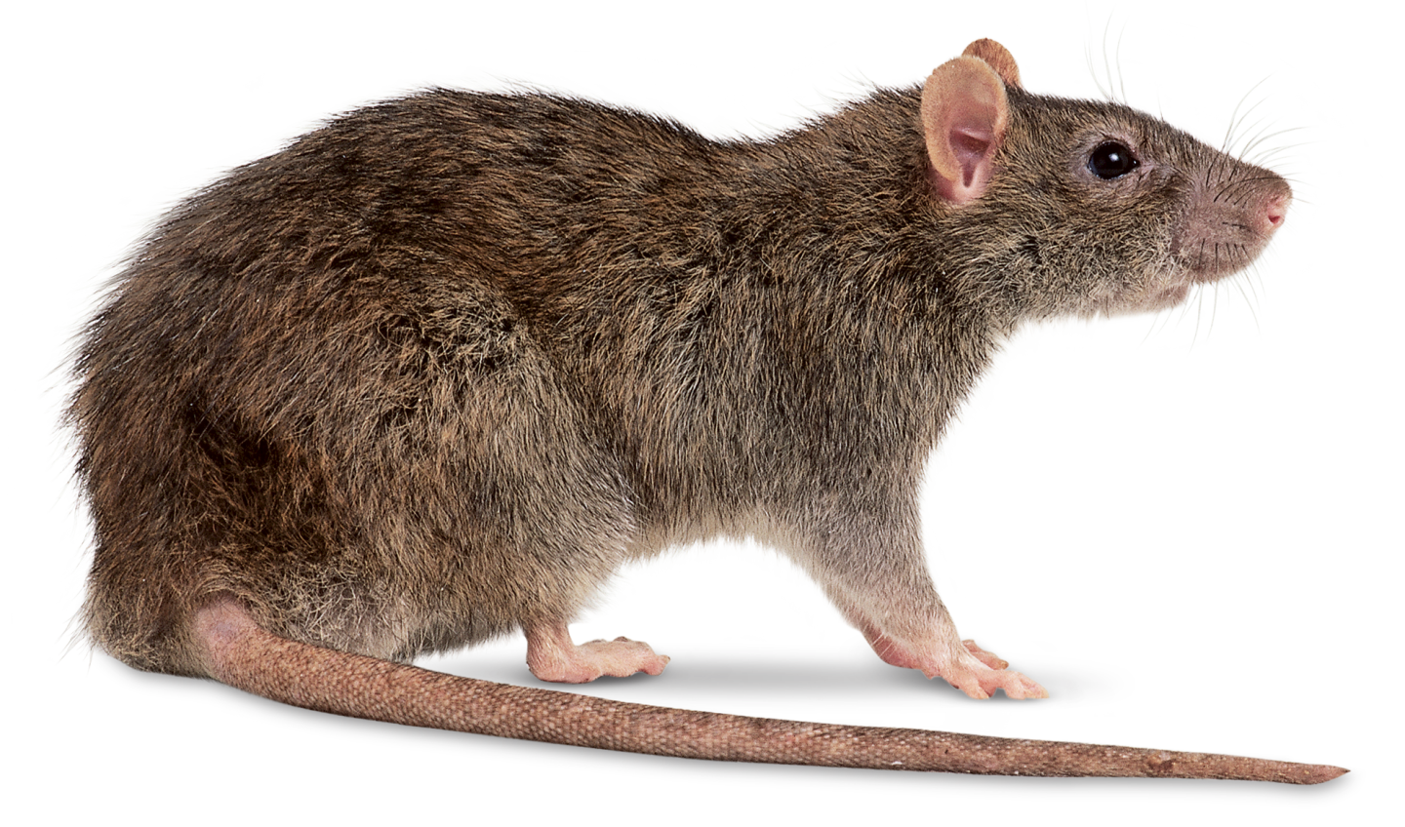
Lecture 3:
The Good Enough Dam

Slide 2

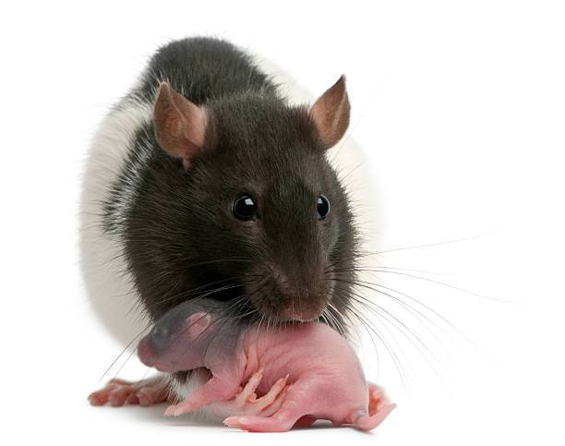
Don’t mind me, I’ll just be judging you today.

Slide 3
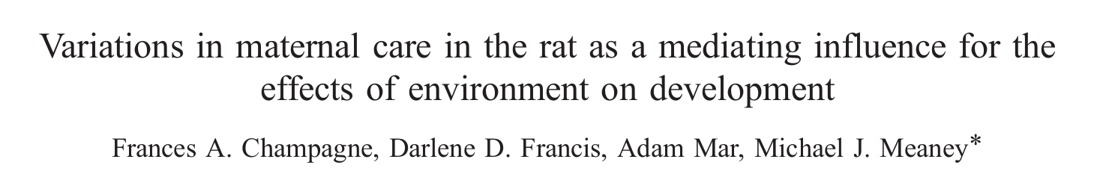
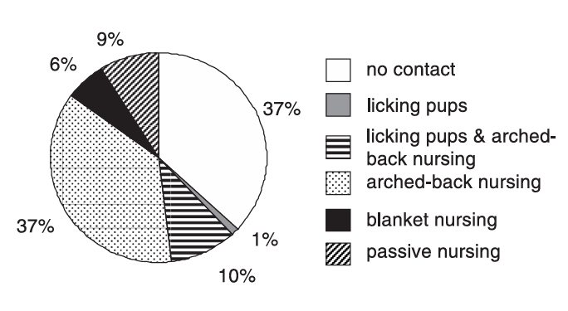
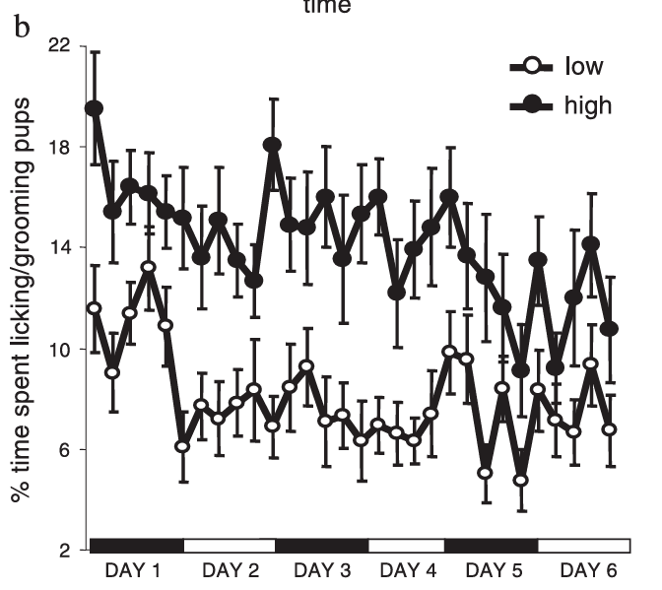

Slide 4
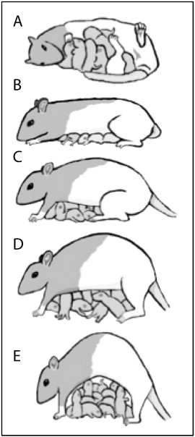
Supine
Passive
Arched-Back 1
Arched-Back 2
Arched-Back 3
Popoola et al., 2015

Slide 5
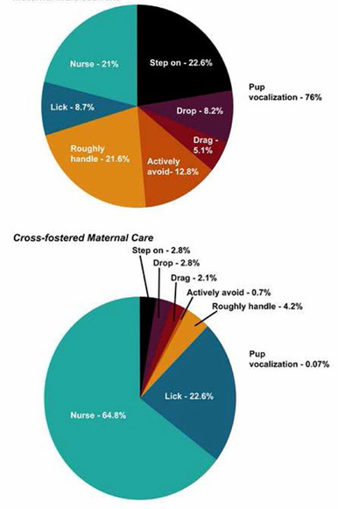
Limited Bedding
Impact of Stress on Maternal Behaviours
Standard Reared
Mums with limited bedding were “abusive” (i.e., increased observations of “rough handling”
Roughly handled pups grow up to show a range of physiological and behavioural adverse impacts in adulthood
Walker et al., 2017

Slide 6
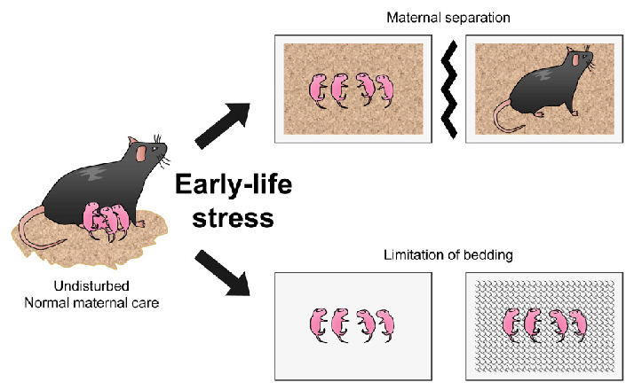
Animal Models of Early Life Stress (ELS)
Models of ELS
Maternal Separation
Maternal Corticosterone (stress hormone) Exposure
Limited Bedding
Lee and Jung, 2023

Slide 7

Impacts of Maternal Separation
(and maternal stress)
Rick Richardson, UNSW

Slide 8
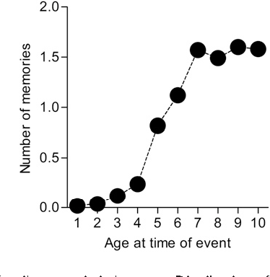
Infantile Amnesia
Weak episodic memory formation typical of young children (before the age of ~3-4)
Josselyn et al., 2012

Slide 9
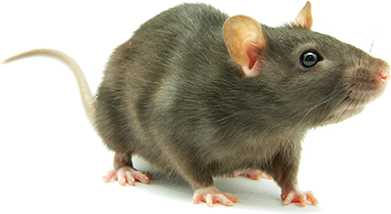

Maternal Separation and Infantile Amnesia
Fear Conditioning
Animals are placed in a chamber and exposed to several pairings of an auditory stimulus and a mild foot shock
After conditioning, animals will exhibit fear responses when exposed to the auditory stimulus

Slide 10
Maternal Separation and Infantile Amnesia
Fear Conditioning
Animals are placed in a chamber and exposed to several pairings of an auditory stimulus and a mild foot shock
After conditioning, animals will exhibit fear responses when exposed to the auditory stimulus
Fear Extinction
Animals are placed in a new chamber and exposed to repeated presentations of the auditory stimulus with no foot shock
Fear decreases as they learn that the sound is no longer dangerous
Contextual Renewal
Following extinction, adult rats/mice will show low fear to the sound in the extinction context. However, the fear will return if they are tested in the original fear conditioning context

Slide 11


Maternal Separation and Infantile Amnesia
Contextual Renewal
Following extinction, adult rats/mice will show low fear to the sound in the extinction context. However, the fear will return if they are tested in the original fear conditioning context
This shows that extinction does not cause “forgetting”, but rather the formation of a new competing memory
Infant rats/mice do not show contextual renewal. This suggests that extinction causes “erasure” of the original fear memory in young animals (i.e., infantile amnesia).

Slide 12
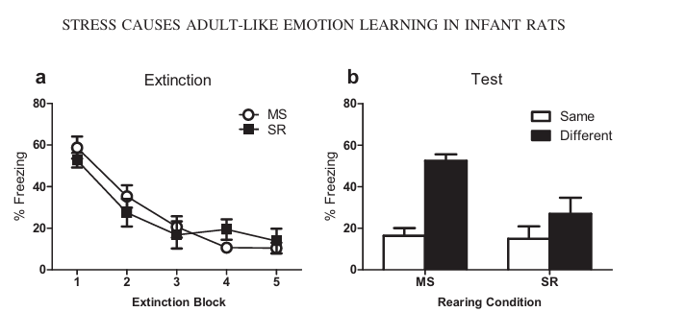
Maternal Separation and Infantile Amnesia
Infant rats were given fear conditioning (in Context A), extinction (in Context B), and a post-extinction test in either Context A or Context B
SR = Standard Reared
MS = Maternal Separation
Context B
Context A
Adapted from Callaghan and Richardson, 2011
MS infants showed contextual renewal (i.e., premature formation of adult-like fear memories)

Slide 13

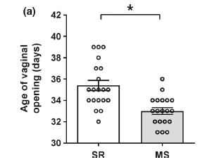
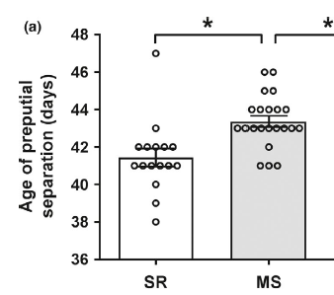
Additional impacts of ELS
Impacts on pubertal development
  Premature puberty in females, delayed puberty in males
Cowan and Richardson, 2018

Slide 14
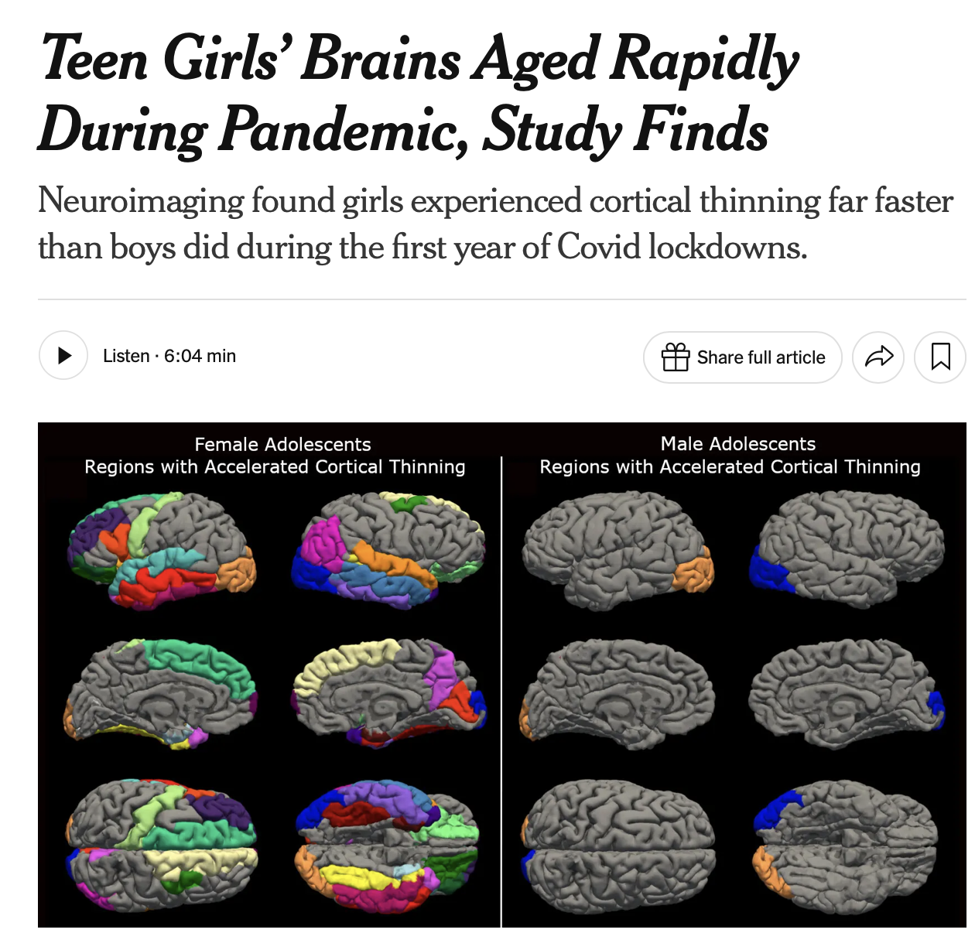
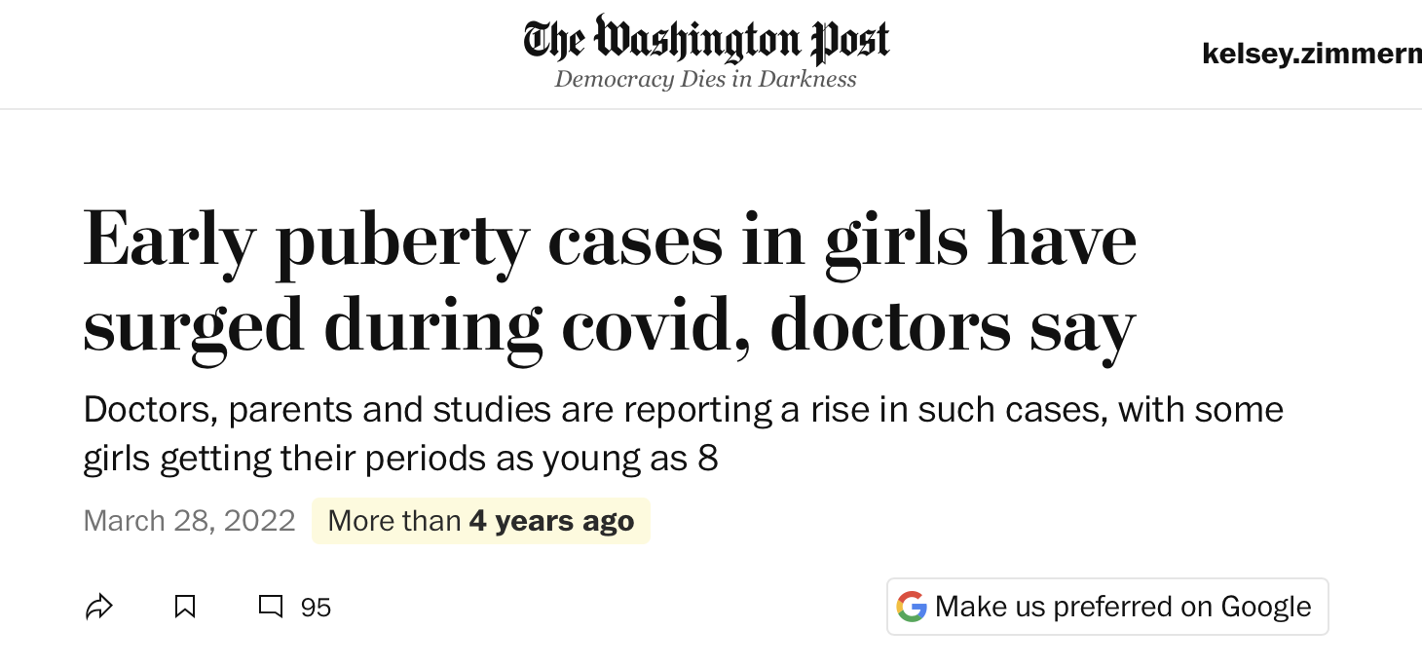
Impacts of ELS: Translational Perspectives

Slide 15

Example: Examining impacts of screen time on language acquisition
Low screen time
High screen time
Divide sample population into Low Screen Time and High Screen Time based on questionnaire. Test language skills at a single time point.
Start with sample population before screens are introduced. Include only subjects that are meeting expressive language benchmarks at Time Point 1. Test at several time points in a longitudinal study and compare trajectories for “Screen Restricted” vs “Screen Unrestricted” children.

Slide 16
Example: Examining impacts of screen time on language acquisition
A = Low screen time
B = High screen time
Twin Study: Compare language acquisition in monozygotic twins reared apart in high screen vs low screen homes.

Slide 17
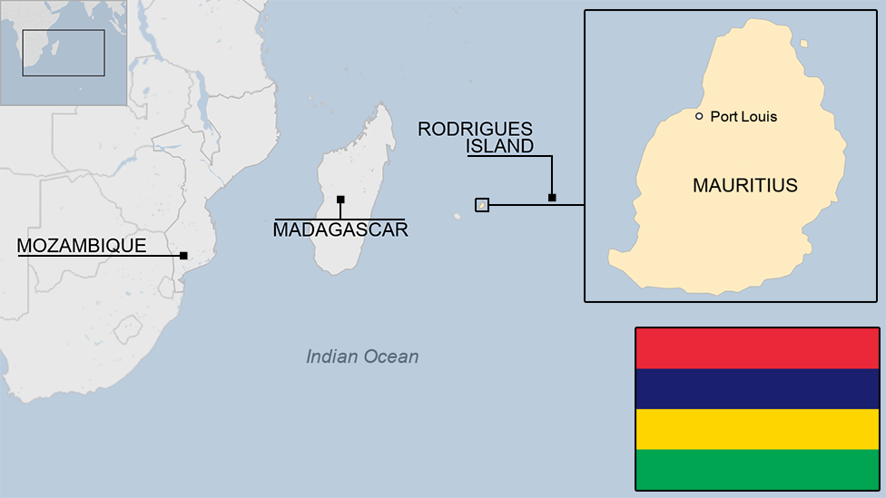
Mauritius Child Health Study
Longitudinal study that has been ongoing since 1972 to examine child health and development
Cohort of 1,795 children born in 1969 (subjects assessed at 3 years old)
Follow-ups at 8, 11, 17, 23, 28, 35, and 39yo

Slide 18
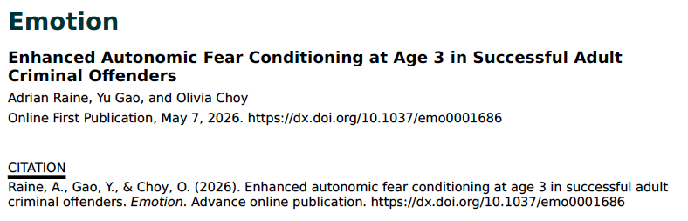
Early Maturation of Learning and Memory:
A Predictive Tool?
One measure taken at 3yo: fear conditioning
Conditioned Stimulus (CS+): Tone that co-terminated with an aversive sound
(CS-): Different tone that was not paired with the aversive sound

Slide 19
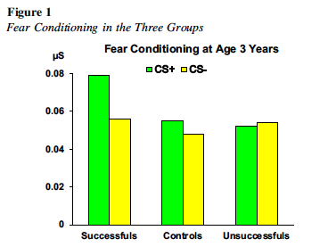
Early Maturation of Learning and Memory:
A Predictive Tool?
Controls showed successful fear conditioning. Small effect attributed to maternal buffering
Unsuccessful criminals (i.e., those who were caught), showed reduced fear conditioning relative to non-criminal controls
Successful (not caught) criminals showed enhanced fear conditioning
Raine et al., 2026

Slide 20
Conclusion
Nature and Nurture are both important!
Exposure to early life stress has lasting impacts on development
It is difficult to study the impact of isolated variables on human development
Combining data and methods from multiple studies may give us a more complete picture
Beware of oversimplified headlines!

