Slide 1
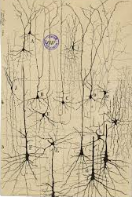
Neuron Primer
Neurons and Action Potentials
PSYC1003

Slide 2
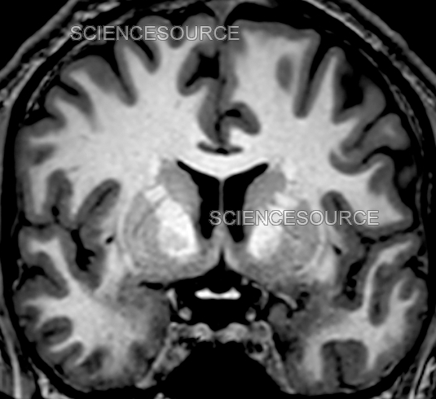
Terminology: Brain Composition
Gray Matter
  Neurons (dendrites and cell bodies)
White Matter
  Myelin (axons)
Ventricles
  Cavities containing cerebrospinal fluid (CSF)

Slide 3
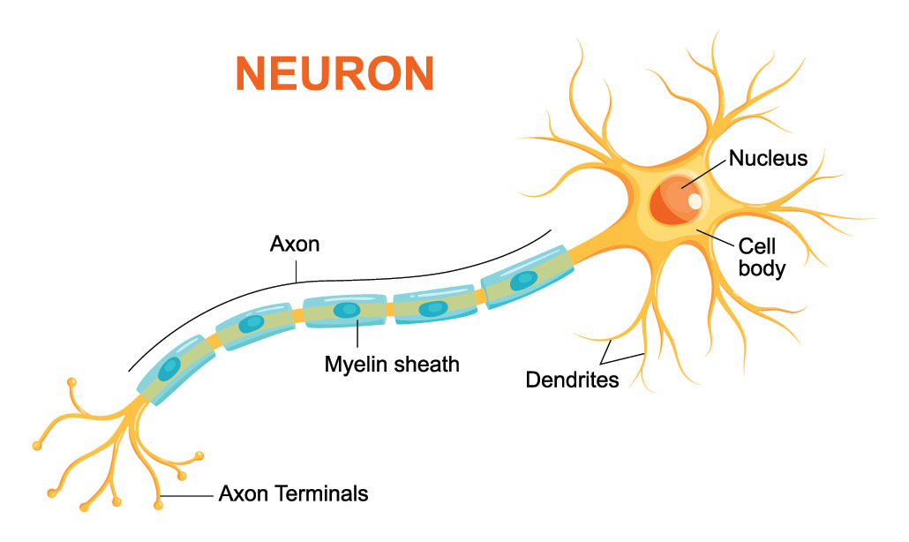
Anatomy of a Neuron
Main Components
  Dendrites
  Cell Bodies (Soma)
  Axons

Slide 4
Neurons we care about (for the moment)
Excitatory
Inhibitory

Slide 5
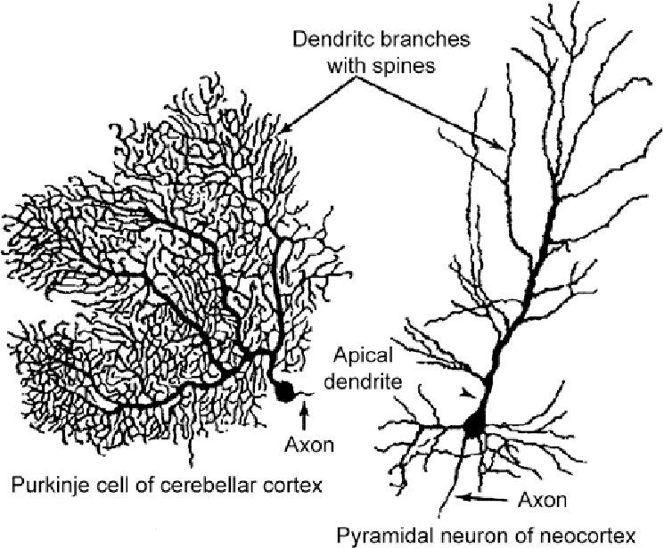
Neurons we care about (for the moment)
Excitatory
  Tells other neurons to fire
  Primary Neurotransmitter: Glutamate

Slide 6
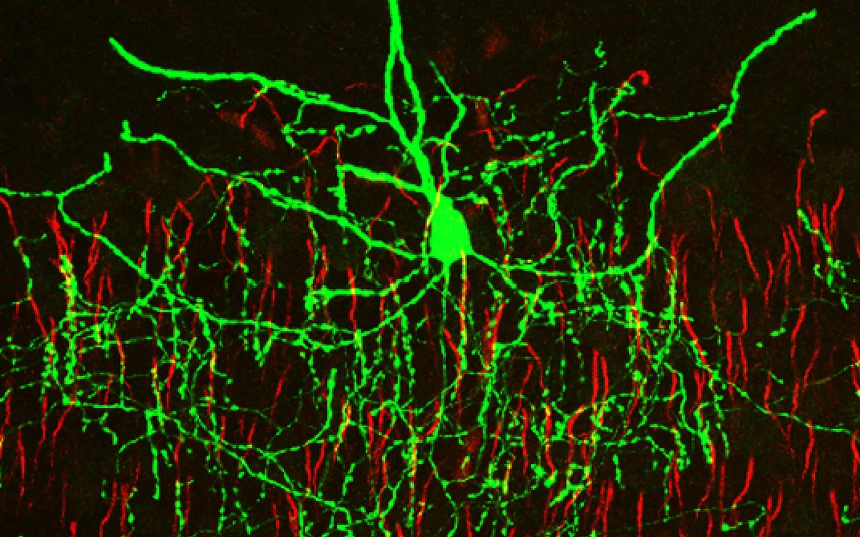
Main Types of Neurons
Inhibitory
  Tells other neurons not to fire
  Primary Neurotransmitter: GABA

Slide 7
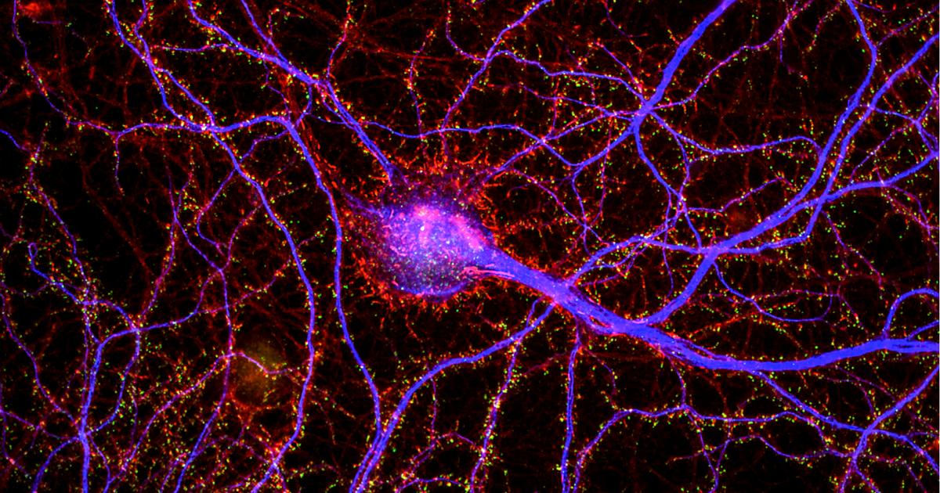
Dendrites
Receive input from other neurons
Information is integrated to determine whether neuron will “fire an action potential” (i.e., send a signal to other neurons)

Slide 8
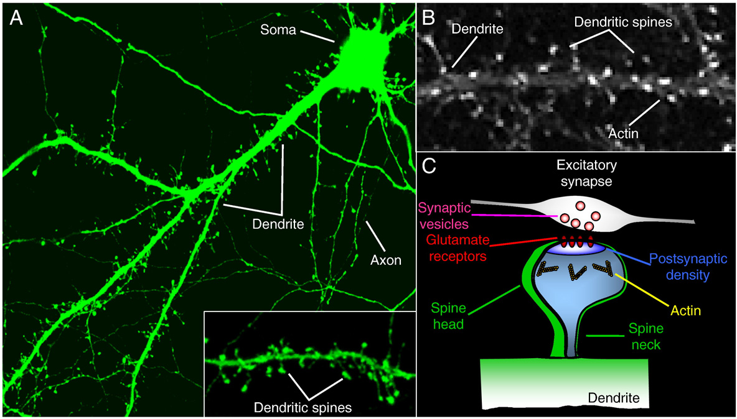
Dendrites
Learning-Dependent Neuroplasticity: Experience-dependent changes in the structure or function of neurons that facilitate learning retention and memory recall
NOTE: Growth vs retraction of dendrites and dendritic spines are the main reason that grey matter volume differences in specific brain regions are observed (i.e., more spines and dendritic branching = larger regional volume)
Dendritic Spines
  Tiny, highly plastic “bumps” on dendrite branches that receive excitatory input from other neurons
  Major site of learning-dependent neuroplasticity
Penzes et al., 2010

Slide 9
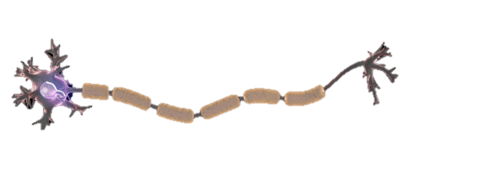
Axons
Project from the cell body
Send signals to other neurons (within or between brain regions)
Axon
Axon Terminals

Slide 10
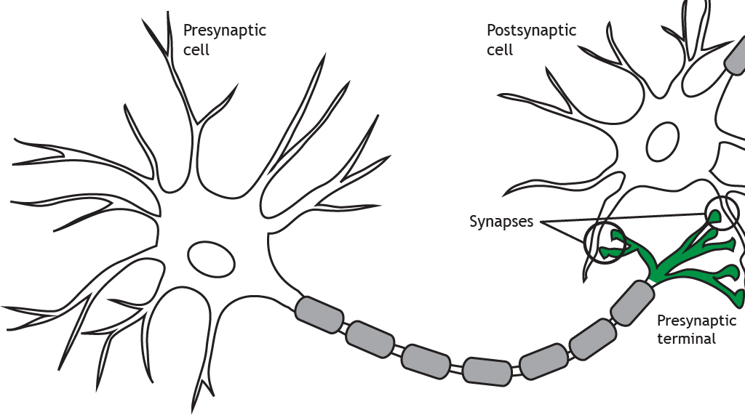
Action Potentials
1) Excitatory input onto dendrites

Slide 11
Action Potentials
1) Excitatory input onto dendrites
2) Action potential generated

Slide 12
Action Potentials
1) Excitatory input onto dendrites
3) Action potential travels down axon
2) Action potential generated

Slide 13
Action Potentials
1) Excitatory input onto dendrites
4) Axon terminals release neurotransmitter (type depends on neuron)
3) Action potential travels down axon
2) Action potential generated

