Slide 1
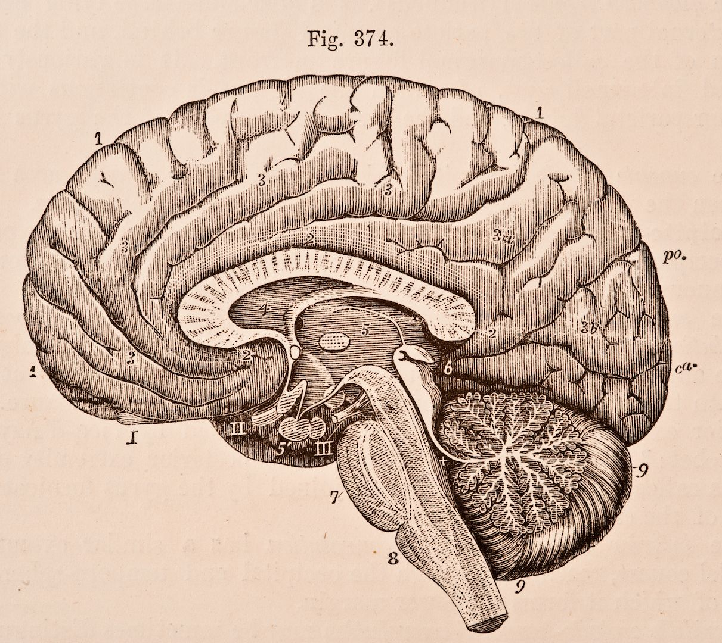
PSYC1003
Week 5: Neuroscience

Slide 2
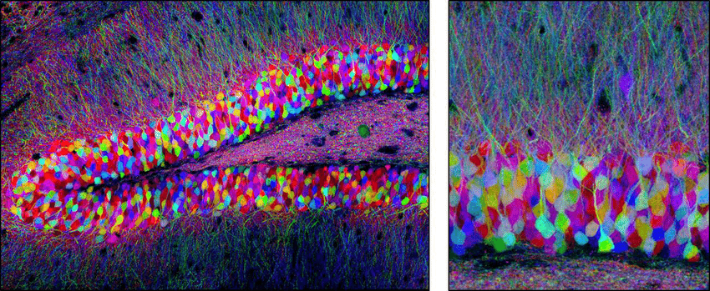
Outline
Historical/Cultural Impacts of Neuroscience Research
Sensations and Learning
Emotions and Memory
Neuroscience Methods
Castagnola, 2014

Slide 3
What were (and are) the implications of attributing our ideas, emotions, and memories to basic biological processes?

Slide 4

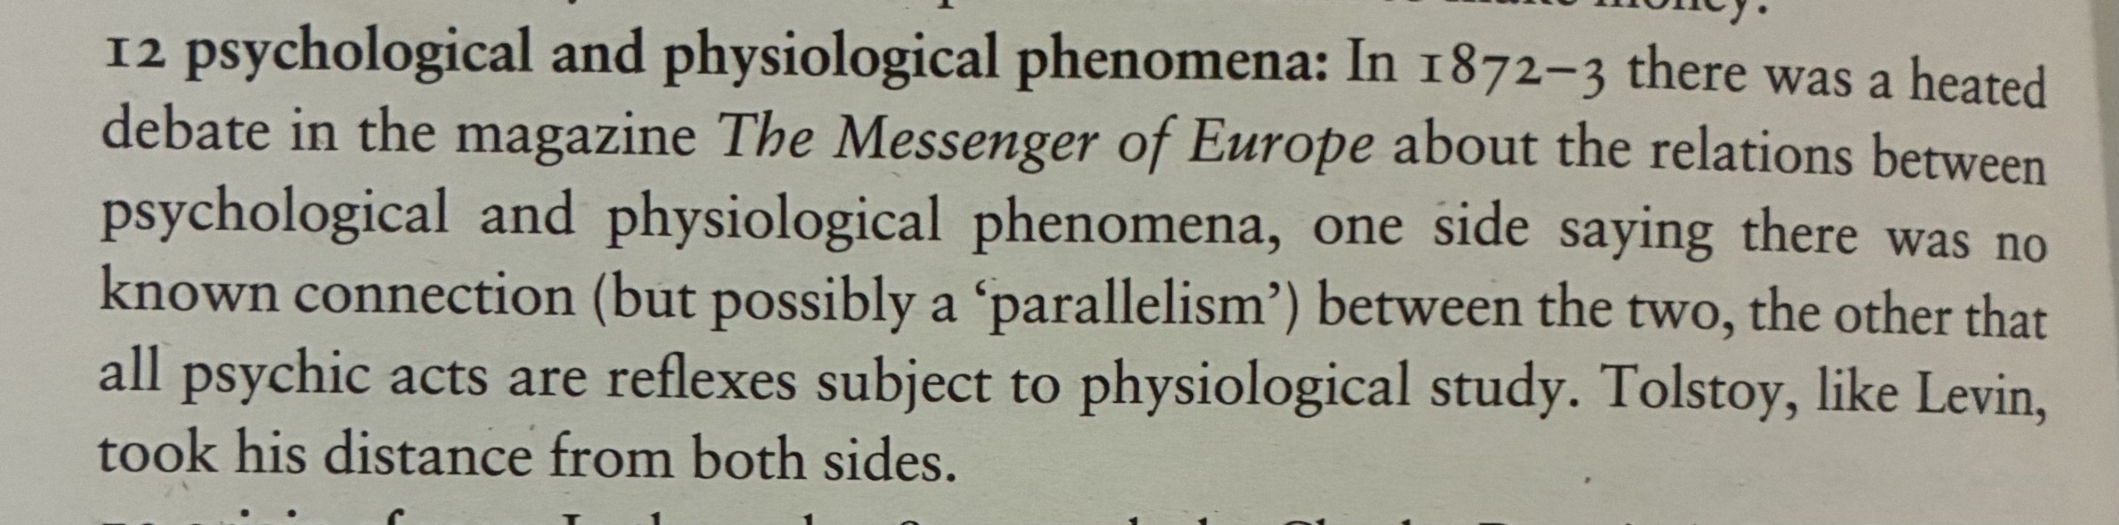
“The discussion was about a fashionable question: is there a borderline between psychological and physiological phenomena in human activity, and where does it lie?^{12”}
“I can by no means agree…that my whole notion of the external world stems from sense impressions. The fundamental concept of being itself is not received through the senses for there exists no special organ for conveying that concept.*”
*(The “organ” exists.)
1878

Slide 5
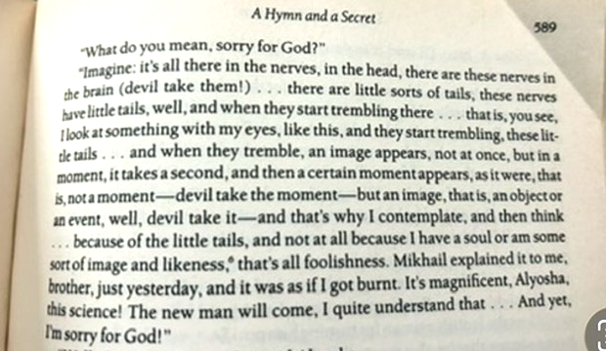

1880

Slide 6
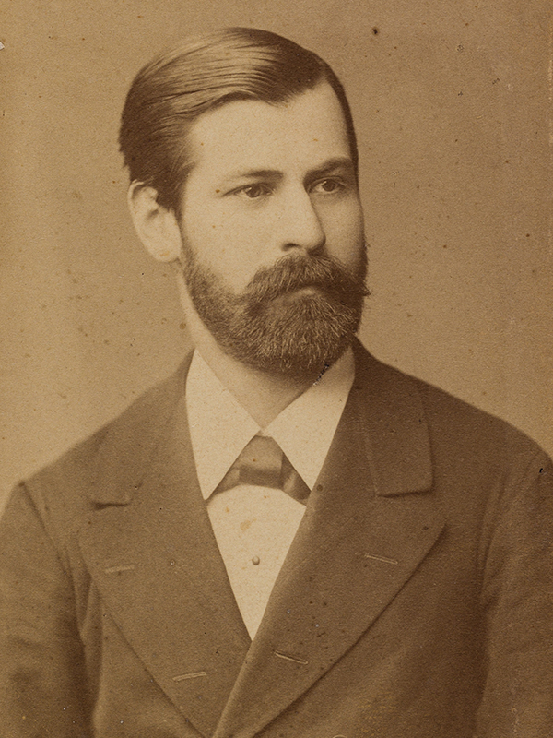
Freud: The Prodigal Neuroscientist
Medical training, research focussed on neuroanatomy
Credited with findings that contributed to the discovery of neurons
Desired to understand the physiological phenomena underlying psychoanalysis
Sigmund Freud, c. 1885

Slide 7
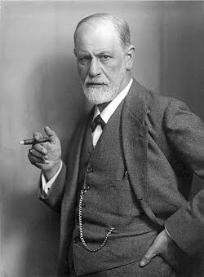
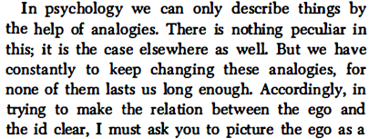
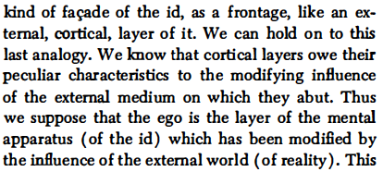
Once a neuroscientist, always a neuroscientist…
-The Question of Lay Analysis
Sigmund Freud, c. 1921

Slide 8
Freud’s theory:
Id: Instinctual, motivational drives (food, sex, safety, etc)
Ego: Receives sensory input, adapts, learns, helps control the id and direct behaviour so basic motivational drives can be safely achieved
Sigmund Freud, c. 1921

Slide 9
How to make a (meaningful) memory
Sensory cortices receive information from the five senses

Slide 10
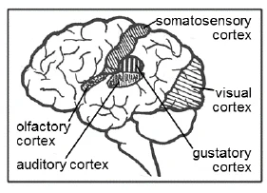
Sensory Cortices:
Areas of the brain that receive information from the senses

Slide 11
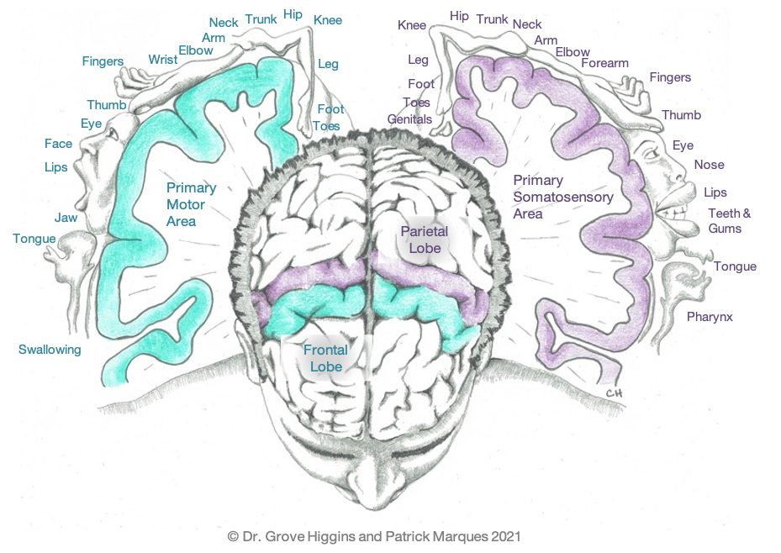
Primary Somatosensory Cortex:
Area of the brain that receives localised information about touch
Homunculus – cortical map of the human body on the primary somatosensory and primary motor areas

Slide 12
How to make a memory
Sensory cortices receive information from the five senses
Sensory information is sent to higher order association areas and to subcortical limbic structures (regions involved in emotion and memory)
Limbic structures coordinate a behavioural response

Slide 13
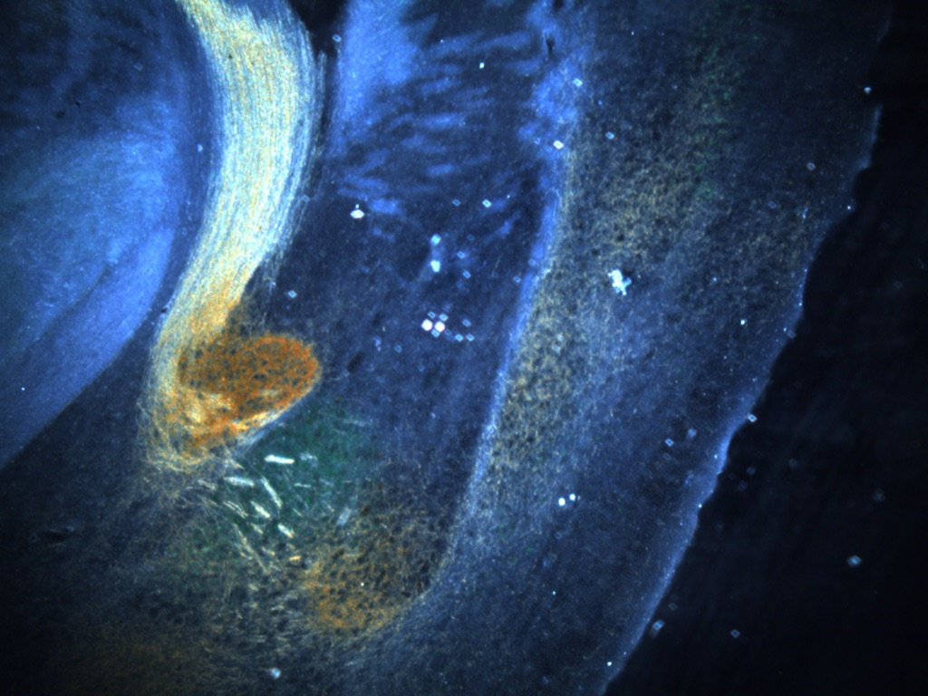
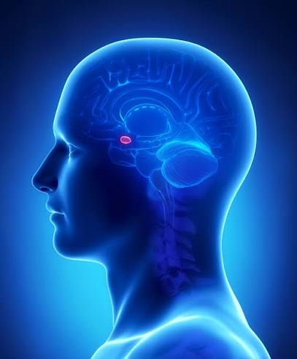
Amygdala
Critical for emotional learning and behavioural coordination
Two important amygdala subregions: Basolateral and Central Nuclei – BLA and CeA

Slide 14
Amygdala
BLA:
  “Coincidence Detector” that integrates meaningful sensory information to form associations
  Helps us form predictions about our environments
CeA:
  Receives input from BLA and coordinates a behavioural response (e.g., run, lever-press, etc)
  Sensitive to changes in motivation (hunger, anxiety, etc)

Slide 15
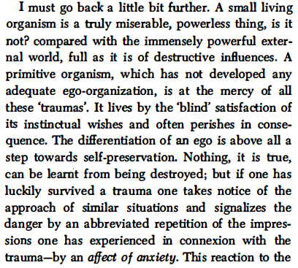
-The Question of Lay Analysis

Slide 16
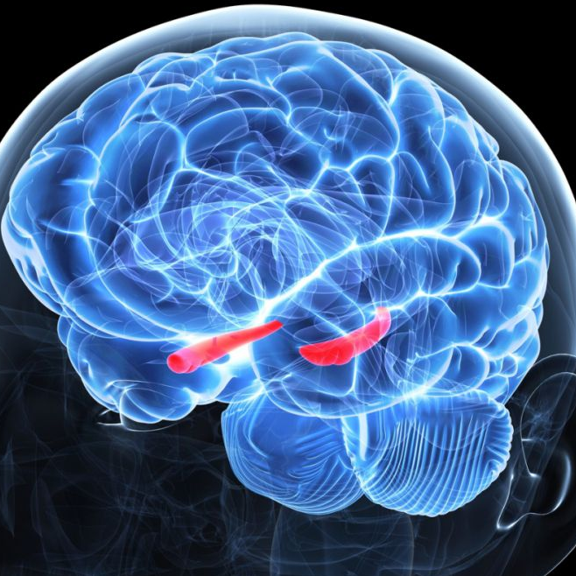
Hippocampus
Critical for the formation of episodic memories
Receives integrated sensory information, along with information from areas like the amygdala, to make a contextually-rich, emotionally salient memory
Also critical for regulating stress (helps shut down the fight or flight response after a threat is encountered)

Slide 17
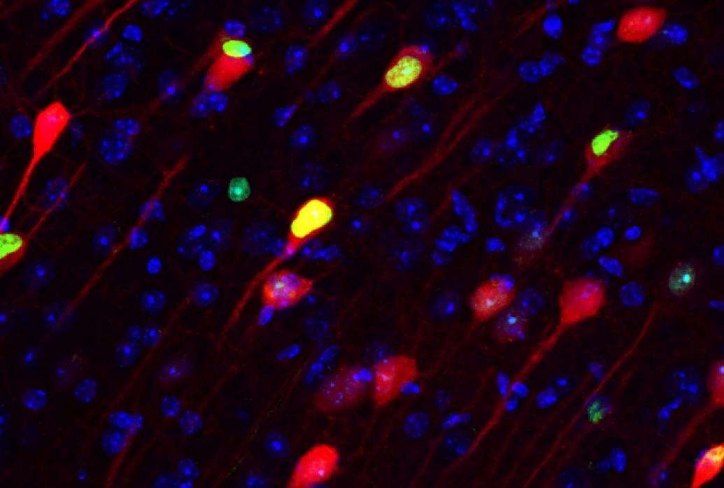
Hippocampus
Episodic memories in the hippocampus are stored as “engrams” – a specific group of interconnected neurons activated together during learning, and reactivated upon recall

Slide 18
Stages of Memory
When an engram is reactivated by memory recall, it becomes temporarily “labile” or ”plastic”, i.e., it can be modified!
Allows us to update our memories and add new information, which can be good and bad…
Acquisition (Learning)
Engram formed
~4h
Consolidation (Memory is made “long-term”)
Engram becomes stable
Recall
(Memory is retrieved)
Engram is reactivated

Slide 19
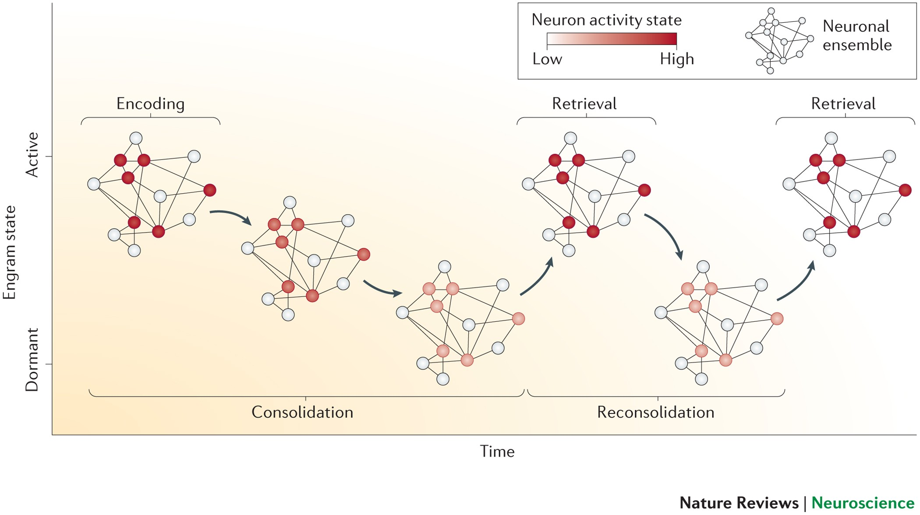
Josselyn et al., 2015

Slide 20
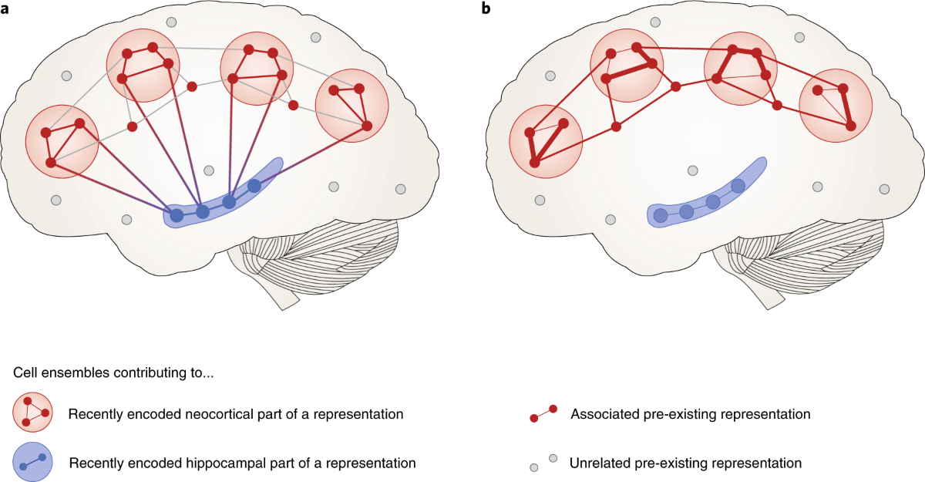
Systems Memory Consolidation
With time, memories formed in the hippocampus are transferred to the neocortex for long-term storage
Hippocampal engrams weaken, as the new cortical engrams strengthen (Kitamura et al., 2017)
Klinzing et al., 2019

Slide 21
The Neural Legacy of Fear and Trauma:
The BLA helps us associate certain environments and stimuli with potential threats
The CeA helps us respond defensively
The hippocampus forms contextually-rich episodic memories about the traumatic event
These episodic memories become plastic and susceptible to editing every time they are recalled/reactivated
As the memory shifts from the hippocampus to the cortex, it becomes further susceptible to “editing”

Slide 22
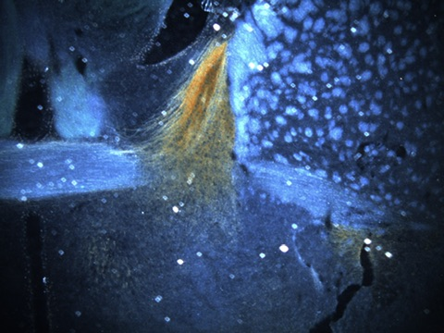

Slide 23
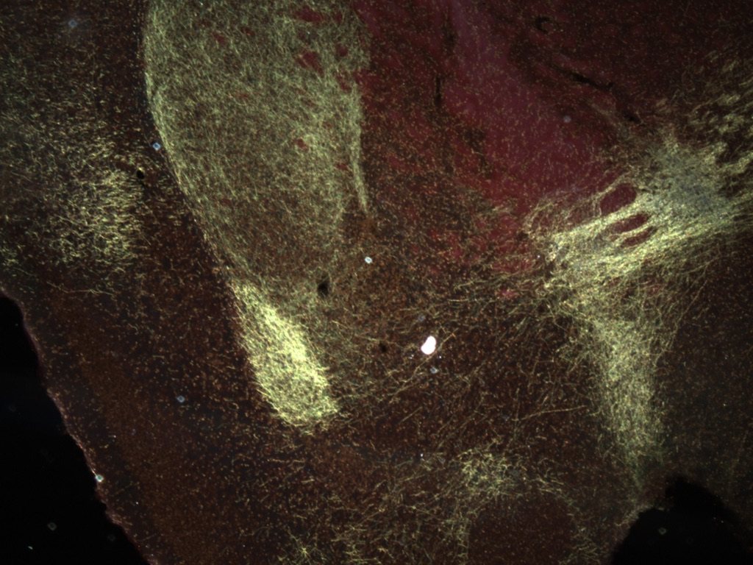

Slide 24
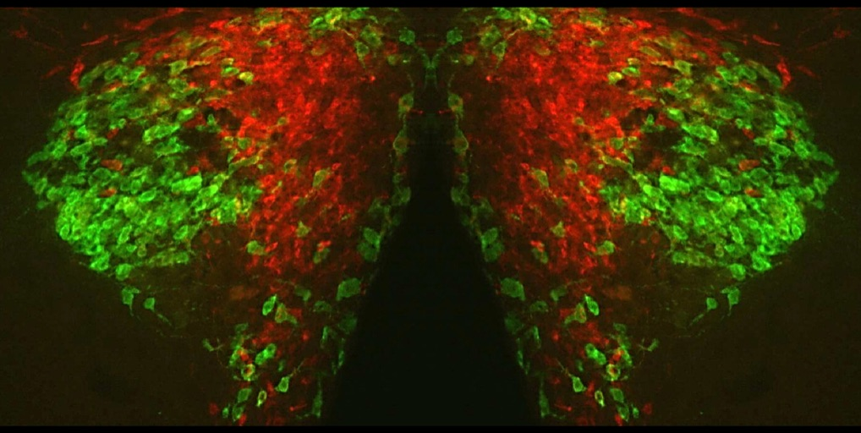

Slide 25
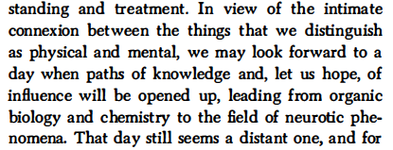


Slide 26
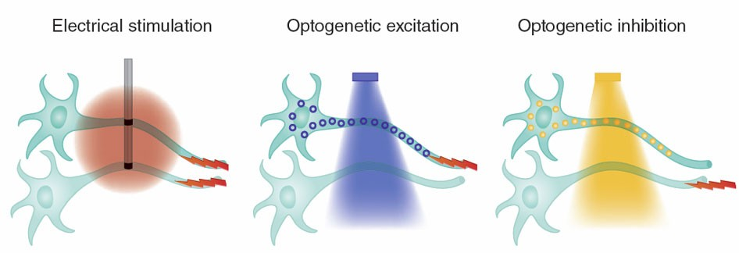
At the Cutting Edge
Optogenetics
Light-sensitive channels virally implanted into neurons
Optical fibre implanted in brain for laser stimulation
Neurons can be turned on and off as the animal is performing a task

Slide 27
At the Cutting Edge
Capturing Engrams
Technique that allows implantation of light sensitive channels (optogenetics) specifically within the engram associated with a discrete memory
This allows the memory to be activated or silenced when light is delivered to the brain region of interest

Slide 28
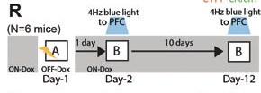
Kitamura et al., 2017
Used engram capture to examine systems memory consolidation
Mice were placed in Context A and given several foot shocks. They learn to fear Context A, but normally do not express fear in a novel context B.
Here, the fear conditioning engram is captured on Day 1 and tagged with a light-sensitive channel. When blue light is delivered to the brain, it “turns the engram on”.

Slide 29
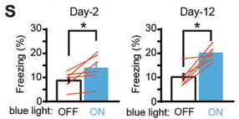
Kitamura et al., 2017
When mice are tested 2 or 12 days later in Context B, they show no fear at baseline. When blue light is delivered, the fear conditioning engram activates, and the animals show fear.

Slide 30

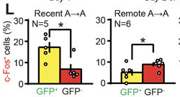
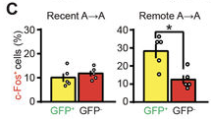
Kitamura et al., 2017
Red: Labels neurons that were recently active
Green: Labels engram
Hippocampus Engram
Prefrontal Engram
Yellow bars: Engram neurons activated by re-exposure to fear conditioning context
Red bars: Non-engram neurons activated by re-exposure to fear conditioning context

Slide 31
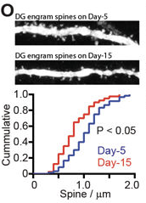
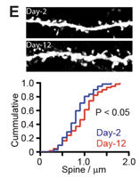
Kitamura et al., 2017
Hippocampus engram
Prefrontal Cortex Engram
Hippocampal engram neurons have a lot of dendritic spines (indication of activity/excitation) 2 days after training but show a reduction in spines 15 days after training. Engram is weakening.
The prefrontal engram neurons show the reverse pattern. Engram is strengthening.

