Slide 1
MeteoCal
Mkhatvari
Xia

Slide 2
Overview
The system permits only to the owner of the event the deletion, update of the schedule;
Users can create an event;
The system is able to send invitations and receives responses from the users;
In case of forthcoming bad weather conditions, the system has to notify to all partecipants about the forecast situation for outdoor events one day before;
In case of forthcoming bad weather conditions, the system has to suggest to the creator the earliest sunny day (if any) three days before the scheduled event;

Slide 3
Overview
For private events, only invited users can view the details of the occasion;
The system provides forecast for the upcoming events;
Users can view their own notifications and personal schedule;
Users can see other users' schedule if the calendar is set as public, check when they are busy and in case of public event, to see the details of the latter.

Slide 4
Assumptions
Bad weather conditions: rain, snow, storm;
X days before: 24h*X before a given event;
Notifications are sent immediately after the event creation;
Modification of the event: if any of the fields have been modified (e.g. location or date), the notifications shall be sent to all the original participants.
Overlapped events: an user can create an event only if he isn't participating to any other scheduled event during that lapse of time; (Not implemented)

Slide 5
Requirements
Interaction
Information
Privacy
Notification

Slide 6
Interaction
Users can create an event and view personal notifications, invitations and schedule;
Users can decline or accept the invitation at any time;
Updates and cancellation of event can be performed by the organizer at any time;
The organizer can shift only forward in time;
Any interaction with the calendar is possible only when the user is logged into the system;
Only the organizer is allowed to add more users to the event;
During the creation of an event the user has to fill the mandatory information fields, otherwise it won't be possible to proceed with the creation;

Slide 7
Information
Each event has a summary log at least with essential details: weather forecast, date, place, name of activity, and its type (i.e. outdoor or indoor);
User can check own schedule;
User can access to other users' calendar and see details of events;
Users can access to event's summary from the calendar;

Slide 8
Privacy
User can choose privacy settings for own calendar and events;
Each user can see detail of events on other calendars only if they're public;
Private calendar is hidden or inaccessible to public except its owner;
Only owner and invited users can see private events;

Slide 9
Notification
Once a new event is submitted, invitations containing all details about the event are sent to the involved users;
If any modifications to one of the fields are submitted, new invitations are sent to all invited users;
In case of upcoming bad weather conditions a reminder is sent to all participants in outdoor activities one day before;
In case of upcoming bad weather conditions the system suggests the closest consecutive sunny days (if any) for the outdoor events;

Slide 10
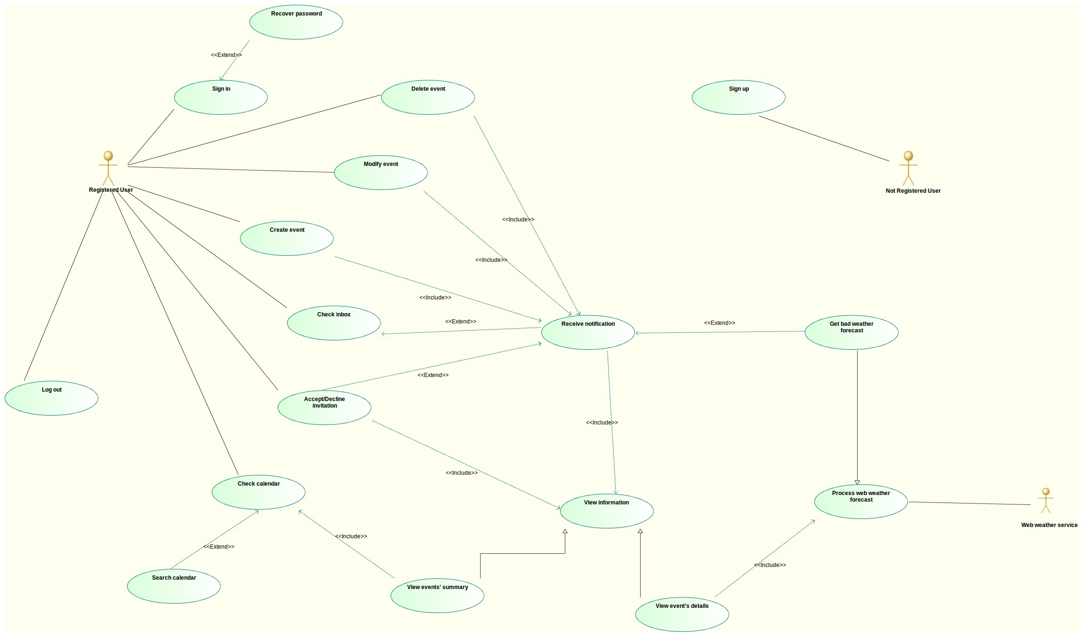

Slide 11
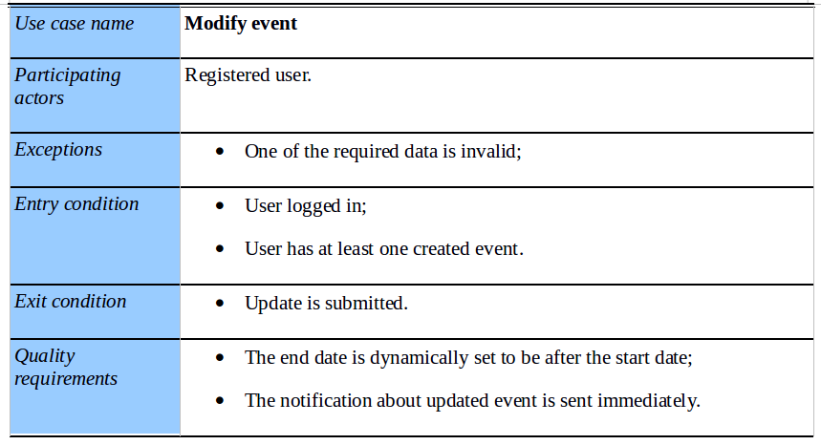
Use Case

Slide 12
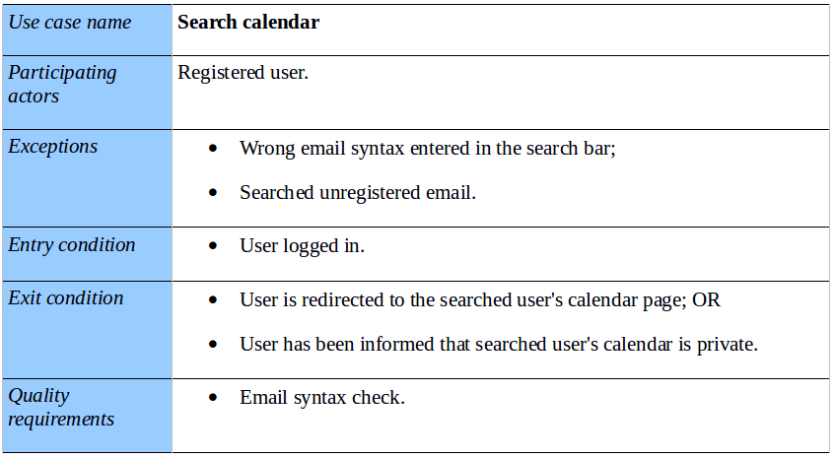
Use Case

Slide 13
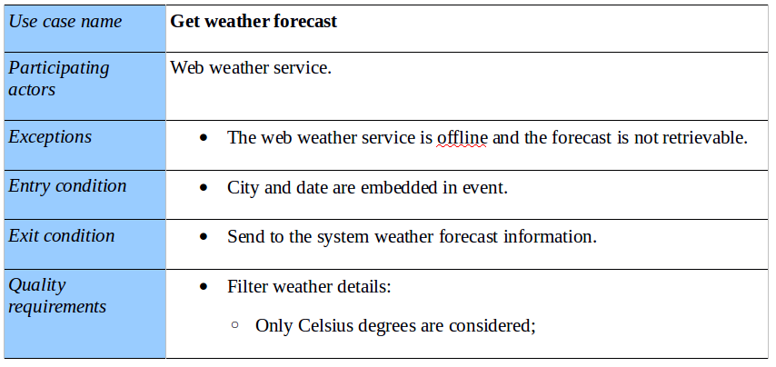
Use Case

Slide 14
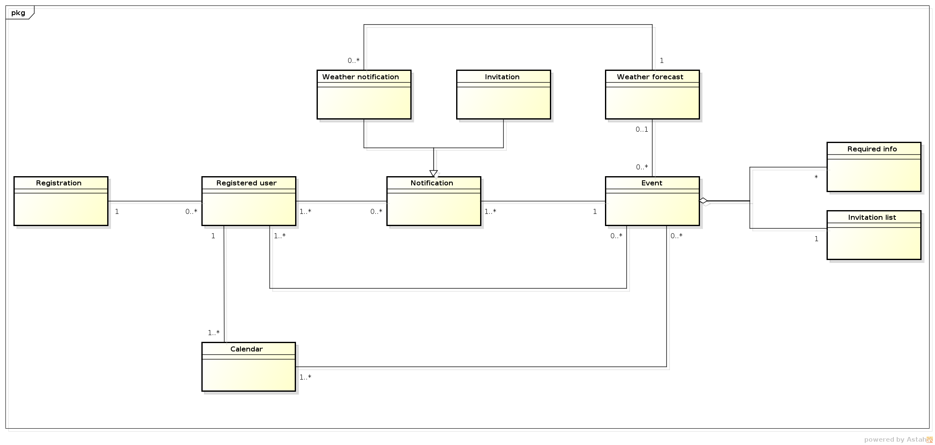
Class Diagram

Slide 15
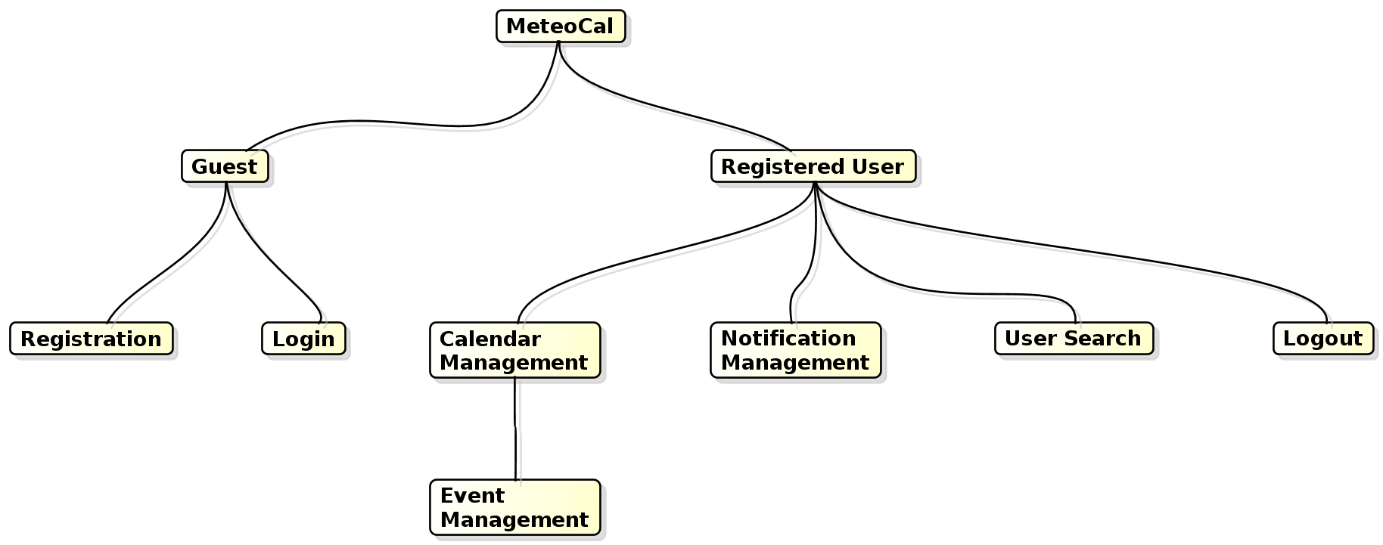
Top-Down Analysis
The subsystem are divided in:

Slide 16
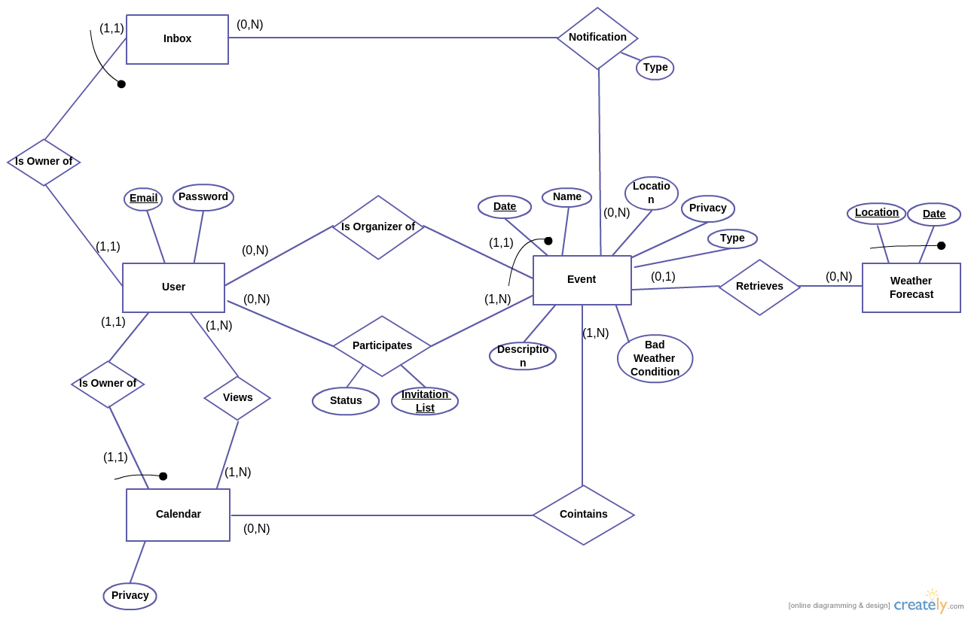
Persistant Data Management
Initial Conceptual Design

Slide 17
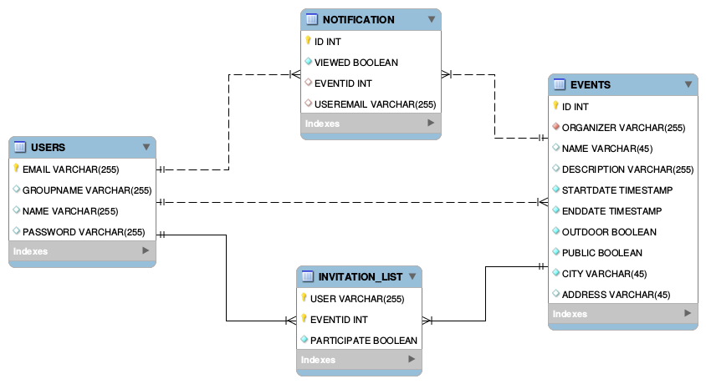
Persistant Data Management
Final Logical Design

Slide 18
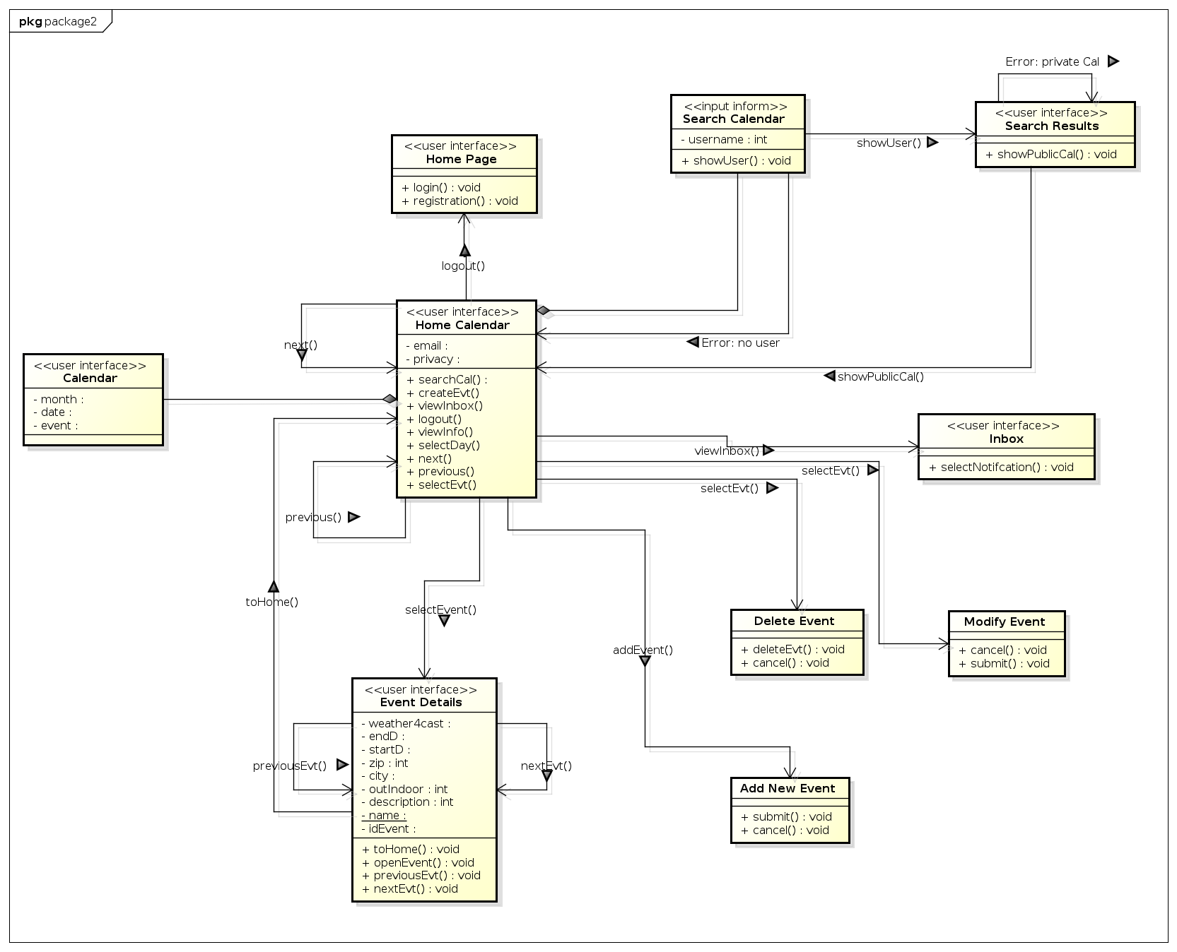
User Experience

Slide 19
Cost Estimation
Funtion Points Analysis
Total number of FPs: 108
Estimated SLOC = Total FPs * AVC(= 53)
=> SLOC = 108 FPs x 53 = 5724 LOC .
Our real LOC is 2875 that is much lower.

Slide 20
Cost Estimation
COCOMO
Our SLOC = 108 FPs * 46 = 4968
Effort = 2.94 * EAF * (KSLOC)^E = 17.13 Person/Month
Duration = 3.67 * (Effort)^E = 9.04 Months
Num People = Effort/Duration = 2 people

