Slide 1
Room Rate Prediction System
( SI699 Project Proposal )
Team Dragonflies:
Jing Wang, Yuan Li

Slide 2

Idea
What factors impact room rate?
How can customers know if they overpay?
Can we build a room-rate prediction system?
Notes:
Depend on a lot of factors, e.g:... → leading factors?
Possible for customer to see if overpay ? → prediction system

Slide 3
Data
1. Personalize Expedia Hotel Searches - ICDM 2013 (Link:https://www.kaggle.com/c/expedia-personalized-sort/data)
It contained nearly 10 million historical hotel search results representing approximately 400 thousand unique search queries on the popular travel booking website Expedia.com.
Features : ~ 54 features
Search (time, location, etc.)
User (country, historical data, etc.)
Hotel (price, star, reviews, etc.)
2. Inside Airbnb
(Link: http://insideairbnb.com/get-the-data.html)
It contains airbnb listing data throughout 85 major cities around the world; web crawling on a monthly basis
The total listings of a city are highly variant with the size of the city.
E.g., Amsterdam shows about 20,010 available listings
Features: ~ 96 features
Host (historical. etc.)
Room (facilities, neighborhood, etc.)
Listing (ratings, reviews, etc.)
Notes:
Limitation of Expedia data:
Dataset very sparse → include many null values
User historical data is usually null (HARD to get user info.)
Anonymous data
Limitation of Airbnb data:
Huge dataset → need to narrow down the scope ourselves (e.g: selecting several cities to study)
* Seeking advice from professors & Ph.d’s

Slide 4
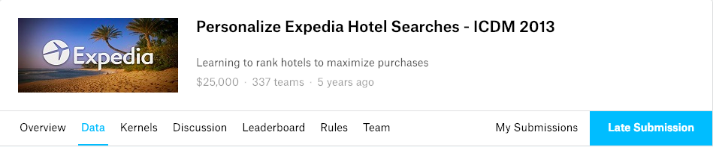
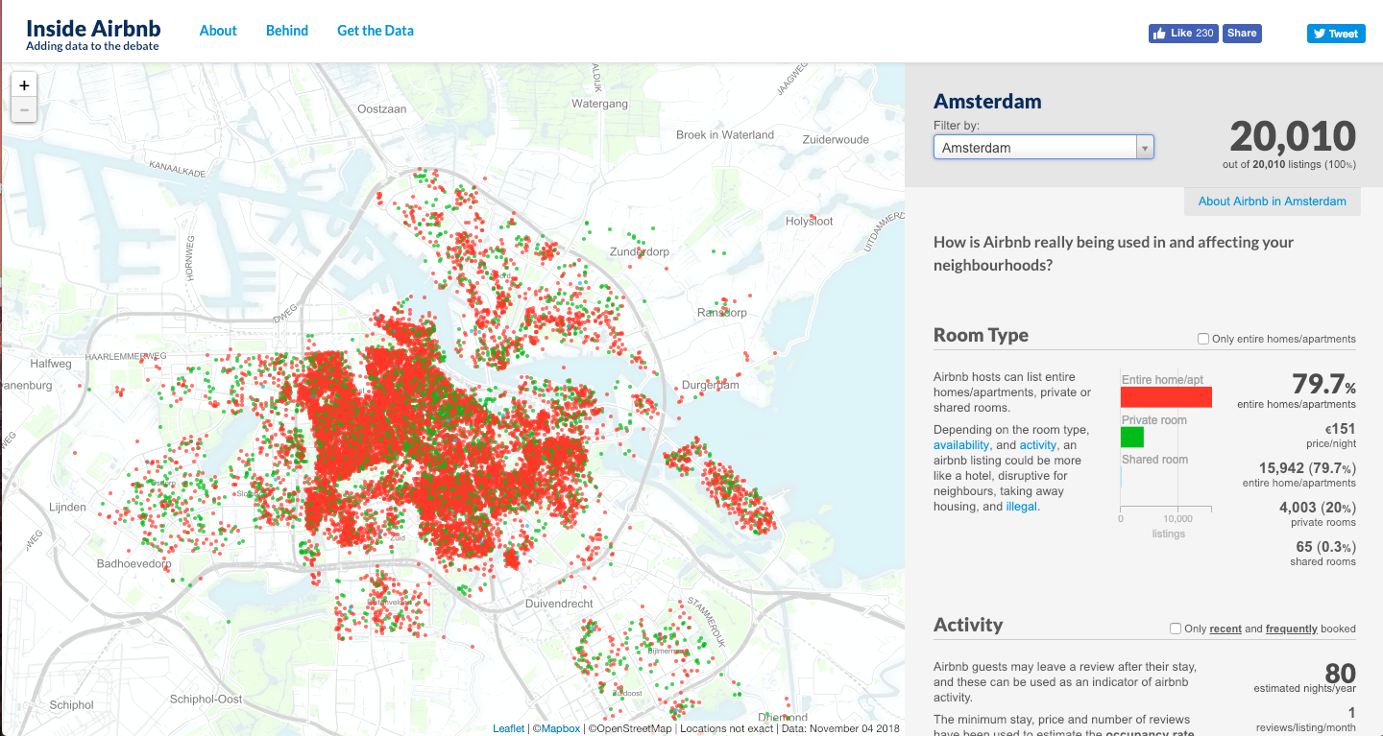

Slide 5

Methodology
Historical data analysis
Main factors identification
Hotel facilities
Hotel location
User’s aggregate purchase history
season
Algorithm explore
Collaborative filtering
Content-based filtering
Hybrid recommender system
System Evaluation
RMSE
RSS
Notes:
Collaborative filteringapproaches build a model from a user's past behaviour (items previously purchased or selected and/or numerical ratings given to those items) as well as similar decisions made by other users. This model is then used to predict items (or ratings for items) that the user may have an interest in.^{[8]} Content-based filtering approaches utilize a series of discrete characteristics of an item in order to recommend additional items with similar properties.^{[9]} These approaches are often combined (see Hybrid Recommender Systems).
Root Mean Square Error (RMSE) is the standard deviation of the residuals (prediction errors).
The residual sum of squares (RSS) is the sum of the squares of residuals(deviations predicted from actual empirical values of data). It is a measure of the discrepancy between the data and an estimation model. A small RSS indicates a tight fit of the model to the data. It is used as an optimality criterion in parameter selection and model selection.

Slide 6

Deliverables
Expected Outcome:
Target group: for users who would want to get the cheapest rate of room listed
A prediction system that could take information of a room listing as input, and output a predicted price for that listing within a period of time
System Evaluation Results
Notes:
Root Mean Square Error (RMSE) is the standard deviation of the residuals (prediction errors).
The residual sum of squares (RSS) is the sum of the squares of residuals(deviations predicted from actual empirical values of data). It is a measure of the discrepancy between the data and an estimation model. A small RSS indicates a tight fit of the model to the data. It is used as an optimality criterion in parameter selection and model selection.

Slide 7

Work Plan
Week 1, 2, 3: Introduction, Team building and Project Design
Week 4, 5: Data collection and analysis
Week 6, 7: Key factors identification and selection
Week 8: Halfway report submitted, reviewed, and presented in class
Week 9, 10: Prediction model build
Week 11, 12: Prediction model optimization
Week 13: Project results submitted and reviewed.
Week 14: Final presentations and result dissemination.

