Slide 1

FSML Python Implementation
Nicolas Beck
GitHub url : https://github.com/nico1510/sle

Slide 2
1) Parsing
Is done by antlr generated Parser + Lexer (python Code)
Grammar is identical to specification grammar
fsm : state* EOF ;
state : initial? 'state' id {self.addState($initial.text,$id.text)} '{' transition* '}' ;
initial : 'initial' ;
transition : input_ ('/' action )? ( '->' id )? ';'
{self.addTransition($input_.text, $action.text, $id.text)} ;
id : NAME ;
input_ : NAME ;
action : NAME ;
NAME : ('a'..'z'|'A'..'Z')+ ;
WS : ( '\t' | ' ' | '\r' | '\n'| '\u000C' )+ { self.skip() } ;

Slide 3
1) Parsing
Is done by antlr generated Parser + Lexer (python Code)
Grammar is identical to specification grammar
semantic actions are included directly in the grammar
fsm : state* EOF ;
state : initial? 'state' id {self.addState($initial.text,$id.text)} '{' transition* '}' ;
initial : 'initial' ;
transition : input_ ('/' action )? ( '->' id )? ';'
{self.addTransition($input_.text, $action.text, $id.text)} ;
id : NAME ;
input_ : NAME ;
action : NAME ;
NAME : ('a'..'z'|'A'..'Z')+ ;
WS : ( '\t' | ' ' | '\r' | '\n'| '\u000C' )+ { self.skip() } ;

Slide 4
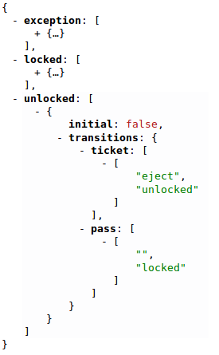
1) Parsing
→ Result is a python Dictionary,
representing the FSM

Slide 5
2) Constraints
Constraints are checked with the help of the dictionary

Slide 6
2) Constraints
Constraints are checked with the help of the dictionary
1) distinct Ids
length == 1 ?

Slide 7
2) Constraints
Constraints are checked with the help of the dictionary
1) distinct Ids
2) single initial
length == 1 ?

Slide 8
2) Constraints
Constraints are checked with the help of the dictionary
1) distinct Ids
2) single initial
3) deterministic
length == 1 ?
length == 1 ?

Slide 9
2) Constraints
Constraints are checked with the help of the dictionary
1) distinct Ids
2) single initial
3) deterministic
4) resolvable
length == 1 ?
length == 1 ?
contained in dict ?

Slide 10
2) Constraints
Constraints are checked with the help of the dictionary
1) distinct Ids
2) single initial
3) deterministic
4) resolvable
5) reachable (done with recursion)
length == 1 ?
length == 1 ?
contained in dict ?

Slide 11
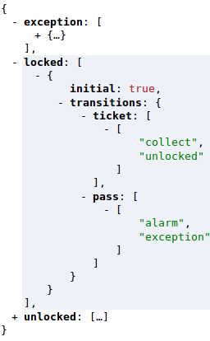
3) reference semantics
Input = [ticket, pass]
Output = [ ]
→ output „collect“
Go to state „unlocked“

Slide 12
4) Code Generation
Is done by jinja2 package (template library for python)
Python Code is generated
Handler and Stepper Classes
no Enums like in the Java Version of the Spec

Slide 13
4) Code Generation
class DefaultTurnstileHandler():
def __init__(self):
self.actions = dict()
{% for action in actions %}
self.actions['{{ action }}']= self.handle{{ action|default('Empty', true)|capitalize() }}
{% endfor %}
def handle(self, Action):
self.actions[Action]()
def addHandlerFunction(self, action, function):
self.actions[action] = function
{% for action in actions %}
def handle{{ action|default('Empty', true)|capitalize() }}(self):
print "handling {{ action|default('Empty', true)|capitalize() }}"
{% endfor %}

Slide 14
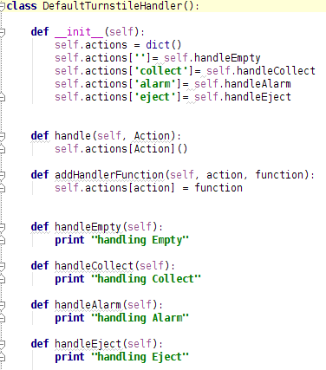
4) Code Generation
Generated Code

Slide 15
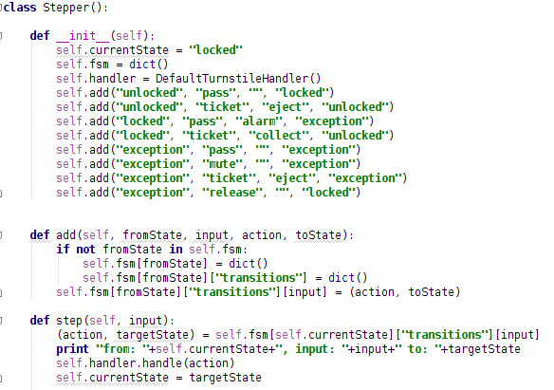
4) Code Generation
Generated Code

Slide 16
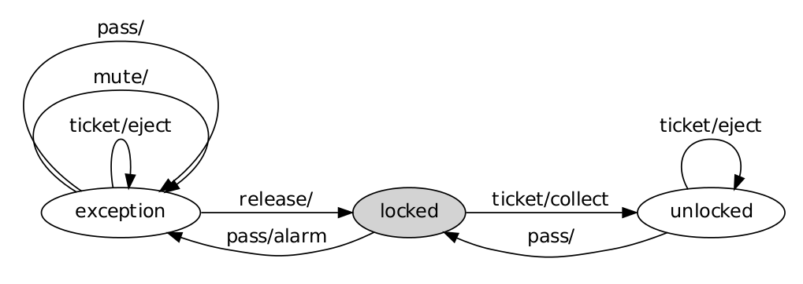
5) Visualization
Is done by pygraphviz package (python API for graphviz)
Again the fsm dictionary is used :
  every entry corresponds to a node
  every transition corresponds to an edge

Slide 17
6) Test Cases
Testing is done with python's unittest module
Incorrect *.fsml files are taken from the spec
  Also test cases from Appendix E ( ParserError, infeasible Input, illegal Input ) are taken Care of
Testing Code : https://github.com/nico1510/sle/tree/master/tests

