Slide 1
SLE Assignment 4
Test Data Generation
Nicolas Beck

Slide 2
Testing objectives
test parsing (1),
constraint checking (2),
and simulation (3)...
… of my fsml implementation
What sort of errors are you trying to catch?
Implementation errors in the modules for (1),(2),(3)

Slide 3
Testing objectives
What sort of generated test-data set helps in this context?
randomly generated valid *.fsml + input files
randomly generated invalid *.fsml + input files
How do you implement your test strategy?
generate test data (see next slides)
use data-driven testing approach (unittest Testsuite)

Slide 4
Test data generation
Use nltk library (Natural Language Toolkit) to generate all possible combinations of CFG up to a certain depth
FSM -> ISTATE STATES
ISTATE -> 'initial' 'state' '#initState#' '{' TRANS '}'
STATES -> STATE STATES |
STATE -> 'state' '#stateDecl#' '{' TRANS '}'
TRANS -> TRANSITION TRANS |
TRANSITION -> '#input#' '/' '#action#' '->' '#newState#' ';'

Slide 5
Test data generation Step 1
possible combination
can't be used by template library in this form
initial state #initState# {
#input# / #action# -> #newState#
#input# / #action# -> #newState#
}
state #stateDecl# {
#input# / #action# -> #newState#
#input# / #action# -> #newState#
}
initial state #StateDecl# {
}

Slide 6
Test data generation Step 2
template for use with jinja library
→ next step: generate random graph with edges :
2 , 2 , 0
initial state {{ states[0] }} {
{{ states[0].input[0] }} / {{ states[0].action[0] }} -> {{ states[0].newstate[0] }}
{{ states[0].input[1] }} / {{ states[0].action[1] }} -> {{ states[0].newstate[1] }}
}
state {{ states[1] }} {
{{ states[1].input[0] }} / {{ states[1].action[0] }} -> {{ states[1].newstate[0] }}
{{ states[1].input[1] }} / {{ states[1].action[1] }} -> {{ states[1].newstate[1] }}
}
state {{ states[2] }} {
}

Slide 7
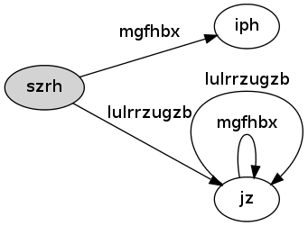
Test data generation Step 3
generate random (valid) graph with edges : 2 , 2 , 0
own algorithm, result looks like :

Slide 8
Test data generation Step 4
Fit the generated graph into the template
initial state szrh {
lulrrzugzb / „“ -> jz
mgfhbx / „“ -> iph
}
state jz {
lulrrzugzb / „“ -> jz
mgfhbx / „“ -> jz
}
state iph {
}

Slide 9
Input generation
The generated graph is also used to generate valid Input files (by randomly walking through the graph and dumping the output)
This gold standard output is then compared to
1) the implemented simulation of the fsml spec
2) the simulation of the generated Code
→ all 3 have to be equal
Python allows to import the generated modules dynamically

Slide 10
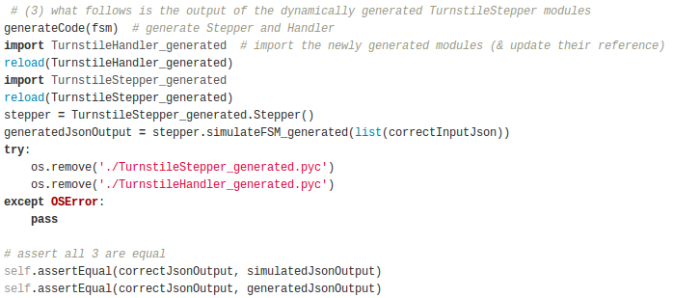
Input generation

Slide 11
Negative test cases
For each possible error : syntax error, infeasible input, illegal input, duplicate ids, single initial, reachability, resolution, determinism invalid test data is generated (up to a certain depth)
1) valid fsm is constructed like shown on prev slides
2) add error at random position
3) fit the invalid fsm into the (invalid?) template
single initial & parser errors are constructed by changing the template

Slide 12
Negative test cases
Example : reachability error

Slide 13
Negative test cases
Example : reachability error
select random state

Slide 14
Negative test cases
Example : reachability error
select random state
redirect all transitions to this state
mgfhbx

Slide 15
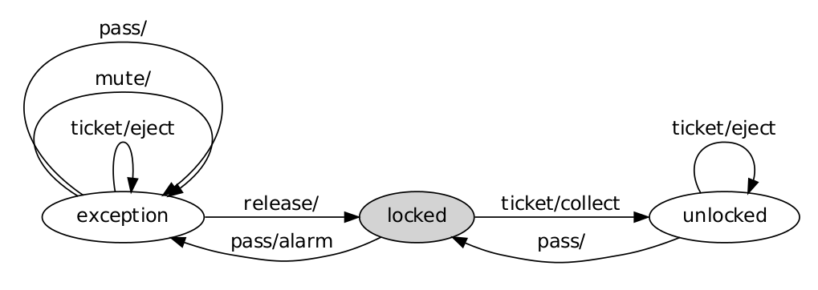
Negative test cases
Example : infeasible input
start at initial node
[ mute ]
[ release ]

Slide 16
Negative test cases
Example : infeasible input
start at initial node
walk through graph and append input to inputfile
[ mute ]
[ release ]
[ ticket , mute ]
[ ticket , release ]
[ ticket , mute ]

Slide 17
Negative test cases
Example : infeasible input
start at initial node
walk through graph and append input to inputfile
[ mute ]
[ release ]
[ ticket , mute ]
[ ticket , release ]
[ ticket , mute ]

Slide 18
Negative test cases
Example : infeasible input
start at initial node
walk through graph and append input to inputfile
select one possibility randomly
[ mute ]
[ release ]
[ ticket , mute ]
[ ticket , release ]
[ ticket , mute ]

Slide 19
Negative test cases
Results for depth = 7
~ 300 test data files for positive and negative test cases → 3000 test cases in total
depth = 8
~ 1900 test data files for positive and negative test cases → 19000 test cases in total

