Slide 1




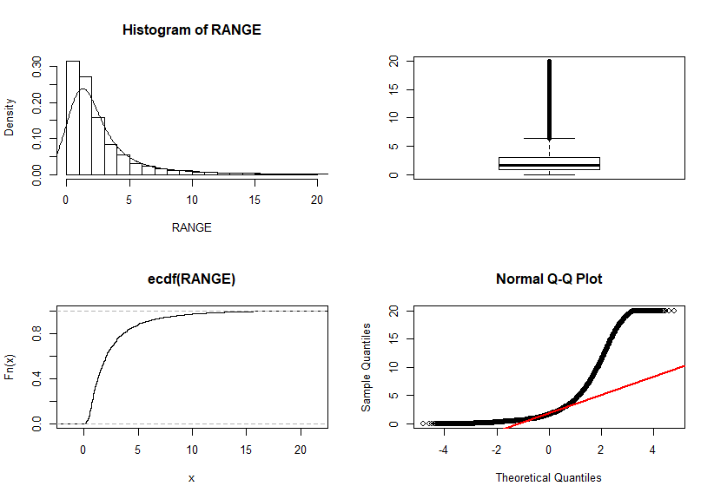
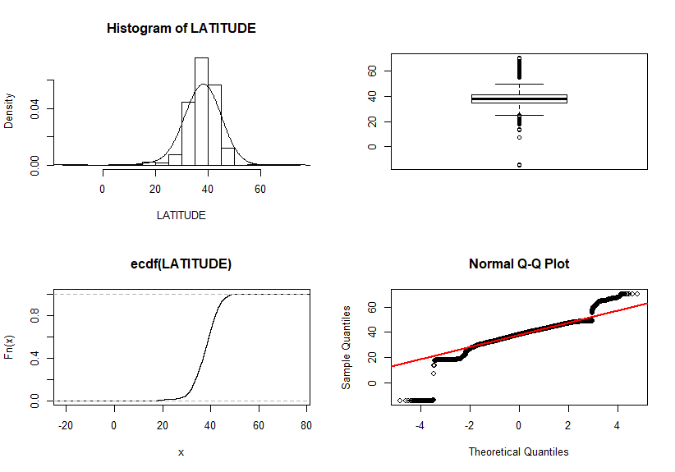
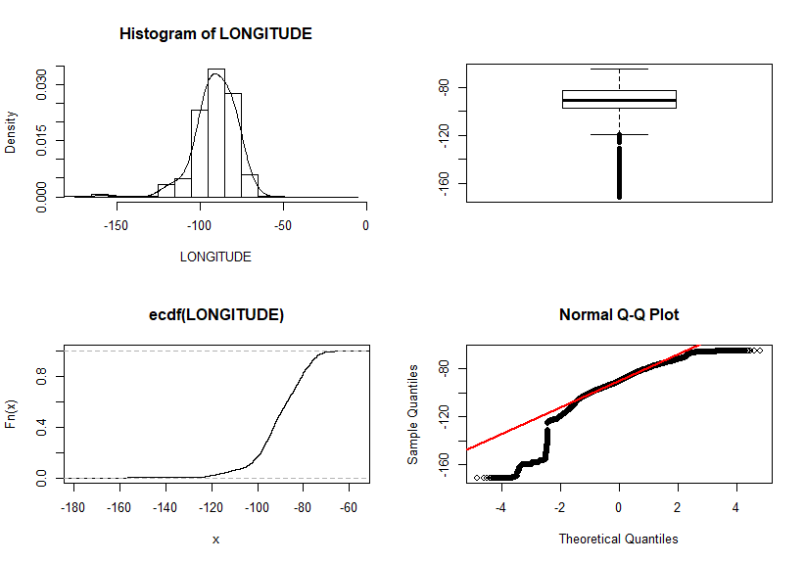
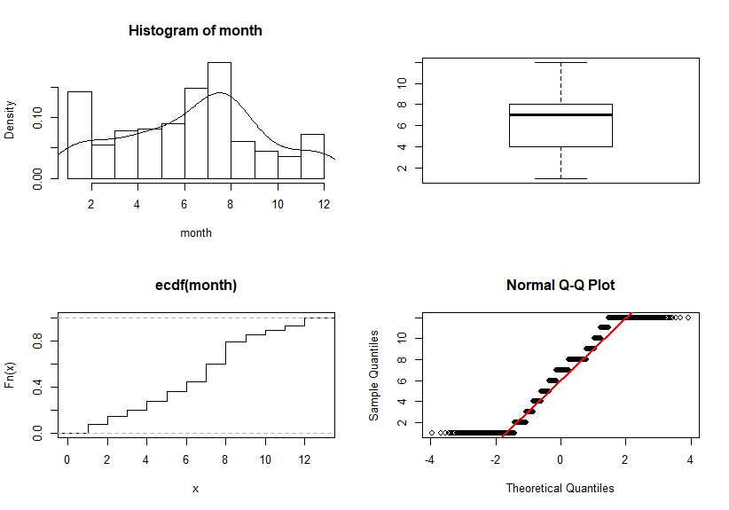
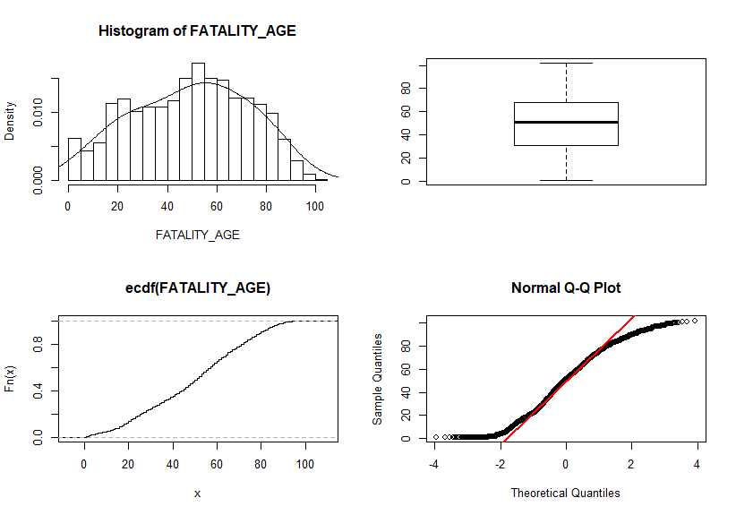

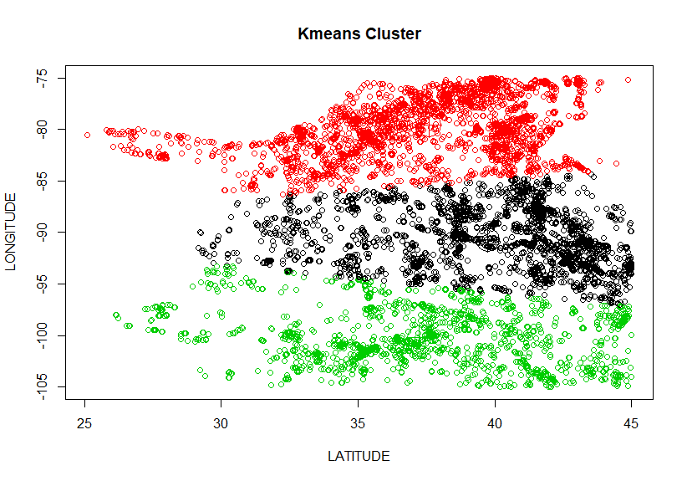
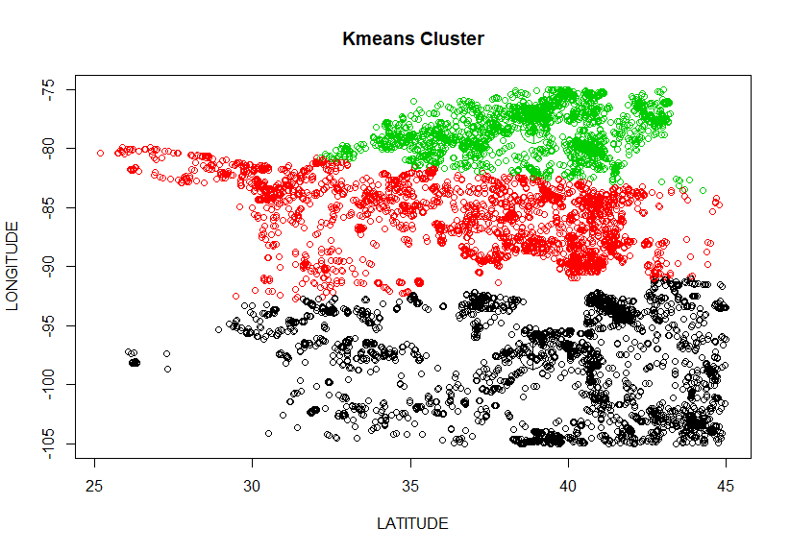
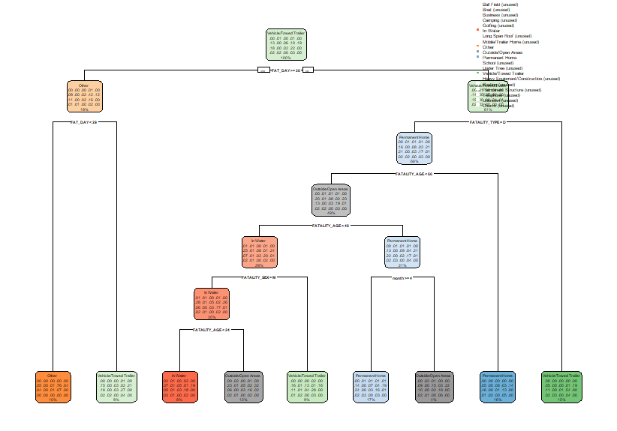
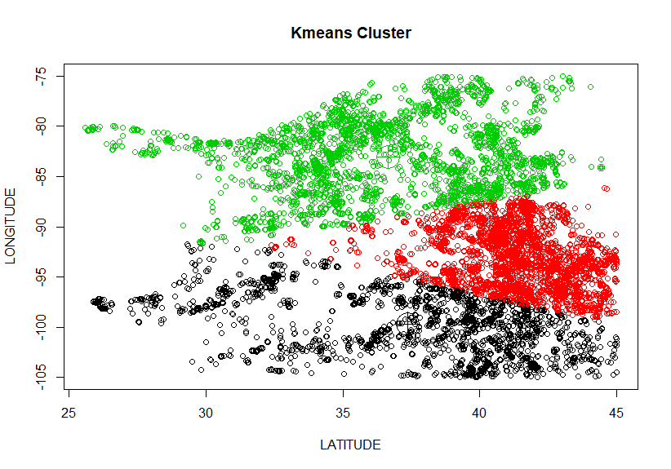
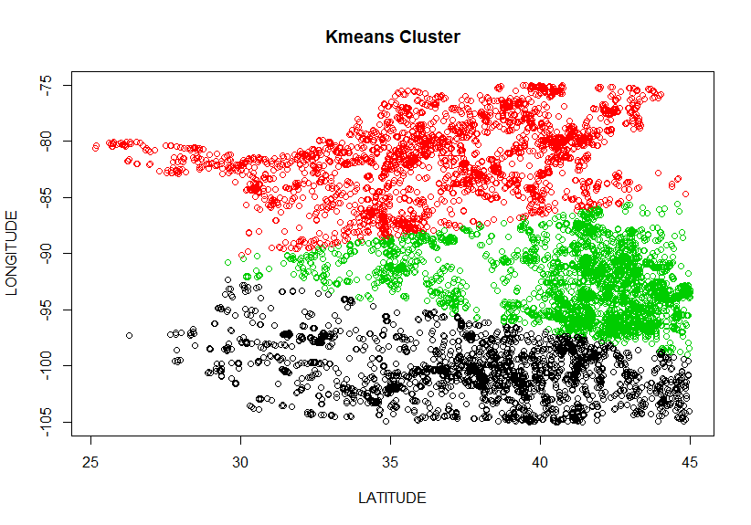
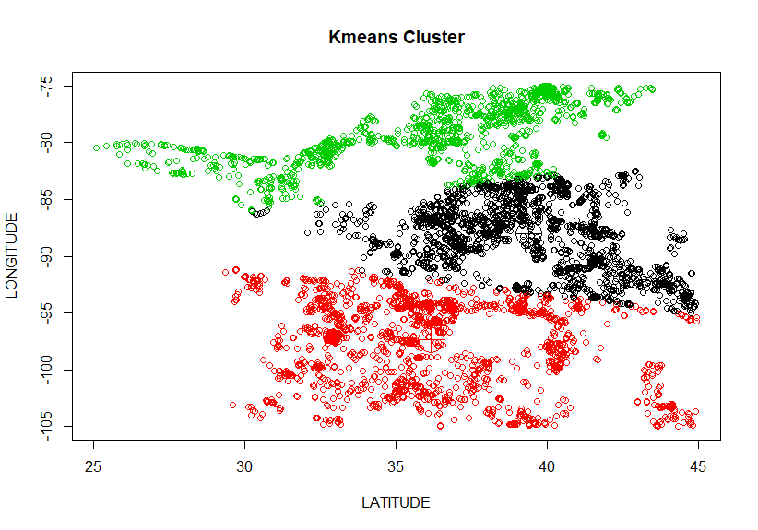
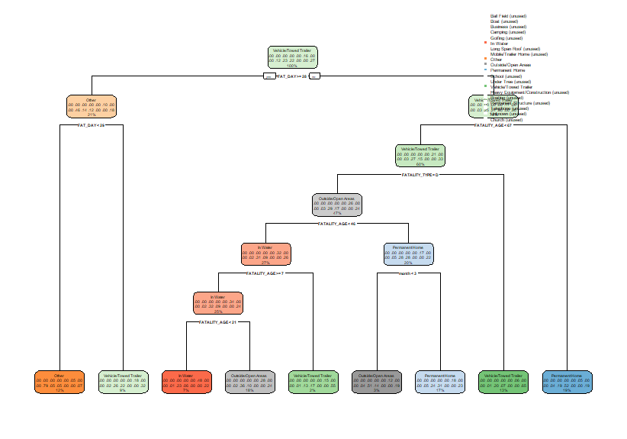
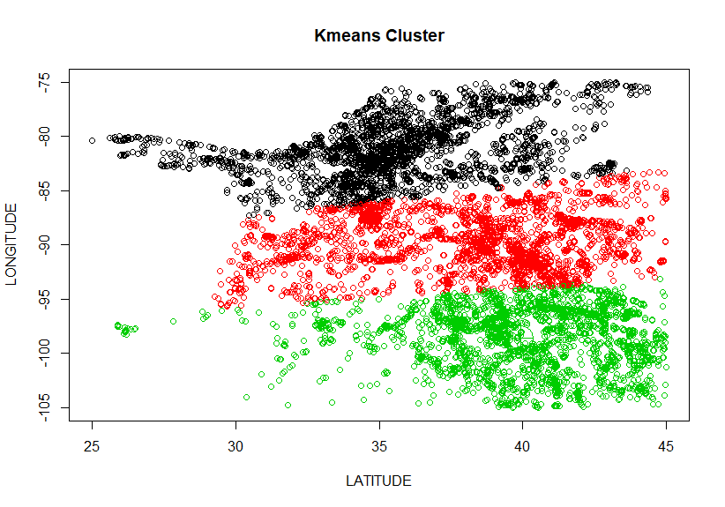
The analysis of storm events
Zhiyu Chai^{1 (chziz@rpi.edu)},
(¹Rensselaer Polytechnic Institute 110 8th St., Troy, NY, 12180 United States)
Basic analysis
Every year, storms comes to this planet and bring economic losses and danger to people’s life. With the dataset of past years, we can cluster the storm into several group and set rescue team at the cluster center. Also, we can classify the type of victims, so the rescue team can take special equipment when they depart.
The storm dataset is collected from NCDC (National Climate Date Center). The data covers from 1950 through to the present and is updated monthly. NCDC Storm Event database allows users to find various types of storms, including year, month, range, latitude, longitude and victim detail. Based on its reliability and diversity, these dataset will be the source of the project
These six plots has shown the distribution of six main variables used in this project. It’s easy to find that storms happen more often in June and at the latitude between 25 to 45, longitude between -105 to -75 . Most storm range is under 20. People are usually injured or killed by the storm in July. The victims include children, young people and old people.
Based on these analysis, clustering model will be used on the coordinate of the storms and decision tree will be used to classify the type of victims.
Clustering Model
Decision Tree Model
Based on the basic analysis, I will use data with month of 6, latitude between 25 to 45, longitude between -105 to -75 and range under 20 to analyze.
In this model, past-twenty-years datasets are used. Variable fatality_location is used as the independent value. First, all kinds of fatality_location is used to the model, but only five of them can presented in the model. The percent of these five kinds is 82%. Then only use five kinds of fatality_location create a new decision tree.
With this decision tree, rescue team can figure out the fatality_location of the victim and get special equipment before they depart.
Data of 2013
Data of 2015
Decision tree model with all kinds of fatality_location
Data of 2010
Data of 2014
Data of 2019
According to the model, 3 clusters has been create for six years of past ten years. Thus, it’s better to set three rescue center. According to those six models, the centers should be set at (37.06754, -80.56880), (39.69604, -90.36194), (37.99728, -98.90951).
Decision tree model with five main kinds of fatality_location
Clustering model, when using silhouette() function to validate, the average silhouette width is about 0.46, far from 1.For decision tree model, its accuracy is about 48.84%.
In the future, if NCDC can give more specific information of storms, both models can be improved.
Source
Data of 2011
https://catalog.data.gov/dataset/ncdc-storm-events-database
Poster: MT15A-08
Glossary:
RPI – Rensselaer Polytechnic Institute
TWC – Tetherless World Constellation at Rensselaer Polytechnic Institute
Conclusion
Github URL
In this project, clustering model and decision tree model are applied to help set the rescue center and help rescue team get special equipment before they depart. Both models have given a initial result.
However, Both models have their own problem. For
https://github.com/nico37alonso/DataAnalyticsSpring2020Project
Acknowledgments:
Person1 and Person2 from the Tetherless World Constellation at RPI

