Slide 1
Final Project
EEL5722 – FPGA Design
Fall 2024

Slide 2
Logistics
Return lab equipment by: 12/04/2024 (contact David for extension david.douglas@ucf.edu)
Final Project Submission Due: 12/06/2024 11:59 PM
Submission Items: (zipped as a single file)
Verilog sources [40%]
Bitstream file [10%]
Demo video [20%]
Project report [30%]

Slide 3
Recap
Lab | Learning Outcome
01 | Clock division, Counters, Debouncing, Multiplexing
02 | VGA interfacing
03 | USB Keyboard interfacing, shift registers, bin to BCD
04 | Creating ROM, VGA x/y interfacing
05 | Creating RAM, Read/Write COE values

Slide 4
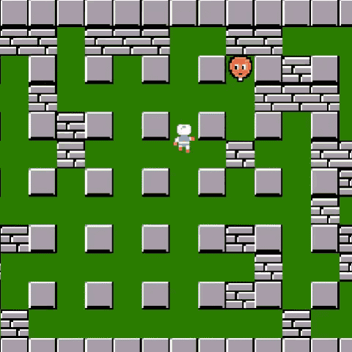
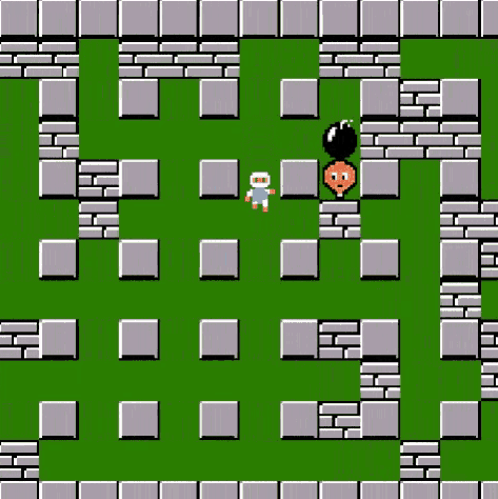
Overview – Final Project
Develop a digital system that plays
retro video game
Similar to Bomberman (Wiki)
Use the skills from your lab experience
Play online: (Click here)
Another Example: (Click here)
Indestructible pillar
Bomb
Bomberman
Enemy
Brick block (destructible)

Slide 5
Project Files – Verilog Scripts
Enemy Module – develop FSM for enemy logic (20%)
Bomb Module – bomb and explosion algorithm (FSM again) (20%)
Bomberman Module – displace the bomberman with key presses & animate a life bar (25%)
Animate Power-ups – Display power-ups after a block destruction from bomb explosion (15%)
Score Display & Life Bar – develop a counter against enemy kills & Animate a life bar (20%)

Slide 6
Project Files – Graphics COEs
Block block.coe
Block map block_map.coe
Bomb bomb.coe
Pillar pillar.coe
Bomberman player.coe player_death.coe
Enemy enemy.coe
Explosion explosions.coe
Block Destruction block_destructions.coe
Power-up powerup_radius.coe, powerup_speed.coe
Each COE has memory radix of 10
(decimal data values)

Slide 7
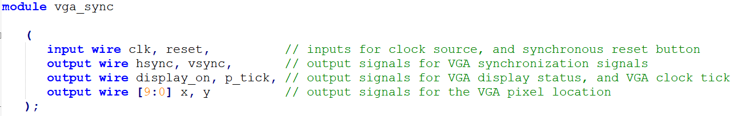
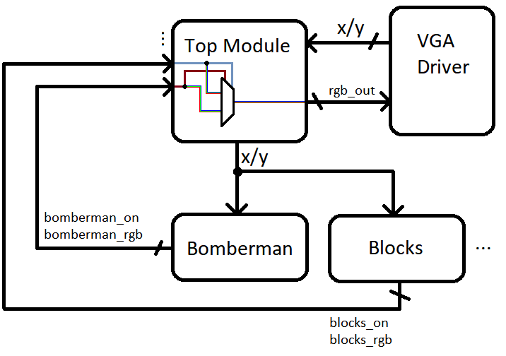
Project Files – Missing VGA module

Slide 8
Deliverables – Rubric (For Source & Demo)
1.) Animate Bomberman 20%
2.) Bomb and Explosion FSM 25%
3.) Animate Power-ups 15%
4.) Linear Feedback Shift Register 05%
5.) Enemy Finite State Machine 20%
6.) Binary to BCD 10%
7.) Bomberman Life Bar 05%
8.) Your Creative Expansion 20%
Total: 120%

Slide 9
Deliverables – Animate Bomberman
Register input from user (button press on FPGA board)
Determine walking direction on button press
Displace bomberman sprite while cycling through COE images

Slide 10
Deliverables – Bomb and Explosion
The FSM should be included in bomb_module.v file
State Machine – (no bomb, deployed, timer, explosion, post explosion)
Algorithm logic is provided in project manual as flow chart with states

Slide 11
Deliverables – Animate Power-ups
In case a bomb explosion destroys a block, a power-up can drop randomly
Two types – bomb radius increase & speed increase
You can decide the maximum number of power-ups available in a game (can be a high value)

Slide 12
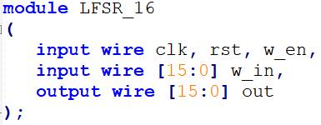
Deliverables – Enemy FSM & Shift Register
Assert random direction of the enemy walk
Develop pseudorandom 16-bit linear shift register (hint link)
Determine if the move is legal (enemy should not walk over pillars/blocks)
If illegal, choose new random value until legal direction is determined
Start motion timer and animate the enemy, increase the speed and the randomness of the enemy movement each time it is hit
The logic flow chart is given in the project description manual.

Slide 13
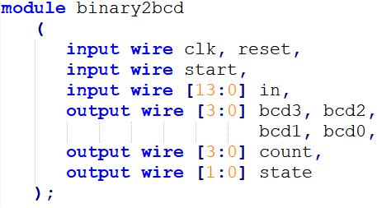
Deliverables – Binary to BCD
Convert binary value of score register into BCD (like we did in lab 3)

Slide 14
Deliverables – Bomberman Life Bar
Animate a red life bar on the top right corner (width of 20 pixels, height of 8 pixels)
Every time the bomberman receives damage from the enemy or explosion, a portion of the life bar fills up with black color (5 lives maximum)
Once all the 5 lives are lost, the entire red bar becomes black
No coe file provided for the life bar, use custom logic

Slide 15
Deliverables – Rubric (For Source & Demo)
1.) Animate Bomberman 20%
2.) Bomb and Explosion FSM 25%
3.) Linear Feedback Shift Register 05%
4.) Enemy Finite State Machine 25%
5.) Binary to BCD 10%
6.) Bomberman Life Bar 15%
6.) Your Creative Expansion 20%
Total: 120%

Slide 16
Deliverables – Expansion (optional)
Some Suggestions:
Modify the game for two-players
Include additional power-ups and bomb displacement
Implement pause functionality
Include sound effects to the game

Slide 17
Q/A
- Office hours: the lab sessions
- You can help each other but DO NOT plagiarize the work
Best of Luck!

