Slide 1
Data Engineer Task: Spark Pipeline
by Nicolás Andrés Zimerman

Slide 2
Preface
Due to the limited time and resources, I decided to solve this task using a Community’s account of Databricks, where everything is ready and free to go. The pipeline was therefore tested with a 1-node Cluster with 1 core and 6 GB of RAM.
Please read the Readme.txt, in order to change the directory where you would like the .CSVs to be generated.

Slide 3
Overview
Normalization
Integration
1
2
3
4
5
Pre-processing
Extraction
Data enrichment

Slide 4
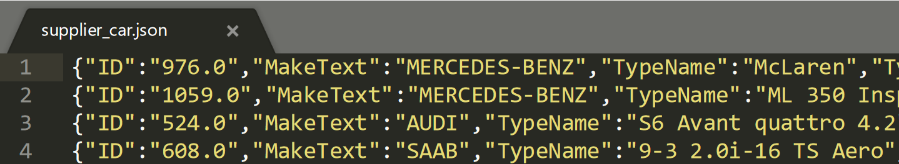
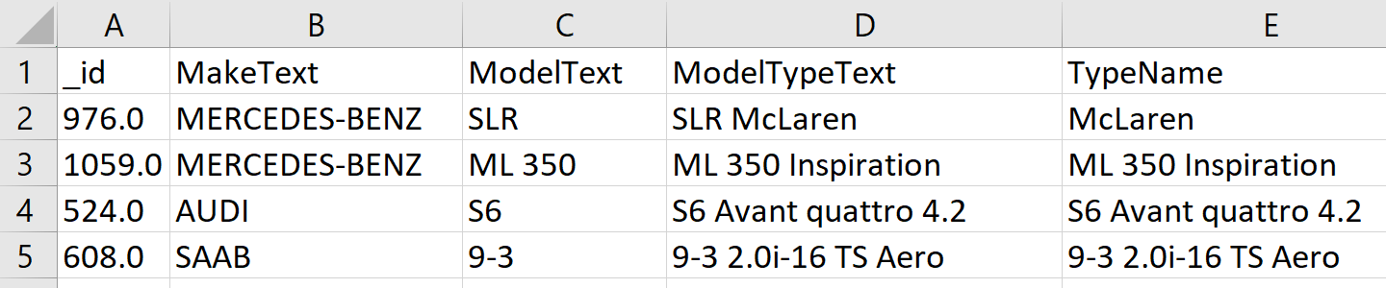
1. Pre-processing
Initial state of input file
JSON format
Data is semi-structured
Each row represents one object
There are 2 attributes that could be used as index
Import
Pivot
Rename
Actions
Importing JSON as DataFrame to Spark, then to Pandas
Pivoting
Renaming ID to _id, not to have issues while importing from Excel
Pivoting

Slide 5
2. Normalization
State after pre-processing
Pandas DataFrame
Data is structured
Each row is a car instance
Each col is a variable/attribute
Variables are mostly categorical
Normalizations
Translations GER=>ENG:
BodyColorText
InteriorColorText
BodyTypeText
DriveTypeText
ConditionTypeText
TransmissionTypeText
FuelTypeText
Formatting:
MakeText=> title case
Properties: 4 steps, see next slide
Observations
Attributes Ccm, City, TypeName, ModelText will be normalized during the integration phase, as they will be merged into one attribute directly
Translating
Formatting
rebuilding

Slide 6
2. Normalization …continued
…
2. Formatting:
…
Properties: 4 steps
Step 1 – Remove “” .replace('"', '')
‘ “Ab MFK” ‘=> ‘Ab MFK’
Step 2 – Remove spaces after ‘,’ and split by commas
.strip(' ').split(‘,’)
‘Ab MFK, Rennwagen’=> [‘Ab MFK’,‘Rennwagen’]
Step 3 – Translate:
[‘Ab MFK’,‘Rennwagen’]=>[‘freshly serviced’,‘racing car’]
Step 4 – Produce a joined string ', '.join(map(str, normalizedProperties.iloc[index])
[‘freshly serviced’,‘racing car’] => ‘freshly serviced, racing car’

Slide 7
3. Extraction
Extractions
entity_id into _id
ConsumptionTotalText (splitted) into:
extracted-value-ConsumptionTotalText
& extracted-unit-ConsumptionTotalText'
City=>countryCode + countryFull=>LHD/RHD:
-Extracted countryCode and countryFull (country full name)
by finding the location of the city through GeoPy.
-Extracted drive attribute by comparing each car’s
country with a list of LHD countries (see countriesLHD.csv)
mileage_unit = ‘kilometer’ #manually entered, not extracted from any col
information
new fields
split

Slide 8
4. Integration
delete
rename
order
TypeName=> model_variant = normalize(TypeName – ModelText)
Ccm + City=>city (there are rows of target data with postal code preceding city name)
Ccm=>zip (target data has names of cities in zip attribute, I assumed they are wrong)
Deleted attributes
_id, Ccm, City, ModelTypeText, TypeName, TypeNameFull, entity_id,
ConsumptionTotalText, countryFull, extracted-value-ConsumptionTotalText,
TransmissionTypeText, Seats, Properties, InteriorColorText, Hp, FuelTypeText,
DriveTypeText, Doors, ConsumptionRatingText, Co2EmissionText
Renamed attributes
"BodyColorText": "color", "MakeText": "make", "BodyTypeText": "carType",
"ConditionTypeText": "condition", "ModelText": "model",
"ConsumptionRatingTest": "Energy_label", "FuelTypeText": "fuel_type",
"extracted-unit-ConsumptionTotalText": "fuel_consumption_unit",
"InteriorColorText": "interior_color", "FirstRegMonth": "manufacture_month",
"FirstRegYear": "manufacture_year", "Co2EmissionText": "CO_2_emissions",
"Km": "mileage"

Slide 9
4. Integration …continued
delete
rename
order
New attributes initialized as ‘null’:
df["currency"] = 'null'
df["type"] = 'null'
df["price_on_request"] = 'null'
Ordering of attributes according to target data

Slide 10
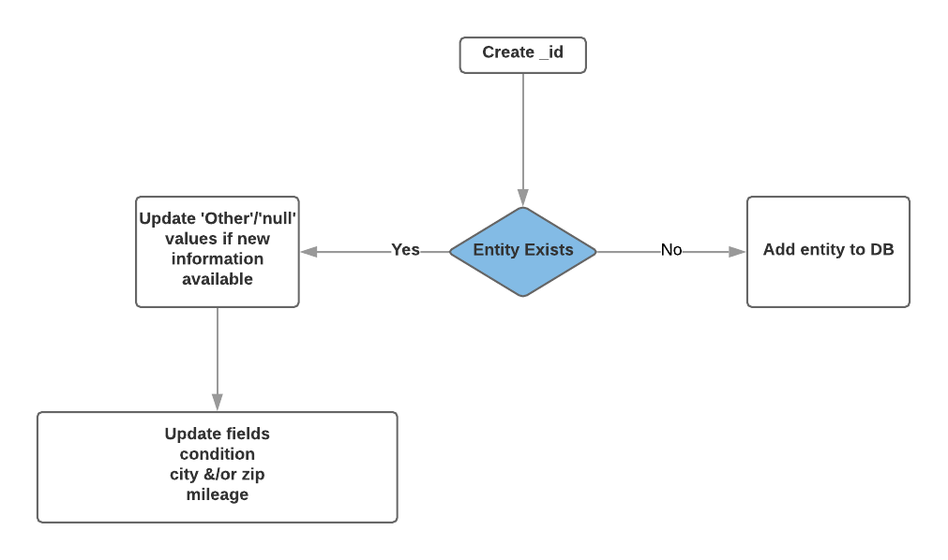
5. Data Enrichment
Key ideas
Comparing all fields can be avoided by the introduction of an index.
_id attribute has been erased to match target data during the Integration phase,
but it should be kept for identifying stored entities.
Enriching existing entities=>if entity’s index _id exists, update entity’s information.
Updating entity’s’ information: possible just those attributes that are either ‘Other’ or ‘null’
in the database, as comparing all attributes would be too expensive.

Slide 11
Conclusions
Extracting country codes from city’s geo coordinates was the most expensive processing part. I tried to find a workaround by adding the instance’s city-country pair to a dictionary (dictCountries). Each entity city’s existence lookup in the dictionary before using the geolocator reduced the time considerably, but still is a very expensive computation. Splitting this task into a multi-node cluster might be a better solution. Unfortunately I did not have the resources to try this.
_id attribute has been erased to match target data during the Integration phase, but it should be kept/added to the target data for its enrichment.
Thank you a lot for this opportunity, I had much fun in doing this task!

