Slide 1
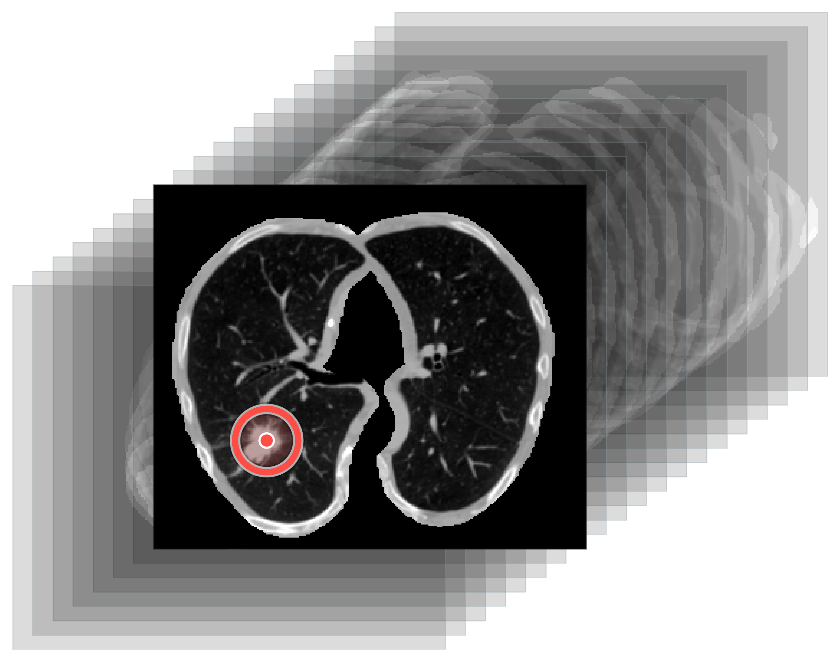
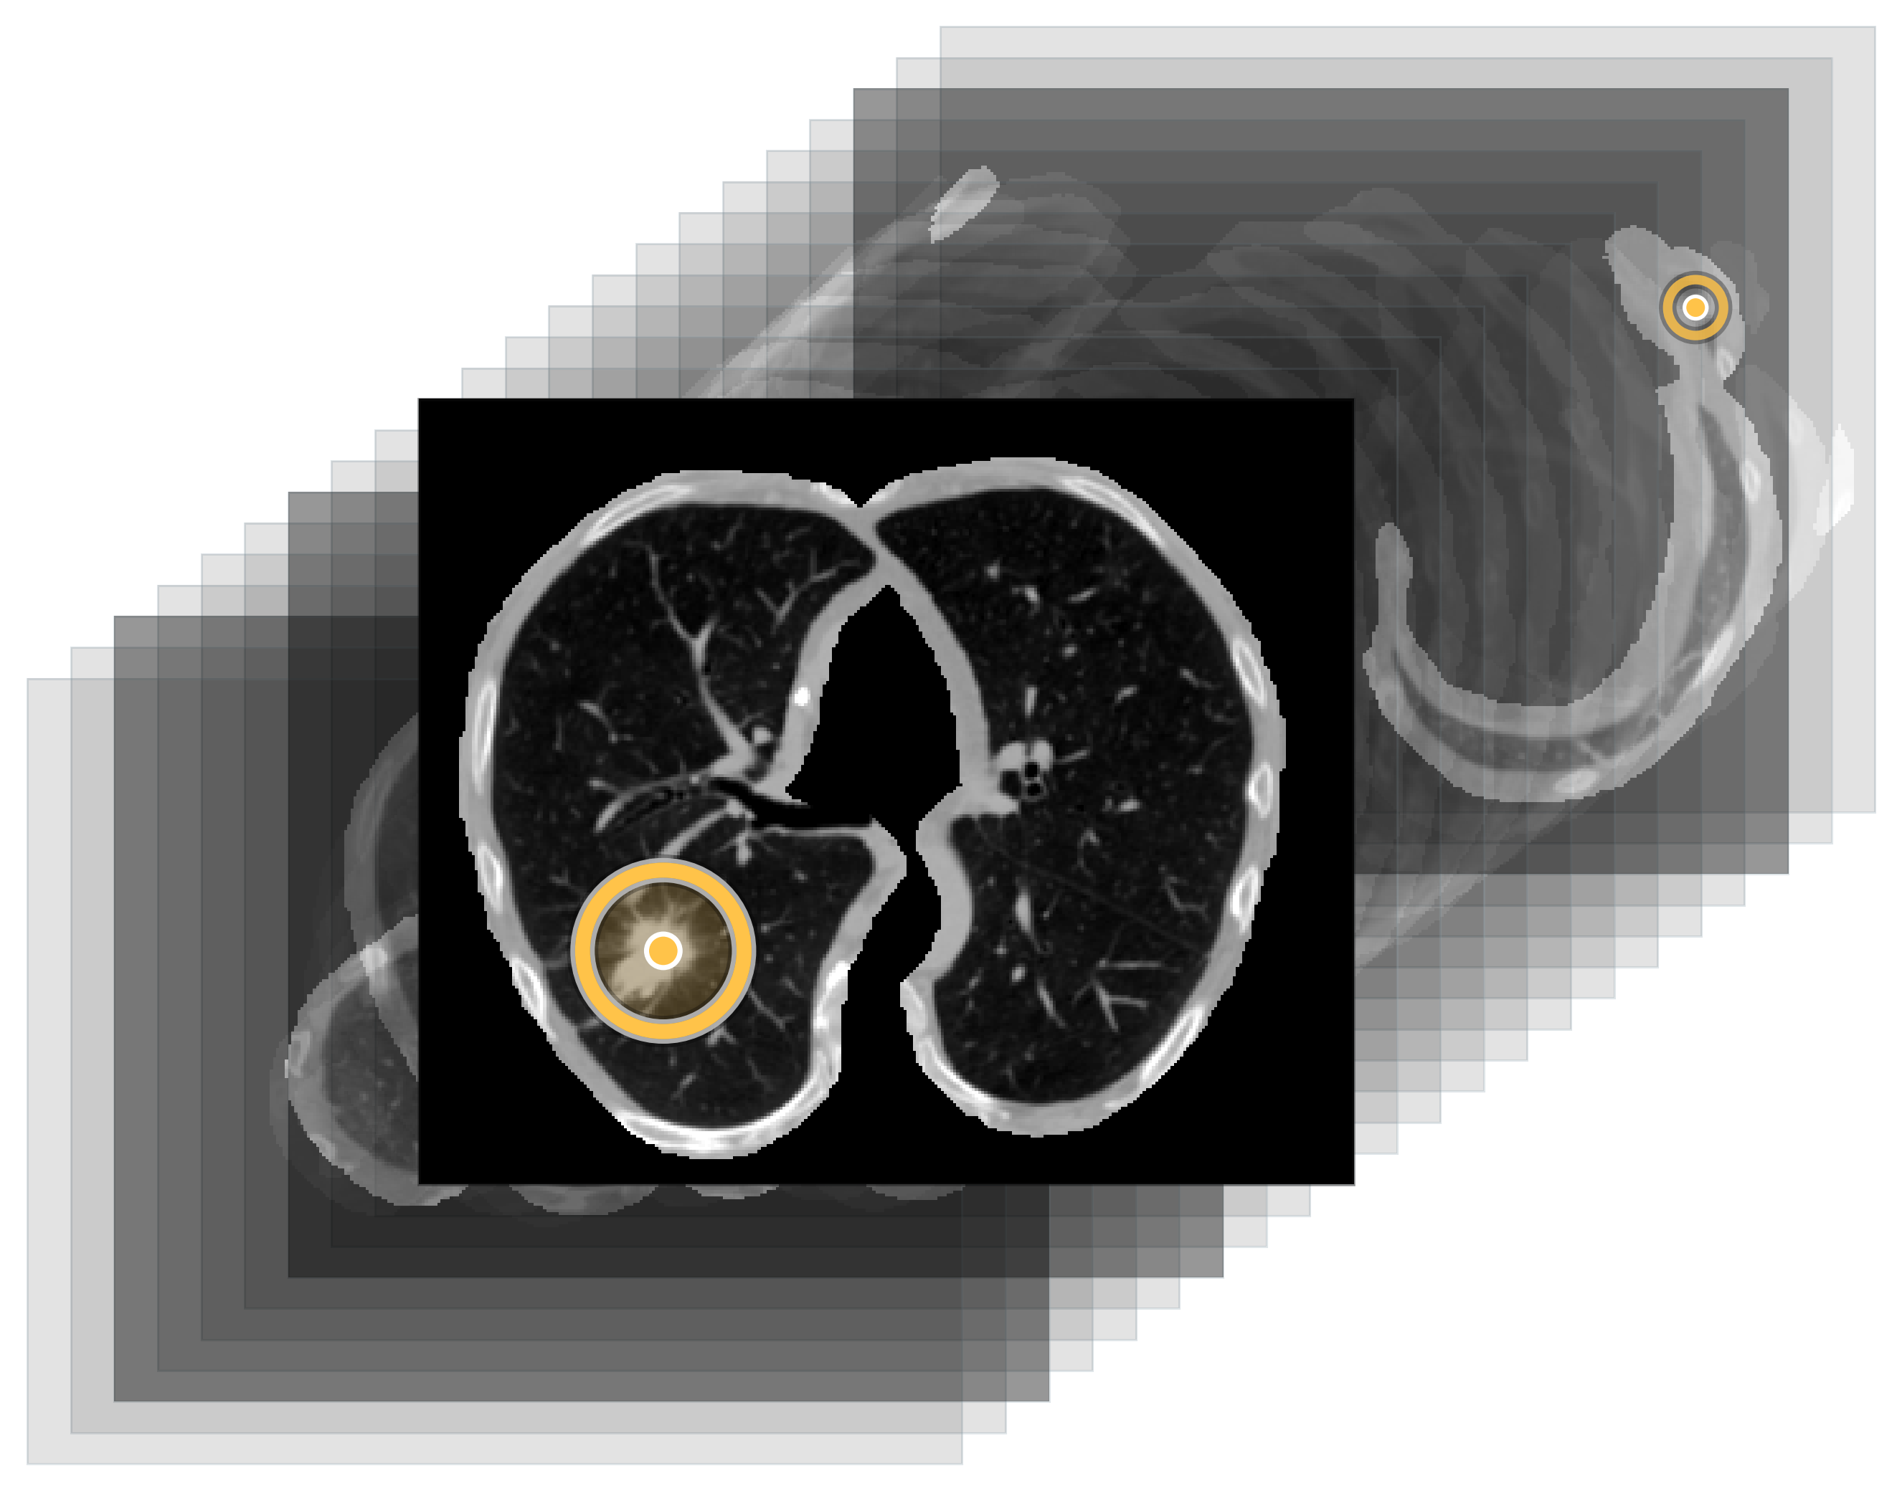
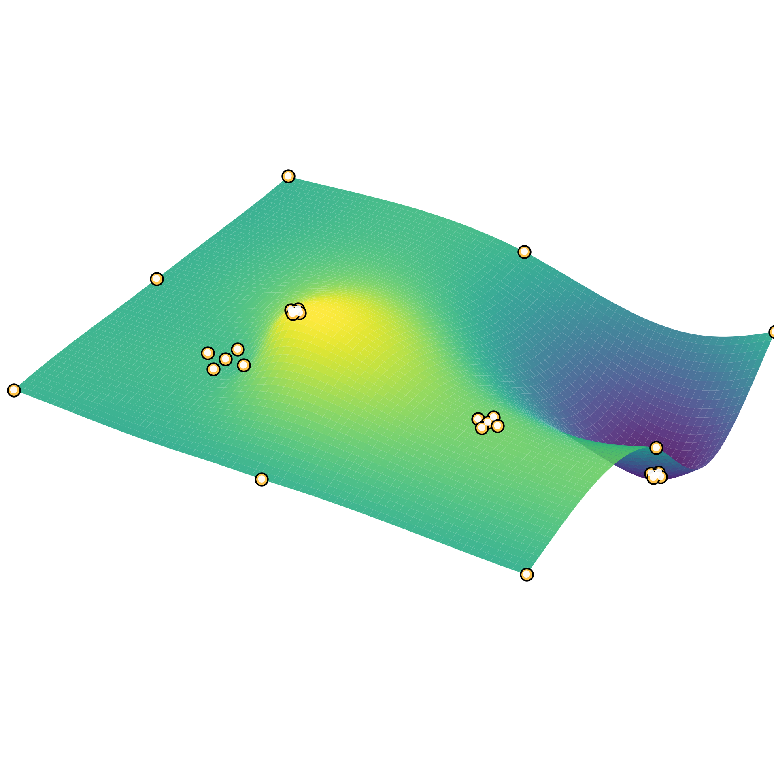
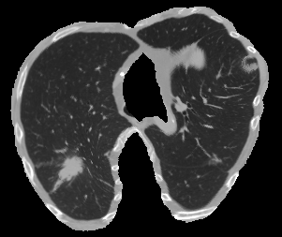
VISUAL KEY
LUNG CT
ground truths
detections
DETECTOR
RBF SURFACE
SYNTHETIC 2D
EFFICIENTNETV2-S
k=4
benign
malignant

