Slide 1
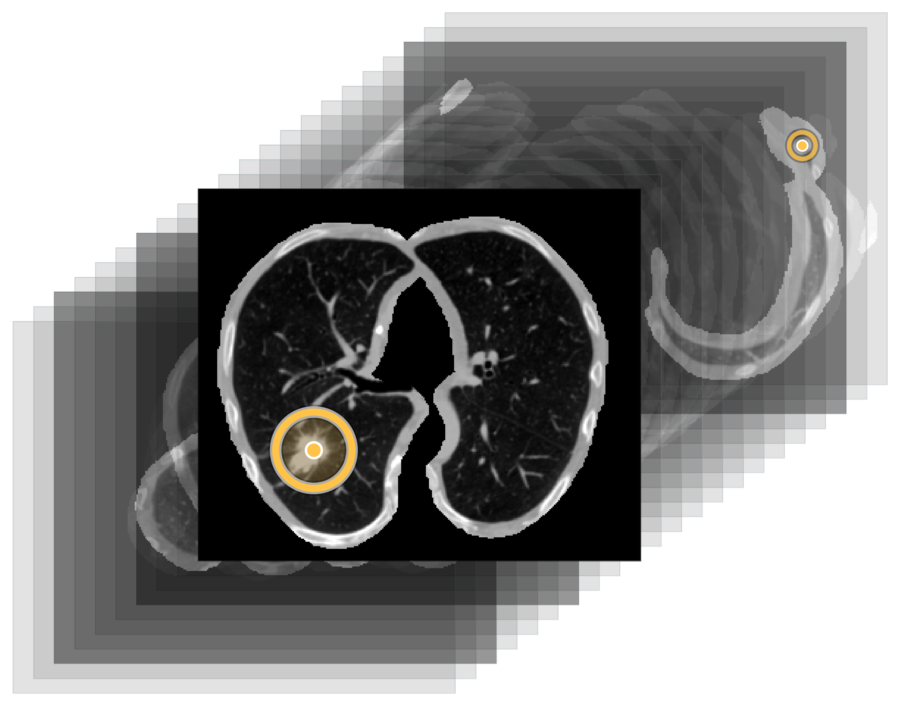
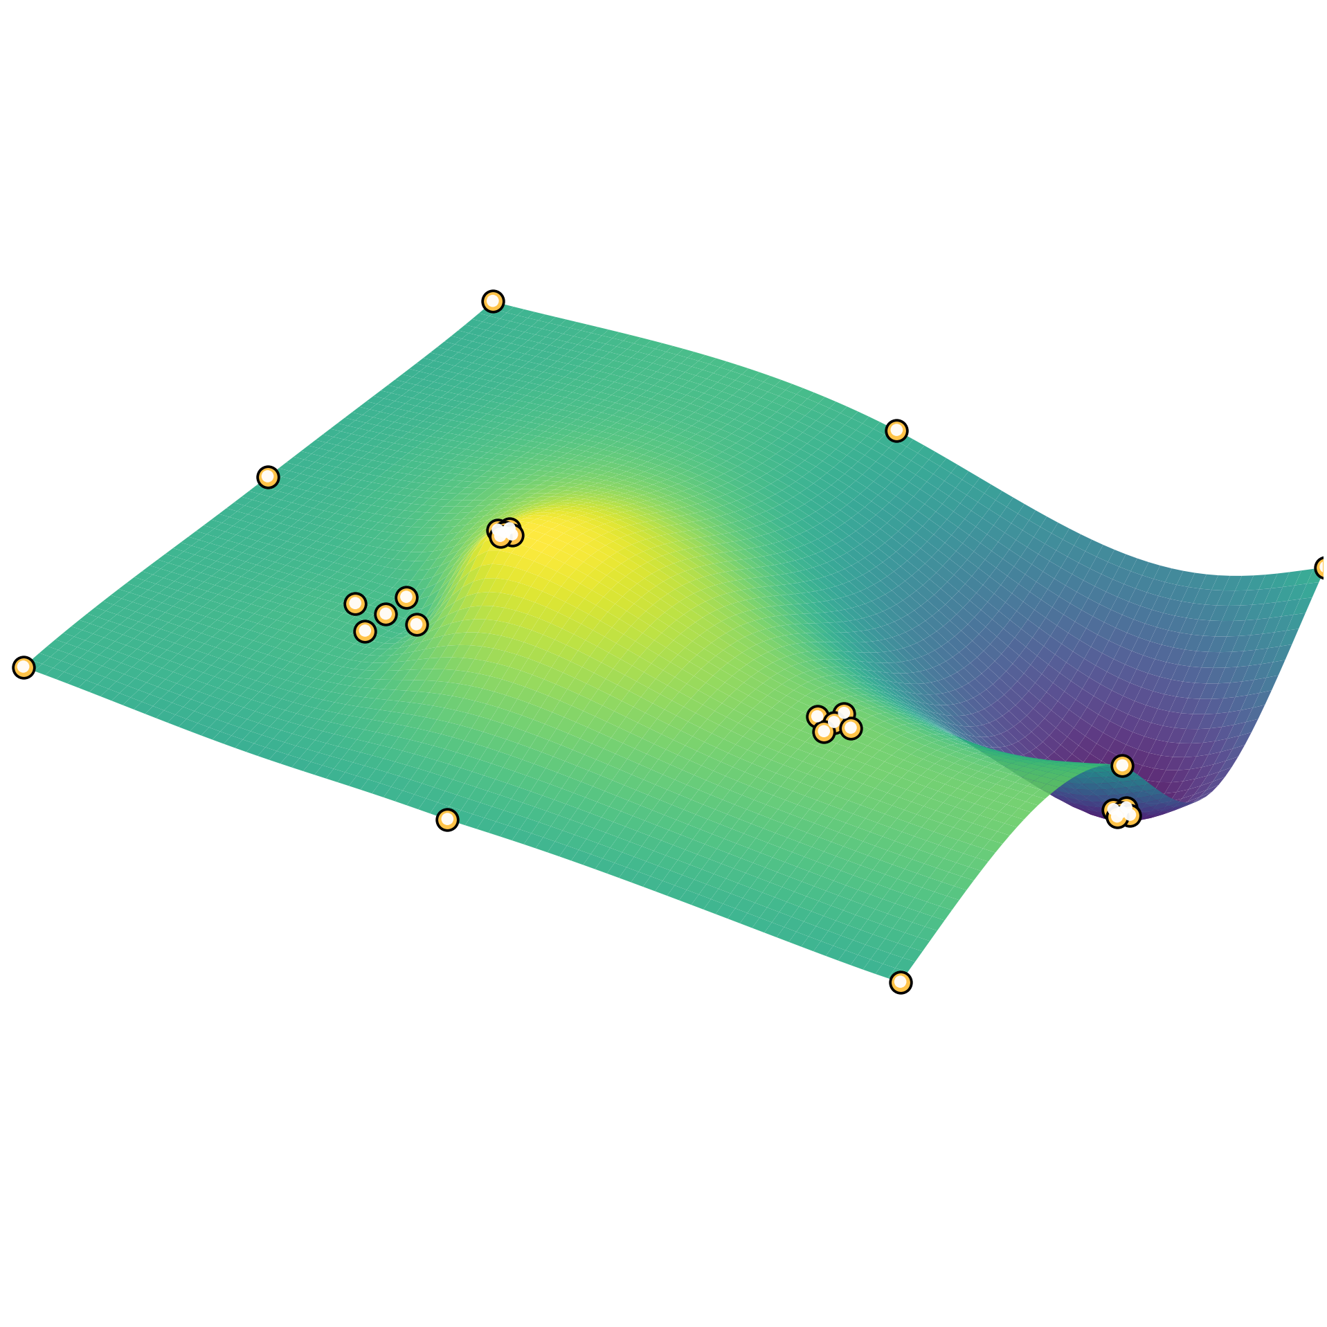
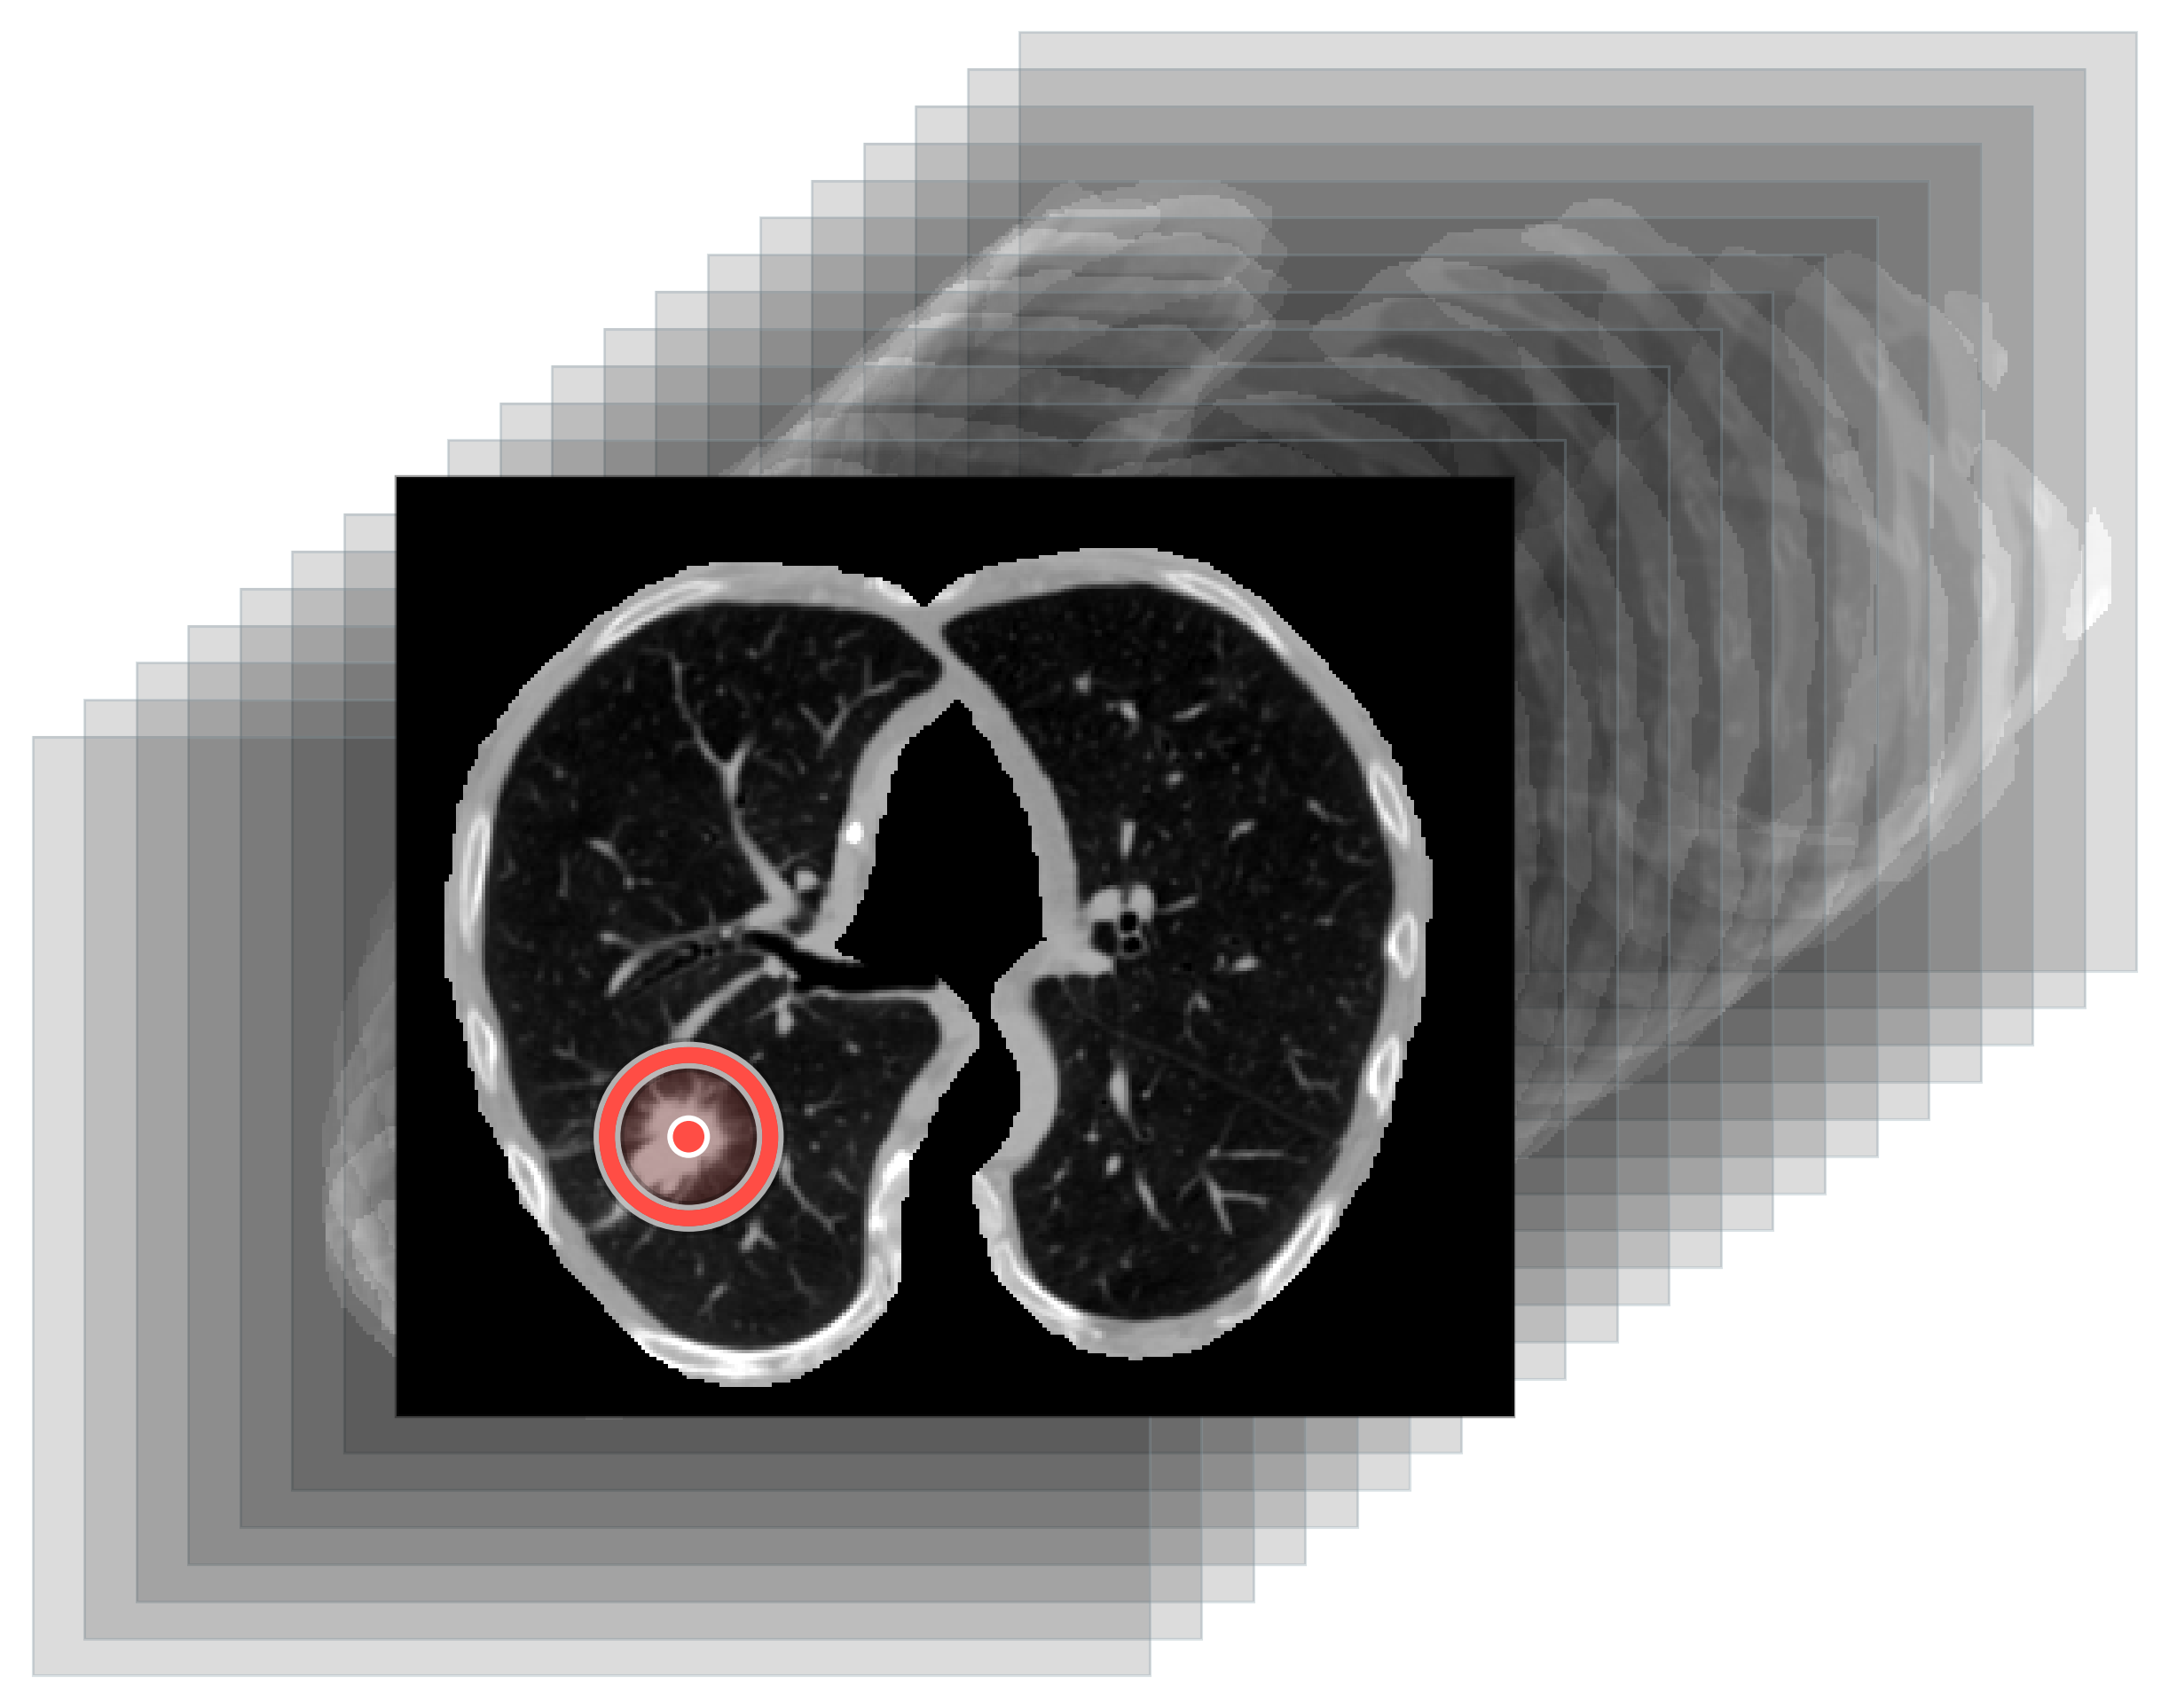
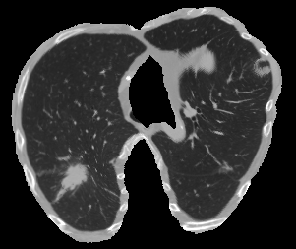
VISUAL KEY
ground truths
detections
LUNG CT
DETECTOR
RBF SURFACE
SYNTHETIC 2D
EFFICIENTNETV2-S
k=4
t=0.5
benign
malignant

