Slide 1
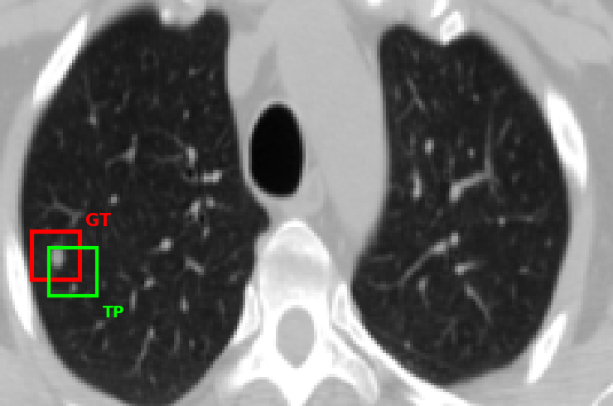
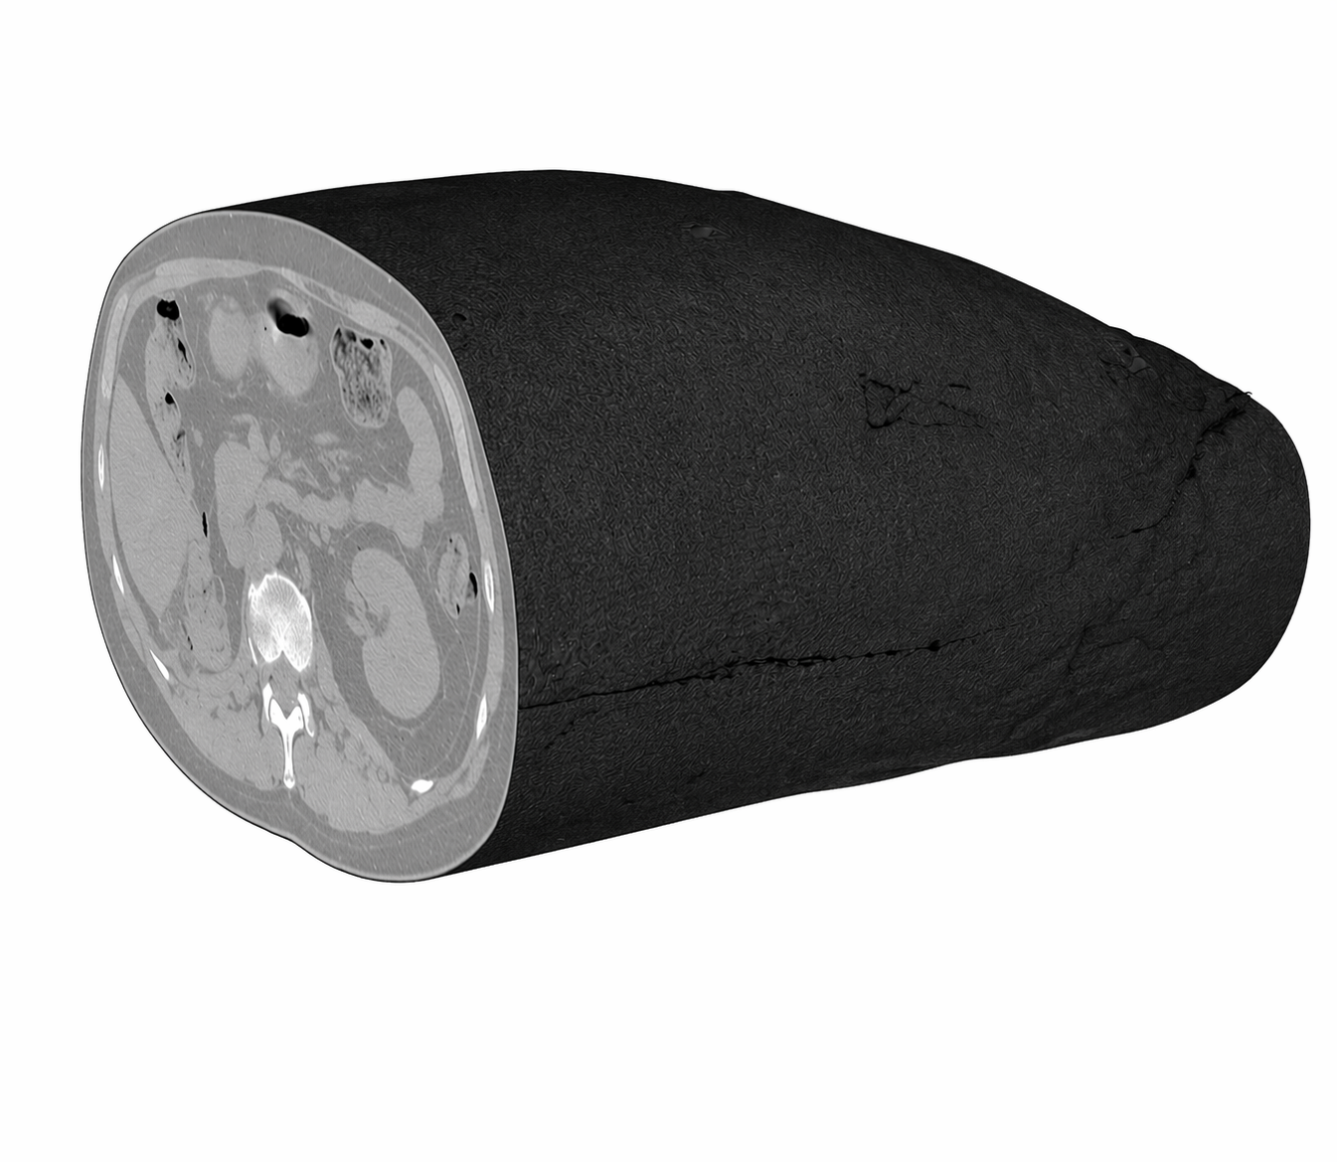
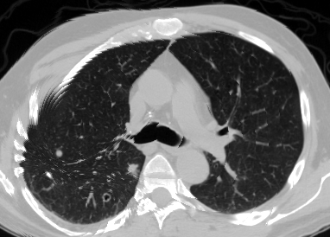
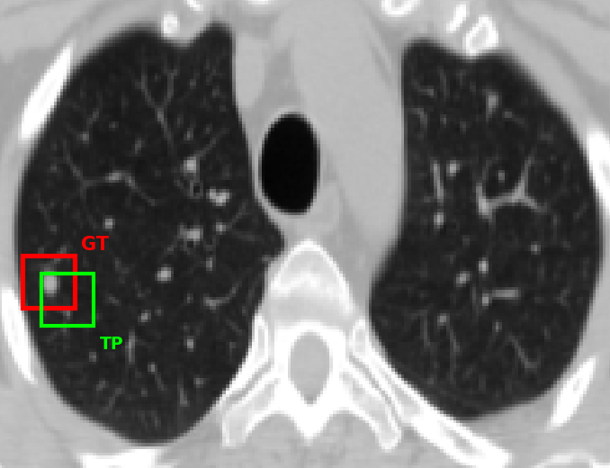
STAGE 1
STAGE 2
STAGE 3
GRAVITY NET
2D SYNTHESIS
MALIGNACY CLASSIFICATION
3D CT Volume
Nodules detection
Synthetic 2D Image

