Slide 1


Programming and actual operation of BESS hybrid PFV-ANDES2B (SEN-Chile) v1.0 2023/11/02
Prepared for

Slide 2
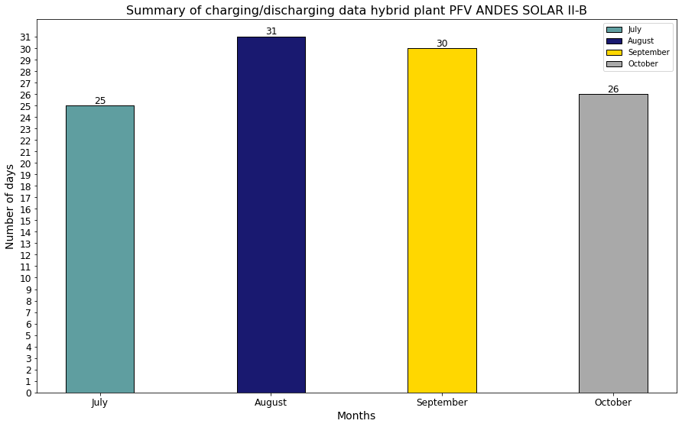
Summary of charging/discharging data hybrid plant PFV ANDES SOLAR II-B
Intraday programming data information
Type of Project | Name | Reported BESS Capacity (MW)
Hybrid project BESS+PV | PFV ANDES SOLAR II-B | 112
Other Information | Data
Intraday programming start publication | 2023-07-07
Last intraday programming analyzed | 2023-10-26
Total days analyzed | 112
Num. of BESS discharge hours reported | 5
Remarks:
Date format: year-month-day.
If there are multiple intraday schedules for the same day, the last (later) intraday schedule is used.

Slide 3
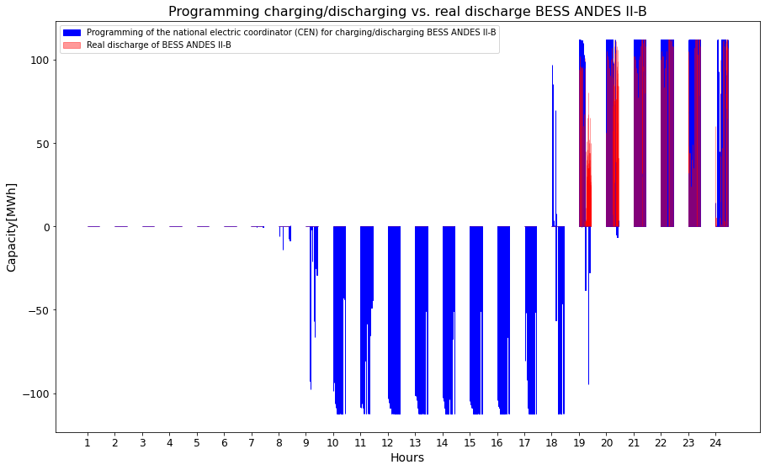
Programming of charging/discharging by CEN vs. real discharge BESS ANDES SOLAR II-B
National electric coordinator (CEN) programming
+110 Diff. profiles
BESS charging between 10:00 and 18:00 hrs (9 hours
interval).
BESS discharge between 20:00 and 24:00 hrs (5 hours interval).
Real charge/discharge data
Real charge/discharge data only publishes the energy discharge
Remarks:
The BESS hybrid plant data does not separate the energy fed into the system from the solar plant and the BESS.
Therefore:
It is assumed that at 19:00 hrs there is still solar energy available.
It is assumed that the energy delivered during the 19:00 hours considers energy introduced by the solar plant +BESS
It is assumed that the energy delivered only by the BESS starts between 20:00 and 24:00 hrs.

Slide 4
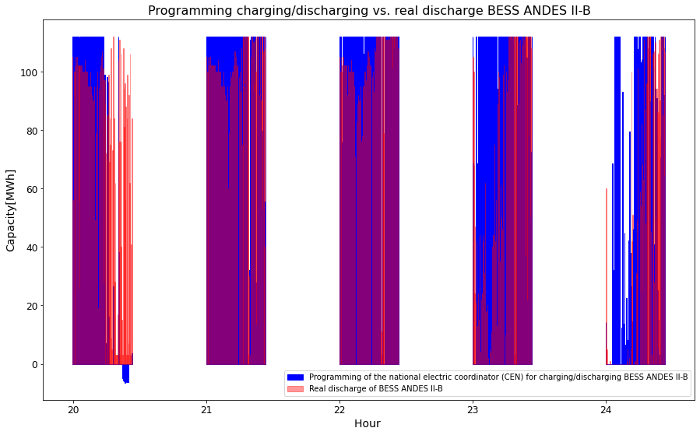
Programming of charging/discharging by CEN vs. real discharge BESS ANDES SOLAR II-B
National electric coordinator (CEN) programming
Desv.\hour | 20 | 21 | 22 | 23 | 24
Mean prog. Discharge [MW] | 59.6 | 98.8 | 103.3 | 95.8 | 52.5
Max. [MW] | 112 | 112 | 112 | 112 | 112
Real discharge of BESS ANDES II-B
Desv.\hour | 20 | 21 | 22 | 23 | 24
Mean actual discharge [MW] | 77.2 | 96.4 | 98 | 70.8 | 42.5
Max. [MW] | 112 | 112 | 112 | 112 | 112
Remarks:
There is variation between the programmed discharge energy vs. the delivered energy.
Note:
The large deviation during the 20th hour suggests that the energy delivered during the 20:00 hours considers energy introduced by the solar plant +BESS

Slide 5
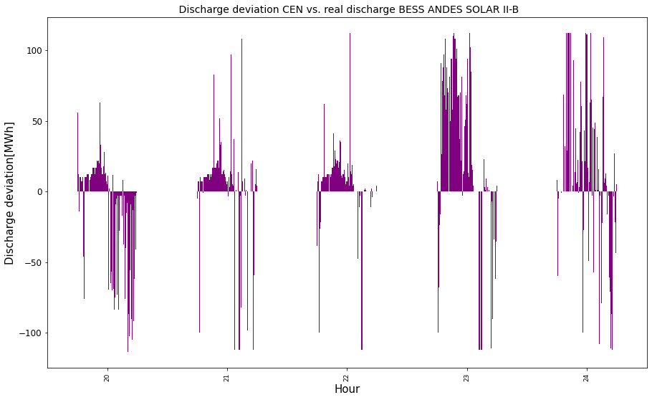
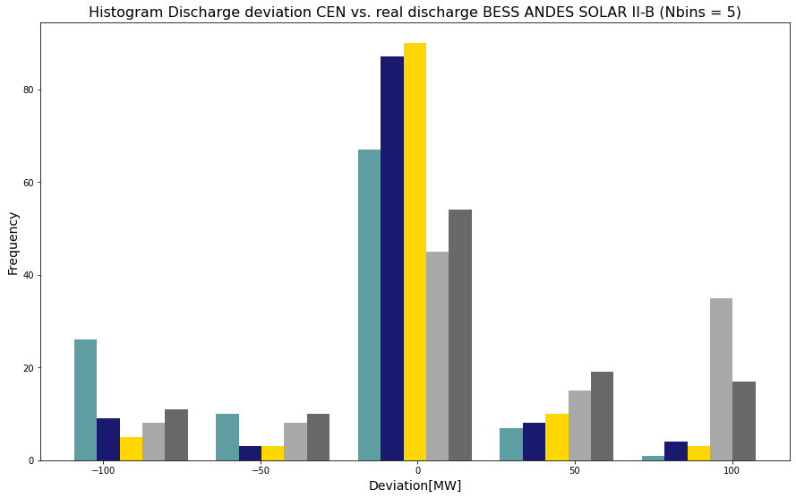
Discharge deviation CEN vs. real discharge BESS ANDES SOLAR II-B
Discharge deviation (Scheduled discharge - real discharge)
Desv.\hour | 20 | 21 | 22 | 23 | 24
Mean Desv.[MW] | -18 | 2.2 | 5.1 | 24.8 | 9.4
Max desv. | 93 | 112 | 112 | 112 | 112
Histogram of deviations
If we consider a absolute deviation <= 23 MW as edge parameter:
Then:
Hour 20 : ---> 62% of the cases under the edge parameter.
Hour 21 : ---> 82% of the cases under the edge parameter.
Hour 22 : ---> 84% of the cases under the edge parameter.
Hour 23 : ---> 42% of the cases under the edge parameter.
Hour 24 : ---> 50% of the cases under the edge parameter.

Slide 6
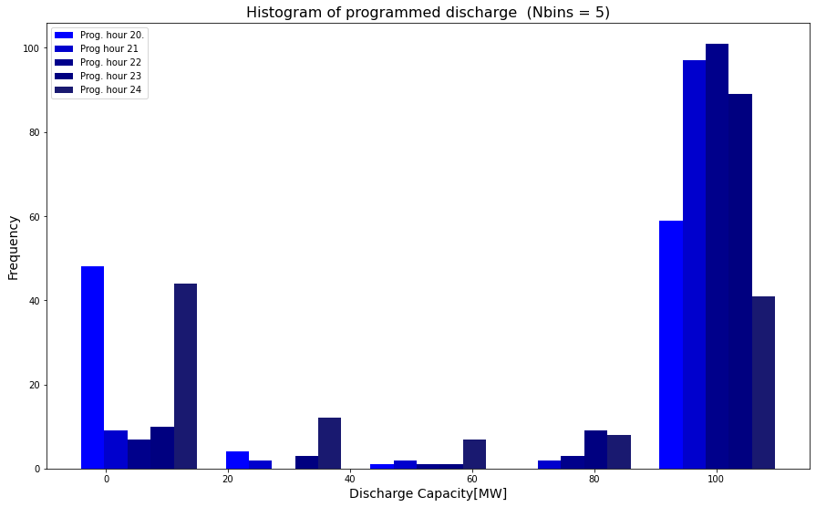
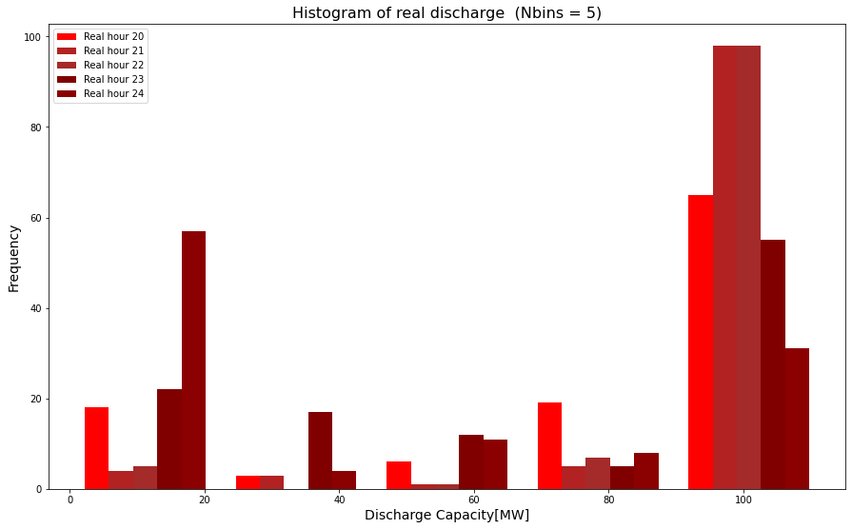
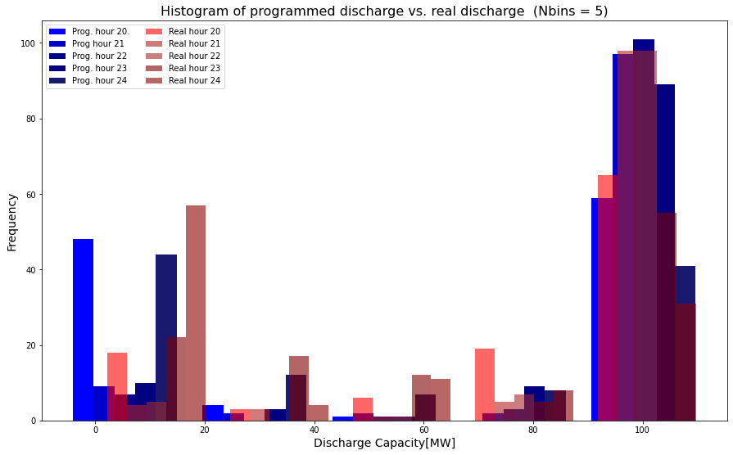
Frequency and probabilities programed/real discharge
Desv.\hour | 20 | 21 | 22 | 23 | 24
Freq. of programmed discharge | 48 | 9 | 7 | 10 | 44
% | 42 | 8 | 6 | 9 | 39
Range[MW] | -6.4 | -6.4 | -6.4 | -6.4 | -6.4
Desv.\hour | 20 | 21 | 22 | 23 | 24
Current discharge freq. | 18 | 4 | 5 | 22 | 57
% | 16 | 3.5 | 4 | 20 | 50
Range[MW] | 0 | 0 | 0 | 0 | 0
Desv.\hour | 20 | 21 | 22 | 23 | 24
Freq. of programmed discharge | 4 | 2 | 0 | 3 | 12
% | 3.5 | 2 | 0 | 2.6 | 10
Range[MW] | 17 | 17 | 17 | 17 | 17
Desv.\hour | 20 | 21 | 22 | 23 | 24
Current discharge freq. | 3 | 3 | 0 | 17 | 4
% | 2.6 | 2.6 | 0 | 15 | 3.5
Range[MW] | 22 | 22 | 22 | 22 | 22
Desv.\hour | 20 | 21 | 22 | 23 | 24
Freq. of programmed discharge | 1 | 2 | 1 | 1 | 7
% | 1 | 2 | 1 | 1 | 6
Range[MW] | 41 | 41 | 41 | 41 | 41
Desv.\hour | 20 | 21 | 22 | 23 | 24
Current discharge freq. | 6 | 1 | 1 | 12 | 11
% | 5.3 | 1 | 1 | 10 | 10
Range[MW] | 45 | 45 | 45 | 45 | 45
Desv.\hour | 20 | 21 | 22 | 23 | 24
Freq. of programmed discharge | 0 | 2 | 3 | 9 | 8
% | 0 | 2 | 2.6 | 8 | 7
Range[MW] | 65 | 65 | 65 | 65 | 65
Desv.\hour | 20 | 21 | 22 | 23 | 24
Current discharge freq. | 19 | 5 | 7 | 5 | 8
% | 17 | 4.5 | 6 | 4 | 7
Range[MW] | 67 | 67 | 67 | 67 | 67
Desv.\hour | 20 | 21 | 22 | 23 | 24
Freq. of programmed discharge | 59 | 97 | 101 | 89 | 41
% | 52 | 86 | 90 | 79 | 36.6
Range[MW] | 88 | 88 | 88 | 88 | 88
Desv.\hour | 20 | 21 | 22 | 23 | 24
Current discharge freq. | 65 | 98 | 98 | 55 | 31
% | 58 | 88 | 88 | 50 | 28
Range[MW] | 89 | 89 | 89 | 89 | 89

Slide 7
Summary of charging/discharging BESS ANDES SOLAR II-B
Intraday programming start publication ---> 2023-07-07.
both in programming and in actual operation, the BESS operates at full load (112 [MW]).
BESS charging between 10:00 and 18:00 hrs (9 hours
interval).
BESS discharge between 20:00 and 24:00 hrs (5 hours interval).
Current discharge data indicates that the average discharge between 20:00 and 24:00 hrs is 76.9 [MW].
If we consider a absolute deviation <= 23 MW as edge parameter:
Then:
Hour 20 : The BESS deviation is less than the edge parameter in 62% of the cases.
Hour 21 : The BESS deviation is less than the edge parameter in 82% of the cases.
Hour 22 : The BESS deviation is less than the edge parameter in 84% of the cases.
Hour 23 : The BESS deviation is less than the edge parameter in 42% of the cases.
Hour 24 : The BESS deviation is less than the edge parameter in 50% of the cases.
The BESS ANDES II-B is capable of supplying power to the grid for 5 hours.
The average discharge deviation between 21:00 and 24:00 hrs is 10.3 [MW].
Discharge deviation (Scheduled discharge - Real discharge)
Desv.\hour | 20 | 21 | 22 | 23 | 24
Mean Desv.[MW] | -18 | 2.2 | 5.1 | 24.8 | 9.4

Slide 8
Carlos Barría
carlos@gzecon.com

