Slide 1

CookWithMe
By Matteo Rizza, Nicola Di Santo, Giovanni Buono

Slide 2

What is this?
A simple app that will give you the imagination you need in the kitchen using only the ingredients you already have.

Slide 3
Target Users
Age: 18 – 30
Gender: male and female
Occupation: any
Education: any
Location: Italy
Technology: familiar with apps
Passion: any

Slide 4
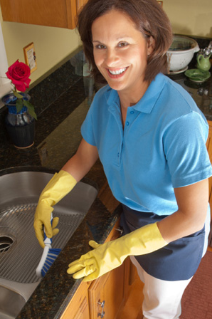
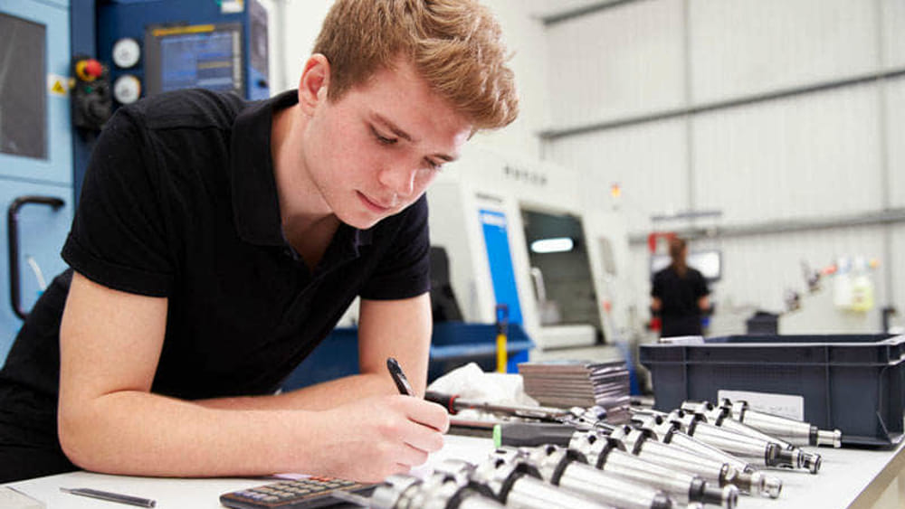
Personas
Maria is 45 years old and she is a housewife. Spending a lot of time at home, she developed a passion for cooking. She also has two slightly capricious young children so she must always invent ways to make children eat vegetables. She lives in fair economic conditions but cannot afford to always have the refrigerator full of a large variety of foods.
Fabio is 22 years old and is an engineering student. He lives with the money his parents send him every month for renting the room and shopping. He spends a lot of time in university between lessons and studying in the library but can't wait to go home to play his beloved video games. Cooking bores him a little but above all he can't stand washing dishes and cleaning the kitchen, which he never had to do when he lived with his parents.

Slide 5
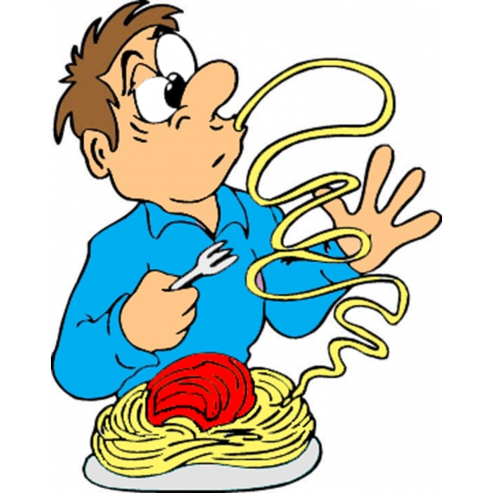
Scenario 1
It's Monday. Maria has just finished cleaning up the house and has no time to go to the supermarket because it is almost lunchtime and her children are returning home from school. Maria opens the fridge and pantry. She finds ham, mozzarella, courgettes, cherry tomatoes and a few eggs. Mozzarella would be good to use because it has already been in the fridge for some time and is likely to go bad. Nothing comes to mind so she tries to consult some recipe site on the internet but there are hundreds of recipes and she has little time. In the end she decides to do the usual tomato pasta and mozzarella. Tomorrow it will be better...

Slide 6
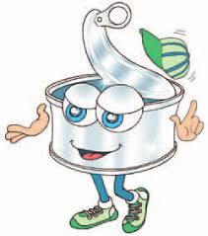
Scenario 2
Fabio woke up late this morning as yesterday he stayed to play video games until late in the evening. In the afternoon he has to go to university for courses so he has to hurry up as he has to wash and have lunch. Fabio hates cooking and has finished all the tuna cans so he is forced to invent something but, not having so much
imagination in the kitchen and few ingredients, he doesn't have time to think about what to cook and how to cook it so he decides to skip lunch. Today Fabio will go to university fasting...

Slide 7
Competitors
 | GialloZafferano | Cucchiaio d’argento | Yummly | CookWithMe
Filter by dish type | √ | √ | √ | √
Filter by cooking type | √ | √ | √ | √
Filter by time | √ | X | √ | √
Filter by difficulty | √ | X | X | √
Filter by diet | √ | X | √ | √
Filter by cuisine type | X | X | √ | √
Filter by available ingriedents | X | X | X | √
Save recipe | √ | √ | X | √
Shopping list | √ | √ | √ | √

Slide 8
Focus Group
The goal was to properly select a group of people to debate on a new service.
People have been chosen carefully such that they all enjoy cooking, but they have different styles, different tastes and cook different plates.
The group is composed of 4 females and 1 male.

Slide 9
Focus Group Members
Asia, student of law, 20 years old, lives in Italy with her parents.
Antonella, student of law, 21 years old, lives in Italy with her parents.
Francesca, student of Finance and Statistics, 23 years old lives in Italy with her family
Riccardo, books translator, is 25 years old and lives in Belgium.
Erika, phd student in linguistcs, is 25 years old and lives in London.
Nicola is the moderator

Slide 10
Focus Group
The discussion is divided into two main parts:
first part is a warmup where each member introduces himself to the group and answer about few questions about him habits in the kitchen.
The second part is the debate about the service and how they think it should work.

Slide 11
Focus Group – Warmup QA
Do you like cooking? Why do you cook (pleasure, need)?
Where do you find inspiration for your recipes?
Have you ever had a few heterogeneous ingredients in the fridge and not knowing how to consume them together?
Most of the members cook for need
They find recipes giallozafferano.it, Youtube, chefincamicia.com, mysia.info
All of them struggles to combine ingredient sometimes
Questions
Answers

Slide 12
Focus Group – Discussion of the Product
The moderator introduces the “CookWithMe” idea, asks to the group which kind of functionalities they expect and invites the group to debate on each other’s opinions.
As a result, lot of functions we do not even thought about came out and we had a different perspective on the product we are going to implement!

Slide 13
Focus Group – Discussion of the Product
Necessity emerged from Focus group Users:
The app should advise for dishes with same ingredients but that represent a different plate.
The app should give suggestion on what to buy to integrate what I have home to cook a nice meal (this must be balanced with suggestions using only what I have home).
Qualified sources (no ananas on the pizza).

Slide 14
Focus Group – Discussion of the Product
Necessity emerged from Focus group Users:
User enters their own skill level and they are offered recipes based on it.
Filters based on recipe difficulty, time needed, price of missing ingredients.
Give importance to vegan people or people with some food intolerance.

Slide 15
Single Interviews
Six people were interviewed.
The interviews were used for a better understanding of the target. As a result we have see how cooking is appreciated at all ages, from passion to daily cooking. The responses of the interested parties show us how each of the interviewees is concerned about not wasting ingredients and optimizing their use.

Slide 16
Single Interviews
As there was no discussion, there were not many ideas to improve the service, but It emerged the focus on the idea of making it as visual as possible, even with video recipes.
Furthermore the application itself must be intuitive so that it is easy to use for all ages.

Slide 17
Interviews Members
Renato, student, 24 years old, lives in Italy with his housemates.
Giuseppe, student, 24 years old, lives in Italy with his parents.
Giancarlo, employee, 56 years old lives in Italy with his family
Angela, employee, 20 years old and lives with her mum.
Massimiliano, student, 23 years old and lives with his girlfriend.
Maria Rosaria, 56 healthcare worker, lives with her family.
Matteo is the interviewer

Slide 18
Focus Group vs. Interviews
In our particular case, in which the product is in an embryonal phase, we had more benefits from the focus group, since a debate on the goal of our service opened up our minds on users needs.
Interview were also useful but they give us a more static feedback.

Slide 19
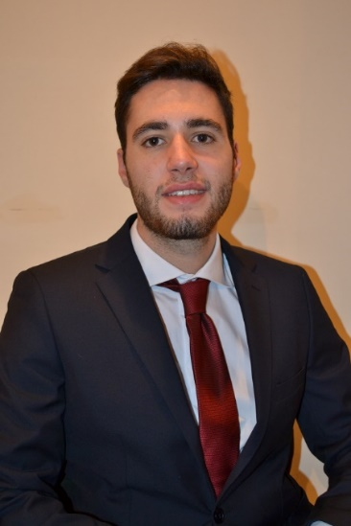
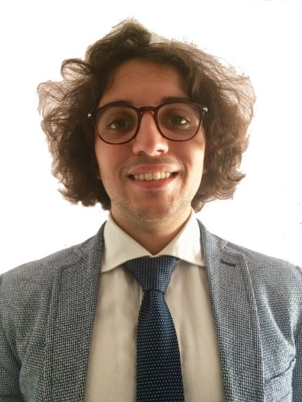
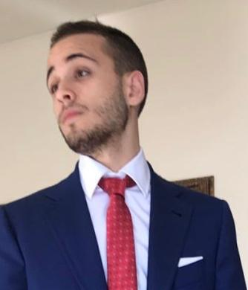
Thanks for the attention
Matteo Rizza | Nicola Di Santo | Giovanni buono
https://www.linkedin.com/in/matteo-rizza/ | https://www.linkedin.com/in/nicola-di-santo-b98647192/ | https://www.linkedin.com/in/giovanni-buono-5229941a4/

