Slide 1
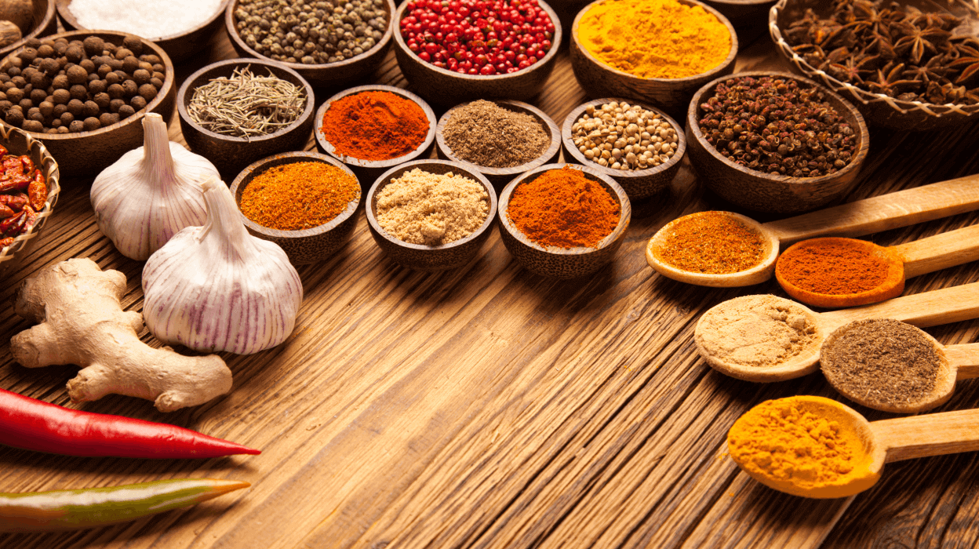
CookWithMe
By Matteo Rizza, Nicola Di Santo, Giovanni Buono

Slide 2

What is this?
A simple app that will give you the imagination you need in the kitchen using only the ingredients you already have.

Slide 3
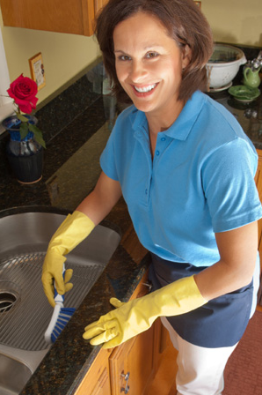

Personas
Maria is 45 years old and she is a housewife. Spending a lot of time at home, she developed a passion for cooking. She also has two slightly capricious young children so she must always invent ways to make children eat vegetables. She lives in fair economic conditions but cannot afford to always have the refrigerator full of a large variety of foods.
Fabio is 22 years old and is an engineering student. He lives with the money his parents send him every month for renting the room and shopping. He spends a lot of time in university between lessons and studying in the library but can't wait to go home to play his beloved video games. Cooking bores him a little but above all he can't stand washing dishes and cleaning the kitchen, which he never had to do when he lived with his parents.

Slide 4
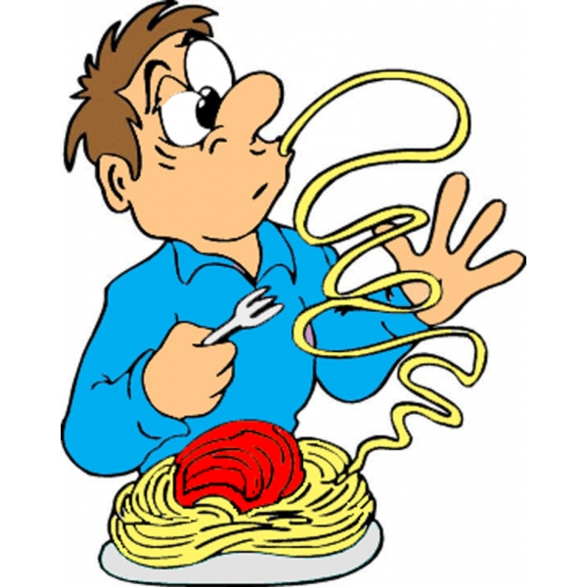
Scenario 1
It's Monday. Maria has just finished cleaning up the house and has no time to go to the supermarket because it is almost lunchtime and her children are returning home from school. And she doesn't want to trim the usual tomato pasta ...

Slide 5
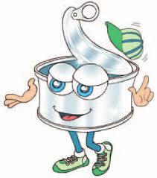
Scenario 2
Fabio woke up late this morning and in the afternoon he has to go to university for courses. He hates cooking but he has finished all the tuna cans and has no time to think what to cook and how to cook it ...

Slide 6
Competitors
 | GialloZafferano | Cucchiaio d’argento | Yummly | CookWithMe
Filter by dish type | √ | √ | √ | √
Filter by cooking type | √ | √ | √ | √
Filter by time | √ | X | √ | √
Filter by difficulty | √ | X | X | √
Filter by diet | √ | X | √ | √
Filter by cuisine type | X | X | √ | √
Filter by available ingriedents | X | X | X | √
Save recipe | √ | √ | X | √
Shopping list | √ | √ | √ | √

Slide 7
Survey
1.How old are you?
2.How much time do you spend to cook?
3.How long would you like to spend on cooking?
4.Do you have imagination in the kitchen?
5.What you are looking for in a kitchen app?

Slide 8
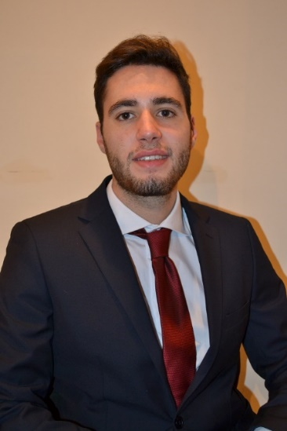
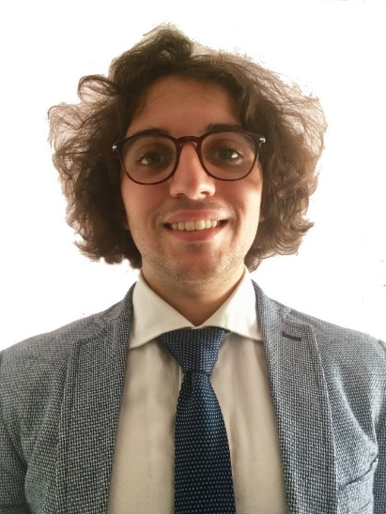

Thanks for the attention
Matteo Rizza | Nicola Di Santo | Giovanni buono
https://www.linkedin.com/in/matteo-rizza/ | https://www.linkedin.com/in/nicola-di-santo-b98647192/ | https://www.linkedin.com/in/giovanni-buono-5229941a4/

