Slide 1
Flag Football Official Rules

Slide 2
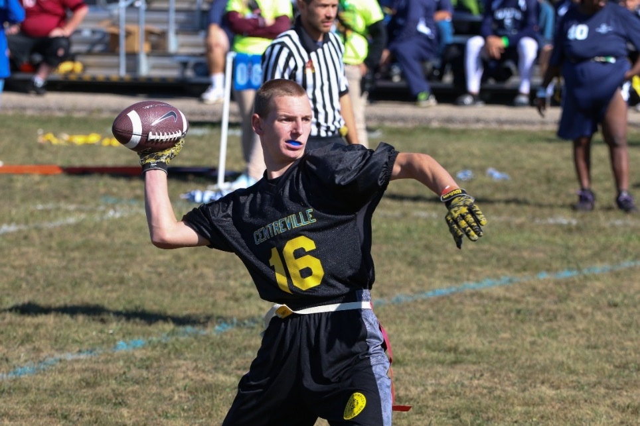
A picture paints a thousand words
“Let me win, but if I cannot win, let me be brave in the attempt.”
“Let me win, but if I cannot win, let me be brave in the attempt.”
Use the Picture and Caption format to create strong compelling slide like this. Don’t’t forget to caption where possible. For best effect crop the image to fill the placeholder.

Slide 3
Uniform Guidelines and Equipment
Uniforms consist of a jersey, shorts, and sport shoes. All team members must have identical uniforms in color and design.
Athletes may wear rubber-cleated or flat soled athletic shoes.
All players must have a mouthpiece to be used during competition at all times.

Slide 4
Course Layout

Slide 5
Playing Field
The playing field is 60 yards long (including the end zones) and 25 yards wide. If insufficient space is available, a slightly smaller space can be used. A space of at least 5 yards around the field must be free and clear of obstructions.
No-Run Zones are in place to prevent teams from conducting power run plays. While in the No-Run Zones (a 5-yard imaginary zone before midfield and before the end zone), teams cannot run the ball in any fashion. All plays must be pass plays, even with a handoff.

Slide 6
Playing Field Cont.
Each offensive team approaches only TWO (2) No-Run Zones in each drive (a 5-yard zone before midfield to gain the first down and before the end zone, 5 yards from the goal line to score a TD).

Slide 7
Positions Offense (5v 5)
Running Back/Blocker
Quarterback
Wide receiver
Center
Wide receiver
Offense and Offense Positions on the field
Line of scrimmage (where you line up to start a play)

Slide 8
Positions Offense (7 v 7)
Running Back/Blocker
Quarterback
Wide receiver
Offensive Lineman
Center
Offensive Lineman
Wide receiver
Offense and Offense Positions on the field
Line of scrimmage (where you line up to start a play)

Slide 9
General Rules

Slide 10
General Rules
Flag Football is non-contact. In all aspects of Special Olympics Flag Football, rulings shall be made with player safety as the primary consideration.
Neither team shall commit any act which, in the opinion of the referee, tends to make a travesty of the game. This includes intentionally committing penalties to gain an advantage. The referee will enforce any penalty he/she considers equitable, including the award of a score for an unfair act.

Slide 11
Scoring
Touchdown: six (6) points.
Extra Point: one (1) point from the 5-yard line, two (2) points from the 12-yard line (or any distance outside 5 yards due to a penalty).
Safety: two (2) points.

