Slide 1
Flag Football Rules and Game Play
Alexander Physical Education
2018-2019

Slide 2
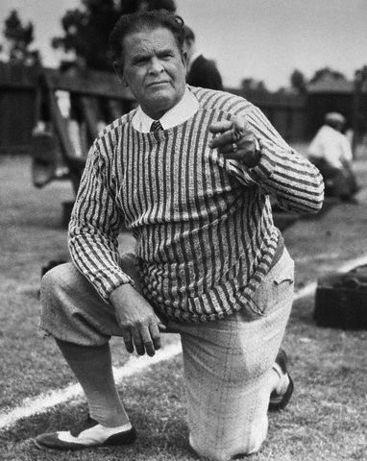
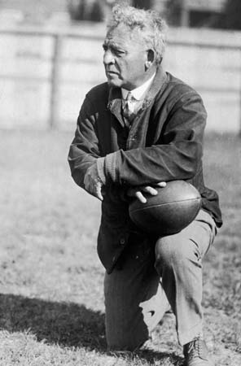
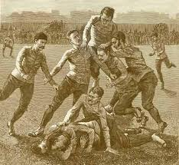
History of Football
American football, like you see today, developed in the late 1800s from two English sports, rugby and soccer.
Walter Camp is considered the father of American football. Alonzo Stagg, Knute Rockne and Pop Warner are considered pioneers of developing gameplay.

Slide 3
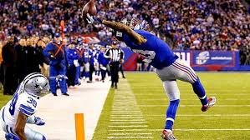
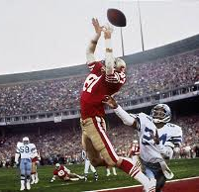
Objective of Football
Score more points than your opponent by running or passing the ball into their “endzone” (touchdowns).
Famous touchdowns include those by Dwight Clark and Odell Beckham

Slide 4
Offense
Has possession of the ball
Passes or runs the ball in direction of their opponent’s endzone
Creates and “runs” plays

Slide 5
Offense and Offense Positions on the field
Running Back/Blocker
Quarterback
Wide receiver
Offensive Lineman
Center
Offensive Lineman
Wide receiver
Line of scrimmage (where you line up to start a play)

Slide 6
Defense
Attempts to stop the offense from scoring “touchdowns” by pulling flag of player with ball, stopping team on downs or intercepting the ball
Each defender “lines up” across from an offensive player

Slide 7
Defense Positions on the field
Line of scrimmage (where you must stay behind until the ball is hiked)
Defensive Lineman
Defensive Lineman
Linebacker
Linebacker
Defensive Back
Defensive Back
Safety

Slide 8
Scoring
A touchdown is worth 7 points and occurs when the offensive team passes or carries the ball over the opponent’s goal line (end zone) without their knee touching the ground or having their flag pulled. There is no “extra” point try or field goals.

Slide 9
Game Play Rules
The game starts with the ball placed on the 10-yard line. Once the ball is placed on the line, that spot becomes the line of scrimmage and both teams must line up on their respective sides, in their team player position.
A team has 4 downs (attempts) in order to score a touchdown or move the ball past the midline (a “first down”), where the downs start over again.
If they fail to do this in 4 downs, the ball goes to the other team where the play ended. No “punting”.
The quarterback must hand the ball off or throw the ball over the line of scrimmage.

Slide 10
Game Play Rules continued
The defense must line up behind the “line of scrimmage” and one defensive player can rush the quarterback after counting, out loud, to 1003 starting at 1001.
There are no fumbles - when the ball touches the ground, the play is “dead”, or over.
If a defensive player “intercepts” the ball they may advance the ball until their knee touches the ground or their flag hits the ground.
Defensive player must drop flag where it was pulled.

Slide 11
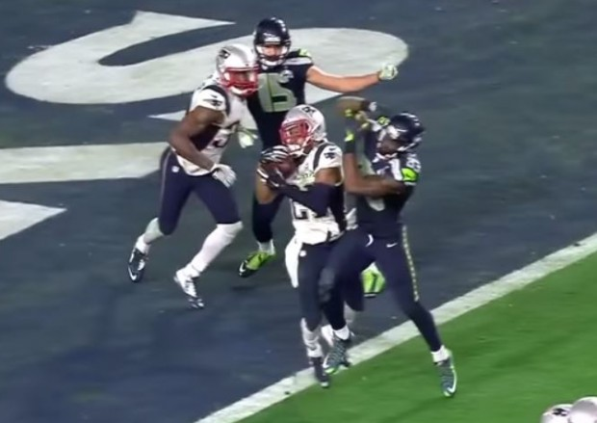
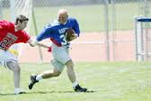
Terms to Know
Blocking: the act of preventing a defensive player from getting to the player who has the ball; blockers use their arms and bodies, but cannot hold an opponent.
Down: one of the four chances an offensive team has to get the ball to the midline of the field or score a touchdown.
Interception: a pass caught in the air by a defender whose team immediately gains possession of the ball and becomes the offense.
Flag Guarding: When a player is running with the ball and swats away a defenders hand

Slide 12
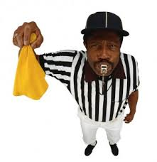
Personal Fouls-5 yard penalties
A player shall not:
Intentionally try to create a “fumble”
Trip an opponent
Make any contact with an opponent which is deemed unnecessary
No flag guarding or tying the flag belt in front. Flag belt clip must be worn in front.
Players cannot jump or hurdle defenders to avoid having flag pulled.

Slide 13
Wide Receiver Routes
Slant Pattern
This is the most famous and most used SHORT route in all of football. As soon as the ball is snapped, take 3 hard steps forward, then an angled path toward the center of the field. You will get the ball quickly, before you end your route.

Slide 14
Wide Receiver Routes
Post Pattern
This is the most famous and most used DEEP route in football. Go up the field, then cut toward the goal post. This is usually a deep play for a gain of many yards (the post being the goal post). If no goal post exists, go to the center of the field.

Slide 15
Wide Receiver Routes
Streak Pattern
Also called the fade or the fly; Just keep running down the field fast, trying to out run your defender.

Slide 16
Wide Receiver Routes
Curl Pattern
You run up the field, as fast as you can, then turn toward the quarterback so receive the pass.

Slide 17

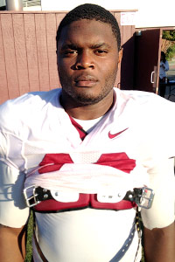
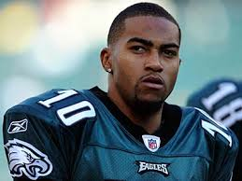
NFL players from Southern Ca
Mark Sanchez
Richard Sherman
Jaleel Pinner
Terrel Davis
DeSean Jackson
Keyshawn Johnson

