Slide 1
Flag Football Rules and Game Play

Slide 2
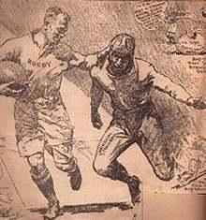
History of Football
Although team games using a kicked ball date back to the beginning of the Christian era, American football as we know today developed in the late 1800s from two English sports, rugby and soccer.

Slide 3
Some colleges in the US (Yale, Columbia, and Princeton) began to play each other in football following the soccer-based London football Association rules in 1860. Under those rules, teams could kick the ball, but not carry it. Harvard challenged Yale to a game played primarily under rugby rules but with modifications that started a move toward the more liberal game we know today. Walter Camp, later known as the father of football, was a freshman on this team.

Slide 4
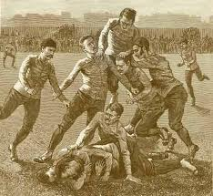
In 1876, the Intercollegiate Football Association was formed, and this organization developed many uniform rules of the game, including setting the scrimmage line, the system of downs, and the scoring system.

Slide 5
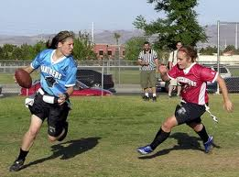
Touch and flag football modifications that can be played without the use of pads – grew out of the interest in American football. Flag football eliminated controversy that was common in the touch football game since a tackle was clearly successful when a defender removed a flag.
The skill to grab or protect the flag also made flag football more interesting than touch football.

Slide 6
Flag Football Rules
A flag football team consists of 7 players.
The offense is the team with possession of the ball.
Offensive positions are: quarterback, center, two offensive linemen, two receivers, running back/blocker.

Slide 7
Offense Positions on the field
Running Back/Blocker
Quarterback
Wide receiver
Offensive Lineman
Center
Offensive Lineman
Wide receiver
Line of scrimmage (where you line up to start a play)

Slide 8
The defense is the team that is trying to stop the offense from scoring.
The defensive positions are two defensive linemen, two linebackers, two defensive backs, and one safety.
They must line up behind the line of scrimmage and cannot go past that line until the ball is hiked (passed) by the center to the quarterback.

Slide 9
Defense Positions on the field
Line of scrimmage (where you must stay behind until the ball is hiked)
Defensive Lineman
Defensive Lineman
Linebacker
Linebacker
Defensive Back
Defensive Back
Safety

Slide 10
Scoring
The team that scores the most points wins the game. Two types of scores are possible in flag football: the touchdown and the conversion.
A touchdown is worth 6 points and occurs when the offensive team passes or carries the ball over the opponent’s goal line (end zone).
The offense can also score a 2 point conversion immediately after a touchdown by moving the ball over the opponent’s goal line from 3 yards away.

Slide 11

Game Play Rules
The game starts with the ball placed on the 10-yard line. Once the ball is placed on the line, that spot become the line of scrimmage and both teams must line up on their respective sides.
A team has 4 downs (attempts) in order to score a touchdown or move the ball past the midline. If they fail to do this in 4 downs, the ball goes to the other team where the play ended. You may run the ball forward down the field, pass the ball forward, or pass the ball to the side (lateral pass). No backward passes allowed.

Slide 12
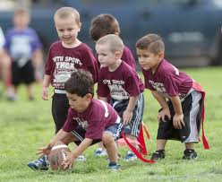
Rules of the Offensive Team
Must be on their own side prior to the “hike” and must remain motionless until it is “hiked”.
Can move across the line of scrimmage when the ball is hiked by the center.
Has 30 seconds to huddle, get to the line of scrimmage, and put the ball in play; defense counts (penalty 5 yards)
May block the defense with the hands and arms at their sides or behind their back. If they use hands, elbows, legs, or body to initiate contact, it is a personal foul (penalty 10 yards)
May pass the ball forward only from the line of scrimmage
Ball must be “hiked” from the ground between the legs of the center

Slide 13
Offensive Game Play
If the offensive team does not get the ball across the midline or score a touchdown in 3 downs, they may decide to punt the ball on the 4th down. They will announce to the defense they will kick the ball. All players, except for the punter, will be on the line of scrimmage and they may not move until the ball is kicked. The ball is dead when it touches the ground or touches another player. It is this point on the field where the defense will take possession of the ball and begin play as the offensive team.

Slide 14
Rules of the Defensive Team
Must be on their own side prior to the offense hiking the ball and can move around freely before the “hike”
Can only cross the line of scrimmage when the ball is “hiked”
Cannot intentionally hit the ball from the hands of the runner
Will be the referee and make all call – their calls are never wrong and are made in all fairness
On a punt by the offense, they may not cross the line of scrimmage

Slide 15
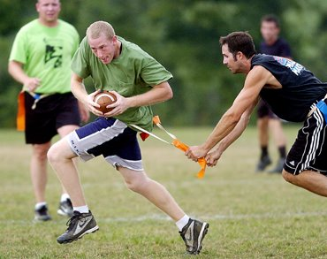
Uniforms
Shirts must be tucked in and not permitted to hang over the belt. If a player would lose their flag belt and she gets the ball, she may be tagged by one hand touching the player between the shoulders and the knees. Flags are to be worn on the side of the body (over the hips) with the correct side out.
Players must have a ball in order for their flags to be taken. If a player removes another player’s flag belt and DOES NOT have the ball, it is a 10 yard penalty. Only one flag has to be pulled in order for the player to be down. Runners cannot use their hands, arms, or ball to guard their flag and prevent another players from removing it. This also results in a 10 yard penalty.

Slide 16
Personal Fouls-10 yard penalties
A player shall not:
Attempt to steal the ball from a player
Trip an opponent
Contact an opponent who is on the ground
Throw the runner on the ground
Make any contact with an opponent which is deemed unnecessary
Deliberately run into a defensive player
Tackle the runner

Slide 17
Terms to Know
Blocking: the act of preventing a defensive player from getting to the player who has the ball; blockers use their arms and bodies, but cannot hold an opponent.
Down: one of the four chances an offensive team has to get the ball to the midline of the field or score a touchdown.
Fumble: when a ball carrier loses possession by dropping the ball or having it knocked away before a play ends; the first player to regain possession of the loose ball is said to make a recovery and her team becomes the offense.
Holding: a foul where a player stops the movement of an opponent by grasping or hooking any part of her body or uniform. (10 yard penalty)
Interception: a pass caught in the air by a defender whose team immediately gains possession of the ball and becomes the offense.
Lateral: a pass thrown to a teammate backwards from the team’s line of scrimmage or parallel to it; unlike a forward pass (which can be thrown only once per play), players may lateral the ball as often as they want.
Safety: when a ball carrier is tackled in his own end zone after bringing the ball there under his own power; the defense earns 2 points and receives a free kick from the offense’s own 20 yard line.

Slide 18
Wide Receiver Routes
Out Pattern
You go up the field about 5 yards, then take a sharp turn towards the sideline. Make sure it is a sharp right angle.

Slide 19
Wide Receiver Routes
Slant Pattern
This is the most famous and most used SHORT route in all of football. As soon as the ball is snapped, take 3 hard steps forward, then an angled path toward the center of the field. You will get the ball quickly, before you end your route.

Slide 20
Wide Receiver Routes
Deep Out Pattern
This is similar to the out, except it is run at 10 yards. Go straight up the field hard, like you are running a sprint, then turn very hard toward the sideline.

Slide 21
Wide Receiver Routes
Post Pattern
This is the most famous and most used DEEP route in football. Go up the field, then cut toward the goal post. This is usually a deep play for a gain of many yards (the post being the goal post). If no goal post exists, go to the center of the field.

Slide 22
Wide Receiver Routes
Go Pattern
Also called the streak or the fly; Just keep running down the field fast, trying to out run your defender.

Slide 23
Wide Receiver Routes
Buttonhook Pattern
You run up the field, as fast as you can, then turn toward the quarterback so receive the pass.

