Slide 1
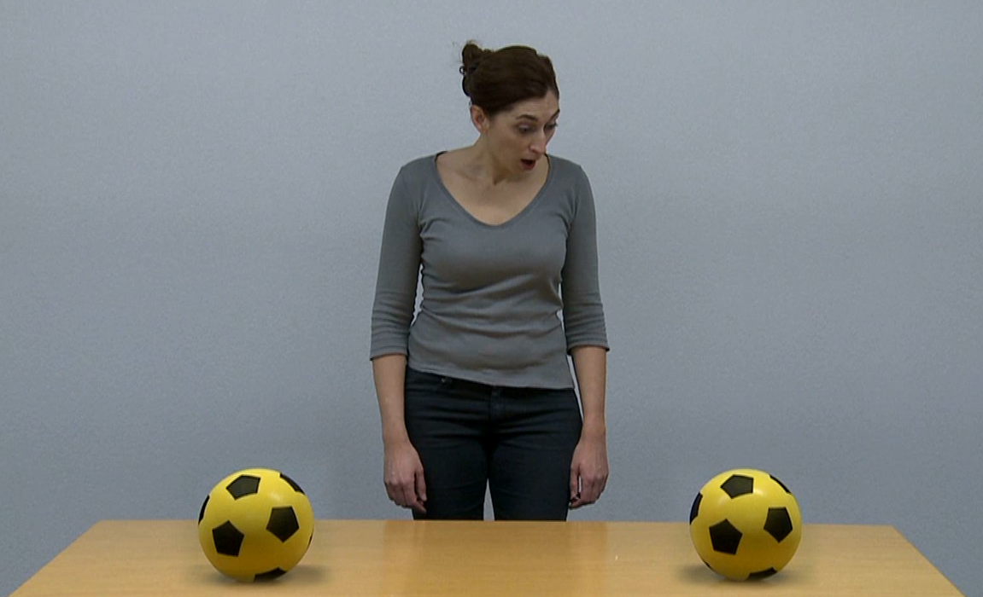
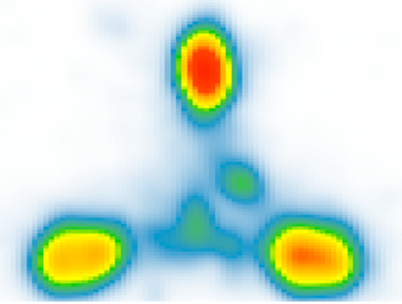


ASSESSMENT
EYE-TRACKING
VIDEO BASED STIMULI
REACTIVE JOINT ATTENTION (RJA)
BASELINE (BL)
END-OF-INTERVENTION (ET)
FOLLOW-UP (FU)
RJA FINDINGS
AUTISTIC
EARLY INTERVENTION
ET :
FU:
TREATMENT AS USUAL
ET:
FU:
AUTISTIC
NON-
AUTISTIC
BL:
ET:
FU:
>
0 months
+12 months
+36 months
Icons by Flaticon

