Slide 1
Claro
Banking support with
verified outcomes
4.43M
transactions audited
Spanish and Portuguese transaction support
with confirmed cases for human review
42
distinct customer utterances
in organizer transcripts
We keep organizer analysis, authored language scenarios and public demo fixtures separate.
Factored AI & Data Hackathon 2026 / Team nicoceron
Notes:
Problem and scope: 23,495,188 organizer synthetic rows across 13 tables. Exactly 4,425,008 transaction rows. 171,321 transcripts contain only 42 distinct customer text strings, with no demonstrated Portuguese coverage or trustworthy dispute-intent labels. Source: docs/DATA_FINDINGS.md and docs/evidence/data-profile-summary.json. Focus on transaction support and confirmed dispute intake rather than inventing aligned dialogue labels. Public examples and policies are independently team-authored fixtures.

Slide 2
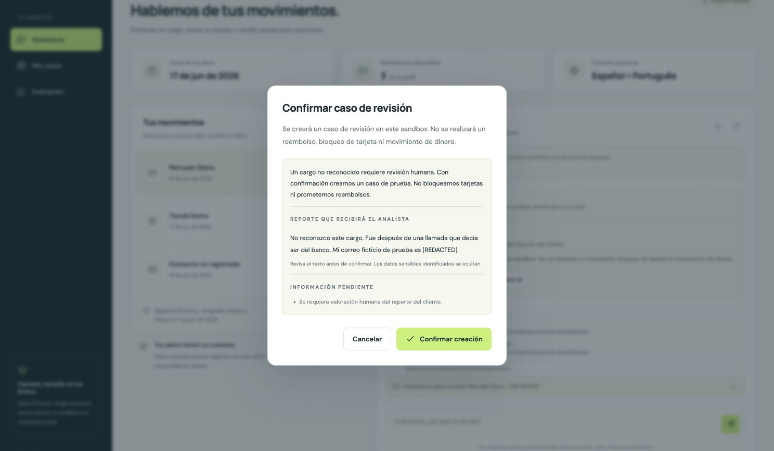
Specific requests, verified cases and follow-up
1 Preserve the request
Retain redacted customer
words beside verified facts.
2 Confirm and verify
Commit one sandbox case.
Read it back before success.
3 Persist follow-up
Save the analyst question,
customer reply and status.
Claro / Factored 2026 / 2
Notes:
Screenshot: actual local Claro UI, team-authored synthetic fixtures, with external providers disabled. The customer report preserves specific redacted allegations through transaction clarification and is labeled unverified; permitted record facts remain separate. Customer sees the text before confirming. Atomic case commit and fresh read-back precede the receipt. Analyst questions and customer replies persist as scoped, idempotent case history. No real money movement, refunds or card blocking. Sources: docs/SYSTEM_EVALUATION.md, docs/OPERATIONS.md, api.py, privacy.py, store.py and workflow.py.

Slide 3
Permissions and actions stay in service code
Optional providers are implemented and mock-tested. Live inference remains unverified.
ES / PT browser
Scoped sessions
and record tools
Jev or local
routing
Deterministic
workflow
Optional DeepSeek Flash
phrasing with constrained
facts and local fallback
Case history
and follow-up
SQLite commit
and read-back
Explicit case
confirmation
Opaque sessions + CSRF Customer/workspace isolation Idempotent confirmed writes
Claro / Factored 2026 / 3
Notes:
Diagram objects/connectors are native and editable. Sequence shows responsibility boundaries, not an exhaustive call graph. Optional Jev one-shot classification and DeepSeek Flash composition are implemented and tested using mocked transports. Live provider inference has not been verified. No claimed provider accuracy or actual spend. Classifier never chooses identity or performs tools. Composer receives minimized permitted context and cannot replace authoritative financial facts, case receipts or policy actions. Provider attempts, validated token usage, tariff estimates, unknown cost and budget reservations are separately accounted. Public personas are sandbox identities. SQLite uses reserved idempotency fingerprints and fresh read-back. Private DuckDB jobs never serve organizer raw rows. Sources: docs/AI_PROVIDERS.md, docs/OPERATIONS.md, api.py, providers.py, privacy.py, store.py, workflow.py.

Slide 4
Fraud candidates did not earn release
4,425,008 validated transactions
451,823 test transactions / 409 fraud labels
Average precision
Contracts, quarantine and source hashes
Strictly prior customer/currency history
Two full runs with identical feature bytes
Temporal evaluation
Train before January 2026
Calibrate January, select February
Test March through the June snapshot
4 / 409
fraud labels reached at 1% review
capacity by each learned candidate
Synthetic retrospective labels. Demo fixtures receive no fraud probability.
Claro / Factored 2026 / 4
Notes:
Exact held-out results in docs/evidence/ml-evaluation.json and docs/ML_REPORT.md. Logistic AP0.0009415226700474275, CatBoost AP0.0009380975559168019, constant0.0009052217350599682. At1% review capacity:4,519 reviewed,4TP/4,515FP for either learned model. Training population3,735,596; fitted deterministic sample471,012 including all3,712positives, inverse-propensity negative weights8. Candidate promotion fixed on February before test. Excludes supplied fraud_score, target, current snapshots and future/simultaneous history. Full-snapshot feasibility diagnostics preceded temporal evaluation, so no externally blind claim. No learned promotion. Runtime organizer-domain population prior is explicitly not personalized. Public fixtures are out of domain. No prevented-loss or production-accuracy claim.

Slide 5
Measured language and workflow results
Intent classification
Current local workflow
140 frozen authored cases / macro-F1
140 exposed cases / correct regression outcomes
117/140 exact labels correct
60/60 handoffs preserve the request
Six status/currency strata: 122/140 each. Same utterances, no demographic claim.
Authored tests, no independent human review. New 70-case provider challenge unscored.
Claro / Factored 2026 / 5
Notes:
Sources: docs/LANGUAGE_EVALUATION.md, docs/SYSTEM_EVALUATION.md and aggregate evidence. Component train196/development56/test140 uses frozen semantic groups. Local TF-IDF/logistic117/140 macroF10.8230; rules65/140 F10.4207; local Gemma3 4B115/140 F10.8045. Small ML/Gemma difference is not claimed significant. Workflow figure is request-preservation-v2 current local regression. First untouched challenge remains61/70 learned versus43/70 rules, with28/30 required transfers. Separate exposed regression 63/70 follows fixes; it is never relabeled blind. Six strata contain140 unique utterances and70 semantic pairs, counterbalanced ES/PT,840replays/system. These are selected-transaction status/currency groups, not demographic fairness. All labels/translations are assistant-authored without independent human/native-language review. Fresh prospective70 is frozen but unscored. Zero offline provider attempts do not establish free provider inference. No hardware/hosting or representative customer cost claim.

Slide 6
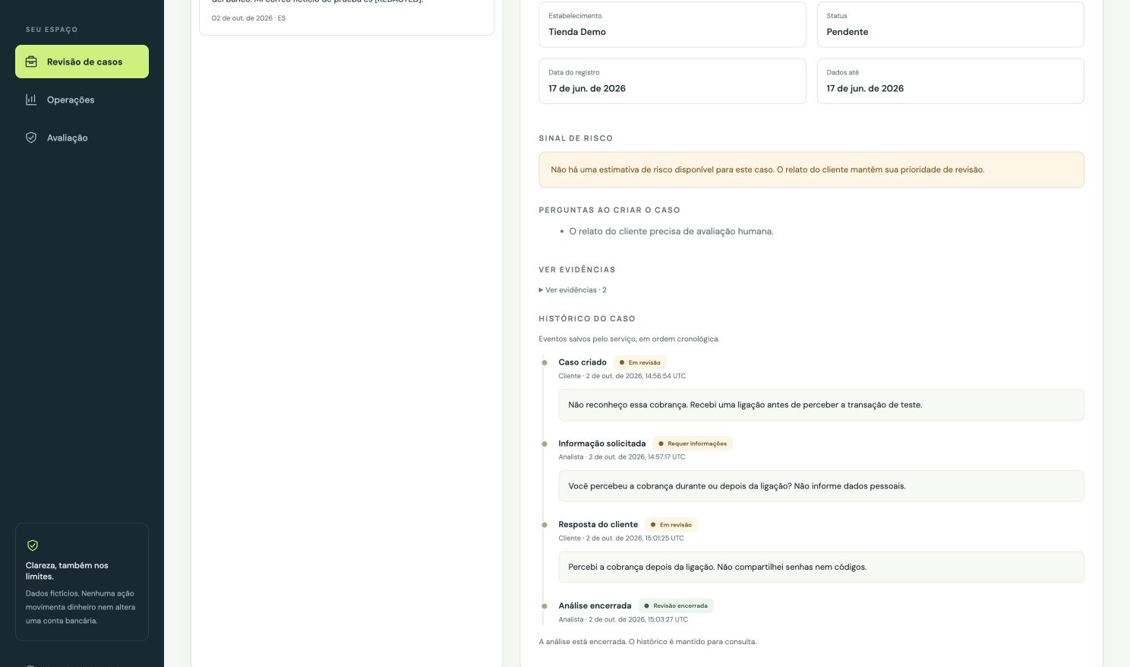
Demo and the route to a bank integration
Deliberate trade-offs
Single worker and SQLite
Simple deployment. Free-host restarts
can reset sandbox state.
Optional external models
Usage and tariff estimates are logged.
Live provider results are still unverified.
Public demo / release receipt linked
Before real customers
https://claro-banking-hackathon-2026.onrender.com
Bank identity, approved policies, durable
storage and independent ES/PT review.
Claro / Factored 2026 / 6
Notes:
Repository: https://github.com/nicoceron/factored-hackathon-2026-nicoceron . Public URL is tied to the commit and verification date in submission/deployment.json. Current local screenshots do not independently prove that a newer branch is deployed. Optional Jev/DeepSeek adapters are implemented/mocked but live inference remains unverified pending authorized metered use. External tariff estimates are not invoice spend. Screenshot is the actual local app using team fixtures and disabled providers. Free-host filesystem may reset. Sources: docs/AI_PROVIDERS.md, docs/OPERATIONS.md and submission/deployment.json. Real-bank requirements include approved identity/entitlements/MFA/policies, durable data, monitored rollout, privacy controls, independent ES/PT review and staffing. Organizer submission is intentionally outside requested scope. No real-bank operation or production safety certification.

