Slide 1

Regularization

Slide 2
Regularization
Regularization seeks to solve a few common model issues by:
Minimizing model complexity
Penalizing the loss function
Reducing model overfitting (add more bias to reduce model variance)

Slide 3
Regularization
In general, we can think of regularization as a way to reduce model overfitting and variance.
Requires some additional bias
Requires a search for optimal penalty hyperparameter.

Slide 4
Regularization
Three main types of Regularization:
L1 Regularization
LASSO Regression
L2 Regularization
Ridge Regression
Combining L1 and L2
Elastic Net

Slide 5
Regularization
L1 regularization adds a penalty equal to the absolute value of the magnitude of coefficients.
Limits the size of the coefficients.
Can yield sparse models where some coefficients can become zero.

Slide 6
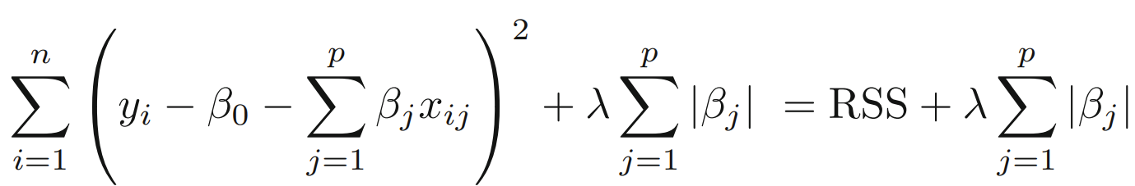
Regularization
L1 regularization adds a penalty equal to the absolute value of the magnitude of coefficients.

Slide 7
Regularization
L2 regularization adds a penalty equal to the square of the magnitude of coefficients.
All coefficients are shrunk by the same factor.
Does not necessarily eliminate coefficients.

Slide 8
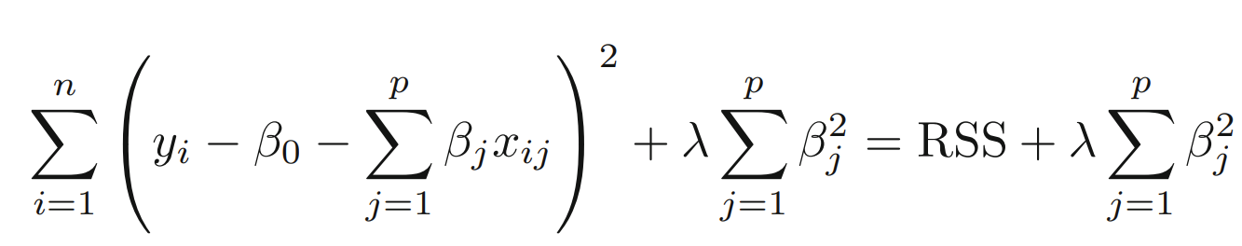
Regularization
L2 regularization adds a penalty equal to the square of the magnitude of coefficients.

Slide 9
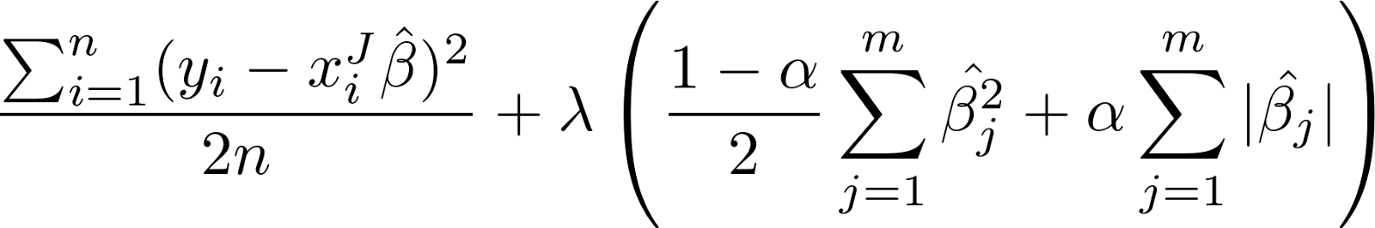
Regularization
Elastic net combines L1 and L2 with the addition of an alpha parameter deciding the ratio between them:

Slide 10
Regularization
These regularization methods do have a cost:
Introduce an additional hyperparameter that needs to be tuned.
A multiplier to the penalty to decide the “strength” of the penalty.

Slide 11
Regularization
Later on, we will actually cover L2 regularization (Ridge Regression) first, due to the intuition behind the squared term being easier to understand.

Slide 12
Regularization
Before we dive straight into coding regularization with Scikit-Learn, we need to discuss a few more relevant topics:
Feature Scaling
Cross Validation

Slide 13
Feature Scaling

Slide 14
Feature Scaling
Feature scaling provides many benefits to our machine learning process!
Some machine learning models that rely on distance metrics (e.g. KNN) require scaling to perform well.
Let’s discuss the main ideas behind feature scaling...

Slide 15
Feature Scaling
Feature scaling improves the convergence of steepest descent algorithms, which do not possess the property of scale invariance.
If features are on different scales, certain weights may update faster than others since the feature values x_{j} play a role in the weight updates.

Slide 16
Feature Scaling
Critical benefit of feature scaling related to gradient descent.
There are some ML Algos where scaling won’t have an effect (e.g. CART based methods).

Slide 17
Feature Scaling
Scaling the features so that their respective ranges are uniform is important in comparing measurements that have different units.
Allows us directly compare model coefficients to each other.

Slide 18
Feature Scaling
Feature scaling caveats:
Must always scale new unseen data before feeding to model.
Effects direct interpretability of feature coefficients
Easier to compare coefficients to one another, harder to relate back to original unscaled feature.

Slide 19
Feature Scaling
Feature scaling benefits:
Can lead to great increases in performance.
Absolutely necessary for some models.
Virtually no “real” downside to scaling features.

Slide 20
Feature Scaling
Two main ways to scale features:
Standardization
Rescales data to have a mean (μ) of 0 and standard deviation (σ) of 1.
Normalization
Rescales all data values to be between 0-1.

Slide 21
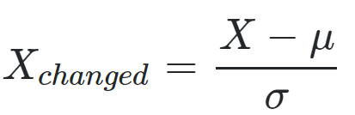
Feature Scaling
Standardization:
Rescales data to have a mean (μ) of 0 and standard deviation (σ) of 1 (unit variance).

Slide 22
Feature Scaling
Standardization:
Namesake can be confusing since this is also referred to as “Z-score normalization”.

Slide 23
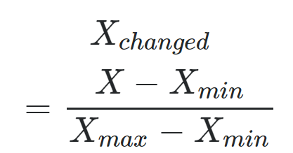
Feature Scaling
Normalization:
Scales all data values to be between 0 and 1.

Slide 24
Feature Scaling
Normalization:
Simple and easy to understand.

Slide 25
Feature Scaling
There are many more methods of scaling features and Scikit-Learn provides easy to use classes that “fit” and “transform” feature data for scaling.
Let’s quickly discuss the fit and transform calls in more detail when it comes to scaling.

Slide 26
Feature Scaling
A .fit() method call simply calculates the necessary statistics (Xmin,Xmax,mean, standard deviation).
A .transform() call actually scales data and returns the new scaled version of data.
Previously saw a similar process for polynomial feature conversion.

Slide 27
Feature Scaling
Very important consideration for fit and transform:
We only fit to training data.
Calculating statistical information should only come from training data.
Don’t want to assume prior knowledge of the test set!

Slide 28
Feature Scaling
Using the full data set would cause data leakage:
Calculating statistics from full data leads to some information of the test set leaking into the training process upon transform() conversion.

Slide 29
Feature Scaling
Feature scaling process:
Perform train test split
Fit to training feature data
Transform training feature data
Transform test feature data

Slide 30
Feature Scaling
Do we need to scale the label?
In general it is not necessary nor advised.
Normalising the output distribution is altering the definition of the target.
Predicting a distribution that doesn't mirror your real-world target.

Slide 31
Feature Scaling
Do we need to scale the label?
Can negatively impact stochastic gradient descent.
stats.stackexchange.com/questions/111467

Slide 32
Feature Scaling
Now that we understand the benefits of feature scaling, let’s move on to understanding the benefits of cross-validation!

Slide 33
Cross Validation

Slide 34
Cross Validation
Cross validation is a more advanced set of methods for splitting data into training and testing sets.
Cross Validation Relevant Reading:
Section 5.1 of ISLR

Slide 35
Cross Validation
We understand the intuition behind performing a train test split, we want to fairly evaluate our model’s performance on unseen data.
Unfortunately this means we are not able to tune hyperparameters to the entire dataset.

Slide 36
Cross Validation
Is there a way we can achieve the following:
Train on all the data
Evaluate on all the data
While it sounds impossible, we can achieve this with cross validation!
Let’s have an overview of the concept...

Slide 37
Cross Validation
Imagine our data set:
X
y
x₁ | x₂ | x₃ | y
x¹₁ | x¹₁ | x¹₁ | y₁
x²₁ | x²₁ | x²₁ | y₂
x³₁ | x³₁ | x³₁ | y₃
x⁴₁ | x⁴₁ | x⁴₁ | y₄
x⁵₁ | x⁵₁ | x⁵₁ | y₅
Area m² | Bedrooms | Bathrooms | Price
200 | 3 | 2 | $500,000
190 | 2 | 1 | $450,000
230 | 3 | 3 | $650,000
180 | 1 | 1 | $400,000
210 | 2 | 2 | $550,000

Slide 38
Cross Validation
Let’s convert this data into colored blocks for cross-validation
X
y
x₁ | x₂ | x₃ | y
x¹₁ | x¹₁ | x¹₁ | y₁
x²₁ | x²₁ | x²₁ | y₂
x³₁ | x³₁ | x³₁ | y₃
x⁴₁ | x⁴₁ | x⁴₁ | y₄
x⁵₁ | x⁵₁ | x⁵₁ | y₅
Area m² | Bedrooms | Bathrooms | Price
200 | 3 | 2 | $500,000
190 | 2 | 1 | $450,000
230 | 3 | 3 | $650,000
180 | 1 | 1 | $400,000
210 | 2 | 2 | $550,000

Slide 39
Cross Validation
Convert to generalized form
X
y
x₁ | x₂ | x₃ | y
x¹₁ | x¹₁ | x¹₁ | y₁
x²₁ | x²₁ | x²₁ | y₂
x³₁ | x³₁ | x³₁ | y₃
x⁴₁ | x⁴₁ | x⁴₁ | y₄
x⁵₁ | x⁵₁ | x⁵₁ | y₅

Slide 40
Cross Validation
Color based off train vs. test set.
X
y
x₁ | x₂ | x₃ | y
x¹₁ | x¹₁ | x¹₁ | y₁
x²₁ | x²₁ | x²₁ | y₂
x³₁ | x³₁ | x³₁ | y₃
x⁴₁ | x⁴₁ | x⁴₁ | y₄
x⁵₁ | x⁵₁ | x⁵₁ | y₅

Slide 41
Cross Validation
Color based off train vs. test set.
X
y
x₁ | x₂ | x₃ | y
x¹₁ | x¹₁ | x¹₁ | y₁
x²₁ | x²₁ | x²₁ | y₂
x³₁ | x³₁ | x³₁ | y₃
x⁴₁ | x⁴₁ | x⁴₁ | y₄
x⁵₁ | x⁵₁ | x⁵₁ | y₅
TRAIN
TEST

Slide 42
Cross Validation
Color based off train vs. test set.
X
y
x₁ | x₂ | x₃ | y
x¹₁ | x¹₁ | x¹₁ | y₁
x²₁ | x²₁ | x²₁ | y₂
x³₁ | x³₁ | x³₁ | y₃
x⁴₁ | x⁴₁ | x⁴₁ | y₄
x⁵₁ | x⁵₁ | x⁵₁ | y₅
TRAIN
TEST

Slide 43
Cross Validation
For now just consider training vs testing:
X
y
x₁ | x₂ | x₃ | y
x¹₁ | x¹₁ | x¹₁ | y₁
x²₁ | x²₁ | x²₁ | y₂
x³₁ | x³₁ | x³₁ | y₃
x⁴₁ | x⁴₁ | x⁴₁ | y₄
x⁵₁ | x⁵₁ | x⁵₁ | y₅
TRAIN
TEST

Slide 44
Cross Validation
For now just consider training vs testing:
x¹₁ | x¹₁ | x¹₁ | y₁
x²₁ | x²₁ | x²₁ | y₂
x³₁ | x³₁ | x³₁ | y₃
x⁴₁ | x⁴₁ | x⁴₁ | y₄
x⁵₁ | x⁵₁ | x⁵₁ | y₅
TRAIN
TEST

Slide 45
Cross Validation
Now we have all data, colored by training set versus test set.
TRAIN
TEST

Slide 46
Cross Validation
Rotate and resize:
TRAIN
TEST

Slide 47
Cross Validation
Rotate and resize:

Slide 48
Cross Validation
Rotate and resize:

Slide 49
Cross Validation
Rotate and resize:

Slide 50
Cross Validation
Now we can represent full data and splits:
TRAIN
TEST

Slide 51
Cross Validation
Let’s start with the entire original data:

Slide 52
Cross Validation
How does cross validation work?

Slide 53
Cross Validation
Split data into K equal parts:

Slide 54
Cross Validation
1/K left as test set

Slide 55
Cross Validation
Train model and get error metric for split:
ERROR 1
TRAIN
TEST

Slide 56
Cross Validation
Repeat for another 1/K split
ERROR 1
ERROR 2

Slide 57
Cross Validation
Keep repeating for all possible splits
ERROR 1
ERROR 2
ERROR 3

Slide 58
Cross Validation
Keep repeating for all possible splits
ERROR 1
ERROR 2
ERROR 3
...
...
ERROR K

Slide 59
Cross Validation
Get average error
ERROR 1
ERROR 2
ERROR 3
...
...
ERROR K
MEAN ERROR

Slide 60
Cross Validation
Average error is the expected performance
ERROR 1
ERROR 2
ERROR 3
...
...
ERROR K
MEAN ERROR

Slide 61
Cross Validation
We were able to train on all data and evaluate on all data!
We get a better sense of true performance across multiple potential splits.
What is the cost of this?
We have to repeat computations K number of times!

Slide 62
Cross Validation
This is known as K-fold cross-validation.
Common choice for K is 10 so each test set is 10% of your total data.
Largest K possible would be K equal to the number of number of rows.
This is known as leave one out cross validation.
Computationally expensive!

Slide 63
Cross Validation
One consideration to note with K-fold cross validation and a standard train test split is fairly tuning hyperparameters.
If we tune hyperparameters to test data performance, are we ever fairly getting performance metrics?

Slide 64
Cross Validation
How can we understand how the model behaves for data that is has not seen and not been influenced by for hyperparameter tuning?
For this we can use a hold out test set.
Let’s explore what this looks like...

Slide 65
Cross Validation
Start with entire data set:

Slide 66
Cross Validation
Remove a hold out test set

Slide 67
Cross Validation
Perform “classic” train test split:

Slide 68
Cross Validation
Train and tune on this data:

Slide 69
Cross Validation
Or K-Fold cross validation
...

Slide 70
Cross Validation
Train and tune on this data:
...

Slide 71
Cross Validation
After training and tuning perform final evaluation hold out test set.
...

Slide 72
Cross Validation
Can not tune after this final test evaluation!
...

Slide 73
Cross Validation
Train | Validation | Test Split
Allows us to get a true final performance metric to report.
No editing model after this!
TRAIN
VALIDATION
TEST

Slide 74
Cross Validation
All these approaches are valid, each situation is unique!
Keep in mind:
Previous modeling work
Reporting requirements
Fairness of evaluation
Context of data and model

Slide 75
Cross Validation
Many regularization methods have tunable parameters we can adjust based on cross-validation techniques.
For simplicity, there are times in the course we will opt for a simple two part train test split.

Slide 76
Regularization for Linear Regression
Data Set Up

Slide 77
Ridge Regression
Theory and Intuition

Slide 78
Ridge Regression
Ridge Regression is a regularization technique that works by helping reduce the potential for overfitting to the training data.
It does this by adding in a penalty term to the error that is based on the squared value of the coefficients.

Slide 79
Ridge Regression
Ridge Regression is a regularization method for Linear Regression.
Relevant Reading in ISLR:
Section 6.2.1
Let’s explore the main concepts behind how Ridge Regression works...

Slide 80
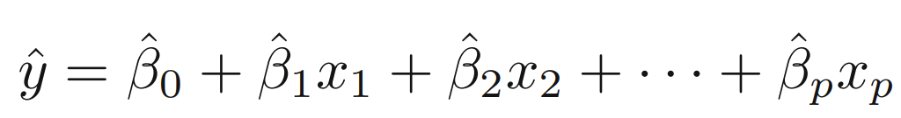
Ridge Regression
Recall the general formula for the regression line:

Slide 81
Ridge Regression
These Beta coefficients were solved by minimizing the residual sum of squares (RSS).

Slide 82
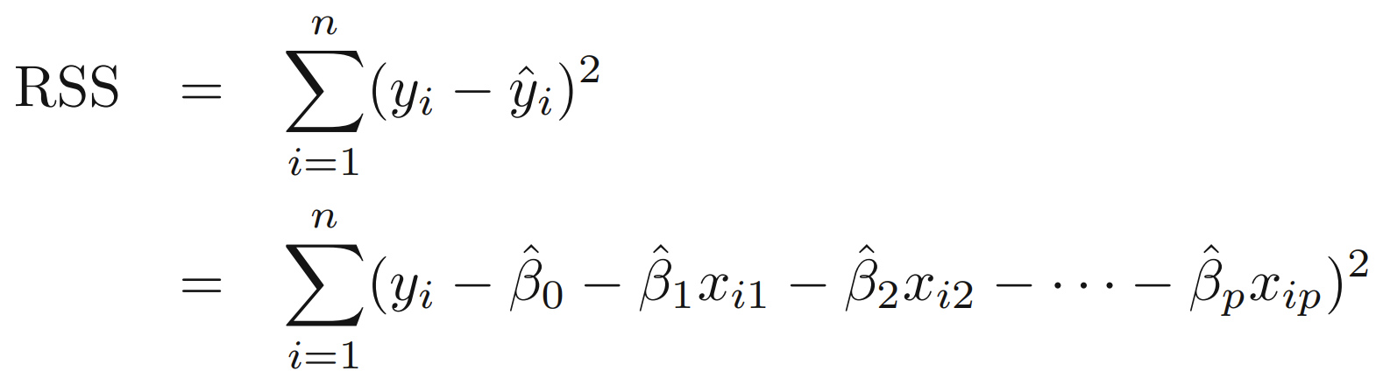
Ridge Regression
These Beta coefficients were solved by minimizing the residual sum of squares (RSS).

Slide 83
Ridge Regression
We could substitute our regression equation for ŷ:

Slide 84
Ridge Regression
We could substitute our regression equation for ŷ:

Slide 85
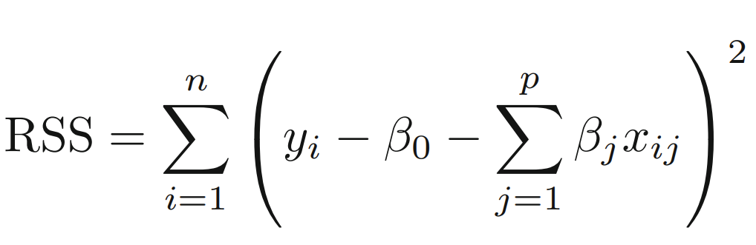
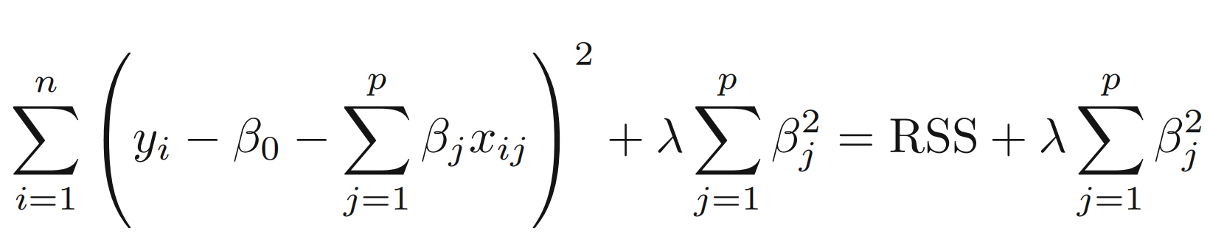
Ridge Regression
We can then summarize RSS as:

Slide 86
Ridge Regression
The goal of Ridge Regression is to help prevent overfitting by adding an additional penalty term.

Slide 87
Ridge Regression
Ridge Regression adds a shrinkage penalty:
Error

Slide 88
Ridge Regression
Ridge Regression seeks to minimize this entire error term RSS + Penalty.
Error

Slide 89
Ridge Regression
Shrinkage penalty based off the squared coefficient:
Error

Slide 90
Ridge Regression
Shrinkage penalty has a tunable lambda parameter!
Error

Slide 91
Ridge Regression
Lambda determines how severe the penalty is.
Error

Slide 92
Ridge Regression
In theory it can be any value from 0 to positive infinity.
Error

Slide 93
Ridge Regression
If it is zero, then it is simply back to RSS.
Error

Slide 94
Ridge Regression
Let’s explore a simple thought experiment to get an intuition behind Ridge Regression...
Error

Slide 95
Ridge Regression
Imagine the following data set.
Y
X

Slide 96
Ridge Regression
We can split it into a training set and test set:
Y
X

Slide 97
Ridge Regression
Now we can fit on the training data to produce the line: ŷ = β₁x +β₀
Y
X

Slide 98
Ridge Regression
Regardless of RSS or Ridge error, we’re still trying to create a line: ŷ = β₁x +β₀
Y
X

Slide 99
Ridge Regression
The only difference would be the coefficients found.
Y
X

Slide 100
Ridge Regression
First let’s fit using only RSS...
Y
X

Slide 101
Ridge Regression
Our fitted ŷ = β₁x +β₀
Y
X

Slide 102
Ridge Regression
Appears to have over fit to training data.
Y
X

Slide 103
Ridge Regression
This means we have high variance.
Y
X

Slide 104
Ridge Regression
We know there is a bias-variance trade-off.
Y
X

Slide 105
Ridge Regression
But could we introduce a little more bias to significantly reduce variance?
Y
X

Slide 106
Ridge Regression
Would adding the penalty term help generalize with more bias?
Y
X

Slide 107
Ridge Regression
Adding bias can help generalize ŷ = β₁x +β₀
Y
X

Slide 108
Ridge Regression
Let’s imagine trying to reduce the Ridge Regression error term:
Y
X

Slide 109
Ridge Regression
There is λ and the squared slope coefficient.
Y
X

Slide 110
Ridge Regression
In the case of ŷ = β₁x +β₀
Y
X

Slide 111
Ridge Regression
In the case of ŷ = β₁x +β₀
Y
X

Slide 112
Ridge Regression
Let’s assume λ = 1
Y
X

Slide 113
Ridge Regression
This punishes a large slope for ŷ = β₁x +β₀
Y
X

Slide 114
Ridge Regression
For single feature this lowers slope
Y
X

Slide 115
Ridge Regression
For single feature this lowers slope
Y
X

Slide 116
Ridge Regression
At the cost of some additional bias (error in training set)
Y
X

Slide 117
Ridge Regression
We generalize better to unseen data
Y
X

Slide 118
Ridge Regression
Consider overfitting to training set:
Y
X

Slide 119
Ridge Regression
An increase in X results in a greater y response:
Y
X

Slide 120
Ridge Regression
An increase in X results in a greater y response:
Y
X

Slide 121
Ridge Regression
An increase in X results in a greater y response:
Y
X

Slide 122
Ridge Regression
An increase in X results in a greater y response:
Y
X

Slide 123
Ridge Regression
Compare to a more generalized model that used Ridge Regression:
Y
X

Slide 124
Ridge Regression
Same feature change does not produce as much y response:
Y
X

Slide 125
Ridge Regression
Trying to minimize a squared Beta term leads us to punish larger coefficients.
Y
X

Slide 126
Ridge Regression
In the case of a single feature, a larger Beta means a steeper sloped line.
Y
X

Slide 127
Ridge Regression
A steeper sloped line would mean more response per increase in X value.
Y
X

Slide 128
Ridge Regression
What about the lambda term? How much should we punish these larger coefficients?
Y
X

Slide 129
Ridge Regression
We simply use cross-validation to explore multiple lambda options and then choose the best one!
Error

Slide 130
Ridge Regression
L2 Regularization

Slide 131
Ridge Regression
Important Note!
Sklearn refers to lambda as alpha within the class call!
Error

Slide 132
Ridge Regression
Important Note!
For cross validation metrics, sklearn uses a “scorer object”.
All scorer objects follow the convention that higher return values are better than lower return values.

Slide 133
Ridge Regression
Important Note!
For example, obviously higher accuracy is better.
But higher RMSE is actually worse!
So Scikit-Learn fixes this by using a negative RMSE as its scorer metric.

Slide 134
Ridge Regression
Important Note!
This allows for uniformity across all scorer metrics, even across different tasks types.
The same idea of uniformity across model classes applies to referring to the penalty strength parameter as alpha.

Slide 135
Lasso Regression
L1 Regularization

Slide 136
Regularization
L1 regularization adds a penalty equal to the absolute value of the magnitude of coefficients.

Slide 137
Regularization
L1 regularization adds a penalty equal to the absolute value of the magnitude of coefficients.
Limits the size of the coefficients.
Can yield sparse models where some coefficients can become zero.

Slide 138
Regularization
LASSO can force some of the coefficient estimates to be exactly equal to zero when the tuning parameter λ is sufficiently large.
Similar to subset selection, the LASSO performs variable selection.
Models generated from the LASSO are generally much easier to interpret.

Slide 139
Regularization
LassoCV with sklearn operates on checking a number of alphas within a range, instead of providing the alphas directly.
Let’s explore the results of LASSO in Python and Scikit-Learn!

Slide 140
Elastic Net
L1 and L2 Regularization

Slide 141
Regularization
We’ve been able to perform Ridge and Lasso regression.
We know Lasso is able to shrink coefficients to zero, but we haven’t taken a deeper dive into how or why that is.
This ability becomes more clear when learning about elastic net which combines Lasso and Ridge together!

Slide 142
Regularization
Let’s dive a little deeper into Lasso.
Lasso was originally introduced in geophysics literature in 1986 by Symes and Santosa.
It was later independently rediscovered and popularized in 1996 by Robert Tibshirani who coined the term “Lasso”.

Slide 143
Regularization
Does the name Robert Tibshirani sound familiar?

Slide 144

Regularization
Robert Tibshirani is one of the authors of ISLR!

Slide 145
Regularization
All the authors have a history of very impressive accomplishments!

Slide 146
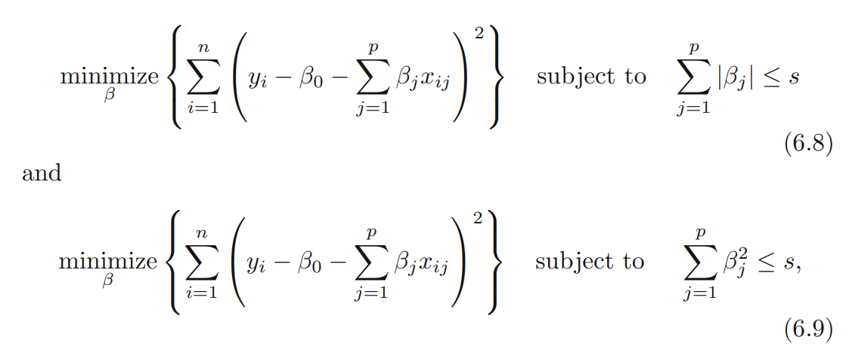
Regularization
We can rewrite Lasso and Ridge:

Slide 147
Regularization
There is some sum s which allows to rewrite the penalty as a requirement:

Slide 148
Regularization
There is some sum s which allows to rewrite the penalty as a requirement:

Slide 149
Elastic Net
Start with a simple thought experiment:
A simple equation:
ŷ = β₁x₁ + β₂x₂
We know that regularization can be expressed as an additional requirement that RSS is subject to.

Slide 150
Elastic Net
Start with a simple thought experiment:
A simple equation:
ŷ = β₁x₁ + β₂x₂
L1 constrains the sum of absolute values.
∑|β|
L2 constrains the sum of squared values.
∑β²

Slide 151
Elastic Net
Start with a simple thought experiment:
A simple equation:
ŷ = β₁x₁ + β₂x₂
There is some sum s that the penalty is less than.

Slide 152
Elastic Net
For the case of only two features:
ŷ = β₁x₁ + β₂x₂
Lasso Regression Penalty:
|β₁|+ |β₂| ≤ s
Ridge Regression Penalty:
β₁ + β₂ ≤ s
2
2

Slide 153
Elastic Net
Let’s plot Lasso: |β₁|+ |β₂| ≤ s
β₂
β₁

Slide 154
Elastic Net
Let’s plot Lasso: |β₁|+ |β₂| ≤ s
β₂
β₁

Slide 155
Elastic Net
Let’s plot Lasso: |β₁|+ |β₂| ≤ s
β₂
β₁

Slide 156
Elastic Net
2
2
Let’s plot Ridge: β₁ + β₂ ≤ s
β₂
β₁

Slide 157
Elastic Net
2
2
Let’s plot Ridge: β₁ + β₂ ≤ s
β₂
β₁

Slide 158
Elastic Net
2
2
Let’s plot Ridge: β₁ + β₂ ≤ s
β₂
β₁

Slide 159
Elastic Net
What would RSS look like?
β₂
β₁

Slide 160
Elastic Net
What would RSS look like?
β₂
β₁

Slide 161
Elastic Net
What would RSS look like?
β₂
β₁

Slide 162
Elastic Net
But were subject to the penalty!
β₂
β₁

Slide 163
Elastic Net
2
2
Penalty for Ridge: β₁ + β₂ ≤ s
β₂
β₁

Slide 164
Elastic Net
Penalty for Lasso: |β₁|+ |β₂| ≤ s
β₂
β₁

Slide 165
Elastic Net
Lasso:
A convex object that lies tangent to the boundary, is likely to encounter a corner of a hypercube, for which some components of β are identically zero.

Slide 166
Elastic Net
Ridge: In the case of an n-sphere, the points on the boundary for which some of the components of β are zero are not distinguished from the others and the convex object is no more likely to contact a point at which some components of β are zero than one for which none of them are.

Slide 167
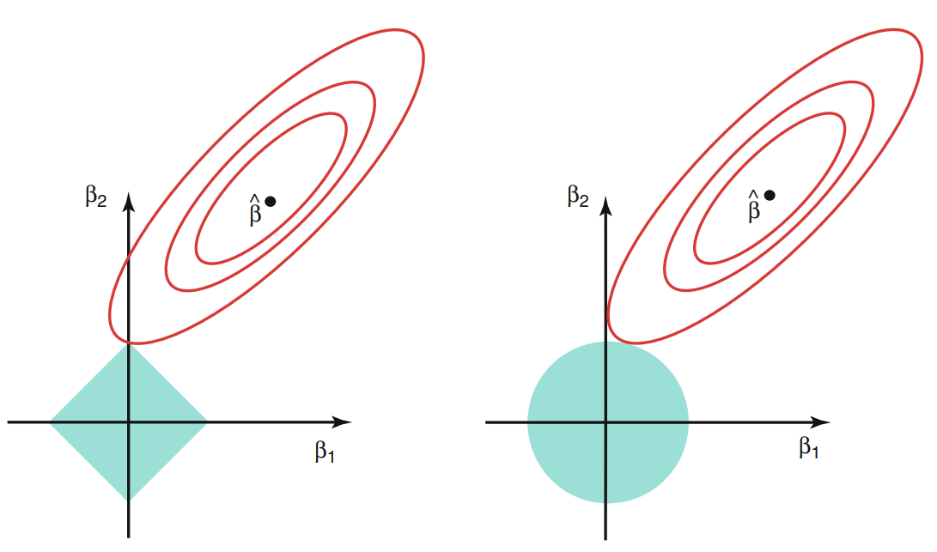
Elastic Net
This is why Lasso is more likely to lead to coefficients as zero.
This diagram is also commonly shown with contour RSS:

Slide 168
Elastic Net
Elastic Net seeks to improve on both L1 and L2 Regularization by combining them:
Error
1
2

Slide 169
Elastic Net
Here we seek to minimize RSS and both the squared and absolute value terms:
Error
1
2

Slide 170
Elastic Net
Notice there are two distinct lambda values for each penalty:
Error
1
2

Slide 171
Elastic Net
We can alternatively express this as a ratio between L1 and L2:

Slide 172
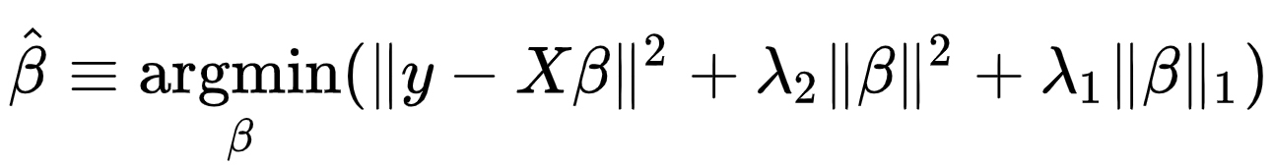
Elastic Net
We can also use simplified notation:

Slide 173
Elastic Net
Elastic Net Penalty Region:
β₂
β₁

Slide 174
Elastic Net
Elastic Net Penalty Region:
β₂
β₁

Slide 175
Elastic Net
Let’s explore how to perform Elastic Net with Python and Scikit-learn!

Slide 176
Linear Regression
Project Dataset
Overview

